Slide 1
Title Slide
Transportation Basics
Mark Elworthy, Director
School Financial Services
WASBO Spring Conference
May 19, 2022

Slide 2
Sources of Pupil Transportation Aid
Students provided specialized transportation as required by the individual student’s IEP (Fund 27).
    Based on the qualifying costs reported.
  Students qualifying to receive pupil transportation and actually participating in one of the (Fund 10) programs from three separate calculations.
    Based on distance from pupil’s residence to school of attendance, following the shortest commonly traveled route.

Slide 3
Fund 10 Pupil Transportation Aid programs
PI-1547SS – public and private school students transported to attend summer sessions and/or interim sessions.
    Starts the school year, due by September 30th of current year.
    Summer session that starts after the previous school year ends and the current school year begins.
    Interim sessions from the previous school year.
    Revised – Only based on one category (distance); whether the student is transported either 2 – 5 miles or over 5 miles.
    Part of the transportation audit process.

Slide 4
Fund 10 Pupil Transportation Aid programs
PI-1547 – public and private school students transported during the regular school year by school districts and charter schools.
    Report opens in May and is due in late July.
    Five distances categories.
    Only district’s that have a DPI approved Unusually Hazardous Transportation (UHT) plan can enter riders in the “Less Than 2 Miles (hazardous area) category.
    Per Board policy a district may transport and include Open Enrolled In students from the district border to school of attendance.
    District can also include students transported based per a contract with a parent or service provider.

Slide 5
Fund 10 Pupil Transportation Aid programs
PI-1547 – public and private school students transported during the regular school year by school districts and charter schools.
    Districts are responsible to provide reliable documentation and NOT undocumented assumptions or estimates to support the number of pupils reported as actually transported at least once during the school year.
      A signed and dated document listing students who rode each bus during the school year by bus driver is great!
      The qualifying distance the student was transported can come from the transportation director/contactor.
    $24,000,000 is distributed based on the PI-1547SS and PI-1547 data from the previous school year in January and June.

Slide 6
Fund 10 Pupil Transportation Aid programs
High Cost Pupil Transportation Aid is a separately funded program.
    Paid in June, for the previous school year, based on audited information. Example FY21 will be paid in June of 2022.
  This aid program provides additional funding to school districts that have higher per pupil transportation costs when compared to the statewide average per pupil transportation cost
    To qualify the district’s Fund 10 cost/student must exceed 140% of state average/student cost and the district has 50 students/square mile or less.
    Allocation = $19,856,200.

Slide 7
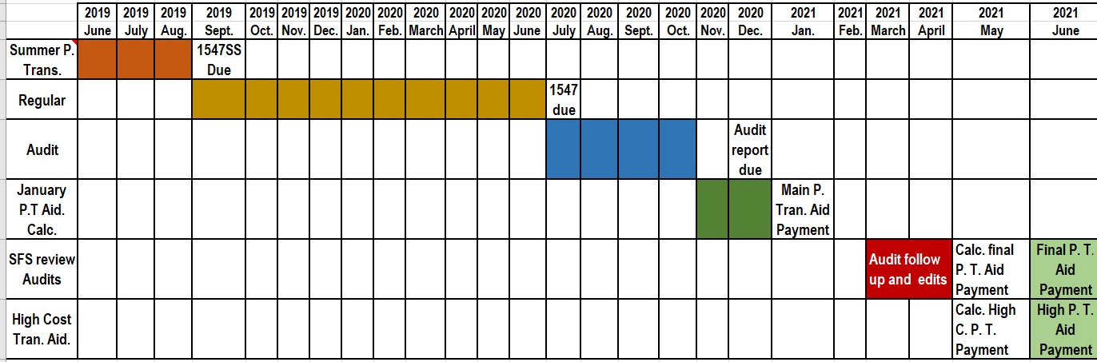
Example - 2019-20 Pupil Transportation Fund 10 Aid calendar
30 months from summer session transportation until final aid payment are made to participating districts and charter schools.

Slide 8
PI-1547SS summer/interim reporting
Distance in Miles | Summer/Interim (PI-1547SS)
Less Than 2 miles (hazardous area) | NA
Over 2-5 miles | $10/pupil
Over 5 up to 8 miles | $20/pupil
Over 8 up to 12 miles | $20/pupil
Over 12 miles | $20/pupil
Revised- Increased and only one factor to be considered for summer school interim: distance from student’s residence to school (attendance).
Districts are not required to transport for summer/interim sessions to the same standard as during the regular school year.

Slide 9
PI-1547 regular year reporting
Distance in Miles | Regular Year (PI-1547)
Less Than 2 miles (hazardous area) | $15/pupil
Over 2-5 miles | $35/pupil
Over 5 up to 8 miles | $55/pupil
Over 8 up to 12 miles | $110/pupil
Over 12 miles | $375/pupil
The “0 to 2 Miles (Hazardous Area Transportation)” category requires DPI approval before data can be entered.

Slide 10
Pupil Transportation Aid Payments
As was outlined earlier; Pupil Transportation Aid is determined by the number of students, public and private schools, who actually are transported from residence to school of attendance at least once.
When the district transports fewer students, under current law and related rules, their regular pupil transportation aid will be less in their January payment the following school year. After the January aid payment, the remainder of the funds (minus the transporting on ice aid - Bayfield) is paid out in June based on the District’s percentage of state pupil transportation aid in January.

Slide 11
Route Planning Tips
Regular meetings throughout year with transportation department and/or bus company
Review procedures with staff annually
Verify student addresses
Familiarize yourself with the bus routes and new students

Slide 12
How to report a student…
Transported to daycare location? If the most direct route to the daycare location is greater than the most direct route to the student’s residence, the district must make the mileage category determination based on the student’s residence location.
Who moved during the school year? A student who is transported at least once will be counted in the mileage category as determined by the LEA on the PI-1547. The determination of the mileage category does not need to be modified for the given school year as long as the student continues residing in the school district.
Being transported by a third party/parent? If the district is paying for this service, the student will be counted in mileage category that reflects the most direct route from residency to school of attendance. This payment is calculated from a contract with the provider at a daily rate.

Slide 13
Transporting Private School students
Q/A # 3. Must a public school district provide transportation to private school pupils on days the public school is not in session?
An opinion from the Attorney General, 61 O.A.G. 240, 244 (1972), stated that a public school board is required to provide transportation for private school pupils attending school on days when the public school district is not in session. The Wisconsin Court of Appeals confirmed that position in Hahner v. Board of Education, Wisconsin Rapids, 89 Wis. 2d 180 (1979). It is beneficial to both the public and private school(s) in the same school district to have school calendars which are as consistent as possible. https://dpi.wi.gov/parental-education-options/transportation/private-school-questions
Also see “Transportation to Private Schools – General Information” https://dpi.wi.gov/parental-education-optins/transportation/private-school-information webpage.

Slide 14
Observed Patterns of Support
Provide training for new employees and develop a District Year-at-a-Glance; Institute a review process.
Meet with your transportation vendor or employees on a regular basis including before student counts.
While one pupil count is required per year, additional counts will provide documentation and probably increased ridership numbers.
Complete counts ahead of time; institute a double-check process; predict what is different this year and plan how to address it.

Slide 15
State & IDEA Eligible Transportation
For those students whose IEPs specify transportation needs, a district may provide specialized transportation and have a portion of those costs included in their overall costs eligible for Special Education and School-Age Parents Aid.
When required by IEP
Eligible route must be 100% IEP-required

Slide 16
State & IDEA Eligible Transportation
Limited Exceptions:
  Incidental Benefit Exception: picked up at same location; no additional costs; doesn’t displace rider with IEP
  Newly Homeless Accommodation or Foster Care: up to 20 days

Slide 17
State & IDEA Eligible Transportation
Additional service on “regular” route (to and from school)
  e.g. bus aide for one student per their IEP
  Only the excess cost of the service is eligible (Fund 27)
  Regular route transportation (Fund 10)
A student maybe be eligible for special education categorical aid for support services while being transported on the regular bus route and be eligible for Pupil Transportation Aid

Slide 18
State & IDEA Eligible Transportation
A student who exclusively rides a specialized transportation route may not be counted for Pupil Transportation Aid.

Slide 19
State & IDEA Eligible Transportation
The following are some transportation examples a district may encounter.

Slide 20
State & IDEA Eligible Transportation
Example: A district operates a route that transports several students with IEPs that require specialized transportation, as well as a few other students who live along the route. Is this route eligible for state Special Education Aid?

Slide 21
State & IDEA Eligible Transportation
No: A route that serves students with and without IEPs is not eligible for state Special Education Aid. The district should report the number of students transported on the route on its PI-1547 Pupil Transportation Report, including the students with IEPs. The entire cost of the route is coded to Fund 10.

Slide 22
State & IDEA Eligible Transportation
Example: A special education student with transportation identified in the student’s IEP received specialized transportation at the beginning of the year, but during the year no longer needed that support and is switched to a regular bus route. Is the cost for transporting the student eligible for special education aid for specialized transportation AND eligible for regular pupil transportation aid for the regular bus route even though both took place in the same year?

Slide 23
State & IDEA Eligible Transportation
Yes: In this example the student is eligible for special education aid for specialized transportation and eligible for regular pupil transportation aid because the student changed from specialized transportation to regular transportation based on IEP changes. However a student exclusively receiving special or additional transportation all year could not also be counted for regular transportation aid.

Slide 24
State & IDEA Eligible Transportation
SPED vehicle/equipment purchases w/ pre-approval
  No approval needed for equipment <$10,000
  Follow instructions on our website for
  Requesting Special Education Aid for Vehicle and Equipment Purchases Over $10,000

Slide 25
State & IDEA Eligible Transportation
Additional Resources
  Special Education Transportation
  Specialized Transportation Aid Eligibility and Funding

Slide 26
Large Van Regulation
NHTSA 49 U.S.C. §30112(a)(2)
  School district may not purchase or lease a 15-passenger van for student transportation unless it meets all of the safety requirements of a school bus.
  School Bus Safety Requirements (According to FMVSS)
    Yellow Paint, Reflective Tape, Stop-arm, Flashing Lights, etc.
Safe, Accountable, Flexible, Efficient Transportation Equity Act: A Legacy for Users (SAFETEA-LU) – August 10, 2005
  Section 10309 states in part: a school or school system may not purchase or lease a new 15-passenger van if it will be used significantly by, or on behalf of, the school or school system to transport preprimary, primary, or secondary school students to or from school or an event related to school, unless the 15-passenger van complies with the motor vehicle standards prescribed for school buses and multifunction school activity buses under this title.

Slide 27
Large Van Regulation
Safe, Accountable, Flexible, Efficient Transportation Equity Act: A Legacy for Users (SAFETEA-LU) (continued)
  Established penalties for dealerships selling or leasing 15-passenger vehicle to a school district without required safety features
  $10,000 penalty, up to $15,000,000 for multiple violations
  Defined 15 passenger – a vehicle that seats 10-14 passengers, not including the driver

Slide 28
Large Van Regulation
Wisconsin DOT School Bus Definition
  motor vehicle which carries 10 or more passengers for the purposes of transporting students to or from school, curricular, or extracurricular activities.
  Recommends avoiding use of van able to hold 11 or more passengers Based on federal guidelines
Wisconsin State Statute §121.555
  Defines alternative methods of transportation
  Limits vehicle size to 9 passengers or less

Slide 29
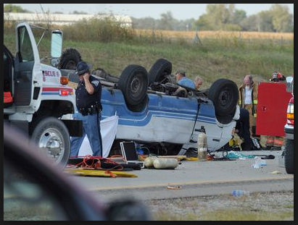
Safety Concerns with Large Vans
2004 – 2013
  653 Americans died in crashes
  65 occupants per year
  60% of fatalities occurred when the van rolled over
2003-2007
  80% of occupants killed were not wearing their seatbelt
  60% killed in single-vehicle accidents were ejected
  92% property restrained survived

Slide 30
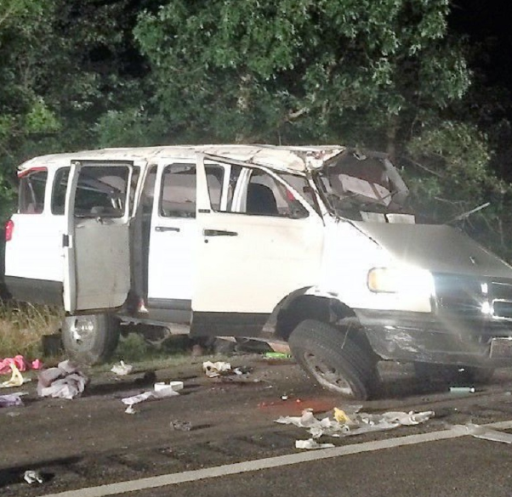
Safety Concerns with Large Vans
Rollover Rates when Vehicle Loaded to or Below Half the Designed Seating Capacity
  Large Van – 2.2
  Minivan – 1.7
  SUV – 1.4
  Pickup Trucks – 1.3
  Passenger Cars – 1.3

Slide 31
Issues with Large Vans
Higher Center of Gravity
  Adding passengers and cargo moves the center of gravity higher and toward the rear of the vehicle.
  Causes instability and the potential for drivers to lose control during emergency handling maneuvers.
Flat sides contribute to instability in crosswinds
Structural rigidity that was designed for the less demanding rigors of transporting cargo

Slide 32
Issues with Large Vans
Underinflated Tires
  NHTSA Study – 75% 15-passenger vans had improperly inflated tires
  Improperly inflated tires changes handling characteristics
  Increases potential for a rollover crash

Slide 33
Safety Recommendations for 10-Passenger Vans
Make sure the vehicle is properly maintained
Properly inflated tires are critical
  Check tire pressure and wear prior to each trip
Large vans handle differently
  Use drivers familiar with handling issues
Keep the load light
  Do not overload the vehicle with students and athletic equipment
  Overloading the vehicle increases rollover tendency

Slide 34
Safety Recommendation for 10-Passenger Vans
Make sure the vehicle is properly maintained
Properly inflated tires are critical
  Check tire pressure and wear prior to each trip
Large vans handle differently
  Use drivers familiar with handling issues
Keep the load light
  Do not overload the vehicle with students and athletic equipment
  Overloading the vehicle increases rollover tendency

Slide 35
Transporting Students in Personal Vehicles
School board must ensure compliance with Wis. Stat. § 121.555, and may consider including in contract the following:
  Required insurance coverage limits
  Annual inspection – comply with DOT rules and requirements of Wis. Stat. § 110.075
  Operator Requirements
    Valid WI driver’s license
    18 years of age
    Sufficient use of hands/feet to operate brake and accelerator - may be waivable
    Medical opinion every 3 years stating no mental or physical disability impacting ability to operate motor vehicle – can use examination report used for school staff
  Limited to transporting the number of passengers that can be seated on permanently mounted seats facing forward without interfering with operator

Slide 36
Tips for a Successful Audit
Stay current on new laws, especially during the development of the bi-annual state budget.
Pre-audit conversation with auditors about areas of emphasis; model what is expected with employees.
Create a checks and balances.
Complete counts on a timely basis.
Maintain documentation.
Call us for assistance.

Slide 37
Thank You!
Mark Elworthy, Director of School Financial Services
608-266-9534
Mark.Elworthy@dpi.wi.gov
Visit our website: http://dpi.wi.gov/sfs

