Slide 1
Title Slide
Tying It All Together
WASBO Spring Conference
Mark Elworthy, Director
Bob Soldner, Assistant Director
School Financial Services Team
May 19, 2022

Slide 2
Sample Text Slide
Summer At a Glance Goals
Introduce the School Financial Services (SFS) team
Provide overview of school finance
Introduce the fiscal year cycle(s)
Show how data elements translate into state aid payments & the revenue limit

Slide 3
Summer Goals
Identify what you need to know now
    Audit preparation, year end activities, Transfer of Service
    Budget Preparation
Review DPI and local reporting requirements
Review upcoming activities and reports

Slide 4

Meet the SFS Team
General Search – All DPI employees
SFS Team Homepage
SFS Team Directory

Slide 5

School Financial Services Team Resources
Conferences and Workshops
SFS Bulletins via the Listserv - sign up today
Web site information, including tutorials - bookmark

Slide 6
School Financial Services Team Resources
Where are We in the Cycle?

Slide 7
Current Year
  Updating Current Year Budget
  Updating Current Year Revenue Limit
  Updating Current Year Membership
  June and July aid withholding for Vouchers and Open Enrollment
  Reports will open / close this summer

Slide 8
Upcoming Year
Summer and Interim Membership
Summer and Interim Transportation
Preparing Budget for Hearing and Possible Adoption
Collecting Data for Transfer of Service

Slide 9
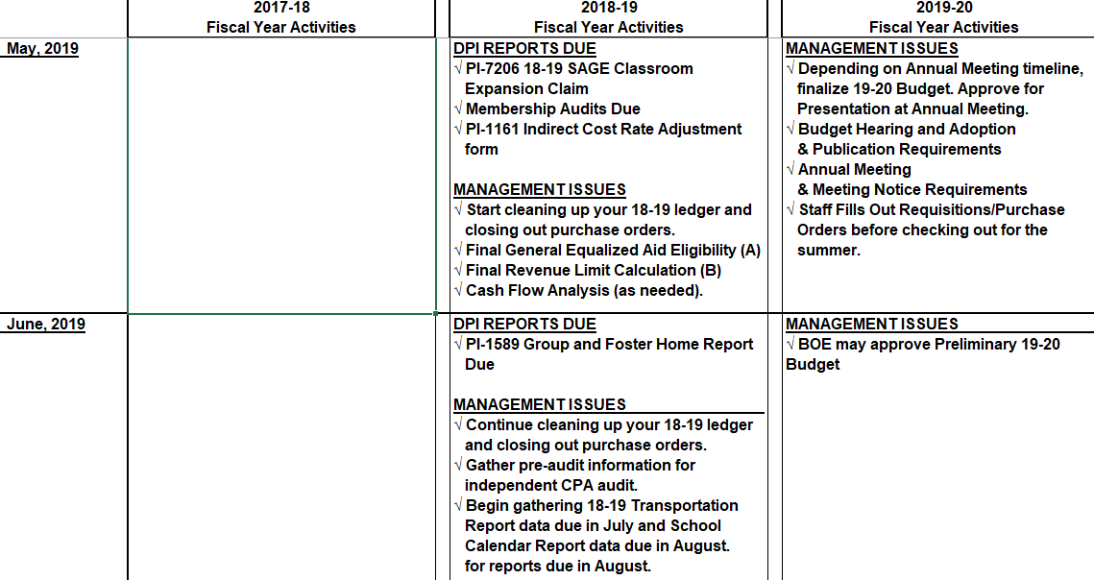
Master Multi-Tasker
Notes:
Fiscal Year "Multi-tasker" Planning Calendar (updated May 2018)
The 2018-19 Multi-tasker Planning Calendar is a 12-month summary chart of the main reports and activities that occur throughout the school year (July - June).

Slide 10
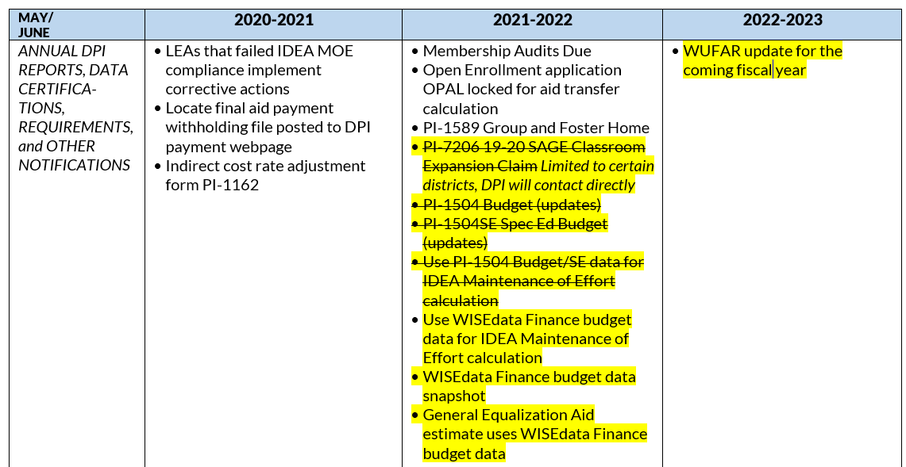
Master Multi-Tasker – new cycle begins
“Multitasker” document (https://dpi.wi.gov/sites/default/files/imce/sfs/pdf/fy22-multi-tasker.pdf).

Slide 11
School Financial Services Team Resources
Summer Activities
Current Fiscal Year Data (2021-2022)

Slide 12
What You Should Do…Today !
Make sure you are identified appropriately in the PI-1500 District Contacts Report
Please ensure updates are made to reflect changes in staff or responsibilities

Slide 13
What You Should Do…Today !
Make sure you are identified appropriately in the PI-1500 District Contacts Report
Please ensure updates are made to reflect changes in staff or responsibilities

Slide 14
Budget Report PI-1504 and PI-1504SE
Reports used to collect districts’ proposed revenues and expenses for the 2021-22 fiscal year (Adopted Budget)
Data is used to calculate the July 1 General School Aids estimate for 2021-22 (§121.15(4)(b)) and MOE for IDEA in WISEgrants
Update/revise entries on or before June 9, 2022
Notes:
The budget report should be amended as changes are made throughout the year to ensure the factors used for the July 1 General aid and MOE estimates are as accurate as possible

Slide 15
PI-1563 Membership Report
Data is used to calculate the July 1 General School Aids estimate for 2022-23
Update/revise entries on or before June 9, 2022
Further adjustments may be made up to September 30th
Email request to Roger.Kordus@dpi.wi.gov
Notes:
The budget report should be amended as changes are made throughout the year to ensure the factors used for the July 1 General aid and MOE estimates are as accurate as possible

Slide 16
Open Enrollment
Verify Students participating in Open Enrollment
    Confirm student status of pupils- both In and Out
Update PI-1563 September and January Pupil Counts for any membership changes
Complete changes in OPAL before May 1st
Aid adjustments for June are then calculated by the Parental Educational OptionsTeam
Update (amend) your Budget if needed

Slide 17
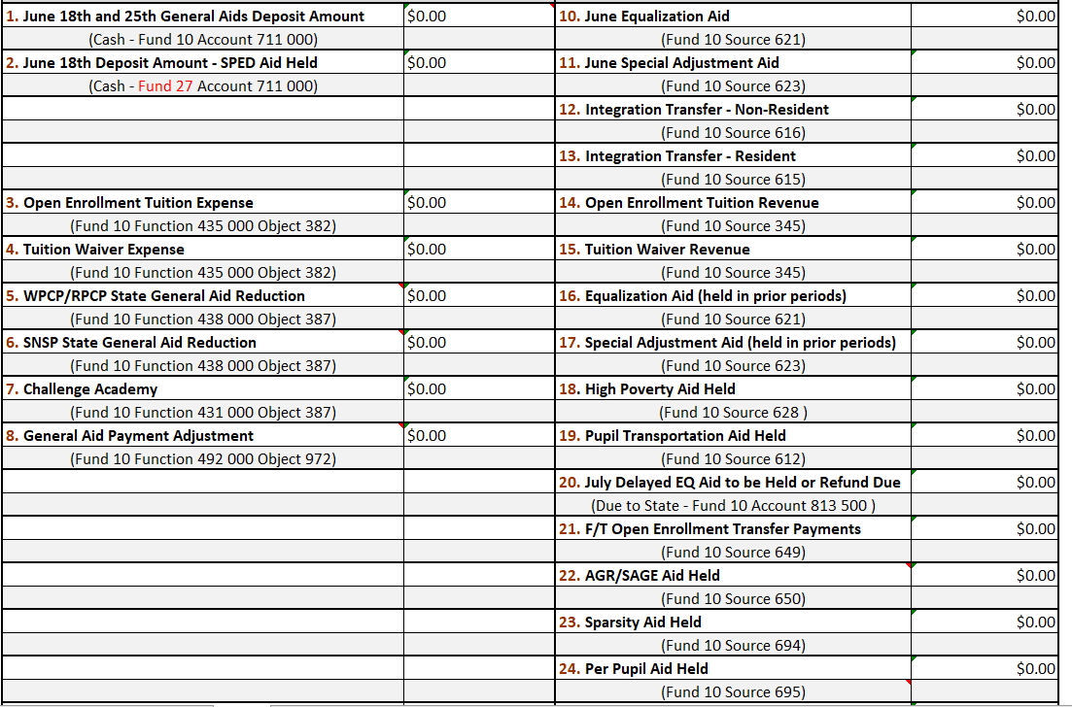
State Aid Payment Adjustments
Aid withheld for Open Enrollment and Voucher adjustment in June
Notes:
.

Slide 18
Open Enrollment
Contact PEO for corrections until June 21st
Update PI-1563 September and January Pupil Counts for any membership changes
Aid adjustments for July are then calculated by the PEO Team

Slide 19
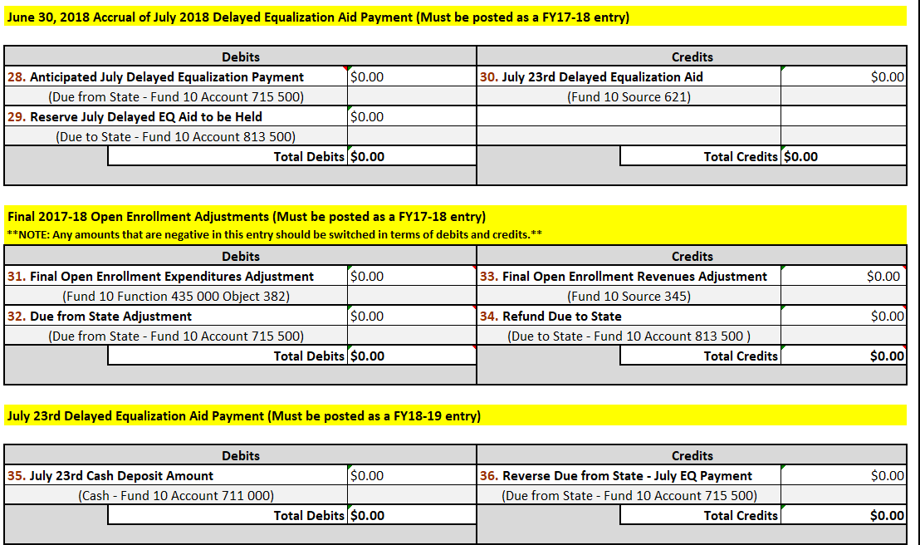
State Aid Payment Adjustments
Aid withheld for Open Enrollment adjustment in July
Notes:
.

Slide 20
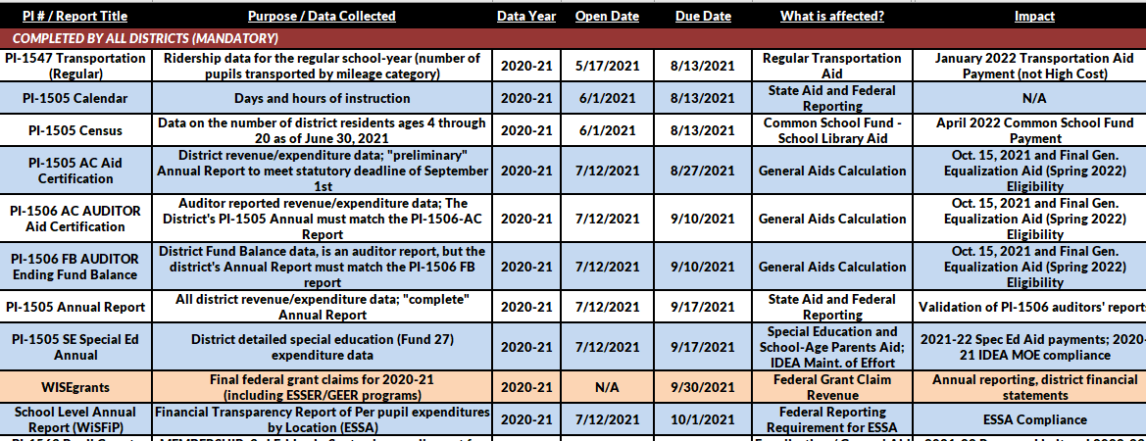
Fiscal Year at a Glance – 2021-22 data
Fiscal Year at a Glance document (https://dpi.wi.gov/sites/default/files/imce/sfs/pdf/fy22-at-a-glance.pdf)
Notes:
Fiscal Year at a Glance (updated May 2018)
The Fiscal Year at a Glance Summer 2018 - Spring 2019 is a single page document (front and back) that lists which financial reports need to be filed with SFS and when they are due.

Slide 21
PI-1547 Transportation Report
2021-22 School Year ridership report is due on early July
Actual home to school ridership by mileage category
Districts will need to document the procedures used to determine actual ridership
Aid is calculated based on the number of pupils riding in a specific mileage category

Slide 22
PI-1547 Transportation Report
Do NOT report students receiving specialized transportation per an IEP in the PI-1547
Eligible expenditures are reported in the 1505SE for State Special Education Categorical Aid
With VERY LIMITED EXCEPTION, pupils without an IEP need for specialized transportation may not ride on such routes and will result in a reduction in aid eligibility
Special Education Categorical Aid contact: dpifin@dpi.wo.gov

Slide 23
PI-1505 Calendar Report
2022-23 days and hours of instruction due the end of July
School days are days on which school is actually taught
and the following exceptional days
  inclement weather, parent teacher conferences closed by order of a local health officer, or threat to the health or safety of pupils or school personnel
Wis. Stats. §115.01(10)(a)

Slide 24
PI-1505 Census Report
2021-22 counts are due early August Includes district resident children ages 4-20
Includes children in private schools and homebased
Excludes children in penal institutions

Slide 25
PI-1505 Census Report
State Statute 120.18(1)(a) allows a district to identify census numbers using one of two established procedures.
Actually, physically count children in the community by June 30th
Use a mathematical calculation to determine a census number which includes the prior year September 3rd Friday count
Reasonability Check Available
https://dpi.wi.gov/sfs/reporting/safr/census-instructions

Slide 26
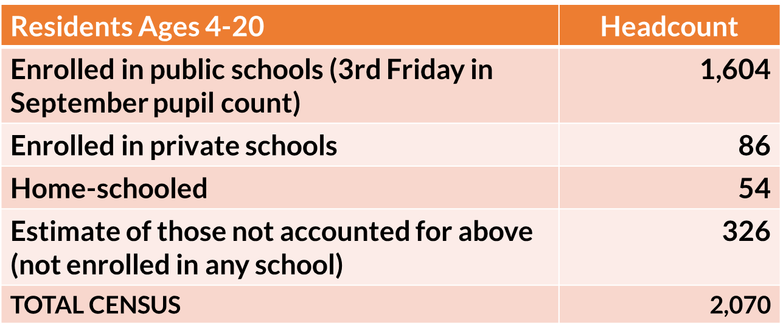
PI-1505 Census Report
Based on September count date or other fixed point in time
Reasonability Check Available https://dpi.wi.gov/sfs/reporting/safr/census-instructions

Slide 27
PI-1505 Census Report
DPI uses this data to calculate & distribute School Library Aid
Net Interest earnings from Common School Funds are distributed annually
Per head allocation -- total funding / statewide census
Aid estimate provided in January = actual payment in April
Aid must used for purchase of School Library materials (including computer hardware and instructional media)
Allocation is to be expended by June 30th of the year in which the aid is received

Slide 28
PI-1589 Group and Foster Home Report
Used to count pupils in a foster placement who were NOT captured in the September or January pupil counts for General Aid membership
Only for pupils in foster placement located on taxable property (excludes pupils who could be claimed for State Tuition)
Report process begins with letter from SFS Team to districts sent out in May – due back to DPI on June 30
Districts may be required to provide follow up data on a student

Slide 29
PI-1524 State Tuition Claim
2021-22 cost claim is due on November 1, 2022
  Report is used to collect data on the costs of educating pupils living in certain institutions or homes (juvenile correction facilities) within the district
  Data is used to calculate eligibility for State Tuition Payments
  This report is not in SAFR – paper form http://dpi.wi.gov/sfs/aid/categorical/state-tuition

Slide 30
PI-1570 High Cost Special Education Claim
2021-22 costs are due December 5, 2022
Reimbursement of net individual pupil costs over $30,000
Sum-certain, prorated if necessary
Cannot receive with Supplemental SPED Aid
dpi.wi.gov/sfs/aid/special-ed/high-cost

Slide 31
PI-1505 Fianical Reports
PI1505AC is used to collect critical financial data from the district’s ledger for the October 15th General Aid Calculation and is due August 30, 2022
District’s Full Annual Report should be prepared and match the district’s PI-1506-AC Audit Report (submitted by district’s auditor) and is due September 13, 2019
PI-1505 and PI-1505SE full annual and special education reports are due September 20, 2022
Notes:
Private School Voucher Expense

Slide 32
Transfer of Service
Transfer of Service
Exemption to the Revenue Limit
Notes:
Private School Voucher Expense

Slide 33
Transfer of Service
The added tax authority increases the ability of districts to fund actual additional costs related to
serving incoming students with Special Education and/or Limited English needs
providing services that were previously provided by another municipality
Decision Tree and other resources https://dpi.wi.gov/sfs/limits/exemptions/transfer-service
Notes:
Private School Voucher Expense

Slide 34
Transfer of Service
What is a Transfer of Service (TOS)?
A recurring exemption to the revenue limit based on the change in responsibility for a service
Allows for an increase local levy authority
What a Transfer of Service is NOT:
  A payment from the State
  A payment from another school district
  A reduction in levy authority
  A means of increasing tax authority to cover rising costs of existing services
Notes:
Private School Voucher Expense

Slide 35
Work to be completed in the Summer
Summer & Intersession Transportation
Summer School membership counts
School Fees
Audit of summer school fees
Budget Preparation

Slide 36
Work to be completed in the Summer
Energy Efficiency Exemption
Debt Schedule
Budget Adoption
WUFAR Updates

Slide 37
Summer & Interim Session Transportation
Summer 2022 ridership report is due on October 1, 2022
Districts will need to document the procedures used to determine actual ridership
Aid is calculated based on the number of pupils riding in a specific mileage category

Slide 38
PI-1804-1805 Summer & Interim Session
Remember: Summer starts the (membership) school year
Report used to collect district minutes of instruction for the just-ended summer term
FTE (full time equivalency) data is used in the calculation of a district’s current year Revenue Limit (40%) and the following year’s Equalization Aid
2019-20 [Summer 2019] is due October 1

Slide 39
School Fees
Fees for the resident student or parent may be charged for individual use supplies (towels, gym clothes, band instruments, notebooks, pencils), textbooks, or similar items (workbooks) if the district claims state aid under state statute 121.14.
Fees may be charged for social, recreational, or extracurricular summer classes and programs which are neither credited toward graduation nor eligible for state aid [s. 118.04(4)]. (not summer courses for FTE)
Notes:
Why are you collecting a fee? Is it Eligible? What is the student receiving of value that is equal to the fee collected? Fee waiver policy.
Winter at a glance will have more, a session on fees.

Slide 40
Audit of Summer School Fees
Complete the fee reconciliation tab in the PI1804 workbook
If your district is required to have a membership audit, the auditor will review your summer school FTE and the PI1804 reconciliation spreadsheet
The auditor will question fees if:
    the fee does not appear to be legal
    the amount of the fee charged per course exceeds the actual cost of the course

Slide 41
2022-23 Budget Preparation
School boards are required to approve a “proposed” budget for presentation at the budget hearing
Board adoption of an “original” budget after the hearing but no later than the meeting in which the levy is set (levy must be set by November 1st)

Slide 42
2022-23 Budget Preparation
School boards are required to approve a “proposed” budget for presentation at the budget hearing
Board adoption of an “original” budget after the hearing but no later than the meeting in which the levy is set (levy must be set by November 1st)
Review and prepare for the annual meeting as well as meeting notice requirements.
DPI provides samples that the district can utilize for this process which are available at
http://dpi.wi.gov/sfs/finances/budgeting/budget-hearing-adoption

Slide 43
Energy Efficiency Savings Reporting
Districts should review their reported utility savings in the SAFR Reporting Portal
Report/update savings within two weeks of the budget hearing date. Confirm before setting your levy
Districts needing to update their energy efficiency utility savings are to contact Roger Kordus at 608-267-3752 or roger.kordus@dpi.wi.gov

Slide 44
Debt Schedule
Submit any changes to debt schedule within 10 days of the change (in the school finance reporting portal - “SAFR”)
New debt issued OR changes to existing debt schedules.
Keeping SAFR updated will ensure consistency with the debt schedule data in the district’s Annual Report
For more information on debt, including reporting instructions, please refer to http://dpi.wi.gov/sfs/finances/debt/overview
Contact: dpifin@dpi.wi.gov

Slide 45
Budget Adoption
The school board shall adopt a budget at a school board meeting after the public hearing and no later than the meeting in which the tax levy is set. This is sometimes referred to as the “original” budget.
  November 1st – deadline for adopting the “original” budget and setting the levy amount
  November 10th – deadline for certifying the levy amount to the municipalities

Slide 46
WUFAR Updates
Minimal changes for the 2022-2023 school year
Released in October and April of the fiscal year
Significant changes occurred in FY19
  Related to Federal reporting of technology
  Non-tech codes are impacted as well
  Common School fund now has a project code

Slide 47
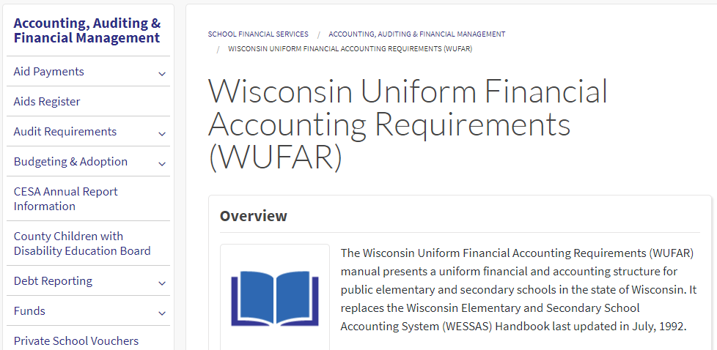
WUFAR Updates
https://dpi.wi.gov/sfs/finances/wufar/overview

Slide 48
Points to Remember
State aids are paid on prior year data (July 1 aid estimate)
You will often have three budget years cycling at the same time (Hopefully only two at this time)
Statutory requirements, reports, and deadlines
Sign up for the DPI SFS listserv and read it
The SFS website and Team are a resource

Slide 49
Contact Us
Team Directory:
dpi.wi.gov/sfs/communications/
staff-directory
General Mailbox: dpifin@dpi.wi.gov

