Slide 1
WASBO Winter at a Glance 12 December 2023
Revenue Limits and Budget Planning
Mark Elworthy, Director
Jennifer Buros, Assistant Director
School Financial Services Team

Slide 2
Overview
Prepare for Budget decisions
Understand how to use FY24 Revenue Limit Worksheet for budget planning
Review key sections/data
Explore additional DPI resources on website: Revenue Limit worksheets, longitudinal data, etc.
Open for questions throughout the presentation!

Slide 3
Let’s Jump to the Revenue Limit Worksheets
Link to Revenue Limit Worksheets: https://dpi.wi.gov/sfs/limits/worksheets/revenue
Find both the FY24 Revenue Limit Worksheet AND the FY25 Blank Executable Worksheet

Slide 4
Polling Questions
Compared to 2022-23, did your student enrollment increase or decrease in 2023-24?
Does your district have a base Hold Harmless non-recurring exemption? If yes, what is the amount on Line 7B?
Does your district have a Declining Enrollment non-recurring exemption? If yes, what is the amount on Line 10B?
Notes:
Year-to-year vs 3YRA; can have a Y2Y membership increase but be in DE

Slide 5
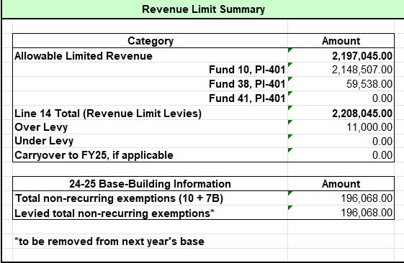
Build the Base Revenue Line 1
Aid Penalty comes from page 3 RLW
Total levied NRE comes from page 3 RLW

Slide 6
Using 2023-24 to Help Plan for 2024-25
Membership trends and projections
2023-24 (FY24) Declining Enrollment (DE) non-recurring exemptions
2020-21: 79.3%
2021-22: 73.6%
2022-23: 74.8%
2023-24: 61.3%
Projecting for 2024-25... case by case basis
Notes:
Know district’s school enrollment trends; size of graduating class vs size of 4K/5K class
How many students are in each of your grade levels? Bubble right now in class size
External factors: new subdivision construction, new charter schools, new workplaces
Review documentation used by predecessor for presenting to school board; meet/exceed
“Low” fall 2021 membership counts just dropped out of “Current” line 6 memb. Calc
Drop of students YOY was less

Slide 7
Knowns for 2024-25 (FY25)
2023-25 biennial budget and adjacent legislation impacted Line 4 of the RLW:
2024-25 Per Member Change $325
2024-25 Low Revenue Ceiling $11,000
Model various MEMBERSHIP scenarios for planning
e.g., Best Case, Worst Case, No Change
Look at the membership value “dropping off” of the current calculation
Notes:
3-year freeze if fail operational referendum STILL IN PLACE FOR NOW (track SB395/AB403)

Slide 8
Low Revenue & Per Member Increases
District One
Line 3: $10,000
Line 5: $11,000
Notes:
Using FY24 for reference
$325 per member change is added first then Low Revenue Increase brings line 5 up to $11,000

Slide 9
Low Revenue & Per Member Increases
District Two
Line 3: $10,855
Line 5: $11,180
Notes:
Using FY24 for reference
$325 addition gets district over $11,000 on line 5

Slide 10
Low Revenue & Per Member Increases
District Three
Line 3: $11,009
Line 5: $11,334
Notes:
Using FY24 for reference
Districts coming in under $11,000 on line 3 will not receive full magnitude of Per Member Change

Slide 11
Low Revenue & Per Member Increases
District Four
Line 3: $13,216
Line 5: $13,541
$364,851 7B Hold Harmless
Notes:
Using FY24 for reference
Hold Harmless means next year’s base will not grow by $325 * membership.
County in which a CCDEB may levy (three in state)

Slide 12
Voucher Deductions: Lines 10H and 10I
From longitudinal RLW
School Choice Expansion and Independent Charter School Fiscal Impacts
Notes:
Amounts not available until mid-October → put in RLW alongside Oct 15 aid amounts
Hard to predict
If not levied for, will have hole in budget

Slide 13
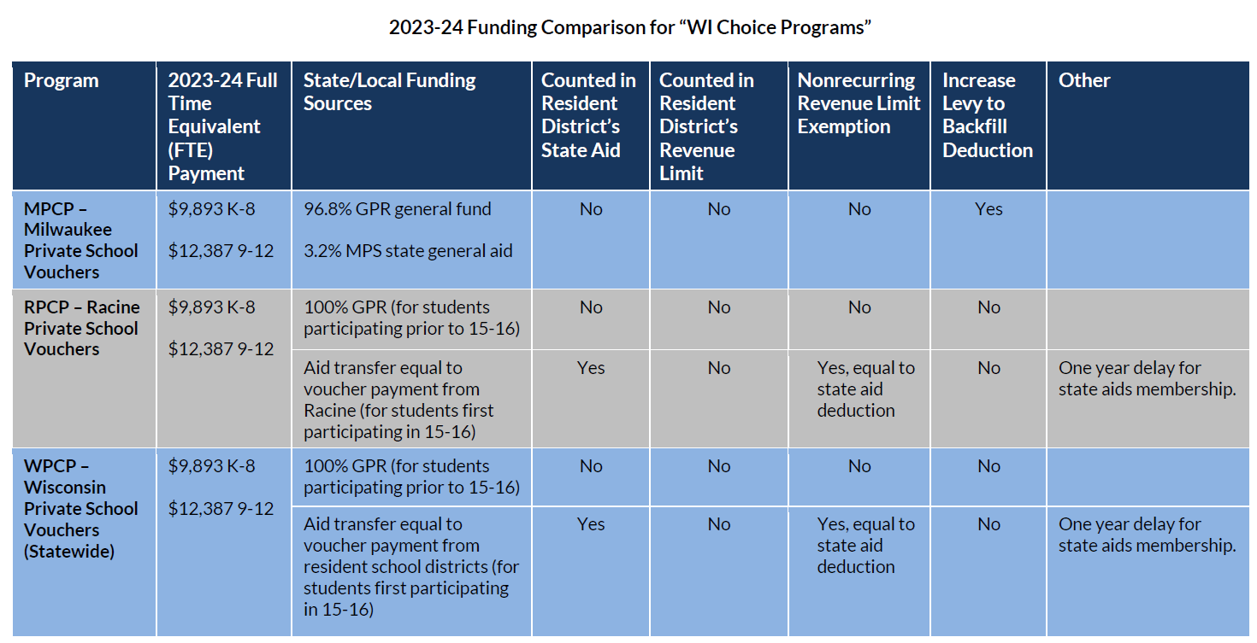
Voucher Impacts
Funding comparison for WI Choice Programs available at
https://dpi.wi.gov/sites/default/files/imce/sfs/pdf/FY24-ChoiceOptionsFundingTable.pdf

Slide 14
Breakout Discussion
How did the increase to the low revenue ceiling impact your district’s budgeting process in 2023-2024?
Did the increase to the low revenue ceiling and/or per member adjustment affect your plans for a future referendum?

Slide 15
Per Member Change Takeaways
Line 5: Maximum Revenue/Member
Line 7B: Hold Harmless Non-Recurring Exemption
Line 10B: Declining Enrollment vs Not
Line 13: Allowable Limited Revenue
Effect on next year’s base
Notes:
FUTURE: Focus on NR nature of exemptions; $$ might be the same but base won’t increase

Slide 16
General Aid Projections?
General Aid (Equalization Aid) is a key component, BUT it will be covered in greater detail in Spring...
Three key factors to consider vs PY:
Membership
Shared cost
Property value

Slide 17
Additional DPI Resources
Revenue Limit Longitudinal Worksheet: https://dpi.wi.gov/sfs/statistical/longitudinal-data/revenue-limit
Key for Membership, Base Revenue, Exemptions
Provides context/historical perspective

Slide 18
Questions?
DPI School Financial Services Team Website: https://dpi.wi.gov/sfs
DPIfin dpifin@dpi.wi.gov 608-267-9114
Jennifer Buros jennifer.buros@dpi.wi.gov 608-266-1966
Ben Kopitzke ben.kopitzke@dpi.wi.gov 608-267-9279

