Slide 1
April 2018
College and Career Ready IEPs (CCR-IEPs)
Improving Outcomes for Students Ages 3 through 21
The Five Step Process
Step 5: Analyzing Progress
Notes:
This is the fifth of a series of webinars on the 5 Step Process for developing College and Career Ready IEPs or CCR IEPs. During Step five the IEP team analyzes progress of IEP goals.
A version of this slide deck was presented as a webinar in April 2018 by Daniel Parker, Assistant Director of Special Education, WI DPI, Paula Volpiansky & Deb Heiss, Consultants on the Special Education Team, WI DPI and Diana Ziegler, WSPEI
The webinar was recorded and is accessible through the CCR IEP learning resources / CCR IEP Five Step Process / Step 1 web page. https://dpi.wi.gov/sped/college-and-career-ready-ieps/learning-resources
Most of the information in this presentation is summarized and supported by our one page “Step 5 At A Glance” handout. A copy of this presentation with speaker notes, and the At A Glance handout is available on the CCR IEP Step 5 Learning Resource page.

Slide 2
What is a CCR-IEP?
CCR-IEP = College and Career Ready IEP
An Individualized Education Program (IEP) developed to:
- meet the unique disability-related needs of the student and
- help ensure the student graduated ready for further education and the work place
Notes:
CCR IEP stands for College and Career Ready Individualized Education Program.
A CCR-IEP is an Individualized Education Program (IEP) developed to meet the unique disability-related needs of the student and help ensure the student graduates ready for further education and the workplace.
CCR IEPs are for all students in public school programs ages 3 through 21 who receive special education services. Thus, CCR IEPs are not just intended for high school students. Rather, CCR IEPs build knowledge, skills, and habits throughout a student’s public school experience, so when they graduate, they are college and career ready. This important foundation begins in early childhood.
Handout: https://dpi.wi.gov/sites/default/files/imce/sped/pdf/ccr-iep-overview-guide.pdf- link on slide

Slide 3
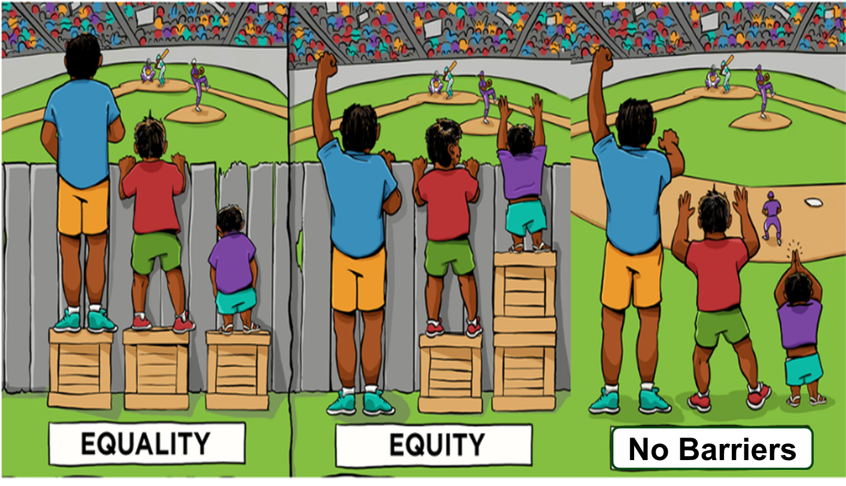
CCR-IEP 5 Beliefs
High Expectations
Culturally Responsive Practices
Student Relationships
Family and Community Engagement
Collective Responsibility
Notes:
Before we continue, I want to briefly mention the 5 Beliefs that are at the core of the CCR-IEP process.
The 5 core Beliefs are essential to developing IEPs that promote college and career readiness. The 5 Beliefs can have an important impact on the success of students with IEPs. Districts and IEP teams, including families, should consider and discuss these beliefs.
It is important to keep the 5 Beliefs in mind when completing each step of the IEP development process:
High Expectations/believing students with disabilities can meet early childhood/grade level academic standards and functional expectations or, for students with most significantly cognitive disabilities, alternate achievement standards aligned with grade level standards;
Culturally Responsive practices to honor and engage students;
Positive Student Relationships;
Family and Community Engagement; and,
Collective Responsibility for working together to support each student in addressing needs and achieving their IEP goals.
For more information on the 5 Beliefs, please visit our CCR IEP Resources webpage.
Handout- A handout of the 5 beliefs is available on the DPI website at - https://dpi.wi.gov/sites/default/files/imce/sped/pdf/rda-ccr-iep-five-beliefs.pdf (link on slide)

Slide 4
College and Career Ready IEP
5 Step Process
Step 1. Understand achievement of grade-level academic standards and functional expectations to identify the student’s strengths and needs.
Step 5. Analyze progress towards goals to evaluate what works and what is needed to close the student’s achievement gaps.
Step 2. Identify how the student’s disability affects academic achievement and functional performance.
Step 4. Align specially designed instruction, services, supports, and accommodations needed to support the goals and ensure access to the general curriculum.
Step 3. Develop ambitious and achievable goals that close achievement gaps and support the unique strengths and needs of the student.
Notes:
College and Career Ready IEPs are developed through a cyclical 5 Step Process in which each step informs the next. It is important to start at the beginning of the cycle with understanding the student’s present levels of performance.
As we go through the presentation today, keep in mind that the 5 Step Process is not about how to fill out an IEP form, but rather, provides a framework for having IEP team discussion about improving student outcomes while operationalizing special education legal (IDEA) requirements.
The outcome of the IEP team’s conversation and analysis using the 5 Step Process for developing CCR IEPs is documented on DPI’s sample IEP Linking Form (Form I-4). An online CCR IEP Discussion Tool has also been developed to help IEP team members prepare for these important conversations. More information about these and other resources is provided at the end of the presentation.
To learn more about all 5 steps, please refer to the resources on our CCR IEP Resources webpage. The link is on this slide and at the end of the presentation.
Handout- A handout on 5 Step Process is available on the DPI website at https://dpi.wi.gov/sites/default/files/imce/sped/pdf/rda-ccr-iep-five-step-process.pdf (link on slide)

Slide 5
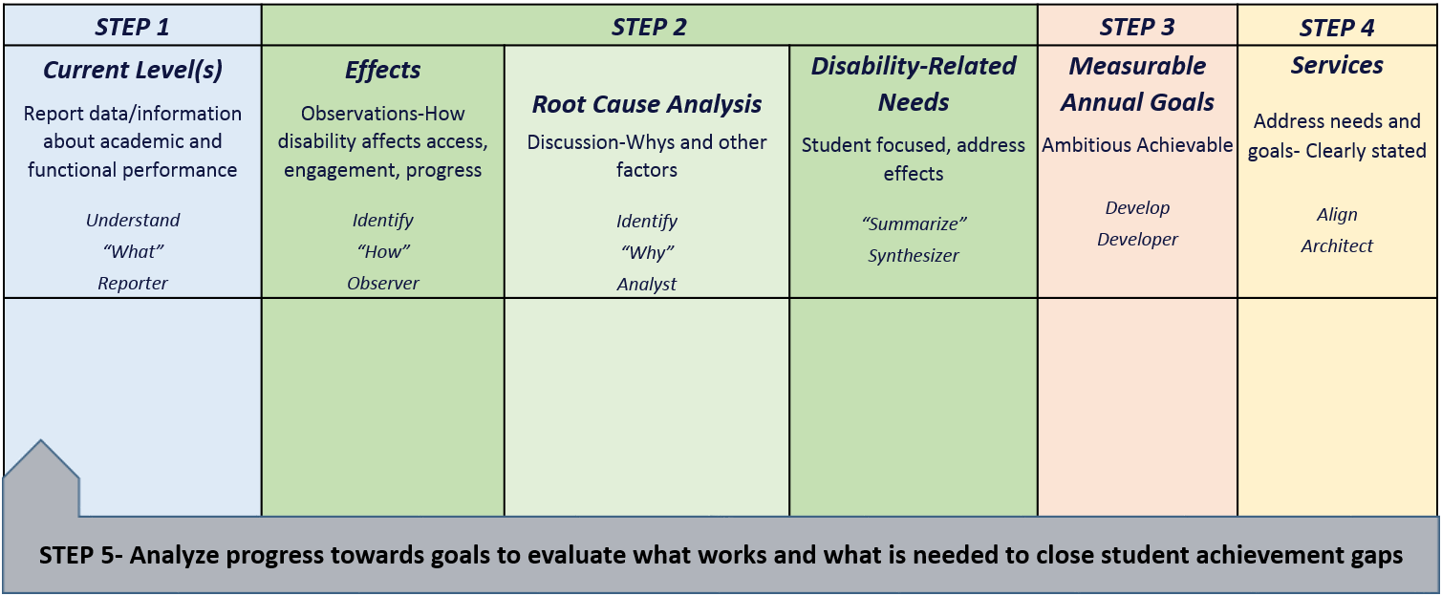
CCR-IEP Process Chart
Notes:
This chart was developed to help clarify the main purposes and linkages between the steps in the 5 step process as well as to highlight the roles IEP team participants play during each step.
On the CCR IEP Learning Resources page, you can download a CCR IEP Process chart with descriptions of each step on one side and a blank copy on the other. The chart can be used both as a training tool when explaining the steps as well as a place to take notes when developing or reviewing IEPs.
https://dpi.wi.gov/sped/college-and-career-ready-ieps/learning-resources/5-step-process
In Step 1 the IEP team’s Understanding of the student’s current levels of academic and functional performance reported during Step 1 provides IEP teams with quantitative information about the student’s skill and behavior at the time, or “the what” that is the basis for discussion in Step 2.
During Step 2, IEP team reflects on the current level and special factor information (if any) and Identifies how the disability affects the student’s access, engagement and progress based on observations, analyzes root causes of these affects (i.e. why the student has difficulty meeting standards and expectations), and finally synthesizes this information into summary statements clearly describing the student’s disability-related need(s). The student’s disability-related needs represent the areas or skills that should be addressed to address the effects of the disability and improve the student’s access, engagement and progress in general education curriculum, instruction, activities and environments.
These needs are the basis for Developing measurable annual IEP goals that are ambitious and achievable during Step 3.
During Step 4 the IEP team Aligns IEP Services that are directly linked to IEP goals and disability-related needs.
In Step 5, the IEP team Analyzes Progress of IEP goals to determine how IEP goals are supporting the student’s disability-related needs and improving the students present level of academic achievement and functional performance and addresses what works and what may need to change to close achievement gaps.

Slide 6
Step 5: Analyze Progress Towards Goals
Analyze progress towards goals to evaluate what works and what is needed to close the student’s achievement gaps.
Notes:
This is a very critical step. The revised forms now help the team document a part of the IEP team process that was rarely documented: the basis of decisions about a student’s progress and whether the students is making sufficient progress toward meeting early childhood/grade level academic standards and functional expectations .
Two new forms were developed to assist IEP teams with this step: the Interim Review of IEP Goals (I-6) and the Annual Review of IEP Goals (I-5). We will talk about these form a bit more, later in the presentation.

Slide 7
Step 5: Key Ideas
Step 5 represents both an ongoing process of progress monitoring as well as scheduled IEP team reviews and includes:
Ongoing data collection for progress monitoring and instructional planning
Periodical review of progress and reporting to parents
IEP team review of progress (must happen at least annually)
Notes:
Let’s summarize the key ideas for Step 5.
Step 5 represents both an ongoing process of progress monitoring as well as scheduled IEP team reviews. It includes 3 main tasks.
Step 5 starts with IEP implementation and the ongoing collection of data used to monitor student progress (using the methods outlined in IEP goals during Step 3).
Educators regularly use this type of progress monitoring for regular instructional planning.
Progress toward each goal must be intermittently reported to parents on the schedule identified in the IEP.
Finally, the IEP team meets and formally reviews progress at least once a year. Depending on the purpose of the meeting, the team could use either the I-6 (Interim review) or the I-5 (Annual Review) forms.

Slide 8
Step 5: Key Ideas
The main purpose of Step 5 is to review progress toward goals and how well disability-related needs are being addressed
Step 5 is about IEP planning, review, and revision
Reviewing progress helps identify what is working and what needs to change
Notes:
We want to emphasize the overall purpose of this step is to review the effectiveness of the IEP in addressing the student’s disability-related needs related to progress towards grade level/early childhood standards and expectations.

Slide 9
Step 5: Key Ideas
When a student is not making sufficient progress towards achieving IEP goals and closing achievement gaps, the CCR IEP Five-Step Process provides a good framework for reviewing and revising the IEP
Notes:
When a student is not making sufficient progress towards achieving IEP goals and closing achievement gaps, the CCR IEP Five-Step Process provides a good framework for reviewing and revising the IEP.
For instance, the IEP team should return to step 1 and consider what team members know about the student including student strengths and current levels of performance in various curricular and functional skill areas, classes, and in different settings.
In this way the summary and analysis of progress becomes part of the current level of performance statement for the next IEP.

Slide 10
Ongoing Data Collection
The Link Between Step 3 and Step 5
IEP goals include the foundation for Step 5
Baseline and expected annual levels of attainment of specified target skills/behaviors linked to needs identify the type of data to be collected
Methods specify how growth in the target skill/behavior will be measured from baseline to level of attainment
Well developed statements will identify how often the measure will be used to collect data
Notes:
Now let’s spend a bit of time on each of the major activities associated with Step 5.
The first major task of Analyzing Student Progress to review IEP goal progress in an ongoing fashion. Ongoing collection of progress data is necessary for a reliable review of progress.
Each IEP goal includes a statement of the methods for measuring progress. A well developed statement will include the type, method, source of progress data, frequency of collection. Each goal page, read as a whole, should provide guidelines for determining adequate progress.
Applying the procedures used to measure progress from baseline to LOA are often referred to a progress monitoring. “Progress monitoring” generally refers to an ongoing process and not a single event.
The decision about how progress from baseline toward LOA will be measured should allow for the collection of multiple data points during each monitoring period. There must be enough information each time to determine if progress is sufficient so this can be reported to the parent. Adequate progress means the student will be expected to meet the annual anticipated level of attainment listed in the goal.
It would not be valid to base this decision on one observation, quiz, probe, or other single assessment.

Slide 11
Periodic Review and Reporting to Parents
The IEP must state when IEP progress will be reported to parents (e.g., quarterly, concurrent with general education report cards, etc.)
Notes:
Teachers, regularly and deliberately review student’s progress and adjust instruction during the course of the typical teaching and learning cycle.
For students with IEPs, this review includes making typical adjustments to instructional practice in response to ongoing review of data collected to review progress toward IEP goals.
Periodically, IEP progress data is summarized and reported to parents on the schedule identified on the student’s IEP. Districts may use the Interim Review of IEP goals for this periodic reporting. It is common to find IEP progress reported on the same schedule as general education progress reports and report cards.
Usually, periodic reporting of progress is done outside of an IEP team meeting. Sometimes teachers and parents will meet informally to go over student progress. Teachers should also consider including students in such periodic reviews.
Reviewing and reporting progress regularly is also important so needed IEP revisions can be timely made when students either meet goals before the end of the IEP or when they are not making sufficient progress in response to typical adjustments to instruction, after a reasonable period of time.

Slide 12
Periodic Review and Reporting
Tips to Analyze IEP Goal Progress
Analyze progress data
Rate of progress, trend
If progress is insufficient, consider a task analysis
Does the student have subskills needed?
Are STOs or benchmarks needed?
Are there different or additional service needs? (if yes, an IEP team meeting is likely needed)
If goal is met, what’s next? (IEP team meeting may be needed)
Increase level of attainment?
Increase complexity?
Increase level of independence?
Goal no longer needed?
Notes:
The same basic steps are followed when reviewing IEP goal progress whether the review occurs as part of regular instructional progress monitoring, information with the parents as when reporting progress or more formally, when an IEP team meeting is held when interim changes are needed because a student has met goals before the end of the IEP term or when the student tis not making sufficient progress, or when the IEP team meets to conduct an annual IEP review, or for any other reason.
Here are some basics steps for completing the analysis of IEP goal progress:
Step 5- Compile and analyze all data collected during ongoing progress monitoring.
Compare baseline to current level of progress to determine if progress is sufficient. If this is the final analysis before the end of the annual IEP team, ask if the student has met the expected level of attainment as written in the IEP.
Based on this analysis, some decisions need to be made as to what happens next.
If the student has not made sufficient progress during the reporting period, an interim IEP team meeting may be needed to conduct a more thorough review and to make needed IEP revisions.
When the student is easily meeting one or more IEP goals prior to end of the current IEP, it is important to ask, “Have the disability-related needs been accurately identified? Are the goals sufficiently ambitious? Are these the right goals? “ An IEP team meeting will likely be needed if substantive changes are needed to IEP goals or services.
In a bit, we will discuss what happens when this analysis occurs during an annual IEP team review meeting.

Slide 13
Step 5: Key Ideas
Two new forms were developed to assist IEP teams with goal reviews:
Interim Review of IEP Goals
Annual Review of IEP Goals
Notes:
As already mentioned, two new forms were developed to help IEP teams with IEP goal reviews.
LEAs may use Form I-6 to document Interim Reviews of IEP Goals and to document the required reports to parents on the student’s interim progress toward IEP goals.
Form I-5 is used to document the annual review of IEP goals that must be completed during an IEP team meeting at least annually.
We will talk about these forms and how they might be used during the various tasks associated with Step 5.
Refer to the explanation in the DPI Forms Guide for more guidance on completing these two forms.

Slide 14
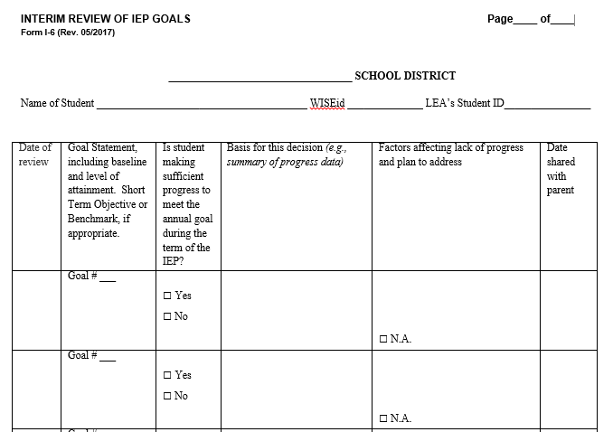
Individualized Education Program
Interim Review of IEP Goals (I-6)
Notes:
The IEP team specifies when progress will be reported to parents on each goal page [Form I-4 (section IV.B.5.] Often progress on IEP goals is reported on a quarterly basis in conjunction with quarterly report cards.
The Interim Review of IEP Goals (Form I-6) may be used to periodically document progress toward the IEP goals and to provide a report to the parents of the student. As just mentioned, this generally occurs outside of an IEP team meeting.
On the form, document the date when progress toward the goal(s) was reviewed, as well as the date the progress report was shared with parents.
For each goal, include the goal number and goal statement, baseline and anticipated level of attainment. This allows for easy comparison with the student’s current level of performance. Don’t forget to include short term objectives or benchmarks, when used.
Indicate by checking “Yes” or “No” if the student is making sufficient progress toward achieving the goal within the specified time period.
Then provide the basis of this decision. This section should include a summary of the data collected using the planned methods of measuring progress from baseline to level of attainment. The methods of measuring goal progress are identified on the goal pages for each goal and must allow for a comparison between the goal baseline and level of attainment.
For example, The goal statement is for the student to improve decoding skills by accurately decoding one and two syllable words on a graded list. The baseline was “On average, accurately decodes 50% of words given 100 single syllable words at the beginning first grade level.” LOA was “On average, the student will accurately decode 80% of the words given 100 one- and two-syllable words at the beginning 2nd grade level.” The methods of measuring progress were: weekly oral word list tally, bi-weekly running records with miscue analysis.
An appropriate interim progress statement at the end of the first quarter might be: “Progress data shows given 100 single syllable words at the beginning first grade level, the student is now able to decode 75% of the words correctly.” A decision would need to be made whether this amount of progress is sufficient for the student to meet the LOA by the end of the year.
If, upon review, teachers or family believe the student is not making sufficient progress, an IEP team meeting may be needed to discuss and identify the factors that may be affecting the student’s lack of progress and to consider new strategies, interventions, or revisions to the IEP to address the factors affecting progress. At this time, the team will want to reexamine the effects of the student’s disability on progress and the disability-related needs, and revise the IEP as appropriate. We turn to the IEP team role in Step 5 and IEP review/ revision next.

Slide 15
IEP Team Review: Key Ideas
The IEP team analyzes the student’s progress towards the IEP goals to inform future IEP development
The IEP must be reviewed periodically, but at least annually
Notes:
Now let’s talk more about the IEP team’s more formal role in Step 5.
We already mentioned that, at least annually, the IEP team must meet to formally review progress toward all IEP goals.
To do this, the IEP team reviews the disability-related needs and the goals (and benchmarks/objectives as appropriate) for which good progress is being made and determine what additional progress may be needed. The team asks, “Has the IEP been effective in addressing the student’s disability-related needs to help the student make progress toward academic standards and functional expectations at the desired rate?”
The IEP team uses the information collected and already reported to the parent during interim review(s) of progress, and any other relevant information, to determine if IEP goals have been met and if special education services are effectively meeting the student’s needs. If not, the team considers what revisions to the IEP are needed to support the student?
If a goal has been met, perhaps the goal is no longer needed or a more ambitious goal should be added (i.e., change in level or increased independence of performance; different aspect/higher level skill).
If not all needs are addressed by a goal, the team should also review the degree to which the need is being met.
Example: A student who requires a wheelchair or walker has a disability that affects the student’s mobility. Therefore, improved mobility to allow access to school is a disability-related need. It is possible that the student has acquired the requisite mobility skills needed to use and transfer from his walker or wheelchair, but still has mobility related needs. In such case, the student may not have an IEP goal related to mobility but will still require the related service of specialized transportation.
When analyzing progress always consider how the student’s strengths, areas of success, and strategies that are working well may apply to areas in which progress is not so good.

Slide 16
IEP Team Review:
Annual Review Requirements
The IEP team must meet at least annually to:
Review the IEP to determine whether the annual goals are being achieved
Revise the IEP as appropriate, to address
Lack of expected progress toward annual goals and in general education curriculum
Results of any reevaluation
Information provided to, or by, parents
The student’s anticipated needs
Other matters
In conducting the review, consider special factors
Notes:
Like any other IEP team meeting, a meeting held to conduct an annual IEP review, must includes all required participants, including the student’s parent(s). A regular education teacher of the student, as a member of the IEP Team, must participate in the review and revision of the IEP of the student (300.324 (b)(3). This is a procedural requirement, but also harkens back to one of the 5 beliefs of CCR IEP development: collective responsibility.
The regular education teacher brings a perspective of what is expected in the general education classroom, a perspective on what same-grade peers are achieving, and first-hand knowledge of how the student is performing in their classroom, including knowledge of the student’s strengths and struggles, as well as possible reasons why the student is struggling.
The annual review occurs before developing new goals. In other words, the IEP team must review the previous IEP goals and progress before developing the next IEP. In addition to progress data, when making IEP revisions as part of an annual review, the IEP team must also consider the effect of the disability on progress, as well as any special factors, the results of any reevaluation or other information provided by the parents.
As a result of the annual review, IEP team must revise the IEP as appropriate to address:
The student’s disability-related needs
Any lack of expected progress toward IEP goals
Any lack of expected progress in the general education curriculum
How IEP goals and services support the student in closing gaps in early learning/academic achievement and functional expectations

Slide 17
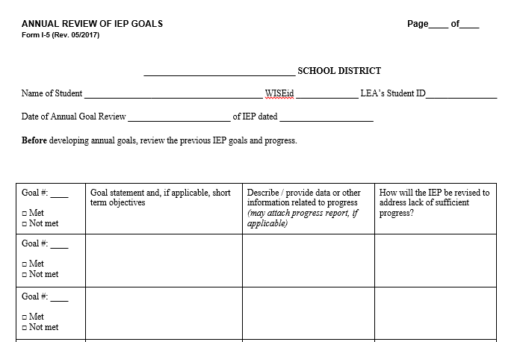
Individualized Education Program
Annual Review of IEP Goals (I-5)
Notes:
Form I-5 is used to document the annual review of IEP goal progress. As noted earlier, the purpose of the annual review is to determine if the student met the previous year’s goals and short term objectives (STOs), and if not, to revise the IEP, as appropriate, to address the lack of progress by changing or adding updated goals and services.
A review of the previous IEP goals and progress will help IEP teams consider if new goals and services are needed. IEP teams should be able to clearly explain lack of progress on IEP goals and develop plans for addressing lack of progress.
To complete this form:
List the goals or short term objectives from the previous IEP. Include the goal number(s).
Provide a summary of the data collected using the progress measures identified in the IEP that reflects the student’s progress from baseline to LOA . Provide available data (attach reports, when appropriate).
As with the interim data used to complete the I-6, the data must allow for the comparison between the baseline and level of attainment so the amount of progress from baseline to LOA can be analyzed and the IEP team can decide if the student accomplished the annual goal.
If the student did not meet a goal, describe how the IEP will be revised to address lack of progress.
When deciding how the IEP should be revised to address insufficient progress, the team may find it important to review the effects of disability (Section E of Form I-4) and summary of disability-related needs (Section F of Form I-4) to reflect why the student continues to struggle to access, engage, and/or make progress toward meeting preschool/grade level standards and expectations. It is important to revisit the team’s understanding of the impact the student’s disability has on academic achievement and functional performance to address the student’s disability-related needs. It may als0 be necessary to conduct a new root cause analysis to determine why the student did not make sufficient progress. Revise the IEP to address the disability-related needs. Revisions documented on Form I-5 should be included in the new IEP.

Slide 18
IEP Team Review of Need and Goal
The IEP team found a student did not meet the following IEP Goal
Disability-Related Need | Goal
Improve reading comprehension | The student will improve reading comprehension by answering inference questions with 90% accuracy on five consecutive weekly quizzes, when given a passage at the 5th grade reading level
Notes:
The following is an example of how the 5 Step Process may assist in the analysis of progress toward IEP goals and for identifying areas where the IEP may need to be revised.
In this example, the student did not meet their goal to improve reading comprehension as defined by improving their ability to answer inference questions and identify the main idea when given a reading passage at the student’s instructional reading level. An IEP team meeting was held to discuss the factors that were affecting the student’s progress and to make appropriate adjustments to special education services as needed.
Before jumping to the assumption that the goal was “too ambitious”, the IEP team should take time to review each of the 5 Steps to see if additional information, discussion, or documentation might assist with supporting the student’s progress in identified areas of need.
On the next slide, some potential questions to ask about goal attainment are discussed.

Slide 19
IEP Team Review Example:
Possible Questions to Ask
Review current information about IEP goal progress. Is there any other new information to consider that might affect our review?
Do we need to revisit the effects of disability, root causes, and disability-related needs?
Given current information, was the goal(s) appropriately ambitious, achievable, targeted to address the need(s)?
Do services need to be realigned to needs and goals? Are other supports/services needed?
Notes:
When reviewing the student’s progress toward meeting IEP goals, the team will first want to look at the data collected specific to monitoring progress toward the goal; in this case the weekly comprehension quiz data. If the IEP team is confident they have enough information, they may then want to ask questions based on the 5 Step Process - to explore the student’s progress further. In the case of this student, here are some questions the team might want to ask:
Related to Step 1 - Understand Achievement: In addition to the progress data directly related to this goal, is there any new or additional data related to this area? Does the student comprehend certain types of text? Is comprehension better in certain environments? When provided certain supports? When certain teaching strategies are used?
Related to Step 2 - Identify Effect of Disability and Disability-related Needs: Based on new/updated current information, are there other root causes that were not previously explored? What factors other than specific reading comprehension skills may be influencing the student’s learning or demonstration of reading comprehension. Are there language concerns? Are social emotional, behavioral, sensory, or other factors affecting the student’s progress during text based activities? This might lead to another discussion about how the nature of the student’s disability may help explain the barriers the student is encountering and why the student may be having difficulty accessing, engaging, and making progress in the general education curriculum, instruction, and environment, and lead to clarification of the student’s disability-related needs, both academic and functional.
Related to Step 3 - Develop IEP Goals: The IEP team can now use the progress data to consider new or revised ambitious and achievable goals. For example, the team may decide other goals are needed to address access or engagement needs or the reading comprehension goal should be broking down into several short-term objectives or benchmarks to focus more specifically on root causes.
Related to Step 4 - Align Services: Based on the updated information, the team can now consider if the existing IEP services adequately support the goal. Does more time for specially designed reading instruction need to be added? Or are other types of services needed? (specially designed instruction, supplemental aids and services, related services, and program modifications for school staff? Will additional services improve the student’s growth in reading comprehension skills? Would training of school staff in instructional or social emotional support strategies enhance their ability to provide or support the implementation of IEP services?

Slide 20
IEP Team Review
Completing the Feedback Loop to Step 1
Review linkages between current level of performance, effect of disability and disability- related needs, goals, and services
If student not making sufficient progress
Review the 5 Step Process
Try back-chaining steps
E.g. Select goal and linked service(s) then trace back to effects of disability, root causes and disability-related needs and current levels of performance
Consider other factors that may influence progress and student learning
Notes:
Here is a summary of recommended activities to guide the IEP team’s completion of Step 5 as the feedback loop to IEP revision starting with Step 1
Analyze progress data to determine if the student has met IEP goals
Reflect on what is “working” – Where has student made progress? What general education and special education services has student responded well to? Are there particular types of instruction, environment, supports, etc. that seem to be most effective?
Reflect on what may not be working so well--- What is inhibiting or serving as a barrier to the student’s progress toward goal achievement? Are the goals too ambitious? Are they the wrong goals? Are services not sufficiently matched to need? Do we have new information about the effects of disability that we were not previously aware of?
Review earlier steps in the 5 Step Process:
Step 1 - Review updated current levels of performance in relation to early childhood/grade level academic standards and functional expectations.
Step 2- Review and update (as appropriate) effects of disability and disability-related needs.
Step 3 - Develop new/revised ambitious and achievable goals, as appropriate, to address needs (including methods to measure progress toward new/revised goals).
Steps 4 - Align services to updated needs and goals.

Slide 21
Multiple Factors Affecting Student Progress
Instruction
Curriculum
Environment
Learner
Notes:
There are many factors that can affect how well IEP services address a student’s needs and the degree to which a student makes progress toward achieving IEP goals.
The four factors on this slide are understood to be critical to consider with both developing instruction and when evaluating the effectiveness of educational programming .
Instruction– such as instructional methods, teaching strategies, interventions, accommodations, academic and behavioral supports
Curriculum- content and materials
Environment- group size, physical space,
Learner- Consideration of the individual student, including the effects of the student’s disability and the student’s unique disability related needs
The can be helpful to consider at all stages of ongoing progress monitoring and analysis as well as when the IEP team meets to consider how to adjust the IEP to improve progress.

Slide 22
Universal Design for Learning (UDL)
A Lens for Factors Affecting Student Performance
Consider how these UDL guidelines apply to Step 5
e.g. Name one engagement barrier that might help explain why a student may
not have met a goal to improve reading comprehension?
Notes:
Universal Design for Learning (UDL) provides another framework for considering how curriculum, instruction, environment, and student characteristics interact to either enable or provide barriers to student progress.
IEP teams can use the UDL Framework to explore why a student may not be making sufficient progress and what may be needed to better address the student’s disability-related needs.
During Step 5, it can help to answer the question: What sources of information can you think of that you might explore if a student is not making progress?
Let’s apply this to our IEP Goal example on the previous slide.
Prompt questions:
Which barrier from engagement do you think is most likely to influence progress toward this need/goal?
How might we find more information about this? What sources of information might we use to learn more about what might be causing or having an effect on the student’s progress?

Slide 23
Engaging Students in Step 5
Have a system for preparing the student to participate in the IEP team meeting
Provide explanations of IEP terminology using language the student understands
Ask students to talk about their year thus far, what is working well and why? What is not working and why?
Ask students what they think would help them better achieve their IEP goals?
Consider student led IEPs
Notes:
Involving students in the development of their IEPs leads to greater student ownership and understanding of their educational program and its outcomes.
This applies to students of all ages and development levels. All students can and should have some role in their IEP.
Here are a few ideas for engaging students in Step 5.
Can you think of any others?

Slide 24
Tips for Engaging Families in Step 5 Analyze and Evaluate
What Families Need to Know…
Student progress
IEP Implementation
Progress monitoring
Identification of what is working and what may need to change
Notes:
In order for families to be a part of the IEP team and process, families need to understand what it is that is being analyzed and evaluated. Families need to understand that it is NOT the student being analyzed and evaluated, but the function of the IEP itself. In order to understand the function of the IEP, we need to be sure families can do the following:
Understand the level of performance and function at the beginning of implementation of the IEP (Step 1); how the student’s disability affects performance and function (Step 2) in order to understand goals that have been set (Step 3) and why specific instruction, services, supports and accommodations were put in place (Step 4); so that student progress can be clearly identified and analyzed (Step 5).
Families need to participate in reviewing the implementation of the IEP. This is necessary in order to inform the formation of future IEPs and the function of future IEP meetings.
It is important that families understand the methods used to monitor the progress of the student. Daily, weekly, quarterly? How is the progress being monitored throughout the school year to allow for the annual review of goals? What ways may the student use to demonstrate knowledge?
And finally, families need to know that their input is important and valued in the identification of what is working and what may need to change in order to support the student in closing his/her achievement gaps.

Slide 25
Tips for Engaging Families in Step 5
Questions to Ask Families
What are some ways you have viewed progress toward goals at home and in the community?
What services or supports do you believe have been effective and why?
If the student is not making progress toward meeting ambitious and achievable goals, what revisions do you think might be helpful?
Which adults in the school is the student/family most comfortable with related to reviewing progress and receiving encouragement/support?
Notes:
What questions can we ask families as we work to analyze student progress toward achievement and functional performance that will help them share information with the team? The questions listed here will allow families to contribute to the conversation. What is shared by the family can be used to enhance analyzation of IEP implementation and evaluate what has been effective in closing those achievement gaps.
Because we are analyzing progress of the WHOLE child, this first question, “What are some ways the family has viewed progress toward goals at home and in the community?”, helps educators understand the effectiveness of those services and supports that were put into place as they pertain to functional performance outside of the classroom.
What services or supports does the family believe have been effective and why can bring a new perspective to educators in understanding the true scope of some of the supports, services or accommodations put into place. Even with healthy discussion of the reasoning behind some of the choices made in creating the IEP, it is likely there will be effects of programming that had not previously been considered. This will assist in the true evaluation of what works and what does not work.
What the family sees that might be helpful is an important component of the IEP. As a general rule, families know their student in a more all encompassing way than educators do. As families may have been “thinking outside the box” for this one child, they may have ideas that school personnel have not considered.
Understanding with which adults in the school both the student and the family have a healthy relationship, affords the opportunity to provide encouragement, support, and constructive criticism that will be more readily accepted by both the student and the family. This relationship will allow the student to comfortably seek assistance which, in turn, assists in the implementation of the IEP which then allows for a more complete analysis and evaluation of the process.

Slide 26
Tips for Engaging Families in Step 5
Remember, parents are their child’s first teacher; it may be hard for them to trust others
Explain progress monitoring process in understandable terms; Provide real life examples
Provide timely copies of progress reports
Encourage families/student to share related information and ask questions
Take notes and connect information to the development of the annual IEP
Notes:
Let’s talk about tips for school staff to help families in the analyzation and evaluation process. The first tip simply reiterates a tip that was shared in discussion of step one of the five step process.
We must acknowledge that parents are their child’s first teacher and it’s sometimes difficult for families to trust that the information, observations, and perspectives shared by others really represents their child. It may take time for some families to understand and in some cases, accept, their child’s ability to reach those ambitious and achievable goals . Families need to feel that you know their child and care before they can trust that you are working with them and the relationship is not an “us”/ “them” but a “we”.
Explain how you have monitored the student’s progress in ways that families will understand. In preparing for the IEP meeting, review your notes and ask yourself, if you were not an educator would you understand the process for monitoring student progress?
In addition to explaining your monitoring process, provide tangible examples of how you reached your conclusions. Whether you used prepared charts and chicken scratches, or daily logging, or anything in between – allow the parents/guardians to see what you are doing.
It is important that parents are aware of what that report will look like so that they are able to give it the attention necessary in their participation on the IEP team. Be sure to let parents know how often they will receive the report so they will be “on the look out” in order to stay abreast of their student’s progress.
When asking questions about progress the family sees at home and in the community, take notes. When families share what they believe works and why, take notes. In this way you are physically demonstrating that the families input is important in the process. In addition, you will have concrete examples of the child’s response to services and supports outside of the classroom that can be used in developing the annual IEP. By showing an acknowledgment of family contributions, you are assisting in the positive construction of the IEP team as a true team. Remember, trust is a difficult thing and acknowledging the value of family contributions helps to build the trust that is needed to be a truly effective team.

Slide 27
Tips and Expectations
Look for
IEP team documents the review of the previous IEP goals and progress BEFORE developing new IEP goals.
Data to determine progress on IEP goals is available at IEP team meeting.
Progress reports include clear summaries of data
IEP revisions are based on analysis of progress
Use the CCR IEP Five Step Process to analyze progress toward IEP goals and revise IEPs as needed
Avoid
No review of progress on previous IEP Goals before IEP revised.
Data is not available at IEP team meeting or data is insufficient to analyze progress toward IEP goals.
Goals are cut and pasted from one year to next year.
No systemic analysis occurs or is documented to determine why the student did not make progress toward meeting IEP goals.
Notes:
The key overall tip to remember is the main purpose of this step is to review the effectiveness of the IEP in addressing the student’s disability-related needs related to progress towards early childhood/grade level standards and expectations.
Again, It may be helpful to also remember that the completion of Step 5 leads directly back to Step 1 when developing a revised IEP.
In addition to tips and Step Checks, each of our At a Glance documents also includes examples of what we would expect to see in practice and what we would hope not to see in practice.
Here are some expectations related to Step 5.
Read slide.
For example:
Look for: Always make sure progress data is collected and analyzed before the meeting to review progress. Staff should be prepared to share and explain the data used to support the decision that the student is or is not making sufficient progress.
Avoid: Being unprepared and not having the necessary data available to show to the parent to help explain the IEP team decision about whether the student is or is not making sufficient progress toward the goal.

Slide 28
Step 5: Analyze Progress Step-Check
Have you compiled all data collected using the methods to monitor progress identified in the IEP goal?
Have you analyzed all data collected to date to monitor IEP goals?
Have you considered other available data or information related to needs/goals (e.g. other classroom data, information provided by the parent, classroom teachers) ?
Have you reviewed progress reports provided to parents?
If this is an interim review, have you analyzed the data to determine if progress will be sufficient for student to meet the annual goal? (compare baseline with LOA)
Have you engaged the student in progress monitoring and understanding progress toward goals?
Notes:
The At A Glance documents also include Step Checks that individuals or teams can use to review their IEPs. Here is the Step 5- Step Check to Analyze Progress.
Review slide.
Each of the At a Glance documents also include tips for IEP teams about each step. We have already gone over the tips for this step during the presentation.

Slide 29
Step 5: Check Your System
Are there set procedures and schedules for reviewing IEP goals?
Are there procedures for ensuring IEPs are implemented with fidelity?
Do all educators have access to data needed to review IEPs?
Are instructional resources available to match student needs with effective interventions?
Do educators need additional training or support to implement IEP services ?
Do educators need additional training or support to monitor and interpret progress data? To adjust instruction based on data?
Notes:
Before we conclude, we want to share one additional list of suggestions.
This list is intended for those involved in strategic planning and system improvement in a district or school. Districts often include input from educators and families when making such decisions, so it is helpful for everyone to be aware of policies and procedures that support the 5 Step Process.
Carrying out step 5 of the CCR IEP process effectively requires a number system prerequisites to be in place. This slide highlights a few of these. District and building level leadership are encouraged to consider these examples as they implement the 5 step process.
Consider the questions on this slide, as you think about your own capacity as well as the capacity of your district to develop and review the effectiveness of IEPs in helping all students meet high expectations as they access engage and make progress in general education curriculum, instruction and environments.

Slide 30
For Further Discussion…
For a student who is not making sufficient progress toward meeting IEP goals, what questions would you ask or information you would need to know to understand “why” progress was not made?
How does knowing “why” the student is not meeting goals Inform “how” to revise IEP goals and services?
Notes:
This activity asks you to think of a student who was not making sufficient progress toward annual IEP goals.
What information or questions would you ask? What information might you need to know to understand “why” progress is not sufficient?
How does knowing “why” the student is not meeting goals inform the “how” to revise annual IEP goals and services?

Slide 31
CCR IEP Learning Resources
Notes:
On this page, you will find links to all DPI CCR-IEP resources. Please check this page often as we will be adding new resources regularly

Slide 32
CCR IEP Discussion Tool
Notes:
We have developed an online discussion tool to help IEP teams prepare to develop a CCR IEP. This tool also supports the 5 step process. It provides guiding questions to consider when identifying the effects of disability, the root cause analysis and the summary of disability-related needs. We encourage you to explore this tool as you prepare for IEP team meetings. For example, some of the questions in the tool will be helpful to discuss during a specific student’s IEP meeting.
A link to the online tool is found on our website under CCR IEPs at https://dpi.wi.gov/sped/college-and-career-ready-ieps/discussion-tool
Presenter Note: Remind participants that this tool is intended to be used individually in preparation for a meeting or during an IEP team meeting. School staff should not meet as a group without the parent to draft the IEP prior to the IEP team meeting. If staff meet to substantively develop/draft parts of the IEP together as a group, it is considered an IEP team meeting and the parent should be invited.

Slide 33
CCR IEP Video
Notes:
We have a 5 minute video that describes the CCR IEP 5 Step Process at https://youtu.be/wRIyZoiHRdQ

Slide 34
Step 5 Resources
Universal Design for Learning
OSERS Policy Letter- FAPE and IEPs
OSERS Policy Letter- IEPs and Behavior Support
Wisconsin RtI Center
Special Education Program Areas
DPI Resources Behavior and IEPs
Also see: https://dpi.wi.gov/sped/college-and-career-ready-ieps/5-step-process/step5
Notes:
Here are a few additional resources specific to Step 5. You can find links to these resources on Special Education Team Website.

Slide 35
Step 5: Analyze Progress Towards Goals
Resources for Families
How Will I Know If My Child is Making Progress? from PACER Center
Balanced Assessment and Progress Monitoring Overview - WI RtI Center Resources
Center on Response to Intervention (RtI) Family Resources
Student Progress Monitoring: What This Means for Your Child (Archived National Center on Student Progress Monitoring)

Slide 36
Additional Resources for Family Engagement
http://www.livebinders.com/play/play?id=2191148
Understood School and Learning
Michigan Alliance for Families: Progress Monitoring
National PTA: Parent’s Guide to Student Success
Reading Rockets: Building Parent-Teacher relationships
YouTube: Do’s and Don'ts of IEP meetings
Also see: Wisconsin Statewide Parent Educator Initiative
Notes:
Here are some additional resources that may be particularly helpful for families. These and other resources for families on the 5 Step Process have been organized into a livebinder by our WSPEI staff.
The link to the WSPEI livebinder is on this slide: http://www.livebinders.com/play/play?id=2191148

Slide 37
Step 5 Debrief
Questions?
Comments
Notes:
Closing:
Remember the 5 Step Process for Developing IEPs is a framework for the IEP team process.
The primary focus is on the content and structure of IEP team conversation, rather than on completing IEP forms.
The conversation drives the IEP documentation, not vice versa.
What is documented on the IEP form should reflect the conversation.
The best way to ensure that there will be sufficient information in the student’s written IEP is to follow the 5 Step Process when preparing for and conducting IEP team meetings and for documenting discussion and IEP team decisions.

Slide 38
Thank you!

