Slide 1
School Based Mental Health
Supporting Guidance for Schools Entering into Outside Partnerships
Christie Gause-Bemis, MSW,LCSW
Wisconsin Department of Public Instruction

Slide 2
Objectives
What is possible….?
Memorandum of Understanding Guidance
Referral Pathways
Guidance on Community Partnerships

Slide 3
…core elements of a full continuum of high quality, evidence-based mental health programming in schools, which includes mental health promotion, prevention, early identification and intervention, crisis intervention, teacher consultation, school staff professional development and resource sharing. Community ….based school mental health programs expand on or augment services that already exist in schools—for example, the work of school psychologists, social workers, counselors, and educators that focuses on assessing and improving children’s emotional and behavioral functioning.
Notes:
Weist, M.D., Evans, S.W., & Lever, N.A. (2003). Handbook of school mental health programs: Advancing
practice and research. New York, NY: Kluwer Academic/Plenum Publishers.

Slide 4
Expanded school mental health programs offer the opportunity for community and school staff to come together in improving success for all students.
Notes:
Mettrick, J., Lever, N., McLaughlin, M., & Weist, M. (June, 2007).
Persistently Dangerous Schools: Roles for School Mental Health. Baltimore, MD: Center for
School Mental Health, Department of Psychiatry, University of Maryland School of Medicine.

Slide 5
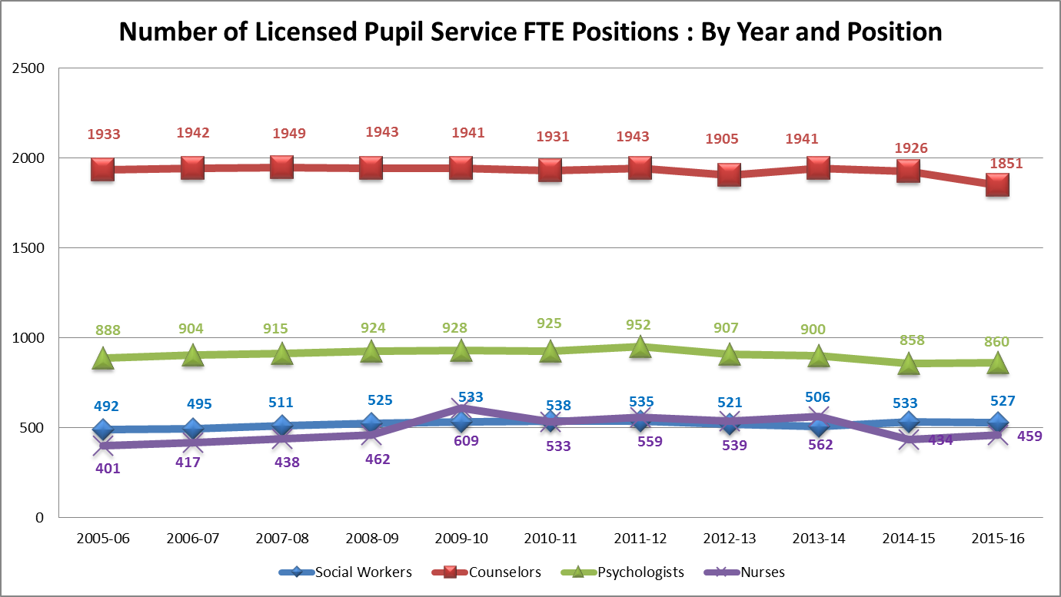
School Based Providers
Notes:
Has remained fairly constant, yet we know that the needs of students and the mental health concerns are on the rise.

Slide 6
Mental Health in Youth
1 in 5 dealing with a mental health issue
20% of students need mental health intervention…Only 30 % of those who need it will get any assistance.
The majority of mental illnesses emerge in childhood, yet fewer than half of children who suffer from mental illness receive treatment.
An estimated 70% of youth have experienced some form of trauma
Notes:
School Mental Health Framework Anecdotal information NITT SMHRP

Slide 7
What is Possible?
Beyond the send and fix
Anti-stigma of mental health
Wellness plans for all
Notes:
Share the story of starting up River Cities High School. Share one or two stories about kids served.

Slide 8
Benefits of Community Mental Health Providers in Schools
Increased access to care
Increase time in the classroom
Deepen the collaboration schools and providers
School as the community for parents
Impact on grades, attendance and behavior

Slide 9
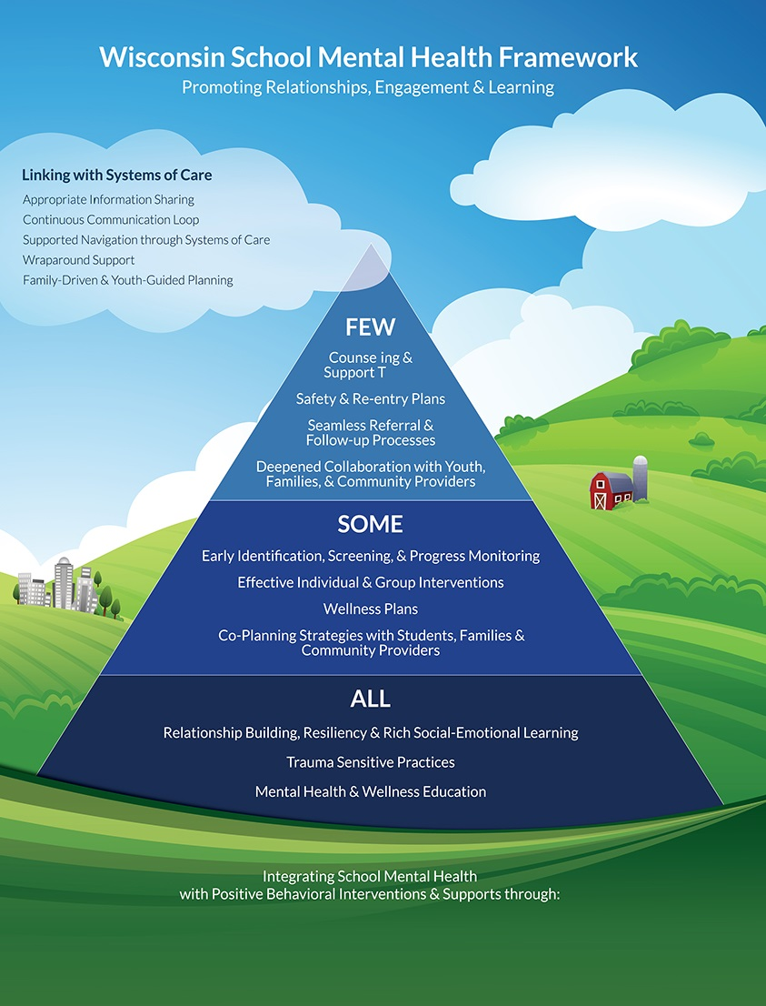
Referrals to Community Providers

Slide 10
Components of an MOU
What are the goals of collaboration and outcomes?
Any special training?
Communication? Crisis?
Contact person at the school?
Confidential environment for service delivery?

Slide 11
Components of an MOU, cont.
Data collection?
Follow up communication?
Communication of availability of services to parents and youth and staff?
Releases and informed consent?
Meeting the needs?
Any school policies or procedures communicated to providers?

Slide 12
Components of an MOU, cont.
Agreements on space, equipment, supplies or other costs
Summer months?
Records kept?

Slide 13
Referral Pathways
Define roles and responsibilities
Clarify the process to manage referrals
Share information efficiently
Monitor efficacy of Evidence Based Interventions
Make decisions on level of intervention, modality collaboratively
Engage Youth voice and family
Notes:
http://www.k12.wa.us/SecondaryEducation/pubdocs/SchoolMentalHealthToolKit-ReferralPathways.pdf

Slide 15
Resources
ToolKit-ReferralPathways.pdf
DPI MOU Guidance and Referral Pathways Guidance: http://dpi.wi.gov/sites/default/files/imce/sspw/pdf/mhmouguidancedoc.pdf

