Slide 1
The Hortonville Area School District’s journey to support students with mental health challenges and promote positive student messaging
E3-Educate, Engage, Empower:
Dr. Heidi Schmidt, District Administrator
Ms. Wendy Neyhard, Director of Student Services
HASD Mission Statement: Our community ensures every student learns at the highest level.

Slide 2
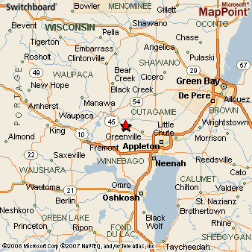
Where is Hortonville?
3800 students
6 buildings (3 elementary schools, 2 middle schools, 1 high school)
280 professional staff/250 support staff
13% students with disabilities
20% free/reduced
93% Caucasian

Slide 3
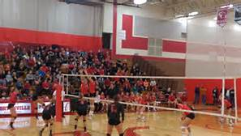
Quick History of Hortonville
Hortonville is a village in Outagamie County, Wisconsin, United States in the Fox Valley.
The population was 2,711 at the 2010 census. Village of Hortonville and Town of Greenville-growing area.
School district student increase of 150 students this year.
The village was founded in 1848 by landowner Alonzo Horton, who created the 75-acre Black Otter Lake.
  He later developed the city of San Diego, California.
Hortonville had one of the first match light factories in the world.

Slide 4
Let us tell you our story…………..
District recognized as model PLC district (first district in the state to receive this recognition)
Teachers have identified and aligned their power standards, learning targets, and are continuing to collaborate in teams on common formative assessments
Data is used for targeted interventions with all buildings having an intervention time/SIT team
Our teachers have done a great job on the academic side of student learning!
HASD Strategic Plan has a focus area on Safety-Physical and Emotional Safety
Referendum $$ helped with main entrance check in at each building, Raptor program, additional surveillance cameras, two way radios, and updated crisis response manual, TECIP training and building teams
The district addressed physical safety needs.

Slide 5
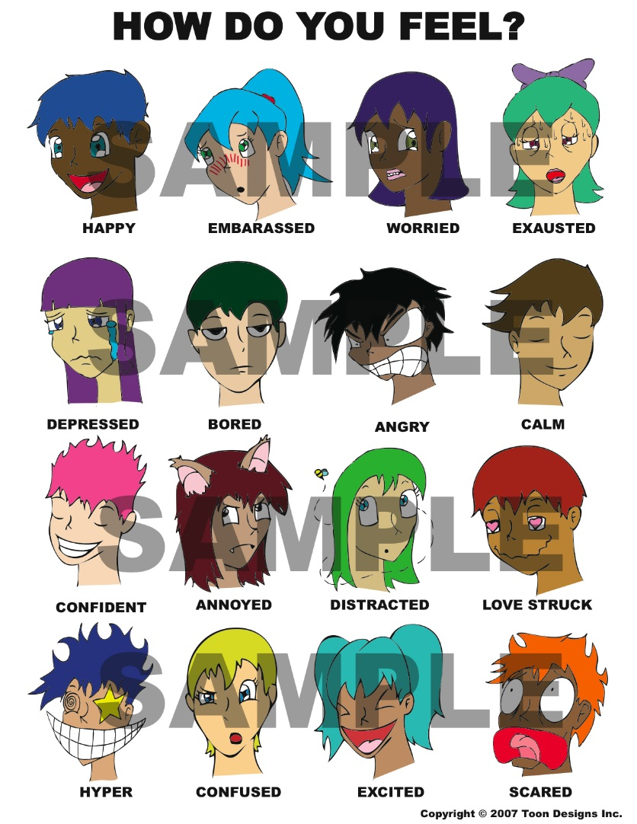
Students need to feel emotionally safe at school to learn at the highest level.

Slide 6
What did the data tell Hortonville? (YRBS, 2015)
23% of students reported feeling sad or hopeless almost every day for two weeks or more in a row and that they stopped doing some usual activities
12.8% of students reported having seriously considered attempting suicide in the last 12 months
11.1% of students reported having a plan about how they would attempt suicide in the last 12 months
11.8% of students reported having attempted suicide at least once in the last 12 months
Our district has also experienced student tragedy

Slide 7
What else did the data tell Hortonville? (YRBS, 2015)
Do you agree or disagree that your family loves you and gives you help and support when you need it? – 89% agree.
Do you agree or disagree that teachers really care about you and give you a lot of encouragement? – 92.2% agree.
Do you agree or disagree that you feel like you belong at this school? – 68% agree.
Is there at least one teacher or other adult in this school that you can talk to if you have a problem? – 65.6% agree.

Slide 8
Additional Data: DPI’s AODA Prevention Program Assessment Tool
Assessment completed with Pupil Services Team and District Administrative Team
Results identified strengths and gaps in programming
  A. School Environment
  B. Curriculum and Instruction
  C. Student Programs
  D. Pupil Services
  E. Adult Programs
  F. Family/Community

Slide 9
What resources/programs existed before E3?
PBIS in each building
Extended learning time at each building for interventions (re-teach)
Collaborative PLC time at each building
Student intervention teams (SIT) meet weekly
Health curriculum-suicide awareness (middle/high school)
United Way PATH counselor 2 days a week for mental health
Pre Action activities/$$ from Outagamie County
K-12 counselors /School psychologists

Slide 10
Our journey began two years ago…..
What can we do different or better to help our students, parents and staff?
  Break down the barriers for mental illness, allow all students access to services, screen all students, positive messaging and support to students for resiliency/grit/perseverance, provide educational training for our staff, and support for parents
What was our vision?
  Comprehensive, collaborative K-12 program to address mental health challenges and promote mental wellness
    Prevention/education (student resiliency, parents, and staff)
    Identification (screening, goal is K-12)
    Intervention (on site therapy)

Slide 11
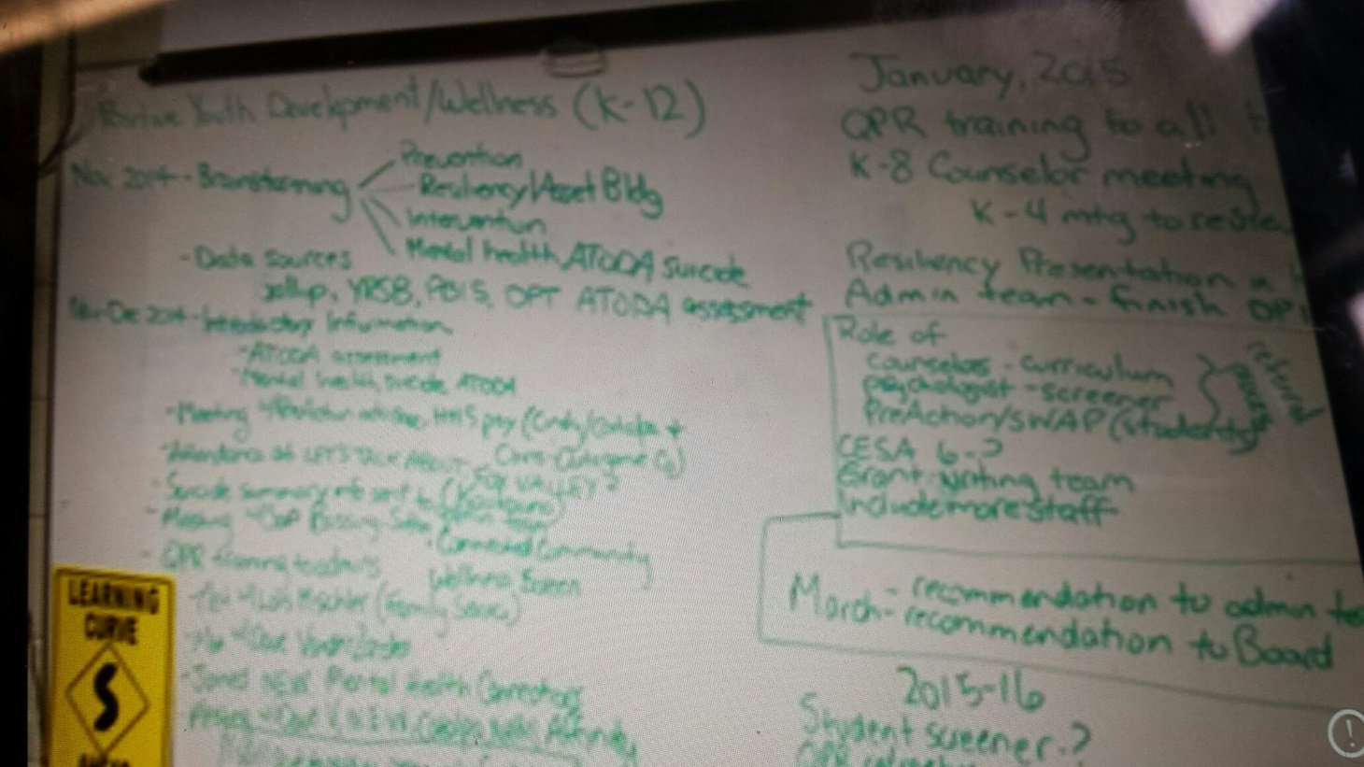

Slide 12





Slide 14
3 Tier Model
On-site individual counseling
Group therapy
Family counseling
Case management
Tier 3
Diagnosis
& Treatment
Tier 2
Early Intervention and
Identification
Tier 1
Universal Prevention for Students, Parents, Staff, Community
Education and Engagement
Teen support group
Consultation to teachers and staff
Classroom shadowing
Social/education groups
2nd step K-8 curriculum
On-site universal screening (2016-17—5th-12th grade)
Case management
QPR (Question, Persuade, Refer)-all staff trained
Student Assistance Program training/Core facilitation training
Youth Mental Health First Aid staff training
NAMI staff training: Mental Health 101 and Recovery 101
Ending the Silence and Breaking the Silence
Awareness campaign/events
Staff book study
Parent education

Slide 15
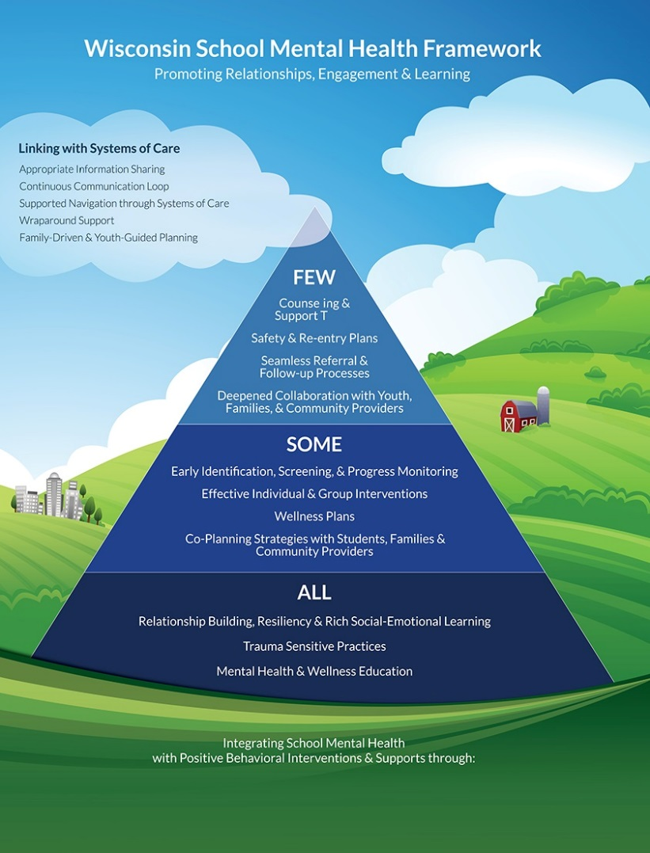

Slide 16
Staff learning
2600 staff, parent and student surveys to get baseline data on attitudes/perceptions regarding mental health.
QPR (Question, Persuade, Refer) suicide awareness training (350 staff, including teachers and bus drivers)
Youth Mental Health First Aid training (40 staff trained)
Student Assistance Program and Core Facilitation Training (30 staff trained)
Book study The Teacher’s Guide to Student Mental Health by William Dinkel (20 staff with brochure on seven mental health disorders as a product)
  Fostering the Resilient Learner 2016-17 book study
NAMI staff training: Mental Health 101 and Recovery 101 (250 staff)
Ending the Silence and Breaking the Silence NAMI classroom presentation (550-10th grade students and 8th grade students)

Slide 17
Engaging and Educating Our Students
K-12 PBIS
K-8 Implementation of Second Step (Skills for Social and Academic Success)
9-12 Began Sources of Strength journey (SAMHSA’s National Registry of Evidence-based Programs and Practices)
  Student Quotes re: Sources of Strength influence
“I feel that Sources of Strength positively impacts me and my peers. Because I am Sources of Strength trained, it has helped me to understand how to be a trusted friend and help my friends and peers when they need support. I feel like I can remind them of different sources when they face challenges. I also have a better understanding of my own sources and how they can help me related to my own mental health and life in and out of school.” - Sophomore female
“Sources of Strength helps me to be able to communicate better with my peers about their mental health and possibly make them feel better about getting help if they are struggling.” – Sophomore male

Slide 18
2015-2016: 1st year implementation data
160 students in the district have received therapy on site
Parents don’t have to take off work, drive to get their child, attend a therapy appointment and then drive the child back to school.
E3 hotline-Parents can call anytime to set up an appointment for their child.
There were 1340 mental health therapist/student sessions.
Students in every building are receiving therapy services.
Each school in the Hortonville Area School District is licensed as a mental health clinic.
All students at Hortonville High School and 8th grade students in both middle schools were screened.
NAMI teen support group has increasing membership
Cost per student approximately $77.00

Slide 19
Other Outcomes
63% of 8-12th grade students screened for anxiety, depression, suicide ideation, suicide attempt and AODA issues
16% of these students were referred for additional services
13% decrease in missing school days of E3 provider referred students
61% decrease in disciplinary actions of E3 provider referred students
71% of E3 patients “significantly or somewhat improved”

Slide 20
Funding (4 year commitment)
Approximately $77.00 per students 8-12th grade
Insurance billing/MA
Community Foundation and other grants
HASD annual amount ($50,000-$65,000-$90,000-$120,000)
Partner in-kind donations

Slide 21
Goals for 2016-17
Screen all 5th-12th grade students (5th grade with a different screener/process)
Revise therapist times at each building based on their building’s need from year 1
Staff training: ACEs (Adverse Childhood Experiences) presentation and strategies
Involve therapist at building SIT teams
Continue parent education/involvement

Slide 22
Mental health disorders in children and adolescents are real, they can be identified, correctly diagnosed, and successfully treated, and teachers play a major role in ensuring the success of students who have these disorders.
        William Dikel, author of THE TEACHER’S GUIDE TO STUDENT MENTAL HEALTH

Slide 23

Thank you for allowing us to tell our story as we journey to mental wellness!

