Slide 1
Comprehensive Bullying Prevention Assessment Tool
Presentation by
Dr. John Bowser, DPI
Beth Herman, DPI
October 19, 2016

Slide 2
Agenda
Definition
State Statute
What is a comprehensive approach and why is it important
What is the Comprehensive Assessment Tool?
Application of the tool
Assessment Tool Resource List
Discussion and Questions

Slide 3
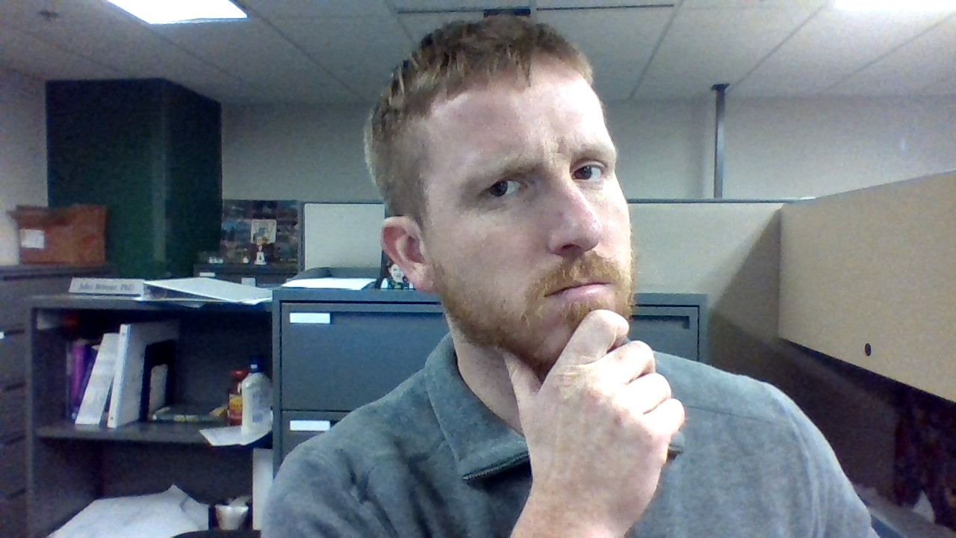
Bowser
Evaluation Consultant
P.I - WI School Violence and Bullying Prevention Study
Co-author - Bullying Assessment Tool
All-around nice(ish) guy
Rarely gets out of house without food on shirt

Slide 4
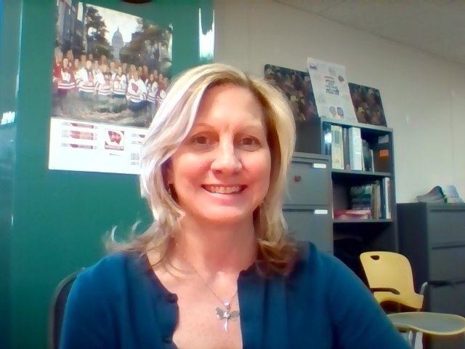
Herman
Education Consultant
Project Coordinator - Safe Schools/Healthy Students
Co-author - Bullying Assessment Tool
A pleasure to be around
Rarely gets out of the house without forgetting something

Slide 5
Definition
Bullying is unwanted, aggressive behavior among school aged children that involves a real or perceived power imbalance. The behavior is repeated, or has the potential to be repeated, over time.
Stopbullying.gov

Slide 6
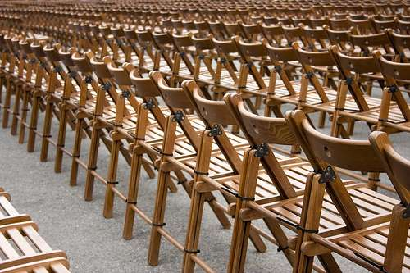
The behavior must be aggressive and include:
Imbalance of power
Repetition

Slide 7
WI 118.46 Policy on Bullying
1. By March 1, 2010 the department shall develop a model school policy on bullying by pupils.
2. By August 15, 2010 each school board shall adopt a policy prohibiting bullying by pupils. The board may adopt the model policy under sub (1) (a)

Slide 8
What the Statute Does not do
Define bullying universally
Provide a state level response/oversight function.
Give any agency/individual authority to ensure compliance.
Require schools or districts to implement any anti-bullying programming.

Slide 9
What is a comprehensive program?
Policy and Procedures
Program selection/implementation
Staff training
Parent education and communication
Classroom instruction/Student training
Universal Components
Selected and Intensive Components
Reporting systems
Analysis and continuous quality improvement

Slide 10
Section 1: Policy and Procedures
Policy in place on prevention and response to bullying behaviors, including reporting
Distinction made between bullying and harassment in policy
Dedicated team active at school consisting of faculty, administrations, students and parents focusing on issues including, but not limited to, bullying
Could be existing team (i.e. PBIS team)

Slide 11
Section 2: Program Selection and Implementation
Externally validated program purchased by school
Program includes addressing vulnerable populations
Externally program implemented
Program implemented fully, as assessed by program-specific fidelity measures

Slide 12
Section 3: Staff Training
Report training on:
How to respond to bullying incidents
Definition of bullying
Procedures for reporting
Asked twice for two different groups:
Faculty/Staff (including non-academic)
Volunteer and after-school staff

Slide 13
Section 4: Parent Education and Communication
Focusing on communication and involvement
Are parents engaged and involved in workgroups/meetings?
Are twice-yearly updated sent on school’s bullying prevention program?

Slide 14
Section 5: Classroom Instruction and Student Training
Classroom instruction (this year) received by students in
How to respond to bullying
Definition
Reporting bullying
Appropriate and effective bystander behavior
Students recruited and trained as peer advocates
Students active in bullying prevention workgroups

Slide 15
Section 6: Universal (tier 1) components
PBIS -- fidelity at tier 1
Bullying policies communicated outside of the school building
Community agencies
Police
Public health
Childcare
Human services

Slide 16
Section 7: Selected (tier 2) / Intensive (tier 3) Components
Services provided to those who evidence problematic school adjustment
including behaviors related to bullying (perpetrator and/or victim)
Supports available to those not responding to less intensive interventions
Referral protocols to services are documented at district level

Slide 17
Section 8: Reporting Systems
Reporting system in place
Faculty/Staff, volunteers and after-school staff trained in incident collection procedures
Quarterly review of submissions done to evaluate degree to which system is used

Slide 18
Section 9: Analysis and CQI
Data analyzed by school safety team at least quarterly
Analysis looks at “hot spots” and disproportionately affected groups
Analysis is shared with staff
Data-informed decisions are made for CQI

Slide 19
https://www.youtube.com/watch?v=mJ4v7R3MbrU

Slide 20
Bullying Prevention Program Assessment Tool

Slide 22
Bullying Prevention Program Assessment Tool Resource List
Section 1: Policy and Procedures
Wisconsin State Statute 118.46 Policy on Bullying https://docs.legis.wisconsin.gov/statutes/statutes/118/46 Use DPI Model Policy: http://sspw.dpi.wi.gov/sites/default/files/imce/sspw/doc/modelbullyingpolicy.doc U.S. Dept. of Ed. OCERS Letter: https://www2.ed.gov/policy/speced/guid/idea/memosdcltrs/bullyingdcl-8-20-13.pdf Establish reporting procedures http://www.stopbullying.gov/prevention/at-school/rules/index.html#Establish a Reporting System Misdirections in bullying http://www.stopbullying.gov/prevention/at-school/educate/misdirections-in-prevention.pdf http://www.tolerance.org/ MA Dept of Education Bullying Prevention and Intervention Resources http://www.doe.mass.edu/bullying/ Guidance, cautions and recommendations for integrating Restorative Practices into bullying prevention initiatives.http://www.safeschools.info/content/BPRPWhitePaper2014.pdf Wisconsin School District Examples http://www.columbus.k12.wi.us/cms_files/resources/5519%20Bullying.pdf http://www.deforest.k12.wi.us/schools/middle/report-harassment-bullying-safety-issues.cfm https://www.madison.k12.wi.us/bullying http://mps.milwaukee.k12.wi.us/MPS-English/OBG/Clerk-Services/MPS-Rules-and-Policies/Administrative-Policies/Chapter-08/Administrative_Policy_08_521.pdf http://www.waukesha.k12.wi.us/Portals/0/pdf/5135.pdf http://www.waukesha.k12.wi.us/Portals/0/pdf/5135.pdf http://www.aasd.k12.wi.us/UserFiles/Servers/Server_457520/File/District%20Leadership/Board%20of%20Education/Individual%20Policy%20PDF's/400s/443-71%20-%20Bullying%20Policy.pdf

Slide 23
Questions? Comments?

Slide 24
Thank You

