Slide 1
Supporting the Emotional Needs of our Students
Lanora Heim, Ph.D.
Director of Pupil Services
Whitewater Unified School District

Slide 2
80% of youth with mental illness are not identified or receiving services (Merikangas, et al 2011)
In 2010, 8% of youth (about 1.9 million people) age 12-17 in the U.S. had experienced a major depressive episode during the past year (SAMHSA, 2012).
In children and adolescents, an untreated depressive episode may last 7 to 9 months, an entire academic year (U.S. Department of Health and Human Services, 199).
Depression has been linked to suicide, poor school performance, substance abuse, running away and feelings of worthlessness and hopelessness.
Overall, approximately 20% of youth will have one or more episodes of major depression by the time they becomes adults (NAMI, 2003)

Slide 3
WUSD GOAL
Create And Implement District Mental Health Programming that will support staff in addressing student mental health and trauma related needs.
Partnerships
Comprehensive Ongoing Professional Development
Policy
Direct Student Support

Slide 4
Create a Movement

Slide 5
Partnerships
Collaborating with Walworth, Jefferson and Rock Counties
Fort Health Care/Rogers Memorial Hospital
UW-Whitewater (Winther Counseling Lab)
Wisconsin Department of Public Instruction (mental health framework)
Community Partnerships (Civic Groups)

Slide 6
Comprehensive Ongoing Professional Development
County Supports
DPI Supports
Attendance at Monthly Pupil Service Team Meetings
Tier I, II, and III training with Jefferson County.
Mental Health First Aid Certification (Kim Propp)
Wisconsin Trauma Project with Walworth County
Mental Health Framework intensive training (building teams)
Trauma Modules
Endless Possibilities Conference (CESA #1)

Slide 7
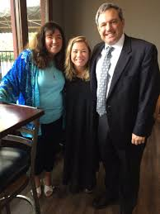
Fostering Resilient Learners: Strategies for Creating a Trauma-Sensitive Classroom by Kristen Souers
Book Study
Key Note Speaker

Slide 8
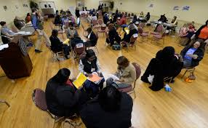
Poverty Simulation

Slide 9
Comprehensive Ongoing Professional Development
District Supports
Resources
Creating a Live Binder
RtI process
Non Violent Crisis Intervention Training
Two Half Days of Professional Development
Monthly Staff Meetings
Monthly Emails
Staff Wellness
Mindfullness/Brain Based Learning

Slide 10
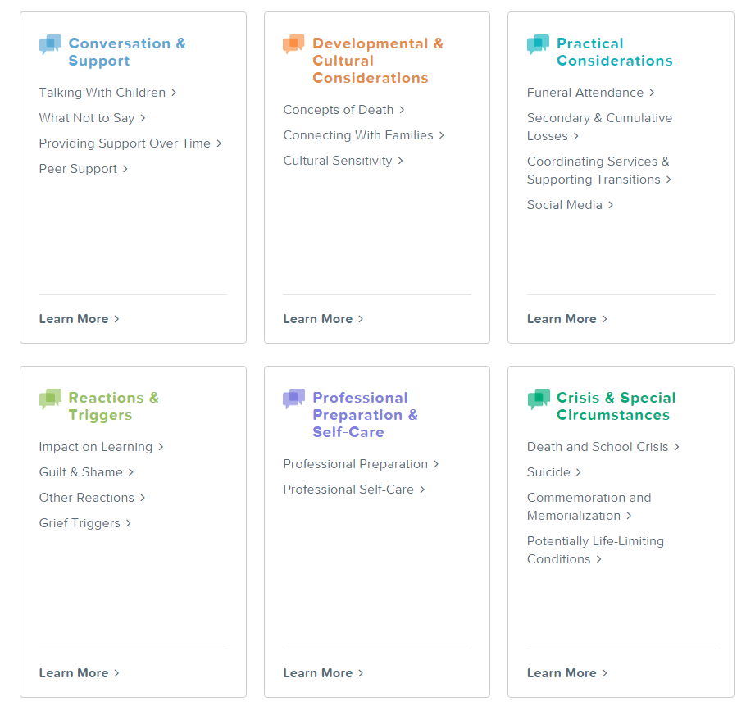
DOES YOUR SCHOOL NEED ADVICE NOW?
Contact us at 877-53-NCSCB
(877-536-2722) or info@grievingstudents.org

Slide 11
POLICY
Awareness
Roadmap
Examples: Suicide Intervention, Prevention, and Postvention, Code of Conduct

Slide 12
Direct Student Supports
YRBS
Collaborating with Walworth, Jefferson, and Rock Counties (training)
Developmental Guidance Lessons
Counseling in schools (add .5 social worker)
Winther Counseling Lab
Mental Health Counseling at WHS
Family Emergency Fund/Funds for Families

Slide 13
Second Step
Grades K-5
One day out of 6 day cycle
Social-emotional skills—like math skills—build on each other. Our universal, classroom-based program is designed to teach children how to understand and manage their emotions, control their reactions, be aware of others’ feelings, and have the skills to problem-solve and make responsible decisions.

Slide 14
SOS – Signs of suicide
Prevention Program including:
Video with real-life scenarios
Small group discussion w/ trained leader
Brief screen for depression

Slide 16
How we all can help our students:
Know them
Listen to them
Be aware
ACT

