Slide 1
COVID-19
Vaccination for Educators
Information current as of 4/1/2021

Slide 2
There are three COVID-19 vaccines currently authorized and recommended for use in the United States, and other vaccines are currently in large-scale clinical trials.
To learn more about the different vaccines for COVID-19 and how vaccines work, visit: https://www.cdc.gov/coronavirus/2019-ncov/vaccines/different-vaccines.html

Slide 3
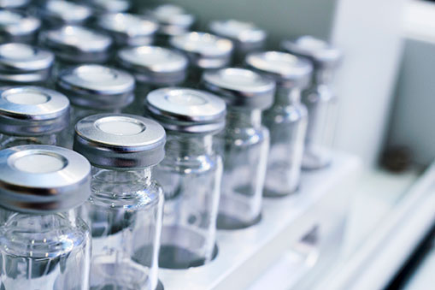
Moderna vaccine
(mRNA-1273)
mRNA vaccine
Two doses- 4 weeks apart (28 days)
94.5% effective
Authorized for 18+
FDA fact sheet: https://www.fda.gov/media/144638/download

Slide 4
BioNTech/Pfizer
(NT1622)
mRNA vaccine
Two doses -3 weeks apart (21 days)
95% effective
Authorized for 16+
Extreme cold storage and shipping requirements have been changed.
FDA fact sheet: https://www/fda.gov/media/144414/download

Slide 5
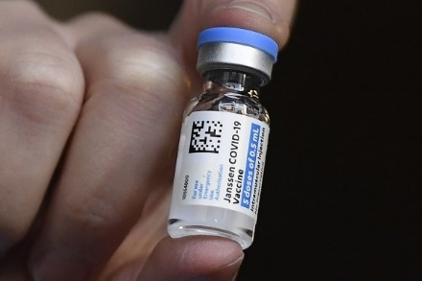
Johnson & Johnson/Janssen COVID Vaccine
Non-replicating viral vector vaccine
One dose
In U.S. 72% effective in preventing moderate to severe/critical COVID-19 occurring 28 days after vaccination
Stored at normal medication refrigerated temperatures 36°- 46 °F.
FDA fact sheet: https://www.fda.gov/media/146305/download
Janssen COVID Vaccine FAQ https://www.fda.gov/emergency-preparedness-and-response/mcm-legal-regulatory-and-policy-framework/janssen-covid-19-vaccine-frequently-asked-questions

Slide 6
Vaccines for Children
The makers of all three vaccines currently in use in the U.S. report they are completing studies on children under 16 years of age. Some reportedly 6 months to 16 years of age.
It is unknown when vaccination for children and adolescents under 16 years of age will begin. Most likely vaccines will be approved for 12-16 year olds first before use in younger children.
Pfizer vaccine is the only vaccine approve for use in adolescents 16- 18 years old. All other vaccines are approved for 18+.

Slide 7
COVID-19 mRNA vaccines teach our cells how to make a piece of a protein to trigger an immune response and build immunity to the virus that causes COVID-19. mRNA does not affect or interact with a person’s DNA, and the cell breaks down and gets rid of the mRNA as soon as it is finished using these instructions.
Learn about mRNA vaccines and how they work:
https://www.cdc.gov/coronavirus/2019-ncov/vaccines/different-vaccines/mrna.html

Slide 8
Viral vector vaccines use a modified version of a different virus (the vector) to deliver important instructions to our cells. For COVID-19 viral vector vaccines, the vector (not the virus that causes COVID-19, but a different, harmless virus) will enter a cell in our body and then use the cell’s machinery to produce a harmless piece of the virus that causes COVID-19. This piece is known as a spike protein and it is only found on the surface of the virus that causes COVID-19. Scientists began creating viral vectors in the 1970s.
Learn about viral vector COVID-19 vaccines and how they work:
https://www.cdc.gov/coronavirus/2019-ncov/vaccines/different-vaccines/viralvector.html

Slide 9
Facts about COVID-19 Viral Vector Vaccines
They cannot give someone COVID-19 or other infections.
Viral vectors cannot cause infection with COVID-19 or with the virus used as the vaccine vector.
They do not affect or interact with our DNA in any way.
The genetic material delivered by the viral vector does not integrate into a person’s DNA.
https://www.cdc.gov/coronavirus/2019-ncov/vaccines/different-vaccines/viralvector.html

Slide 10
None of the COVID-19 vaccines currently authorized for use in the United States uses the live virus that causes COVID-19. You may have symptoms like a fever after you get a vaccine. This is normal and a sign that your immune system is learning how to recognize and fight the virus that causes COVID-19.
Learn more about the facts behind COVID-19 vaccines: https://www.cdc.gov/coronavirus/2019-ncov/vaccines/facts.html

Slide 11
Vaccine efficacy and effectiveness
In clinical trials, researchers measure how well a vaccine prevents illness in a controlled setting. This is called efficacy.
95% efficacy does not mean that 95 out of every 100 people vaccinated will be protected from COVID-19. It does mean that the vaccine reduces the amount of disease by 95% for vaccinated people, compared to people who haven't gotten vaccinated.
https://www.dhs.wisconsin.gov/covid-19/vaccine-safety.htm

Slide 12
What are the side effects of the COVID-19 vaccines?
Side effect: An effect that occurs after receipt of a medication or vaccine. Even though these are unwanted, they can be expected based on previous experience (e.g., clinical trials) and result despite proper use of the medication or vaccine.
Adverse effect: An unexpected effect that occurs after receipt of a medication or vaccine, which may or may not be caused by the medication or vaccine.
Watch this short video to learn more about the differences between side effects and adverse effects.

Slide 13
Side effects after getting a COVID-19 vaccine are normal signs your body is building protection. Side effects may even feel like flu and might affect your ability to do daily activities, but they should go away in a few days.
Learn more:
https://www.cdc.gov/coronavirus/2019-ncov/vaccines/expect/after.html

Slide 14
The most common side effects from the COVID vaccines are:
Fatigue
Headache
Muscle aches
Fever or Chills
Side effects occurred during the first week after vaccination but were most likely one or two days after receipt of the vaccine. Side effects were more frequent following the second dose of mRNA vaccines and more likely to be experienced by younger, rather than older, recipients. Which suggest the mRNA vaccines invoke a strong immune response.
Although most people will not have significant side effects, some people may wish to schedule their vaccination, so that they will not need to call out of work the next day if they don’t feel well.

Slide 15
Can childcare, school staff, or students come to work/school if they have post-vaccination symptoms in the 3 days after vaccination?
  Staff and students should not be at work, school, childcare, or other activities if they have a fever or feel ill at any time during this pandemic.
  If you are experiencing local symptoms (e.g., pain, swelling, or redness at injection site) but you are otherwise well, you can return to all activities.
  Typically, post-vaccination symptoms are seen within 3 days of getting the vaccination.
  Signs and symptoms unlikely to be from COVID-19 vaccination include the presence of respiratory signs and symptoms consistent with COVID-19 (e.g., cough, shortness of breath, nasal congestion/stuff or runny nose, sore throat), as well as loss of taste or smell.
  If you have these symptoms, stay home and consider getting tested or consulting with a medical care provider. Schools and childcare should follow the decision tree.

Slide 16
Most people are able to get the COVID-19 vaccine, once supplies allow for their priority group to be vaccinated. But, a few groups of people should not get the vaccine, and some others should consult with their doctor or follow special procedures.
People who should NOT get the COVID-19 vaccine
Anyone with a previous severe or immediate allergic reaction (i.e., one that causes anaphylaxis or requires medical intervention) to a COVID-19 mRNA vaccine dose, a vaccine component, or polysorbate.
Those younger than 16 years of age.
People currently isolating or experiencing symptoms of COVID-19; these people can get vaccinated once they are finished isolation and their primary symptoms have resolved.

Slide 17
People who may get the vaccine after considering risks and benefits and/or consulting with their healthcare provider
Individuals with a history of severe or immediate allergic reaction to any vaccine or injectable medication (These individuals should be observed for 30 minutes after receipt of the vaccine.)
Pregnant women
People with certain immune-compromising conditions
Breastfeeding women
People on anticoagulants

Slide 18
People who should follow special procedures
Someone with a history of severe or immediate allergic reaction (requiring medical intervention) to anything other than a vaccine or injectable medication can get the vaccine, but they should remain at the vaccination location for medical observation for 30 minutes after receipt of the vaccine.
People who recently had COVID-19 and were treated with antibody-based therapies (e.g., monoclonal antibodies or convalescent plasma) should wait until 90 days after treatment to be vaccinated.
People with a known COVID-19 exposure should wait until their quarantine is over before getting vaccinated
People who got another vaccine (non-COVID-19 vaccine) should wait at least 14 days before getting COVID-19 vaccine. Likewise, if a person got the COVID-19 vaccine, they should wait at least 14 days before getting any other vaccines (non-COVID-19 vaccines).

Slide 19
The Centers for Disease Control and Prevention (CDC) allows for a 4-day grace period when assessing on-time receipt. This means the following ranges of days are considered “on-time” for receipt of the second dose:
Pfizer vaccine: 17 to 25 days after the first dose
Moderna vaccine: 24 to 32 days after the first dose
People should try to get the second dose during this period or as soon after as possible. However, if your second dose is given later than this, you do not need to restart the vaccine. You still only need to get the second dose. However, it is important to note that the first dose did not protect as many people as were protected after the second dose, so if you are exposed to SARS-CoV-2 during the delay, you may or may not have enough immunity to prevent you from experiencing symptoms.

Slide 20
People who are fully vaccinated against COVID-19, meaning it has been two weeks or longer since they have finished their vaccine series, can engage in some social situations. These include:
Visiting with other fully vaccinated people indoors without wearing masks or physical distancing.
Visiting with unvaccinated people from a single household who are all at low risk for severe COVID-19 disease, indoors without wearing masks or physical distancing.
Refraining from quarantine and testing following a known exposure, if asymptomatic.
It continues to be important that fully vaccinated people follow public health best practices in public spaces. This includes wearing a mask and physically distancing. Fully vaccinated people should also continue these practices when visiting unvaccinated people who are at an increased risk for severe COVID-19 disease.

Slide 21
While experts learn more about the protection that COVID-19 vaccines provide under real-life conditions, it will be important for everyone to continue using all the tools available to help stop this pandemic.
To protect yourself and others, follow these recommendations:
Wear a mask over your nose and mouth
Stay at least 6 feet away from others
Avoid crowds
Avoid poorly ventilated spaces
Wash your hands often

Slide 22
Starting April 5, 2021 everyone over age 16 is eligible to be vaccinated in Wisconsin. https://www.dhs.wisconsin.gov/covid-19/vaccine-about.htm

Slide 23
Remember as educators are vaccinated:
If an individual is vaccinated at work they must still use mitigation measures (masks, distancing, hand washing).
Not every educator will choose to be vaccinated.
Some students 16+ may become vaccinated. Younger students will not be vaccinated until vaccines have received the same Emergency Use Authorization.

Slide 24
Quarantine Period After Vaccination
Vaccinated persons with an exposure to someone
with suspected or confirmed COVID-19 are not required to quarantine if they meet all of the following criteria:
are fully vaccinated (i.e., exposure to someone with COVID-19 happened at least two weeks after receiving the last dose of their vaccine series), and
have not had any symptoms of COVID-19 since the current exposure
Teachers and staff who do meet the above criteria and choose not to quarantine should still watch for symptoms of COVID-19 for 14 days following an exposure.

Slide 25
Quarantine Period After Vaccination
Teachers and staff who do not meet the criteria or are unvaccinated against COVID-19 should continue to follow current quarantine guidance after exposure to someone with suspected or confirmed COVID-19.
Even after teachers and staff are vaccinated, schools will need to continue to follow the recommended mitigation strategies for the foreseeable future, including requiring masks in schools and physical distancing.

Slide 26
What We Know and What We’re Still Learning
We know that…
COVID-19 vaccines are effective at preventing COVID-19 disease, especially severe illness and death.
other prevention steps help stop the spread of COVID-19, and that these steps are still important, even as vaccines are being distributed.

Slide 27
What We Know and What We’re Still Learning
We’re still learning…
how effective the vaccines are against variants of the virus that causes COVID-19. (Early data show the vaccines may work against some variants but could be less effective against others.)
how well COVID-19 vaccines keep people from spreading the disease.
how long COVID-19 vaccines can protect people.

Slide 28
References
CDC’s Frequently Asked Questions about COVID-19 Vaccination
CDC’s COVID-19 Vaccine 8 Things To Know about the U.S. COVID-19 Vaccination Program
CDC’s U.S. COVID-19 Vaccine Product Information
CDC’s What to Expect After Getting a COVID-19 Vaccine: https://www.cdc.gov/coronavirus/2019-ncov/vaccines/expect/after.html
CDC When You’ve Been Fully Vaccinated: https://www.cdc.gov/coronavirus/2019-ncov/vaccines/fully-vaccinated.html

Slide 29
References
Harvard Medical School Coronavirus Resource Center: https://www.health.harvard.edu/diseases-andconditions/coronavirus-resource-center
UW Health’s COVID-19 Frequently Asked Questions
Vaccine Makers Project - The Coronavirus Pandemic – Answering Your Questions https://vaccinemakers.org/news-events/coronavirus-pandemic-answering-your-questions

Slide 30
References
Wisconsin Department of Health Services COVID-19: Vaccine webpage
Wisconsin Department of Health Services COVID-19: Vaccine Frequently Asked Questions
Wisconsin Department of Health Services Post Vaccination Guidance for Schools

Slide 31
Resources
CDC Facts about COVID-19 Vaccines
CDC Clinical Resources for Each COVID-19 Vaccine: https://www.cdc.gov/vaccines/covid-19/index.html
CDC Recipient Education
Children’s Hospital of Philadelphia Questions and Answers About COVID-19 Vaccines

Slide 32
Resources
CDC COVID-19 Vaccine Toolkit for School Settings and Childcare Programs
FDA Vaccine Facts - The path for a COVID -19 Vaccine from Research to Emergency Use Authorization: https://www.fda.gov/media/143890/download

Slide 33
Resources
Janssen EUA fact sheet: https://www.fda.gov/media/146305/download
Moderna EUA fact sheet: https://www.modernatx.com/covid19vaccine-eua/eua-fact-sheet-recipients.pdf
Pfizer EUA fact sheet: https://www.fda.gov/media/144414/download?utm_medium=email&utm_source=govdelivery

Slide 34
Resources
Wisconsin Department of Health COVID-19: After You Get the Vaccine
Wisconsin Department of Health Services Vaccine Safety Fact Sheet
Wisconsin Department of Health Services Vaccine Communication Framework PowerPoint
Wisconsin Department of Health Services COVID-19: Vaccine Safety and Efficacy
Wisconsin Department of Health Services Post Vaccination Guidance for Schools

Slide 35

Resources
The HHS Office of Minority Health (OMH) has created a #VaccineReady video series to empower communities to proactively practice COVID-19 safety measures, get the facts about COVID-19 vaccines, share accurate vaccine information and get vaccinated when the time comes.

Slide 36
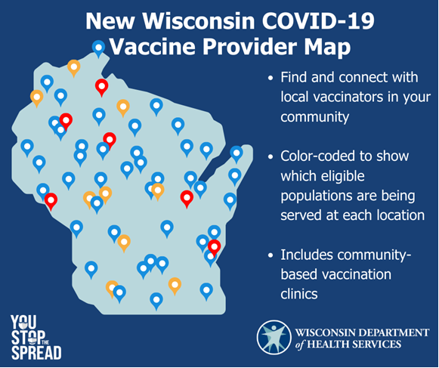
Resources
The Department of Health Services Wisconsin COVID-19 vaccinator map

Slide 37
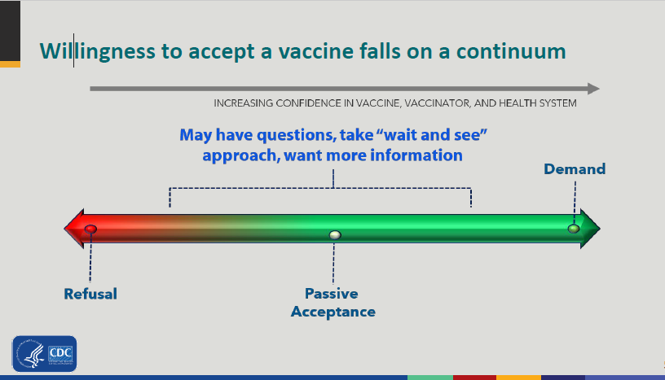

Slide 38
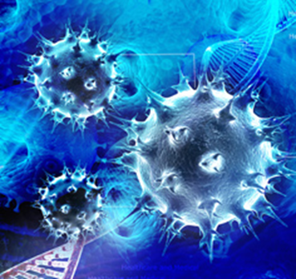
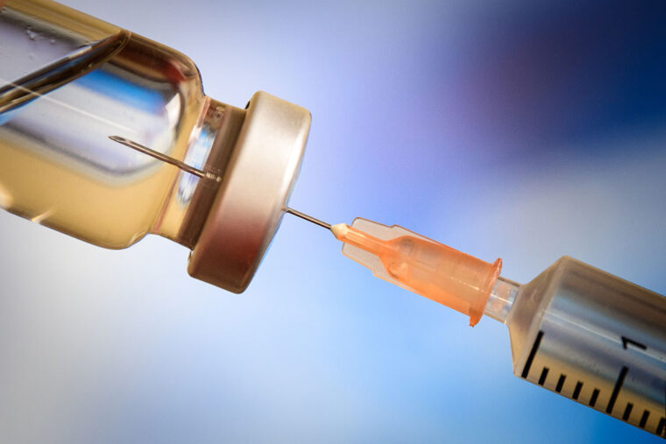
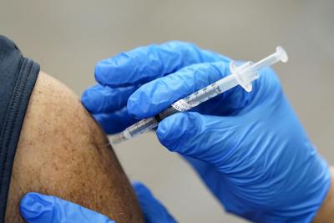

Slide 39
