Slide 1
Personal Protective Equipment (PPE) Awareness Training For Schools- COVID-19
Originally developed by the Department of Safety and Professional Services
- Adapted by the Department of Public Instruction

Slide 2
Objectives
Provide information on the purpose, selection, and use of PPE in schools
Based on current information – August 3, 2020

Slide 3
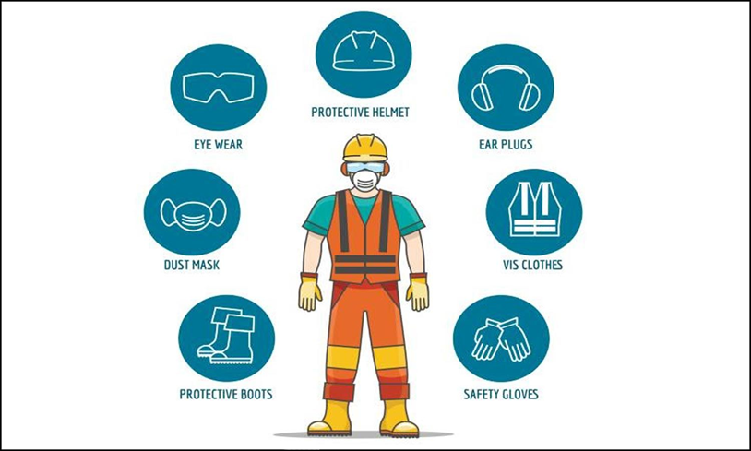
Personal Protective Equipment (PPE)
Personal Protective Equipment, commonly referred to as PPE, is equipment worn to minimize exposure to hazards that cause serious injuries and illnesses.

Slide 4
COVID-19
COVID‐19 (Coronavirus Disease 2019) is a respiratory illness that can spread easily from person‐to‐person. When a person who has COVID-19 coughs, sneezes, talks, sings, or yells they spray respiratory droplets (spit) with parts of the virus into the air and on to surfaces.
If a nearby healthy person breathes in the virus, they can become infected.
The virus can also enter a person’s body if they touch an unclean surface with the virus on it, and then touch their face, mouth, or eyes with unwashed hands.

Slide 5
COVID-19 and PPE
Since COVID-19 is spread via respiratory droplets extra precaution is being taken and an emphasis is being placed on protecting school staff ( and students) from respiratory droplets or sputum.
Under COVID-19 facial coverings are an infection control and mitigation measure for use by all school staff and students. Cloth facial coverings are not considered PPE by the Department of Safety and Professional Services.
Everyone is recommended to wear facial coverings to protect others from the wearer.
*Currently Wisconsin is under an executive order requiring facial coverings

Slide 6
PPE Basics
PPE is provided by school districts (as employers) to school staff who are deemed as needing (extra) protection due to “occupational exposure”.
Certain school staff are recommended to use PPE based upon their job duties and risk of exposure to body fluids.
See your district’s Bloodborne Pathogen Exposure Control Plan – same principles exist.
See DPI’s PPE Considerations for Schools

Slide 7
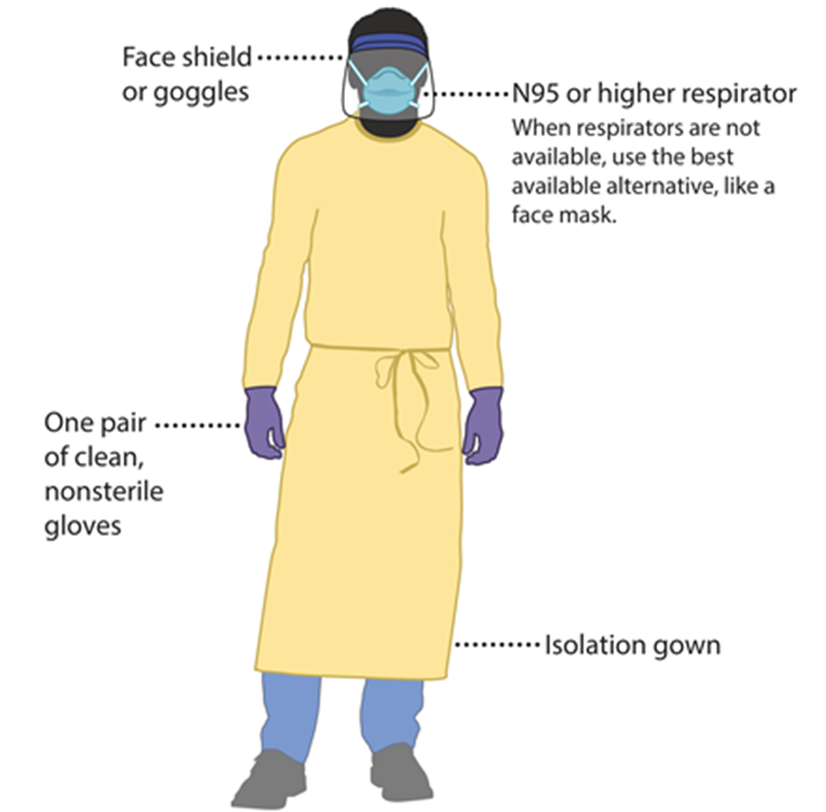
PPE and Communicable Diseases
This is the PPE we more commonly associate with communicable diseases

Slide 8
Personal Protective Equipment (PPE) Consideration for Schools
Cloth Face Covering -protect others from wearer
Fluid Resistant Surgical Mask -protect mouth/nose from liquid splashes
N95 or higher respirator (half/full face or PAPR) -protect mouth/nose
Protective Glasses or Goggles -protect eyes from liquid splashes
Face Shield -protect face, mouth, nose, and eyes from splashes
Gown (Disposable)-protect clothing
Lab Coat or other washable Cloth Covering (Scrub Jacket) -protect clothing
Gloves- protect hands

Slide 9
Cloth Face Co
Cloth Face Covering
May be commercially produced or improvised (i.e., homemade) garments, scarves, bandanas, or items made from t-shirts or other fabrics
Are not considered personal protective equipment (PPE)
Will not protect the wearer against airborne transmissible infectious agents due to loose fit and lack of seal or inadequate filtration
May be disposable or reusable after proper washing
Are worn in public over the nose and mouth to contain the wearer's potentially infectious respiratory droplets produced when an infected person coughs, sneezes, or talks and to limit the spread of SARS-CoV-2, the virus that causes Coronavirus Disease 2019 (COVID-19), to others

Slide 10
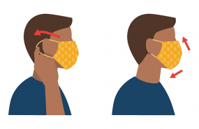
Cloth Face Covering
Wear a cloth face covering to help protect others in case you’re infected but don’t have symptoms
Keep the covering on your face the entire time you’re in public
The cloth face covering needs to cover over nose to below chin
Don’t put the covering around your neck or up on your forehead
Don’t touch the cloth face covering when you are wearing it, and, if you do, wash your hands
Should NOT be worn when:
Person is incapacitated or otherwise unable to remove the cloth face covering without assistance
The child is less than 2 years old

Slide 11
Surgical Mask
Are typically cleared by the U.S. Food and Drug Administration as medical devices (though not all devices that look like surgical masks are actually medical-grade, cleared devices)
Protects others from the wearer's potentially infectious respiratory droplets
Are fluid resistant and provides the wearer protection against large droplets, splashes, or sprays of bodily or other hazardous fluids
In this capacity, surgical masks are considered PPE
Under OSHA's PPE standard (29 CFR 1910.132), employers must provide any necessary PPE at no-cost to workers
Should be placed on sick individuals to prevent the transmission of respiratory infections that spread by large droplets
Will not protect the wearer against airborne transmissible infectious agents due to loose fit and lack of seal or inadequate filtration
No fit tested required

Slide 12
Surgical Mask vs Cloth Face Covering
Mask
Cleared by the U.S. Food and Drug Administration
Fluid resistant and provides the wearer protection against large droplets, splashes, or sprays of bodily or other hazardous fluids
Protects the patient from the wearer’s respiratory emissions
Are loose-fitting
No fit test required
No user seal check required
Does NOT provide the wearer with a reliable level of protection from inhaling smaller airborne particles and is not considered respiratory protection
Leakage occurs around the edge of the mask when the user inhales
Disposable
Cloth Face Covering
Cloth face coverings may slow the spread of the virus and help people who may have the virus and do not know it from transmitting it to others
COVID-19 can be spread by people who do not have symptoms and do not know that they are infected
Cloth face coverings provide an extra layer to help prevent the respiratory droplets from traveling in the air and onto other people
Washable/reusable

Slide 13
Face shields
Face shields protect face, noise, mouth and eyes
Should cover forehead, extend below chin and wrap around side of face
Disposable face shields should only be worn for a single use
Reusable face shields should be cleaned and disinfected after each use
Goggles or safety glasses need to be worn under a face shield
NOTE: It is not known if face shields provide any benefit as source control to protect others from the spray of respiratory particles
CDC does not recommend use of face shields for normal everyday activities or as a substitute for cloth face coverings
Some people may choose to use a face shield when sustained close contact with other people is expected
If face shields are used without a mask, they should wrap around the sides of the wearer’s face and extend to below the chin

Slide 14
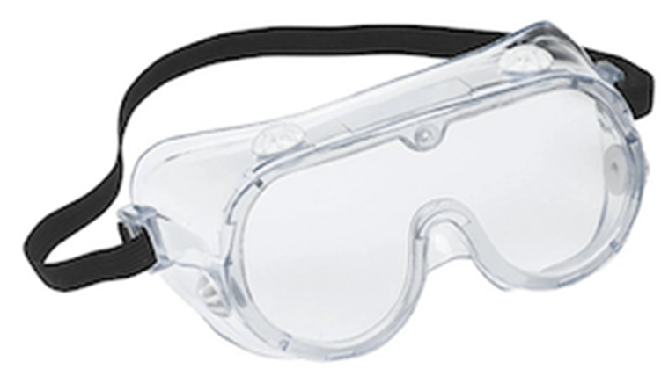
Eye Protection
It is important to make sure that your eye and face protection is put on properly and comfortably so that you are not adjusting it with your contaminated hands or that it falls off during use

Slide 15
When to Use Gloves
When you are routinely cleaning and disinfecting
Follow precautions listed on the disinfectant product label, which may include:
wearing gloves (reusable or disposable) and
having good ventilation by turning on a fan or opening a window to get fresh air into the room you’re cleaning
Possible contact with Bloodborne pathogens
Use disposable gloves when touching or having contact with blood, stool, or body fluids, such as saliva, mucus, vomit, and urine
Do NOT reuse disposable gloves

Slide 16
For Healthcare Professionals (HCP)
FFR
N95 Half/Full Face Respirator PAPR
When to Wear: performing procedures, such as suctioning that aerosolize respiratory secretions
These respirators require:
Comprehensive program (including medical clearance, training, and fit testing) that complies with OSHA’s Respiratory Protection Standard
Program should also include provisions for the cleaning, disinfecting, inspection, repair, and storage of respirators used by HCP on the job according to manufacturer’s instructions
Not everyone can use one due to their own health issues
Specific training will be provided if you wear a N95, Half/Full Face or PAPR

Slide 17
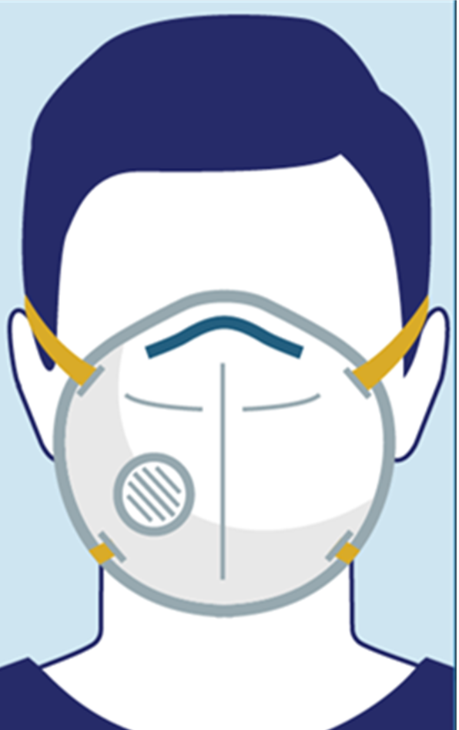
Filtering Facepiece Respirators (FFR)
Are used to prevent workers from inhaling small particles, including airborne transmissible or aerosolized infectious agents
Must be provided and used in accordance with OSHA's Respiratory Protection standard (29 CFR 1910.134)
Must be certified by the National Institute for Occupational Safety and Health (NIOSH)
Require proper training, fit testing, availability of appropriate medical evaluations and monitoring, cleaning, and oversight by a knowledgeable staff member
FFRs, such as a N95, may be used voluntarily, if permitted by the employer
If an employer permits voluntary use of FFRs, employees must receive the information contained in Appendix D of OSHA's Respiratory Protection standard (29 CFR 1910.134)

Slide 18
N95 Respirator vs PAPR
Respirator- N95
Evaluated, tested and approved by NIOSH
Reduces wearer’s exposure to particles including small particle aerosols and large droplets
Tight fitting face seal
Fit testing required
User seal check required each time respirator is put on
Filters out at least 95% of airborne particles including large and small particles
When properly fitted and worn, minimal leakage occurs around respirator edges when user inhales
Single use, or replacement if damaged, deformed or soiled
Power Air Purifying Respirator (PAPR)
Reusable components and replaceable filters or cartridges
Can be used to protect against gases, vapors, or particles, if equipped with the appropriate cartage, canister or filter
Battery –powered with blower that pulls air thru attached filters or cartridges
Provides eye protection
Low breathing resistance
Loose-fitting PAPR does NOT require fit testing and can be used with facial hair
Tight-fitting PAPR requires fit testing

Slide 19
Half & Full Facepiece Respirators
Elastomeric Half Facepiece Respirator
Reusable facepiece and replaceable canisters, cartridges, or filters
Must use appropriate cartridge, canister or filter
Fit testing required
Elastomeric Full Facepiece Respirator
Reusable facepiece and replaceable canisters, cartridges, or filters
Must use appropriate cartridge, canister or filter
Provides eye protection
More effective face seal than elastomeric half-facepiece respirators
Fit testing required

Slide 20
Put on before potential incident
Key Points About PPE
Use carefully – don’t spread contamination, e.g. touching surfaces with contaminated gloves
Remove and discard carefully; contaminated PPE is a source of exposure to you
Immediately wash your hands and/or body parts as applicable to your situation

Slide 21
How to Safely Put on, Use, and Remove PPE

Slide 22
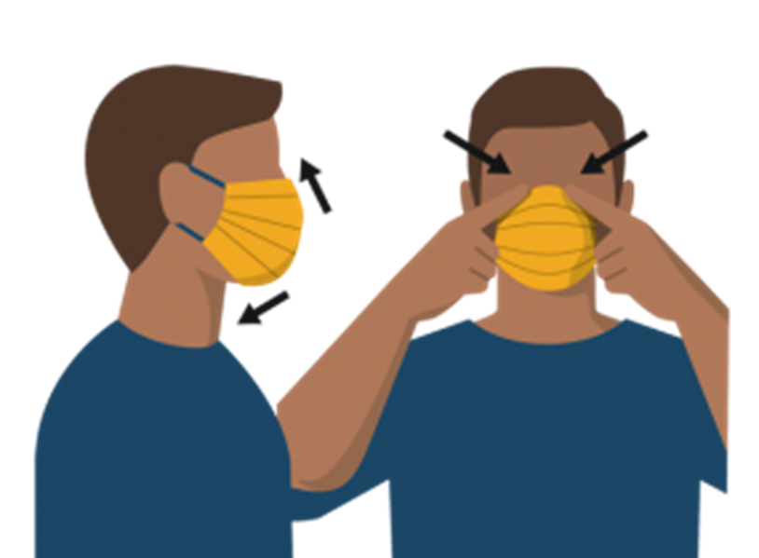
Putting on Surgical Mask or Cloth Face Covering Correctly
Wash your hands before putting on your surgical mask or cloth face covering
Put it over your nose and mouth and secure it under your chin
Try to fit it snugly against the sides of your face
Make sure you can breathe easily

Slide 23
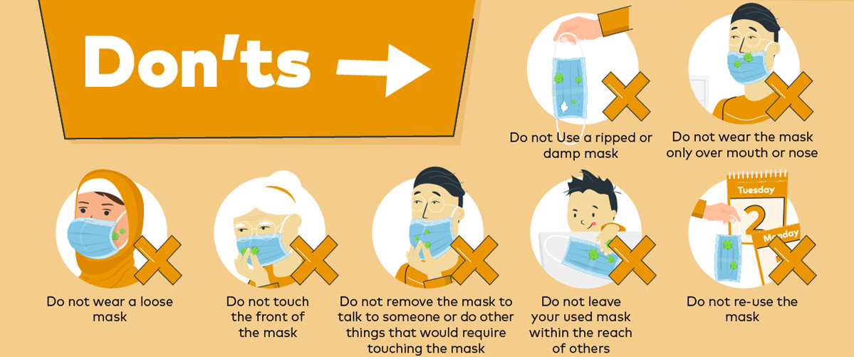
Actions to avoid

Slide 24
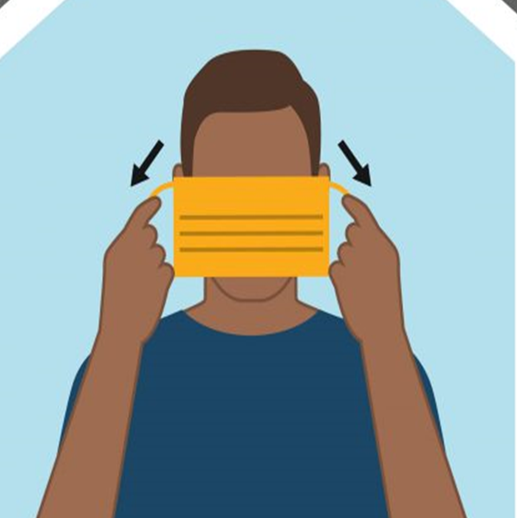
Taking Off Surgical Mask or Cloth Face Covering Correctly
Untie the strings behind your head or stretch the ear loops
Handle only by the ear loops or ties
Fold outside corners together
Place washable cloth face covering in the washing machine
Place disposable surgical mask in waste container
Be careful not to touch your eyes, nose, and mouth when removing
Wash hands immediately after removing

Slide 25
How to Store Surgical Mask or Cloth Face Covering for Reuse
Do not place your cloth face covering in your pocket for later use
Carefully fold the cloth face covering so the contaminated outside is folded inward and against itself
Place it in a paper bag and wash your hands

Slide 26
Reusing Surgical Face Mask or Cloth Face Covering
When putting surgical mask or cloth facial covering back on:
Perform hand hygiene before putting surgical mask or cloth facial covering back on
Be sure to grasp the surgical mask or cloth facial covering by the ear loops or strings
Perform hand hygiene after putting surgical mask or cloth facial covering on

Slide 27
Washing machine
You can include your cloth face covering with your regular laundry
Use regular laundry detergent and the warmest appropriate water setting for the cloth used to make the face covering
Washing by hand
Prepare a bleach solution by mixing:
5 tablespoons (1/3rd cup) household bleach per gallon of room temperature water or
4 teaspoons household bleach per quart of room temperature water
Check the label to see if your bleach is intended for disinfection. Some bleach products, such as those designed for safe use on colored clothing, may not be suitable for disinfection
Ensure the bleach product is not past its expiration date. Never mix household bleach with ammonia or any other cleanser
Soak the face covering in the bleach solution for 5 minutes
Rinse thoroughly with cool or room temperature water
Completely Dry cloth face covering after washing.
Use dryer on highest setting
Air dry. If possible, place in direct sunlight
How to Wash Cloth Face Covering

Slide 28
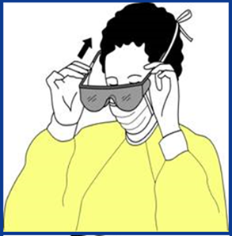
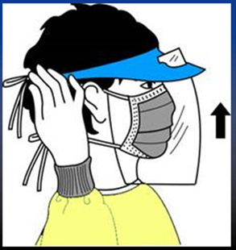
Putting on Eye Protection and Face Shield
Eye Protection
Position goggles or glasses over eyes and secure to your head using earpieces or headband
Face Shield
Position face shield over face and secure on brow with headband
Adjust to fit comfortably

Slide 29
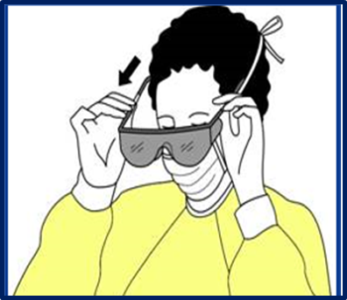
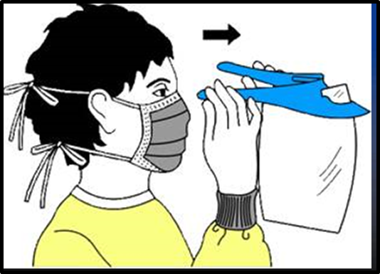
Removing Eye Protection or Face Shield
Grasp ear or head pieces with ungloved hands
Lift away from face
Place on clean surface for cleaning and disinfecting or dispose in appropriate receptacle

Slide 30
How to Clean Face Shield
Using Environmental Protection Agency (EPA) and manufacturer approved cleaning agent:
Wipe front and back of face shield
Wipe elastic band
Wipe foam band
Place face shield on clean surface to dry
Once face shield is dry store in clean container

Slide 31
GLOVES
Gloves:
Offer limited/no protection when heavily soiled, torn or have holes
Avoid “touch contamination”
Don’t touch your face or adjust PPE with contaminated gloves
Don’t touch other surfaces except, as necessary
Change Gloves:
During use if torn and when heavily soiled
When contamination event is over, don’t begin another task until you have decontaminated
Discard gloves in appropriate receptacle
Never re-use disposable gloves even if you think that they are clean

Slide 32
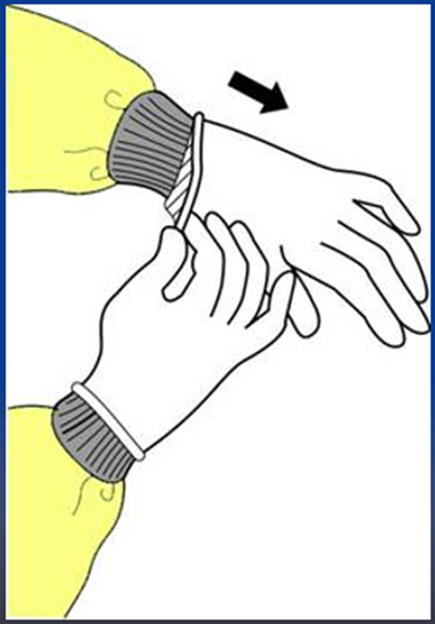
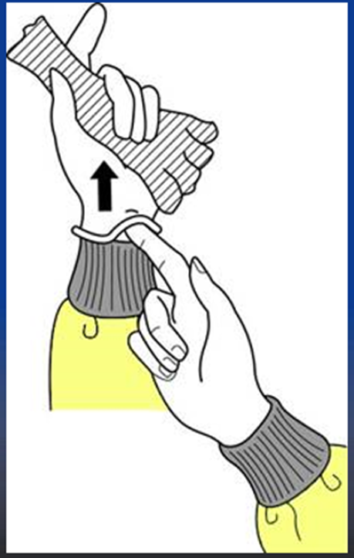
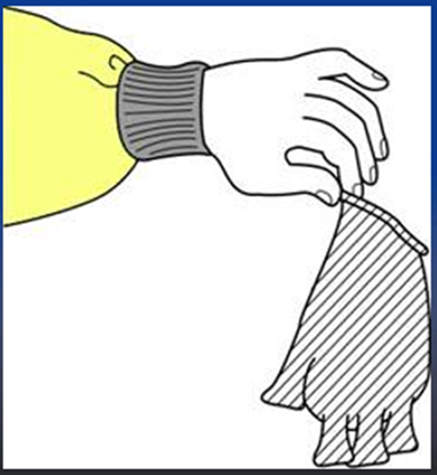
Removing Gloves
Step 1:
Grasp outside edge near wrist
Peel away from hand, turning glove inside-out
Hold in opposite gloved hand
Step 2:
Slide ungloved finger under the wrist of the remaining glove
Peel off from inside, creating a bag for both gloves
Step 3:
Discard gloves

Slide 33
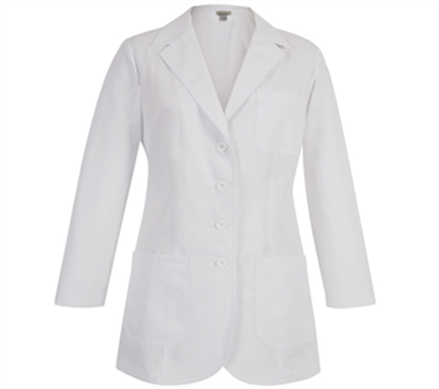
Lab Coat or Other Washable Covering
Used to protect clothing
Should be removed if becomes soiled
Should be cleaned daily per manufacturer’s directions

Slide 34
How to Wash Lab Coat or Other Washable Clothing
You can include your lab coat/scrub jacket with your regular laundry
Use regular laundry detergent and the warmest appropriate water setting for the cloth used to make the coat
Dry completely after washing
Use dryer on highest setting

Slide 35
HAND HYGIENE
Perform hand hygiene immediately after removing PPE
If hands become visibly contaminated during PPE removal, wash hands before continuing to remove PPE
Wash hands with soap and water or use an alcohol-based hand sanitizer with at least 60% alcohol

Slide 36
Keep
Keep gloved hands away from your face
Avoid
Avoid touching or adjusting other PPE
PPE SAFETY REMINDERS
Remove
Remove gloves if they become torn; perform hand washing before putting on new gloves
Limit
Limit surfaces and items touched

Slide 37
Video demonstration How to Safely Put on Personal protective equipment
Click HERE to open link
https://youtu.be/H4jQUBAlBrI

Slide 38
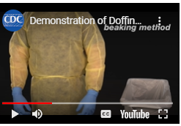
Video demonstration PPE removal
Click HERE to open link
https://youtu.be/PQxOc13DxvQ

Slide 39
CDC Resources
CDC –About Masks. Retrieved 7/31/20 : https://www.cdc.gov/coronavirus/2019-ncov/prevent-getting-sick/about-face-coverings.html
CDC Elastomeric Respirators: Strategies During Conventional and Surge Demand Situations. Retrieved 7/31/20: https://www.cdc.gov/coronavirus/2019-ncov/hcp/elastomeric-respirators-strategy/
CDC Guidance for Child Care Programs that Remain Open. Retrieved 7/31/20 https://www.cdc.gov/coronavirus/2019-ncov/community/schools-childcare/guidance-for-childcare.html#ScreenChildren
CDC School and Child care Programs . Retrieved: 7/3//20
https://www.cdc.gov/coronavirus/2019-ncov/community/schools-childcare/
CDC/NIOSH - Understanding the Difference Between Surgical Masks and N95 Respirators. Retrieved 7/31/20: https://www.cdc.gov/niosh/npptl/pdfs/UnderstandDifferenceInfographic-508.pdf

Slide 40
References
Centers for Disease Control. (n.d.). Sequence for putting on personal protective equipment (PPE). Retrieved August 3, 2020, from https://www.cdc.gov/hai/pdfs/ppe/ppe-sequence.pdf
Centers for Disease Control and National Institute for Occupational Safety and Health. (2010). How to properly put on and take off a disposable respirator. Retrieved August 3, 2020, from https://www.cdc.gov/niosh/docs/2010-133/pdfs/2010-133.pdf
Centers for Disease Control and National Institute for Occupational Safety and Health. (March 27, 2020). Recommended guidance for extended use and limited reuse of N95 filtering facepiece respirators in healthcare settings. Retrieved August 3, 2020, from https://www.cdc.gov/niosh/topics/hcwcontrols/recommendedguidanceextuse.html
Centers for Disease Control. (June 3, 2020). Use personal protective equipment (PPE) when caring for patients with confirmed or suspected COVID-19. Retrieved August 3, 2020, from https://www.cdc.gov/coronavirus/2019-ncov/downloads/A_FS_HCP_COVID19_PPE.pdf
Centers for Disease Control. (June 28, 2020). Strategies for optimizing the supply of facemasks. Retrieved August 3, 2020, from https://www.cdc.gov/coronavirus/2019-ncov/hcp/ppe-strategy/face-masks.html#conventional-capacity
Centers for Disease Control and Prevention, National Center for Emerging and Zoonotic Infectious Diseases (NCEZID), Division of Healthcare Quality Promotion (DHQP). (October 29, 2014). Donning PPE: Put on face shield. Retrieved August 4, 2020, from https://www.cdc.gov/vhf/ebola/hcp/ppe-training/n95respirator_gown/donning_13.html#:~:text=Bending%20forward%2C%20hold%20on%20to,no%20areas%20are%20left%20uncovered.
Centers for Disease Control and National Center for Immunization and Respiratory Diseases (NCIRD), Division of Viral Diseases. (May 17, 2020). Hand hygiene recommendations. Guidance for healthcare providers about hand hygiene and COVID-19. Retrieved August 4, 2020, from https://www.cdc.gov/coronavirus/2019-ncov/hcp/hand-hygiene.html
Centers for Disease Control and National Center for Immunization and Respiratory Diseases (NCIRD), Division of Viral Diseases. (July 14, 2020). Using personal protective equipment. Retrieved August 3, 2020, from https://www.cdc.gov/coronavirus/2019-ncov/hcp/using-ppe.html
Emory University. (March 31, 2020). Store your N95. Retrieved August 3, 2020, from https://med.emory.edu/departments/medicine/divisions/infectious-diseases/serious-communicable-diseases-program/pdf/ppe-conserve-mask-storage.pdf
Emory University. (April 22, 2020). Get the most out of wearing your mask. Retrieved August 3, 2020 from https://med.emory.edu/departments/medicine/divisions/infectious-diseases/serious-communicable-diseases-program/pdf/dos-and-donts-of-masks.pdf

Slide 41
References
Emory University. (May 26, 2020). N95 user seal check. Retrieved August 3, 2020, from https://med.emory.edu/departments/medicine/divisions/infectious-diseases/serious-communicable-diseases-program/pdf-2/n95-user-seal-check.pdf
Emory University. (July 20, 2020). Cleaning your face shield. Retrieved August 3, 2020, from https://med.emory.edu/departments/medicine/divisions/infectious-diseases/serious-communicable-diseases-program/pdf-2/card---emory-decontamination-of-face-shield.pdf
Emory University. (July 20, 2020). Cleaning your goggles. Retrieved August 3, 2020, from https://med.emory.edu/departments/medicine/divisions/infectious-diseases/serious-communicable-diseases-program/pdf-2/card---emory-decontamination-of-goggles.pdf
Emory University. (July 26, 2020). Learn more about masks. Retrieved August 3, 2020, from https://med.emory.edu/departments/medicine/divisions/infectious-diseases/serious-communicable-diseases-program/pdf/learn-about-masks.pdf
Federal Resources. (June 18, 2020). Donning and doffing - AAMI level 3 isolation gown [Video]. YouTube. Retrieved August 3, 2020 from https://youtu.be/gF6EgRxF-xU
Johns Hopkins Bloomberg School of Public Health. (March 30, 2020). The right mask for the task. Retrieved August 3, 2020, from https://www.jhsph.edu/covid-19/articles/the-right-mask-for-the-task.html
Occupational Safety & Health Administration. (n.d.). Personal protective equipment. Retrieved July 25, 2020, from https://www.osha.gov/personal-protective-equipment
Perencevich, E.N., Diekema, J.D., Edmond, M.B. (2020). Moving personal protective equipment into the community face shields and containment of COVID-19. JAMA, 323(22), 2252-53.
Wisconsin Department of Health Services. For medical professionals. Conserve: N95 respirator, face shield, and goggles. Personal protective equipment (PPE). Retrieved August 3, 2020, from https://www.dhs.wisconsin.gov/publications/p02644a.pdf
World Health Organization. (June 5, 2020). How to wear a medical mask [Video]. YouTube. https://www.youtube.com/watch?v=adB8RW4I3o4

Slide 42
This training is based upon Personal Protective Equipment Awareness Trailing for Schools PowerPoint from the Department of Safety and Professional Services.

Slide 43
For more information contact:
DSPSSBHealthandSafetyTech@wi.gov
Your District Occupational Safety and Health Inspector
Public Sector District Safety Inspectors
Your School safety coordinator

Slide 44
DPI Contact:
School Nurse/Health Services Consultant
Louise Wilson, MS, BSN, RN, NCSN louise.wilson@dpi.wi.gov

