Slide 1
Mandated Reporting
of Child Abuse and Neglect
Notes:
This training is intended to provide an overview and considerations for facilitators of local in-service training of school staff as mandated reporters of child abuse and neglect.

Slide 2
Putting Families First:
A Child Welfare Strategic Transformation
Notes:
Putting Families First: A Child Welfare Strategic Transformation

Slide 3
What is it?
Putting Families First is a strategic transformation in Wisconsin’s child welfare system to serve more children, youth, and families in-home with supportive services, and to strengthen local communities.
Notes:
You may have started hearing the phrase “Putting Families First” in professional, community, and personal settings, but what does it actually mean? Putting Families First is a strategic transformation in Wisconsin’s Child Welfare system to serve more children, youth, and families in-home with supportive services when it is safe to do so, and to strengthen local communities. These supportive services may or may not be tied to the child welfare system itself.
The child welfare system is designedfor intervention with families where maltreatment has occurred and/or specific safety concerns are identified. This means that despite the many challenges that a family may face, local child welfare agencies only have legal authority to intervene with families in specific, statutorily defined circumstances. It is important to have a strong local community network that can step in and provide support to families for the situations that fall outside of the Child Welfare System’s jurisdiction.

Slide 4
Why is DCF making this strategic shift?
Children and youth are most successful when they remain in their family and community of origin.
2018 bipartisan passage of the Families First Prevention Services Act (FFPSA) bolstered DCF’s efforts.
Notes:
People often wonder why DCF is mobilizing to transform Wisconsin’s Child Welfare system, and why now? First and foremost, we’re following the lead of families with lived experience in Wisconsin and recent academic research that tells us children and youth are the most successful when they remain with their family and in their communities of origin.
Furthermore, the federal government passed bipartisan legislation in 2018 to support this shift called the Families First Prevention Services Act, often called “Families First” for short. Families First directly encourages nationwide Child Welfare Transformation by allocating federal funding in alignment with in-home services that improve outcomes for children, youth, and families. This is a shift from previous legislation that reserved significant funding exclusively for children placed in Out-of-Home Care.

Slide 5
What does this mean for Mandated Reporters and Supporters?
We’re asking Mandated Reporters and Supporters to take a more active role in supporting families.
This may mean supporting families with access to resources or community-based services.
Notes:
It’s natural to start asking, how will all these changes affect my role as a Mandated Reporter? National advocacy groups, Wisconsin DCF, and Local Child Welfare Agencies are asking mandated reporters and community members to step into an additional role as “Mandated Supporters”. Did you know that in Wisconsin educational personnel are one of the largest groups of mandated reporters to make CPS reports? This means that as a school staff member you have a big opportunity to impact families by embracing your role as a Mandated Reporter AND Supporter. This may mean directly connecting families to services in your community.

Slide 6
What does this mean for Mandated Reporters and Supporters?
You might also notice…
CPS action with families
may look different than
it has in similar situations
in the past.
Increased use of services, supports, and safety planning that allows children and youth to remain at home with their family.
Increased emphasis on maintaining and strengthening children’s connections with people who know and love them.
Empowerment of the child and family to collaborate more closely with school staff, advocate for their child’s needs, and participate in team meetings.
Notes:
Additionally, the range of responses that you see from the Child Welfare system may look different than it has in the past. For example, CPS may create safety plans differently than in the past in order to allow more children and youth to remain in their home. This is a good time to pause and remember that no two families are exactly the same, and child welfare best practices are constantly evolving.
You can be sure that the Child Welfare system shares your desire to see all children, youth, and families thrive, and the Child Welfare Professionals in Wisconsin are highly skilled and trained to make the best decisions available to them through the lens of child safety.

Slide 7
Where can I find more information?
Reach out to your Local Child Welfare Agency and ask them how you can partner in their efforts towards Putting Families First.
The DCF website has an ever-expanding toolbox of resources about Putting Families First.
Notes:
(Note to facilitator: Wrap Up slides at the end of a section may be omitted.)
Building partnerships with Mandated Reporters and Supporters remains a top priority for DCF. Learn more by reviewing information in the additional resources section.

Slide 8
Importance of Preventing Child Maltreatment
Notes:
(Note to facilitator: Title slides may be omitted.)
Now that we heard an overview of the transformation happening in the child welfare system, let’s take a closer look at why preventing child maltreatment is so important.

Slide 9
Adverse Childhood Experiences (ACEs)
Graphic used with permission from PACEsConnection - https://www.pacesconnection.com/ws/Handouts_3RealmsACEs_EN.pdf
Notes:
Note for facilitator: ACE can be read as the word “ace” that rhymes with pace.
Child maltreatment is an adverse childhood experience, also known as an ACE. ACEs include negative situations in the home, community, or environment during childhood that cause toxic stress, such as the various experiences shown in this image (PACEsConnection n.d.).
Many studies have been conducted since the 1990’s that have shown that ACEs have short and long-term negative impacts on health outcomes (Prewitt 2020; Kim et al. 2022).
These studies consistently find that more than half of all people have at least one ACE, and 25% of the population have experienced 3 or more ACEs (Prewitt 2020). The number of ACEs is important, because the higher the ACE score, the greater the increased risk for each negative outcome (Anda, n.d.). Additionally, ACEs can cause trauma which may impact learning, worldview, development, and behavior (AAP 2015).
On a positive note, similar to the accumulative effects of ACEs, the more Positive Childhood Experiences someone has, the lower the odds of negative health outcomes as an adult (Bethell et al. 2019). Positive childhood experiences are events, interactions, or activities that are thought to protect against negative impacts of trauma (Crandall et al 2019). Positive Childhood Experiences include having a caring relationship with a positive supportive adult, safe and nurturing environments, feeling supported by friends, and having a sense of belonging and connection (Kreitz, n.d., Crouch et al 2021). So, keep in mind that when we focus on promoting positive experiences and relationships in schools, we can help lessen the negative effects of adversity (Crouch et al 2021).
If the term ACEs is new to you, please find additional resources for learning in this module.

Slide 10
Vulnerable Populations
Young Children
Children with disabilities
LGBTQ+ individuals
Females (sexual abuse)
Notes:
Child maltreatment happens in families in all racial groups, ability status, and socioeconomic groups, yet some children are placed at a higher risk. We will talk about some of those groups now.
Existing research indicates that young children are the most vulnerable to maltreatment because they may be heavily dependent on caretakers (Fang et al. 2012).
Research also indicates that children with disabilities may be more vulnerable to maltreatment as they may have limited communication skills making it difficult for them to understand and verbalize episodes of abuse (Sullivan 2009). Additionally there may be a heightened financial or emotional stress on the family, increased social isolation, and a lesser ability of the youth to self-protect against harm (Sullivan 2009).
Lesbian, gay, bisexual, transgender, queer or questioning youth are placed at a higher risk due to marginalization and discrimination (Davis et al. 2023). They may face abuse, rejection, and isolation from caregivers and community members (Corliss, Cochran, & Mays 2002; Katz-Wise, Rosario, & Tsappis 2016). They may also fear disclosing abuse due to fears of being punished or rejected due to their sexual orientation or identity (Mills-Koonce, Rehder, & McCurdy 2018). LGBT students were 3.6 times more likely to report sexual assault than heterosexual students (29.2% vs. 8.1%) as reported on the Wisconsin Youth Risk Behavior Survey (or YRBS). (Tortora 2023).
Additionally, females are placed at a greater risk than males for sexual abuse. According to the Centers for Disease Control, about 1 in 4 girls and 1 in 13 boys in the United States experience child sexual abuse (CDC 2022).
These long-term negative outcomes of child maltreatment and heightened risk for certain student groups compel us as schools and communities to examine the underlying causes of childhood adversity in the first place.
Photo - istock - Stock photo ID:1355724998 (Please note that the images in these slide decks were purchased for use in this training by DPI. They may not be copied and reproduced for inclusion in other training or publications.)

Slide 11
Child Maltreatment Prevention is Important
Child maltreatment is an adverse childhood experience
Some groups of students are more vulnerable
Positive Childhood Experiences buffer against negative impacts of adversity
Staff can build supportive relationships at school
Notes:
To wrap up this section, we hope that you now understand more about why child maltreatment prevention is important.
You should be able to recognize that child maltreatment is an adverse childhood experience, or ACE, which has both short and long term negative effects on individuals, families, and communities.

Slide 12
Mandated Reporting Overview
Notes:
(Note to facilitator: Title slides may be omitted.)

Slide 13
Mandated Reporters
All school employees are mandated reporters.
Notes:
All school employees are mandated reporters of child maltreatment. This includes all people who receive a W2 from the school or district.

Slide 14
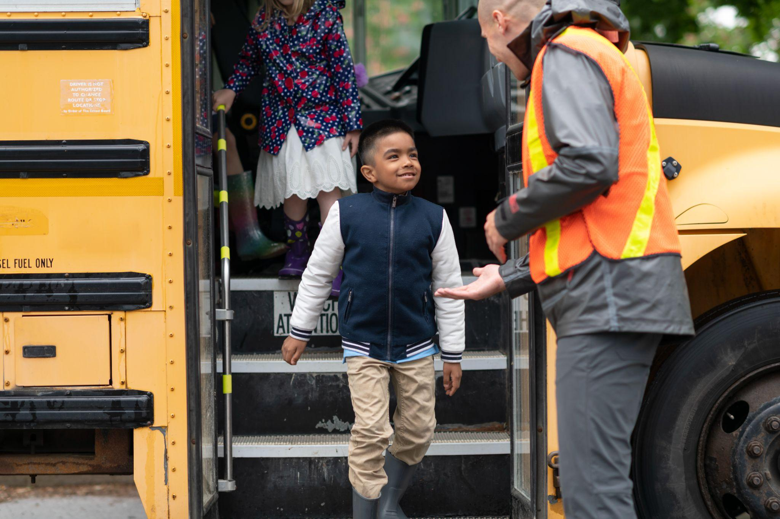
Individuals Not Required to Report
Contracted staff & volunteers
Staff who suspect abuse or neglect while not in the course of their professional duties
Notes:
Some individuals involved in schools are not listed in statute as being mandated reporters and therefore are not required to report suspected child maltreatment, such as contracted staff and volunteers. However, any person with reasonable cause to suspect child maltreatment may make a report to CPS. Also, school policy may require contracted staff and volunteers to engage in training and to notify appropriate school authorities of concerns about maltreatment.
Additionally, school staff are not legally required to report situations they observe in the community while not working.
Photo - Stock photo ID:1166891892 (Please note that the images in these slide decks were purchased for use in this training by DPI. They may not be copied and reproduced for inclusion in other training or publications.)

Slide 15
Mandated Reporters of “Adults At Risk”
Reporting of safety concerns for adult students is different than for children
Examples of these reporters include licensed social workers, counselors, and physical therapists
Wis. Stat. Sec. 55.01(1e), 155.01(7), 55.043(1m)
Notes:
Some students in schools are adults. Safety concerns related to adults are not treated with the same procedures as concerns relating to minors.
The individuals required to report “adults at risk” are different than those listed as mandated reporters of child abuse and neglect. Professionals credentialed through the Department of Safety and Professional Services like social workers, nurses, and physical therapists have an obligation to understand their duty to report concerns related to adult students. More information about adults at risk can be found in the Additional Resources Section.

Slide 16
The Process When a Safety Concern Arises
Gather Information
Engage in Critical Thinking
Consider the Impact of Bias
Report and/or Support
Notes:
Now that we know who is required to report, let’s consider what to do when staff have a safety concern. Under Wisconsin statute, if a mandated reporter has reasonable cause to suspect child maltreatment, they are required to immediately report. If staff are unsure whether they have reasonable cause to suspect child maltreatment, they may follow a 4 step process.
Step 1 - Gather Information
Step 2 - Engage in Critical Thinking
Step 3 - Consider the impact of bias
Step 4 -Report and/or Support a family with resources

Slide 17
Gather Information
Ask open-ended questions
Realize that reporting without basis has consequences
Move away from “When in doubt, report”
Notes:
Gather Information - Gathering information includes asking open-ended questions to get the basic facts of the situation and to consider those facts. Information gathering must proceed immediately and expeditiously, and if and when a school staff member has reasonable cause to suspect child maltreatment they must “immediately” report. We will learn more about how to gather information later in the training.
Reporting without a basis has consequences
Staff might think making a report when there is not reasonable cause to suspect child maltreatment will not hurt anyone, however this approach to reporting can actually have negative consequences for children and families. It can also reinforce racial disparities in system involvement. While the appropriate reporting of suspected child maltreatment is helpful and necessary, unwarranted reports that are not based on reasonable cause to suspect child maltreatment can be harmful and even traumatic.
Move away from “When in Doubt, Make a Report”
Research has shown that the past mindset of “when in doubt, make a report” contributed first and foremost to harm for children and families (Itzkowitz and Olson 2022; Krase 2013; Raz 2020; Krase 2015). Additional unintended consequences of this practice include creating mistrust in child welfare professionals and overburdening the child welfare system with unnecessary paperwork and financial costs (DCF 2022a). However, it is important to remember that if you have reasonable cause to suspect child maltreatment you are legally required to report.
Stock photo ID:1255989249 (Please note that the images in these slide decks were purchased for use in this training by DPI. They may not be copied and reproduced for inclusion in other training or publications.)

Slide 18
Engage in Critical Thinking
Slow down
Consider the situation
Reflect on worldview & bias
Notes:
Step two in the process involves critical thinking. Critical thinking includes a process of slowing down, considering the situation, and reflecting on one’s own worldview to determine whether there is reasonable cause to suspect child maltreatment, This process can lead to better decision-making related to reporting and supporting.
Critical thinking may include, as examples: considering if the explanation made sense, if the story changed over time, if there may be barriers to understanding stemming from disability, language, or child’s developmental level, if enough information about the situation has been gathered, if assumptions have been made, and if there are other incidents involving this student that have caused concern. Staff must use professional judgment and avoid split-second decisions.
Stock photo ID:1180357593 (Please note that the images in these slide decks were purchased for use in this training by DPI. They may not be copied and reproduced for inclusion in other training or publications.)

Slide 19
Consider the Impact of Bias
Consider how your life experiences and worldview impact your decisions.
Notes:
Step three in the process of determining reasonable cause includes considering the impact of bias and worldview that may be impacting the inclination to report, or to support a family with resources. We all have different perspectives and biases based on our life experiences and worldviews. School staff are encouraged to consider how these perspectives impact the way they make decisions about concerns.
Stock photo ID:1124551698 (Please note that the images in these slide decks were purchased for use in this training by DPI. They may not be copied and reproduced for inclusion in other training or publications.)

Slide 20
Report and/or Support
Report when…
staff have gathered enough information to establish there is reasonable cause to suspect a child they have seen as part of their work has been, or will be, abused or neglected Wis. Stat. 48.981(2)(a)
Support a family with connections to resources
Notes:
Step four is determining whether to report and or support a family with resources.
Report - When mandated reporters know or have reasonable cause to suspect that a child has been abused or neglected, a school employee is legally required to immediately report to county CPS or local law enforcement. This occurs when the employee has reasonable cause to suspect a child they have seen as part of their work has been abused or neglected, or has been threatened with abuse or neglect and the employee believes it will occur.
“Reasonable Cause” - Although the statute does not contain a definition of “reasonable cause to suspect,” there is some case law that discusses how that term is interpreted. The test is whether a prudent person would have had reasonable cause to suspect child abuse if presented with the same totality of circumstances. In other words, the individual should have a “belief, based on evidence but short of proof, that an ordinary person would reach as to the existence of child abuse.”
Support - If reasonable cause is or is not established, support a family with connections to resources.

Slide 21
Supporting: A Multifaceted Responsibility
Build positive relationships with students and families
Help connect them with needed services
Offer resources and support
Collaborate with local child welfare agencies
Notes:
A mandated supporter's responsibility toward students and families does not end with a report to local child welfare; but instead, a report when warranted helps initiate a possible collaboration to broaden the students' support system.
A mandated supporter's responsibility toward students and families is multifaceted and includes:
building positive relationships with students and families,
helping connect them with needed services,
offering resources and support, and
collaborating with local child welfare agencies.
Stock photo ID:1385170533 (Please note that the images in these slide decks were purchased for use in this training by DPI. They may not be copied and reproduced for inclusion in other training or publications.)

Slide 22
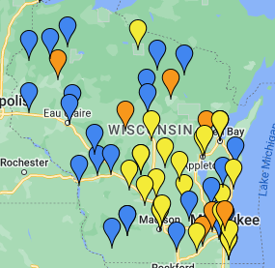
Be Aware of Local Resources
Family Resource Centers (FRCs)
Examples of services FRCs provide include:
Universal parenting supports
Concrete supports and basic needs
Evidence-based/evidence-informed programming
Parent leadership activities
Navigation to community supports
Developmental screening & referral​
Notes:
Support may include linking caregivers with a local Family Resource Center (FRC) or similar organization. An FRC provides and helps connect caregivers to economic resources, parenting classes and strategies to support healthy child development as well as connection to other community resources. An FRC is a community organization serving all types of families with fun and educational programs and activities, opportunities to meet one another and chances for their children to play together while also getting support.
“All families have room to grow by connecting with the FRC in their community!” (Child Abuse and Neglect Prevention Board 2022)
There is a link to the FRCs around Wisconsin in the additional resource section.

Slide 23
Reactions from Parents
Example responses:
“It sounds like your family is going through a difficult situation. I am available to problem-solve with you.”
“If a report was made, the purpose of the report would have been to get more support for your child and family. All families need help at one time or another. Is there anything I could help with?”
“The law requires the identity of any reporter be kept confidential.”
Notes:
When parents have not been included in discussions related to concerns about their student, it is not unusual for parents to feel fear or anxiety about the situation. Sometimes, parents may confront the staff or someone else, like the building principal, about the report. Keep in mind that in these moments parents may be experiencing a range of emotions which could include feeling scared, confused, and hurt. Parents should be treated with empathy and care.
If confronted by parents, staff may be able to avoid sharing confidential information with these examples statements:
“It sounds like your family is going through a difficult situation. I am available to problem-solve with you.”
“If a report was made, the purpose of the report would have been to get more support for your child and family. All families need help at one time or another. Is there anything I could help with?”
“The law requires the identity of any reporter be kept confidential.”
Even if the conversation does not go well, continue to offer positive regard to caregivers and a welcoming space to talk.
Stock photo ID:638647852 (Please note that the images in these slide decks were purchased for use in this training by DPI. They may not be copied and reproduced for inclusion in other training or publications.)

Slide 24
Continued Support at School
Support at school could include:
Check-ins
Rapport building
Making connections
Promoting a positive school climate
Providing opportunities for engagement and leadership
Notes:
Staff should continue to support the student at school through check-ins, rapport building, making connections to other supportive adults and peers, promoting a positive school climate, and providing opportunities for engagement and leadership.
Stock photo ID:1444143004 (Please note that the images in these slide decks were purchased for use in this training by DPI. They may not be copied and reproduced for inclusion in other training or publications.)

Slide 25
Provide an Awareness of Advocates
Survivors of certain offenses have the right to the accompaniment of an advocate
School staff can help make families aware of these services
Notes:
Survivors of certain offenses have the right to the accompaniment of a “victim advocate”. These situations include sexual assault, human trafficking, and child sexual abuse.
“Victim advocate" is a specific designation for an individual who is an employee or a volunteer at an organization who is trained to provide counseling, assistance, or support services free of charge to a survivor. (Wis. stat. Sec. 905.045[1][e])
Advocates can support survivors in many ways, helping them to access basic needs, information about their rights, and accompaniment to hospitals, criminal and court proceedings, and law enforcement interviews (Wis. Stat. sec. 50.378, 950.045).
Stock photo ID:509725020 (Please note that the images in these slide decks were purchased for use in this training by DPI. They may not be copied and reproduced for inclusion in other training or publications.)

Slide 26
Mandated Reporting & Supporting Wrap Up
A mandated reporter supports students and families
Collaboration with child welfare professionals improves outcomes
Notes:
(Note to facilitator: Wrap Up slides at the end of a section may be omitted.)
A mandated reporter’s responsibilities towards keeping students safe does not begin or end with a report to CPS. School staff should consider how to connect with students and caregivers for prevention and ongoing support. Collaboration with child welfare professionals can further improve outcomes.
Stock photo ID:642501464 (Please note that the images in these slide decks were purchased for use in this training by DPI. They may not be copied and reproduced for inclusion in other training or publications.)

Slide 27
Additional Considerations Related to Reporting
Notes:
(Note to facilitator: Title slides may be omitted.)
There are additional considerations related to reporting, which we will discuss now.

Slide 28
Report to CPS or Law Enforcement
School leaders are encouraged to have discussions with CPS and law enforcement agencies related to reporting procedures
Notes:
There are two ways to meet the legal requirement to report suspected abuse or neglect: a) call CPS, or b) call local law enforcement. Since CPS in Wisconsin is county-administered, each county will have slightly different processes for receiving and responding to reports.
It is recommended that school leaders have discussions with the local agencies to provide clarity for school staff around which agency to report to and when, especially when considering physical and sexual abuse. Law enforcement is generally contacted if there may be immediate danger to the student. In some counties, dual reporting is preferred for certain cases. Child Protective Services Agency Contact Information is provided in the Additional Resources.
Stock photo ID:462576863 (Please note that the images in these slide decks were purchased for use in this training by DPI. They may not be copied and reproduced for inclusion in other training or publications.)

Slide 29
Consulting with Other Staff
Consultation is ok when available immediately
Do NOT email or leave voice message
Reporting to school staff does not fulfil the duty to make a report to CPS
Notes:
School staff may wish to consult with a pupil services professional or school leader who has more experience with reporting child abuse and neglect. Keep in mind that if the pupil service professional or school administrator is not available immediately, this should not delay a report that is warranted.
This is very important to understand: an email or voice message sent to another school staff member, like a school social worker, is not helpful and does not fulfill the duty to make a report to CPS.
It is not acceptable for another school staff member to call and make the report on behalf of the staff member who has reasonable cause to suspect abuse. It is acceptable if multiple staff members that have knowledge of the situation make the report together.
Also be aware that a school leader may not prevent a mandated reporter from making a report that they feel is necessary.
Stock illustration ID:875885046 (Please note that the images in these slide decks were purchased for use in this training by DPI. They may not be copied and reproduced for inclusion in other training or publications.)

Slide 30
When Making a Report
Basic demographic information for all family members
Basic description of what happened and when
Statements made by the child
Observations of the child
Child and parent functioning
Protective factors
Information for the Indian Child Welfare Act (ICWA)
Notes:
Note to facilitator: ICWA is pronounced “ick-wa” and WICWA is pronounced “wick-wa”.
When making a report the reporter should be prepared to share detailed information.
The basic information to report includes:
Basic demographic information for all family members, such as name, date of birth, sex, race, address, and phone number
Basic description of what happened and when
Statements made by the child
Observations of the child
Child and parent functioning
Protective factors
And If the child is a Native American per the Indian Child Welfare Act (ICWA)
Stock photo ID:1423646287 (Please note that the images in these slide decks were purchased for use in this training by DPI. They may not be copied and reproduced for inclusion in other training or publications.)

Slide 31
Do Not Assume Others Have Reported
Do not assume or rely on others to report for you
Notes:
School staff should not assume that suspected child maltreatment has been reported by another individual with knowledge of the suspected abuse. For example, in a situation where a student has said that their caregiver is already aware of sexual abuse occurring, school staff must still make a report.
Stock photo ID:1464792046 (Please note that the images in these slide decks were purchased for use in this training by DPI. They may not be copied and reproduced for inclusion in other training or publications.)

Slide 32
Indian Child Welfare Act (ICWA)
Prior to 1978, 25-35% of Indian children were removed from families
ICWA was meant to address harmful policies and practices that separated Indian children from their families
Wisconsin passed WICWA in 2009
CPS will ask if the child has any Native American Heritage
Notes:
Understand basic information about ICWA/WICWA
Note to facilitator: ICWA is pronounced “ick-wa” and WICWA is pronounced “wick-wa”.
Every time a report is made to CPS the reporter will be asked if the child has any Native American Indian Heritage due to state and federal law.
The Indian Child Welfare Act, or ICWA, is a statute passed by Congress in 1978 to address the agency policies and practices that resulted in the extensive separation of Indigenous children from their families.
Before ICWA, State and private agencies were removing as many as 25 - 35% of Indigenous children from their families and placing many of these children in non-Indigenous foster and adoptive homes (Bureau of Indian Affairs 2016). Congress determined that cultural ignorance and biases within the child welfare system were significant causes of this problem (Bureau of Indian Affairs 2016). Congress enacted ICWA to protect the best interests of Indigenous children and to promote the stability and security of Tribal Nations and families (Bureau of Indian Affairs 2016).
In 2009, Wisconsin passed its own version of ICWA, called the Wisconsin Indian Child Welfare Act or WICWA, and this mirrors the federal law. Both WICWA and ICWA are based upon a political classification and apply to those children who are enrolled or eligible for enrollment in a federally recognized tribe. Tribes are sovereign nations and have the right to provide resources and intervene if an Indigenous child of that tribe might be removed from their home, even when the child does not reside on tribal lands.
Mandated reporters should make reports when warranted to the local child welfare agency who will in turn contact Tribal Child Welfare when needed. If the reporter knows that the child is a member of a tribe, they may call the tribe.
Unfortunately, significant over-representation in the child welfare system continues to negatively impact Indigenous children in Wisconsin, and these disparities vary from county to county (National Indian Child Welfare Association 2021). This data presents our systems with a need to consider what else must be done to improve outcomes.
Photo - Stock photo ID:134573583 (Please note that the images in these slide decks were purchased for use in this training by DPI. They may not be copied and reproduced for inclusion in other training or publications.)

Slide 33
Protections and Penalties
Notes:
(Note to facilitator: Title slides may be omitted.)

Slide 34
Appropriate Reports are Helpful
Appropriate reports can help keep kids safe
Notes:
Appropriate reports are helpful
Child abuse and neglect threaten a child’s safety and have long-term negative physical, psychological, and developmental impacts. CPS involvement has greatly improved safety and functioning for many families in Wisconsin. When the right situations are reported, child welfare professionals have been able to partner with families to improve safety and long term outcomes. School staff must make a report when they have reasonable cause.
Photo - Stock photo ID:1403047626 (Please note that the images in these slide decks were purchased for use in this training by DPI. They may not be copied and reproduced for inclusion in other training or publications.)

Slide 35
Protections in the Law for Reporters
A reporter is protected from both civil and criminal liability
The identity of a reporter must be kept confidential
Wis. Stats. 48.981(2)(e), (4), (7)
Notes:
It is important for all mandated reporters to understand that when they make a report in good faith, the law provides for protection against being fired, disciplined, or otherwise discriminated against in regard to employment, or from being threatened with any such treatment.
The reporter is protected from both civil and criminal liability.
When a report is made, there are also confidentiality protections for the reporter’s identity.

Slide 36
Critical Thinking
Slow down
Consider the situation
Reflect on worldview & bias
Notes:
Making a report in good faith includes using professional judgment and critical thinking by pausing, considering the situation, and reflecting on biases that may be impacting an inclination to report.
Stock photo ID:1489663298 (Please note that the images in these slide decks were purchased for use in this training by DPI. They may not be copied and reproduced for inclusion in other training or publications.)

Slide 37
Failure to Report
There are criminal penalties for intentionally failing to report
Notes:
Let’s now consider the Failure to Report
There are criminal penalties outlined in statute for mandated reporters who intentionally violate mandated reporter laws by failing to report.
Ultimately, whether or not a person has complied with the statute and is subject to criminal penalties is a matter for law enforcement. Information provided by DPI in this training is intended only as guidance (not legal authority).
Stock photo ID:1436317121 (Please note that the images in these slide decks were purchased for use in this training by DPI. They may not be copied and reproduced for inclusion in other training or publications.)

Slide 38
Immoral Conduct - Failure to Report
DPI has authority to investigate whether a licensee has committed immoral conduct, as defined by Wis. Stat. § 115.31(c).
There are two main situations:
Notes:
What DPI does have authority over is whether a licensee has committed immoral conduct, as defined by statute as conduct or behavior that is contrary to commonly accepted moral or ethical standards and that endangers the health, safety, welfare, or education of any pupil (Wis. Stat. § 115.31[c]). If DPI finds that a licensee has committed immoral conduct, it may revoke the license. DPI has conducted investigations into whether a licensee’s failure to make a mandatory report constituted immoral conduct, but it is important to note that such investigations are rare.
A licensee will most likely have been found to have engaged in immoral conduct for failing to report in two situations. One, when the licensee knows they should make a mandatory report, chooses not to, and engages in an active “cover-up”. And two, where the requirement to report is so clear that any other reasonable licensee would know they should report and the failure to report is clearly gross negligence.

Slide 39
The Role of Bias in Child Welfare
Notes:
(Note to facilitator: Title slides may be omitted.)

Slide 40
A History of Bias
There is a history of negative impacts of our systems on Black and Indigenous families
Removals result in negative outcomes
Historically and today, there is disproportionate involvement in child welfare of Black and Indigenous families
Notes:
School systems and child welfare agencies have existed for a long time in our society resulting in both positive and negative impacts on individuals and groups. Unfortunately, the negative impacts have disproportionately affected people of color, especially Black and Indigenous families (Dettlaff & Boyd 2020, National Indian Child Welfare Association 2021.).
One example of damaging actions taken by these systems includes the unnecessary removal of children from their families, which has caused trauma and intergenerational harm (Dettlaff & Boyd 2020; Itzkowitz and Olson 2022; Ellis, Krista. 2019).
Families of color have been disproportionately impacted by removals throughout history, including the removal of Black children from their families during slavery, the removal of Indigenous children to boarding schools, and more recently the removal of Latinx children at the Southern border, and removals through the child welfare system. (Itzkowitz and Olson 2022, Department of Children and Families 2022, National Indian Child Welfare Association 2021).
We acknowledge that removals, regardless of length, have been long associated with negative outcomes for both children and families (Department of Children and Families 2022, Dettlaff & Boyd 2020, Itzkowitz and Olson 2022). It is the responsibility of mandated reporters to be aware of this history and to understand the present context, which currently includes a disproportionate involvement of Black and Indigenous children in all aspects of the child welfare system. (Dettlaff & Boyd 2020; Department of Children and Families 2022).
Stock photo ID:1296442639 (Please note that the images in these slide decks were purchased for use in this training by DPI. They may not be copied and reproduced for inclusion in other training or publications.)

Slide 41
Disproportionality in Reporting
All racial disproportionality begins with reporting
African American children are 2X as likely to be reported
Professionals knowingly or unknowingly let personal biases impact their actions or decisions
Notes:
All racial disproportionality within the child welfare system begins with reporting, and this is where school staff have a role.
Disproportionality in reporting on the basis of race, culture, and ethnicity has been evident for more than 50 years and is widespread (Krase 2015; Dettlaff & Boyd 2020).
At the time of the creation of this training, nationally and in Wisconsin, African American children were almost twice as likely as white children to be reported by school staff for child maltreatment. (Krase 2015; DCF 2022).
Additionally, child welfare cases involving Black and Indigenous families were more likely to be reported, screened-in, investigated, substantiated, and recommended for out-of-home placement (Bowman et al 2009, Child Welfare Information Gateway 2021).
These families are also more likely to be faced with poverty and systemic oppression and then to be blamed for how those conditions impacted their children and family (Roberts 2003).
To be clear, racism, not race, is a factor that results in disproportionate numbers of African American and Indigenous families involved in child welfare (Child Welfare Information Gateway 2021).
A 2019 report from the American Bar Association, Race and Poverty Bias in the Child Welfare System, identified that one of the primary factors that helps to explain the evidence of disproportionality of racial groups and low-income families in the child welfare system is mandated reporters' conscious or unconscious biases impacting their decisions.
To reduce these disparities, school staff are encouraged to understand and address the impact of individual biases, develop culturally responsive practices, and engage communities of color when developing policies to address disproportionality and disparities in child welfare systems (Ellis 2019).
Stock photo ID:1096013738 (Please note that the images in these slide decks were purchased for use in this training by DPI. They may not be copied and reproduced for inclusion in other training or publications.)

Slide 42
Be Aware of Bias
Be aware of the possibility for harm and how to avoid it
All human brains use shortcuts to process the information around us
These shortcuts can result in bias, which can be negatively applied to people & groups
Notes:
Let’s look closer at the impact of bias in reporting. The exact same situation could be reported by one person and not by another. School staff use professional judgment to determine whether there is cause to reasonably suspect a child is being maltreated based on an understanding of statutory definitions. Professional judgment is influenced by the worldview of the staff member, which includes conscious and unconscious biases. While bias is not always negative, it can lead to discriminatory actions and harm.
Since the intention of mandated reporting laws is to help keep children safe, and not to cause harm, mandated reporters must be aware of the potential for harm and how to avoid it.
One way to avoid harm is to understand how unconscious, or implicit bias, works in the human brain.
Our brains can process 11 millions bits of information every second, however our conscious minds only manage about 40-50 bits of information per second (Agarwal 2020). Cognitive shortcuts are necessary so that we are not overwhelmed by all the information around us. These cognitive shortcuts can lead to our brains forming groups and associations in our minds. This is a natural process and generally all human brains do this (Agarwal 2020).
However, when our brains use cognitive shortcuts to make associations related to groups and individual people, there can be negative impacts (Agarwal 2020). Again, these cognitive shortcuts are often unconscious and we may not even realize the impact they are having. Though we may not intend to cause harm, it is the impact that matters.
School staff come from a wide variety of backgrounds, cultures, identities, and worldviews, and carry their own implicit and explicit biases, strengths, and weaknesses. It is the responsibility of school staff to become more aware of their own background, worldview, and biases and how these may influence their view of individuals, groups, and situations.
Additional information on implicit bias can be found in the resources section.
Stock illustration ID:1448118932 (Please note that the images in these slide decks were purchased for use in this training by DPI. They may not be copied and reproduced for inclusion in other training or publications.)

Slide 43
Consider the Impact of Bias
Would your view of the situation change if the family had different demographics, race, culture, or identity?
Notes:
When considering how your perspective impacts the way you make decisions about concerns, consider whether your view of the situation would be different if the family had different demographics, race, culture, primary language, family structure, socioeconomic status, or if your perspective is based on individual family member characteristics such as identity, gender, sexual orientation or educational level. Ask yourself if the concern could be explained by a difference in parenting styles; perhaps differences related to hygiene, food choices, youth supervision, or disciplinary practices. Consider whether the concern stems from poverty, as opposed to a true situation of neglect.
Photo - Stock photo ID:1435656847 (Please note that the images in these slide decks were purchased for use in this training by DPI. They may not be copied and reproduced for inclusion in other training or publications.)

Slide 44
Responsibilities of School Staff in Prevention of Child Abuse and Neglect
Notes:
(Note to facilitator: Title slides may be omitted.)
Training all school employees in the mandated reporting of child abuse and neglect is only one aspect of prevention. In this section we will go over additional aspects of prevention. All staff are responsible for building relationships, and promoting a culture of care and support.

Slide 45
Trauma Sensitive Schools
Safety
Trustworthiness
Cultural Responsiveness
Empowerment
Collaboration
Choice
Notes:
Build Trauma Sensitive Schools
Staff and student wellness is a priority in a trauma sensitive school or TSS. A trauma sensitive school environment can support the prevention of child maltreatment.
In TSS, the guiding principles of safety, trustworthiness, cultural responsiveness, empowerment, collaboration, and choice are infused into all aspects of the school.
TSS includes an understanding of the prevalence and impact of trauma, and incorporating this understanding into policy and practice. There is an emphasis on relationship-building and safety.
In TSS, staff promote school belonging for students inclusive of all cultural groups and identities.
This safe and trustworthy environment can promote discussions between students and staff. When students feel that they are able to express their thoughts and emotions to trustworthy adults, they are more willing to engage in help-seeking including disclosing harm or pain (JED Foundation n.d.). A strong referral pathway, which is a clear process for students to ask for and receive help, further promotes help-seeking behaviors.

Slide 46
Teach Students
Protective Behaviors instruction shall be provided to pupils in elementary schools. Wis. Stat. 118.01(2)(d)8)
Best practice includes teaching:
Rights related to Title IX/harassment
Anti-human trafficking
Dating Violence, healthy relationships, and consent
Online Safety
Help seeking
Notes:
Responsibilities of school staff include following the state statute that requires school districts to teach elementary students about recognizing and preventing child abuse and child enticement (Wis. Stat. Sec. 118.01[2][d][8]). Research shows it is better to use an evidence-informed curriculum than trying to put together your own program. School leaders are encouraged to consult with local Sexual Assault Service Providers on abuse prevention programs.
Best practices also include teaching students about their rights under Title IX and pupil non-discrimination laws, an understanding of dating violence, human trafficking, healthy relationships, giving consent, power and control dynamics, online safety, and how to seek help for self or others.

Slide 47
Prevent Abuse by Students, Staff, Volunteers, and Coaches
An estimated 1 in 10 students are subject to adult sexual misconduct in school settings¹
Improve prevention through identifying early signs of inappropriate behavior and speaking up
Self-assess your own behavior
(¹ The Government Accountability Office 2014)
Notes:
School staff responsibilities also include preventing abuse in school programs by other students, staff, volunteers, and coaches.
The Government Accountability Office (2014) estimates that nearly one in 10 students are subjected to adult sexual misconduct in school settings during the course of their academic careers.
Adult sexual misconduct includes behaviors ranging from those that are inappropriate to those that are illegal (REMS 2017).
Important steps towards identifying and preventing this harmful behavior includes school staff being able to identify early signs of inappropriate behavior, and speaking up when inappropriate behavior is occurring (GAO 2014).
It is also important to engage in self-assessment of your own behavior and boundaries with students. The responsibility lies with us as professionals to set and enforce appropriate boundaries, to become aware when those boundaries have become blurry, and to take action to get back into balance. You can find more information on setting boundaries in the additional resources.
Stock photo ID:1130717688 (Please note that the images in these slide decks were purchased for use in this training by DPI. They may not be copied and reproduced for inclusion in other training or publications.)

Slide 48
Recognize and Report Grooming
Gives gifts and rewards to one child or a specific group
Overly interested in a child, spends time with them, eager for affection
Creates opportunities to be around the child
Works to gain trust of child’s caretakers and professionals
Exchanges personal contact information
Walks in on students in the locker room or restroom
Engages in excessive physical contact, including roughhousing
Tells sexually explicit jokes to students or discussing dating life
Notes:
School staff need to learn to recognize and report grooming. Grooming is systematic desensitization of a child through manipulative behavior that the maltreater uses to gain trust, build rapport and compliance, and ensure secrecy with the intent to be sexually abusive (Wolf & Pruitt 2019). It is a process, which can make it challenging for the child or adults to recognize what is happening and to identify that it is unhealthy (Wolf & Pruitt 2019). Maltreaters groom not only the child, but also adults such as parents and school staff members (Wolf & Pruitt 2019). They may also work to make inappropriate behaviors seem normal by continually pushing the boundaries and then crossing them.
If staff notice the following behaviors in other adults, they may need to speak to the adult or their supervisor, for example:
Giving gifts and rewards to one child or a specific group
Overly interested in a child, spends time with them, and is eager for affection
Creates opportunities to be around the child in and outside of school
Works to gain trust of the child’s caretakers and professionals - staff should be alert to the fact that they could also be groomed!
Exchanges personal phone, email, or social media contact information with students
Walks in on students in the locker room or restroom
Inappropriate or excessive physical contact, including roughhousing
Telling sexually explicit jokes to students or discussing dating life
Pause and ask yourself: Does it seem strange? Does it make you feel uncomfortable? Does it happen often? Do other adults notice? We cannot rely on children to recognize when they are being groomed. Though adults may not realize they are being groomed either, sometimes there are signs that an adult picks up on. We want to encourage adults to trust their gut and speak up when they feel something is not right, or when another adult or peer violates a policy or personal boundary.
Photo - Stock illustration ID:1405358437 (Please note that the images in these slide decks were purchased for use in this training by DPI. They may not be copied and reproduced for inclusion in other training or publications.)

Slide 49
Policy Considerations
Do school policies provide employees and volunteers with training on personal conduct?
Do they create a climate that encourages people to question behaviors?
Do they identify situations that pose a greater risk for inappropriate interaction?
Do they inform staff about its policies concerning child sexual abuse prevention?
Do they have a Code of Conduct that staff are aware of?
Prevention in Youth Serving Organizations. Awareness2Action
Notes:
Staff responsibilities include minimizing risk at school. School leaders should review their policies for maintaining safe environments. We will go over some important considerations now and there is a more complete list in the additional resources.
Do school policies provide employees and volunteers with training on personal conduct?
Do they create a climate that encourages people to question behaviors?
Do they identify situations that pose a greater risk for inappropriate interaction?
Do they inform staff about its policies concerning child sexual abuse prevention?
Do they have a Code of Conduct that staff are aware of?

Slide 50
Reporting Staff or Volunteers
Suspected abuse by an educator, volunteer, or coach must be reported to child welfare or local law enforcement in addition to any disciplinary action
An administrator may be required to report child abuse by an employee to DPI , see: Wis. Stat. 115.31 (3)
Notes:
When mandated reporters have reasonable cause to suspect that staff or volunteers have engaged in child abuse or neglect they must report to child welfare or local law enforcement. This is true of child sexual abuse, and also applies to any other maltreatment as defined by statute, including physical abuse. For example, staff may need to make a report about their colleague in situations where another staff member hits a student in a way that may indicate physical abuse has occurred. Best practice includes ensuring both local law enforcement and CPS are notified and involved.
It is essential to understand that managing abuse by staff solely through an employee disciplinary policy does NOT comply with the law. School leaders ensure employees understand professional boundaries, and responsibilities towards reporting other staff and volunteers. This includes following the school’s procedures for reporting violations of staff handbook policies to administration.
It is important to be aware that there are various cases in which a district administrator MUST report immoral conduct, including child abuse, to DPI for possible consideration of license revocation. See statute section 115.31(3) for more details.
Keep in mind that we all form opinions about our colleagues, and some of those opinions may be based on our bias about who that person is, or which cultural or identity group they belong to. While it is important to identify when colleagues are acting inappropriately, we should also keep in mind the worldview and opinions we may be bringing to the judgment and to try to consider the behaviors as objectively as possible.
Photo - Stock illustration ID:1306335330 (Please note that the images in these slide decks were purchased for use in this training by DPI. They may not be copied and reproduced for inclusion in other training or publications.)

Slide 51
Responsibilities - Wrap Up
All staff are responsible for safety
School leaders support cross-system collaboration
All staff can elevate the voice and insight of students and families
Notes:
(Note to facilitator: Wrap Up slides at the end of a section may be omitted.)
To wrap up this section, all staff must be responsible for student safety. School leaders can send a clear message that child protection is a priority, motivate staff to implement skills learned in training, and set clear and consistent prevention policies.
Photo - Stock photo ID:1423165451 (Please note that the images in these slide decks were purchased for use in this training by DPI. They may not be copied and reproduced for inclusion in other training or publications.)

Slide 52
The Structure of Child Protective Services
Notes:
(Note to facilitator: Title slides may be omitted.)

Slide 53
Collaboration is Key
Professionals share a common goal of increasing well-being and success in school for students
Notes:
School staff are encouraged to reach out to their county and tribal child welfare agencies to discuss ways to engage in regular dialogue and to enhance partnerships to benefit children and families in their local community.
No one system can do everything. We all benefit when we work together towards the common goals of supporting child, family, and community wellbeing.
Photo - Stock photo ID:475426704 (Please note that the images in these slide decks were purchased for use in this training by DPI. They may not be copied and reproduced for inclusion in other training or publications.)

Slide 54
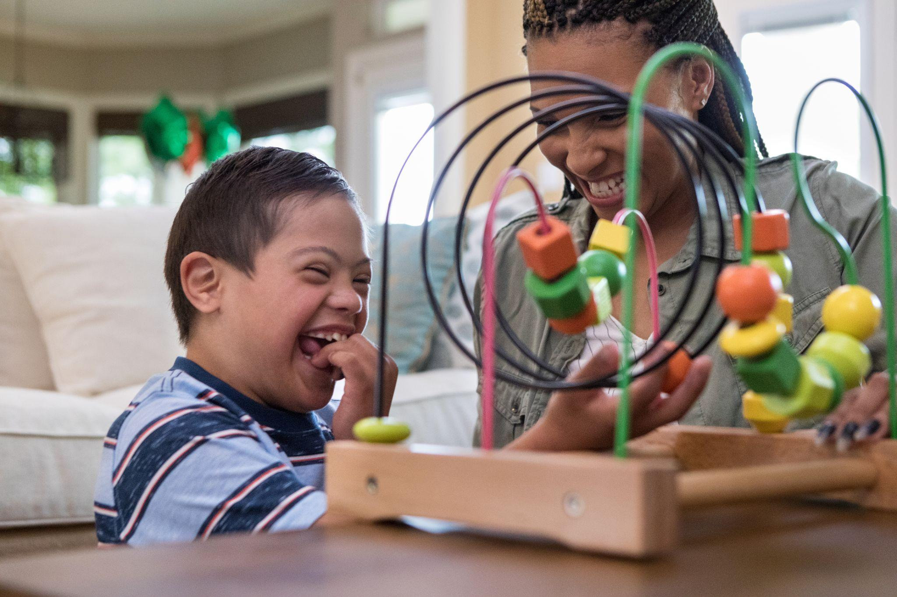
CPS Structure
Goal: To support parents and caregivers in making necessary changes so children are safe and protected in their homes.
Notes:
Collaboration is enhanced when school staff understand the goals and structure of Child Protective Services.
The goal of CPS is to support parents and caregivers in making necessary changes so children are safe and protected in their homes.
CPS in Wisconsin is state-supervised and county-run in 71 counties, and state-run in Milwaukee county.
The Department of Children and Families or DCF works with the eleven federally recognized Tribal Nations located within Wisconsin. Through a collaborative effort that recognizes and respects their sovereignty, DCF consults with the Tribes to support tribal children and families through the Department’s various programs including child welfare.
Stock photo ID:1165345367 (Please note that the images in these slide decks were purchased for use in this training by DPI. They may not be copied and reproduced for inclusion in other training or publications.)

Slide 55
Stages of CPS
Notes:
Wisconsin’s child welfare system is divided into three stages, those are called access, initial assessment, and ongoing.
It is important to note that not every report moves from one stage to the next. In fact, many reports are received and screened out, and the family never has any contact from CPS and may not even know a report was made.

Slide 56
The Access Stage
Notes:
During the access stage, a child welfare professional asks the reporter of the alleged child maltreatment a series of questions to gather relevant information about child safety and other family characteristics (DCF 2022¹). Reports are immediately analyzed to determine if information in the report creates a reason to suspect child abuse or neglect according to Wisconsin law (DCF 2022¹).
The primary decisions are whether to screen in or screen out a report for further assessment, and determining the response time on screened-in reports (DCF 2022¹).
Response times vary from the same day to within five working days. The screening and response time decisions must be made within 24 hours (DCF 2022¹).

Slide 57
Access – Screen In/Screen Out
Screened Out
Does not meet legal definitions of child maltreatment
School and child welfare professionals help connect the family to resources
Screened In
Assigned to 1 of 3 response timeframes
Notes:
If a Report is Screened Out
If the report does not meet the legal definition of suspected child abuse or neglect, it is screened out and the case is closed. The case may be assigned to a child welfare professional who can provide voluntary services to the family (DCF 2022¹). School staff can support families by connecting them to resources as well. The most effective outcomes are achieved when school and child welfare systems work collaboratively.
If a Report is Screened in
If the report meets the legal definition of suspected child abuse or neglect, the case is assigned to one of the three possible response timeframes based on the assessment of information and potential safety concerns (DCF 2022¹). Response times can be same-day, within 24-48 hours, or within 5 business days (DCF 2022¹).

Slide 58
Initial Assessment Stage
Notes:
If a Report is Screened in, the case is assigned to an initial assessment professional. In this Initial Assessment stage, county and tribal child welfare professionals perform interviews with the children, parents, Indian custodians, and other adults who are in contact with the child, and they visit the home (DCF 2022²). Who is interviewed by the CPS professional depends upon the specific allegations, who the suspected maltreater is, and whether there is a legal basis or consent for the interview (DCF 2022²).
The initial assessment may be conducted jointly with local law enforcement.
Using all the information they gather, child welfare professionals make two main decisions.
1) They must determine if maltreatment occurred.
2) The professional will determine if the child is safe and whether additional services may be needed. Evaluating and assessing child safety is continuous and will occur throughout the life of the case (DCF 2022²).
The CPS professional has 60 days to complete this Initial Assessment (DCF 2022²).

Slide 59
Ongoing Services Stage
Voluntary or court ordered
Goals are determined with the family
The primary role of the child welfare professional is to positively engage the family
Notes:
Based on the initial assessment, a family case may be opened for Ongoing Services on a voluntary basis or by a court order. Services are determined based on inclusive assessments and planning with the family to establish goals that achieve measurable outcomes (DCF³ 2022). Throughout the provision of Ongoing Services, the primary role of the child welfare professional is to engage the family in a positive working relationship to achieve a safe, stable home and permanence for their children (DCF³ 2022).
For additional details about what steps occur in each stage, and the timelines in which these occur, please review the flowchart documents in the Additional Resources section.
Stock photo ID:1473235231 (Please note that the images in these slide decks were purchased for use in this training by DPI. They may not be copied and reproduced for inclusion in other training or publications.)

Slide 60
Supporting the Initial Assessment
Allow immediate access in a private space for an interview (Public Schools)
Do not notify or request authorization from parents for the interview
Notes:
(*This slide is optional for private school staff)
There are actions school staff in public schools need to do to support an initial assessment.
Schools should allow immediate access to the student for observation and interview. Child welfare professionals have tight schedules and must not be made to wait until the student has free time.
It is important to remember that under statute CPS professionals are allowed to interview a student in a public school without parental authorization or notification.
Providing a private interview area for the child welfare professional to meet with the student is also necessary.
A school staff member may sit in on the interview only if the student wants this and the child welfare professional approves. If staff are allowed to sit in on the interview, they must not say or do anything that would interfere with the interview and assessment. A staff member that sits in on an interview may be subpoenaed to testify in court.
Stock photo ID:1213739038 (Please note that the images in these slide decks were purchased for use in this training by DPI. They may not be copied and reproduced for inclusion in other training or publications.)

Slide 61
May You Disclose Pupil Records?
Yes, pertinent information from pupil records may be shared for the purposes of making a report of child abuse or neglect
Information from pupil records may be shared to protect someone’s health or safety in an emergency
Wis. Stat. sec. 118.125(2)(p); 34 CFR 99.31, 99.36
Notes:
It is common for CPS and local law enforcement to ask questions about students that involve information from the student’s confidential pupil records. The Family Policy Compliance Office, has issued guidance and has concluded that the disclosure of personally identifiable information from education records, without parental consent is allowable for the purpose of making a report of child abuse and neglect (DPI 2018). Schools should disclose only those pupil records that are necessary.
Hopefully you now have a better understanding of the child welfare system, and its goals, structure, and philosophy.

Slide 62
Definitions of Child Maltreatment
Notes:
(Note to facilitator: Title slides may be omitted.)
It is important for all school staff to be familiar with the definitions of child maltreatment, so that they can recognize when a report is or is not required, and to reduce unnecessary calls to CPS.
As each type of child maltreatment is now discussed, it is important to recognize that a potential concern about a child that arises does not necessarily mean that abuse or neglect is occurring. Instead, employees should critically analyze the situation with curiosity and reflection. We will go through each type of maltreatment, starting with neglect.

Slide 63
Neglect Defined
Failure, refusal, or inability of a parent or other caregiver, for reasons other than poverty, to provide for the basic needs of a child to the point that it seriously endangers a child’s physical health
Includes actual as well as potential harm
Wis. Stat. sec 48.02(12g)
Notes:
Neglect means failure, refusal, or inability on the part of a caregiver, for reasons other than poverty to provide necessary care, food, clothing, medical or dental care, or shelter so as to seriously endanger the physical health of the child. Wis. Stat. sec. 48.02(12g).
Note that "seriously endanger" includes potential as well as actual harm to the child. Actual physical harm need not occur for the child to be seriously endangered; it is sufficient that such harm could happen except for the intervention of others (In the Interest of A.E. v. State, 163 Wis. 2d 270, 274-75 (Ct. App. 1991) (approving Wisconsin Jury Instruction – Civil 7030).)
Really consider this definition and the phrase “for reasons other than poverty”. School staff make unnecessary reports to CPS based on situations where poverty is actually the root cause of the caregiver failing to provide for their child. This is a prime situation where connecting the family to resources and helping to meet their basic needs would be the best actions.
Also, as mentioned, notice that the neglect must seriously endanger the child’s physical health. Neglectful behavior by a parent does not always seriously endanger the child.

Slide 64
Examples that are NOT Neglect
Failing to provide for basic needs due to poverty
Truancy
Failure to give prescribed medication to a child, unless it threatens child’s life or health
Notes:
The following are examples of situations that school staff sometimes mistake for neglect, however these would generally not be neglect.
Failing to provide for basic needs due to poverty. For example, not buying winter boots for a child due to not having enough money.
Truancy is not child maltreatment under Wisconsin law and school districts should follow the provisions in compulsory attendance law in situations involving students who are absent from school for unexcused reasons.
Failure to give prescribed medication to a child, unless it threatens the child's life or health, is not neglect. For example, a parent who declines to provide stimulant medication to a child with Attention Deficit Hyperactivity Disorder, or ADHD, is not threatening the life or health of the child. An example where it would be neglect would be where a parent who has the ability to provide needed insulin to a child with diabetes declines to do so.

Slide 65
Considerations Related to Neglect
Adequate food
Necessary medical and dental care
Adequate shelter
Level of supervision consistent with the child’s needs
Protecting the child from dangers that are within the caregiver’s control
Notes:
When reviewing situations that may involve neglect, consider if the child has been refused adequate food, the necessary medical and dental care when available, and adequate shelter. Consider if the level of supervision is consistent with the child’s needs, and whether the caregiver protects the child from dangers
When staff learn that a student is not living in their family home, this does not indicate that neglect has occurred. It is important to ask open-ended questions to learn more about the youth’s situation and to problem-solve with them any services or needs they may have. Consider obligations under the McKinney-Vento Act relating to supporting unaccompanied homeless youth.
Stock photo ID:501647509 (Please note that the images in these slide decks were purchased for use in this training by DPI. They may not be copied and reproduced for inclusion in other training or publications.)

Slide 66
Physical Abuse Defined
Non-accidental physical injury inflicted on a child.
The maltreater may or may not intend to harm the child, and the injury must be severe enough to meet the "physical injury" definition
Wis. Stat. sec. 48.02(1)(a)
Notes:
Physical abuse is non-accidental physical injury inflicted on a child. The maltreater may or may not intend to harm the child, and the injury must be severe enough to meet the "physical injury" definition.

Slide 67
Physical Injury
"Physical injury" includes but is not limited to
lacerations,
fractured bones,
burns,
internal injuries,
severe or frequent bruising,
or great bodily harm.
Wis. Stat. sec. 48.02(14g)
Notes:
"Physical injury" includes but is not limited to
lacerations,
fractured bones,
burns,
internal injuries,
severe or frequent bruising,
or great bodily harm
Keep in mind that physical abuse means someone hurt a child and does not include when a child harms themselves.

Slide 68
Considerations Related to Physical Abuse
Accidental vs. non-accidental
Multiple Injuries
Pattern Injuries (belts, electrical cords, spoons, etc)
Location of injuries
Severe and Frequent
Great bodily harm
Notes:
When reviewing situations that may involve physical abuse, consider if the incident was accidental or not, if there are multiple injuries, if there are patterns in the injuries such as belt marks, and if there was a delay in seeking medical attention. Bruises on the face or head are almost always considered serious.
Keep in mind that the definition of physical injury includes not simply bruising, but severe or frequent bruising and not simply bodily harm, but great bodily harm..
Some injuries are common in childhood like scraped knees and other bruises and bumps on knees, elbows, and forearms. The location of the injury may be telling if it is in a location that would be uncommon for typical childhood injury such as around the abdomen, neck, back, back of thighs, or if there are injuries on multiple parts of the body.
Consider the child’s explanation for the injury and whether it sounds plausible. There are circumstances where a call to the parent to ask about the injury may be appropriate.

Slide 69
Emotional Damage Defined
Emotional damage for which the child's parent has neglected or refused to obtain necessary treatment, or taken steps to alleviate the symptoms, and this refusal is for reasons other than poverty.
“Emotional damage” - harm to a child's psychological or intellectual functioning
Emotional damage is evidenced by one or more of the following exhibited to a severe degree:
anxiety, depression, withdrawal, outward aggressive behavior
or a substantial or observable change in the child's
behavior, emotional response, or cognition that is not within the normal range for the child's age and stage of development.
Wis. Stat. sec. 48.02(1)(gm) and 48.02(5j)
Notes:
Unlike many other states, Wisconsin’s Children’s Code does not provide a definition of emotional abuse. Instead, our state law defines maltreatment as emotional damage for which the child's parent, guardian, or legal custodian has neglected or refused to obtain necessary treatment or taken steps to relieve the symptoms and this refusal is for reasons other than poverty.
“Emotional damage” means harm to a child's psychological or intellectual functioning.
Emotional damage is demonstrated by one or more of the following exhibited to a severe degree: anxiety; depression; withdrawal; outward aggressive behavior; or a substantial or observable change in the child's behavior, emotional response, or cognition that is not within the normal range for the child's age and stage of development. Wis. Stat. sec. 48.02(1)(gm) and 48.02(5j).
School staff should be aware that due to how the law was written in Wisconsin, the level to which the damage must reach is high and therefore emotional damage is the least substantiated type of maltreatment.

Slide 70
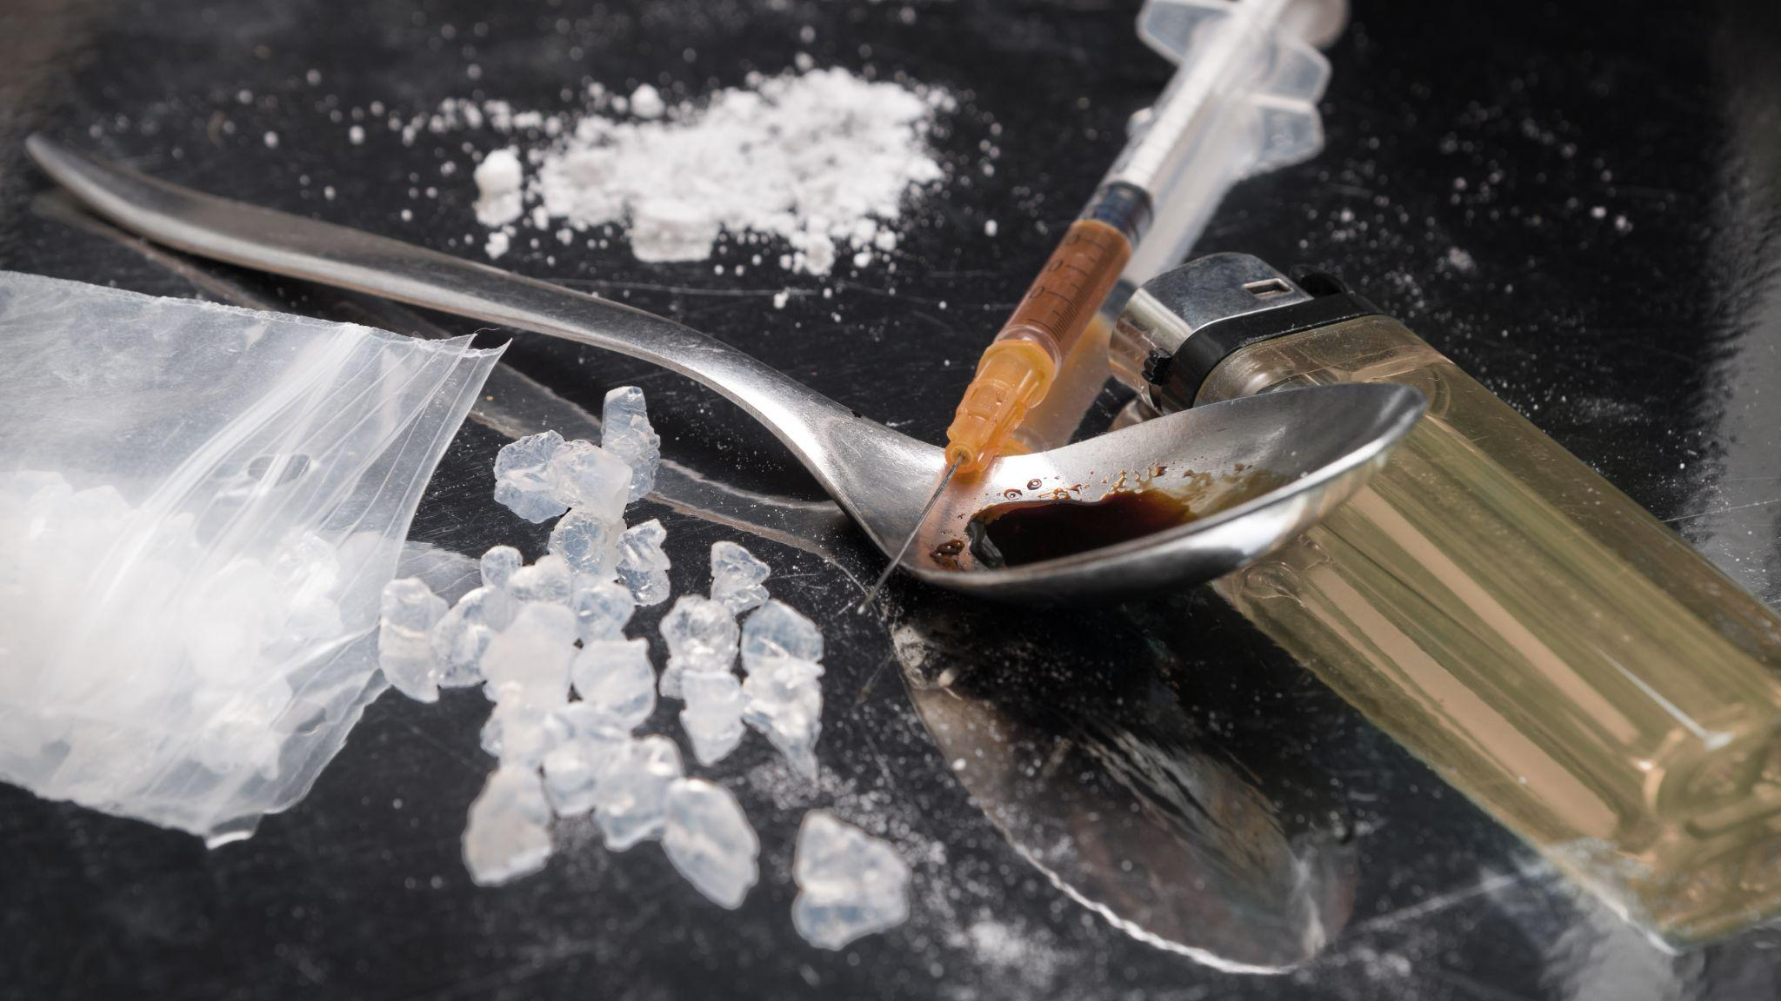
Methamphetamine Manufacture
Methamphetamine manufacture that a child can see, smell, or hear is child abuse in Wisconsin.
Wis. Stat. 48.02(1)(g)
Notes:
The manufacture of methamphetamine, commonly known as the drug “meth” or “crystal meth”, is considered child abuse in Wisconsin when a child is physically present during the manufacture, or when it is made in or around a child’s home, or where a reasonable person should have known that the manufacture would be seen, smelled, or heard by a child. Wis. Stat. sec. 48.02(1)(g).
Stock photo ID:1081637412 (Please note that the images in these slide decks were purchased for use in this training by DPI. They may not be copied and reproduced for inclusion in other training or publications.)

Slide 71
Additional Situations for Consideration
Students Without Parents or Guardians
Situations involving Domestic Violence
Unsupervised Youth
Caregiver Substance Use
Physical Discipline
Notes:
We will address sexual abuse in the next section, but first, more situations need our attention, now that you have a basic understanding of the definitions of child maltreatment.

Slide 72
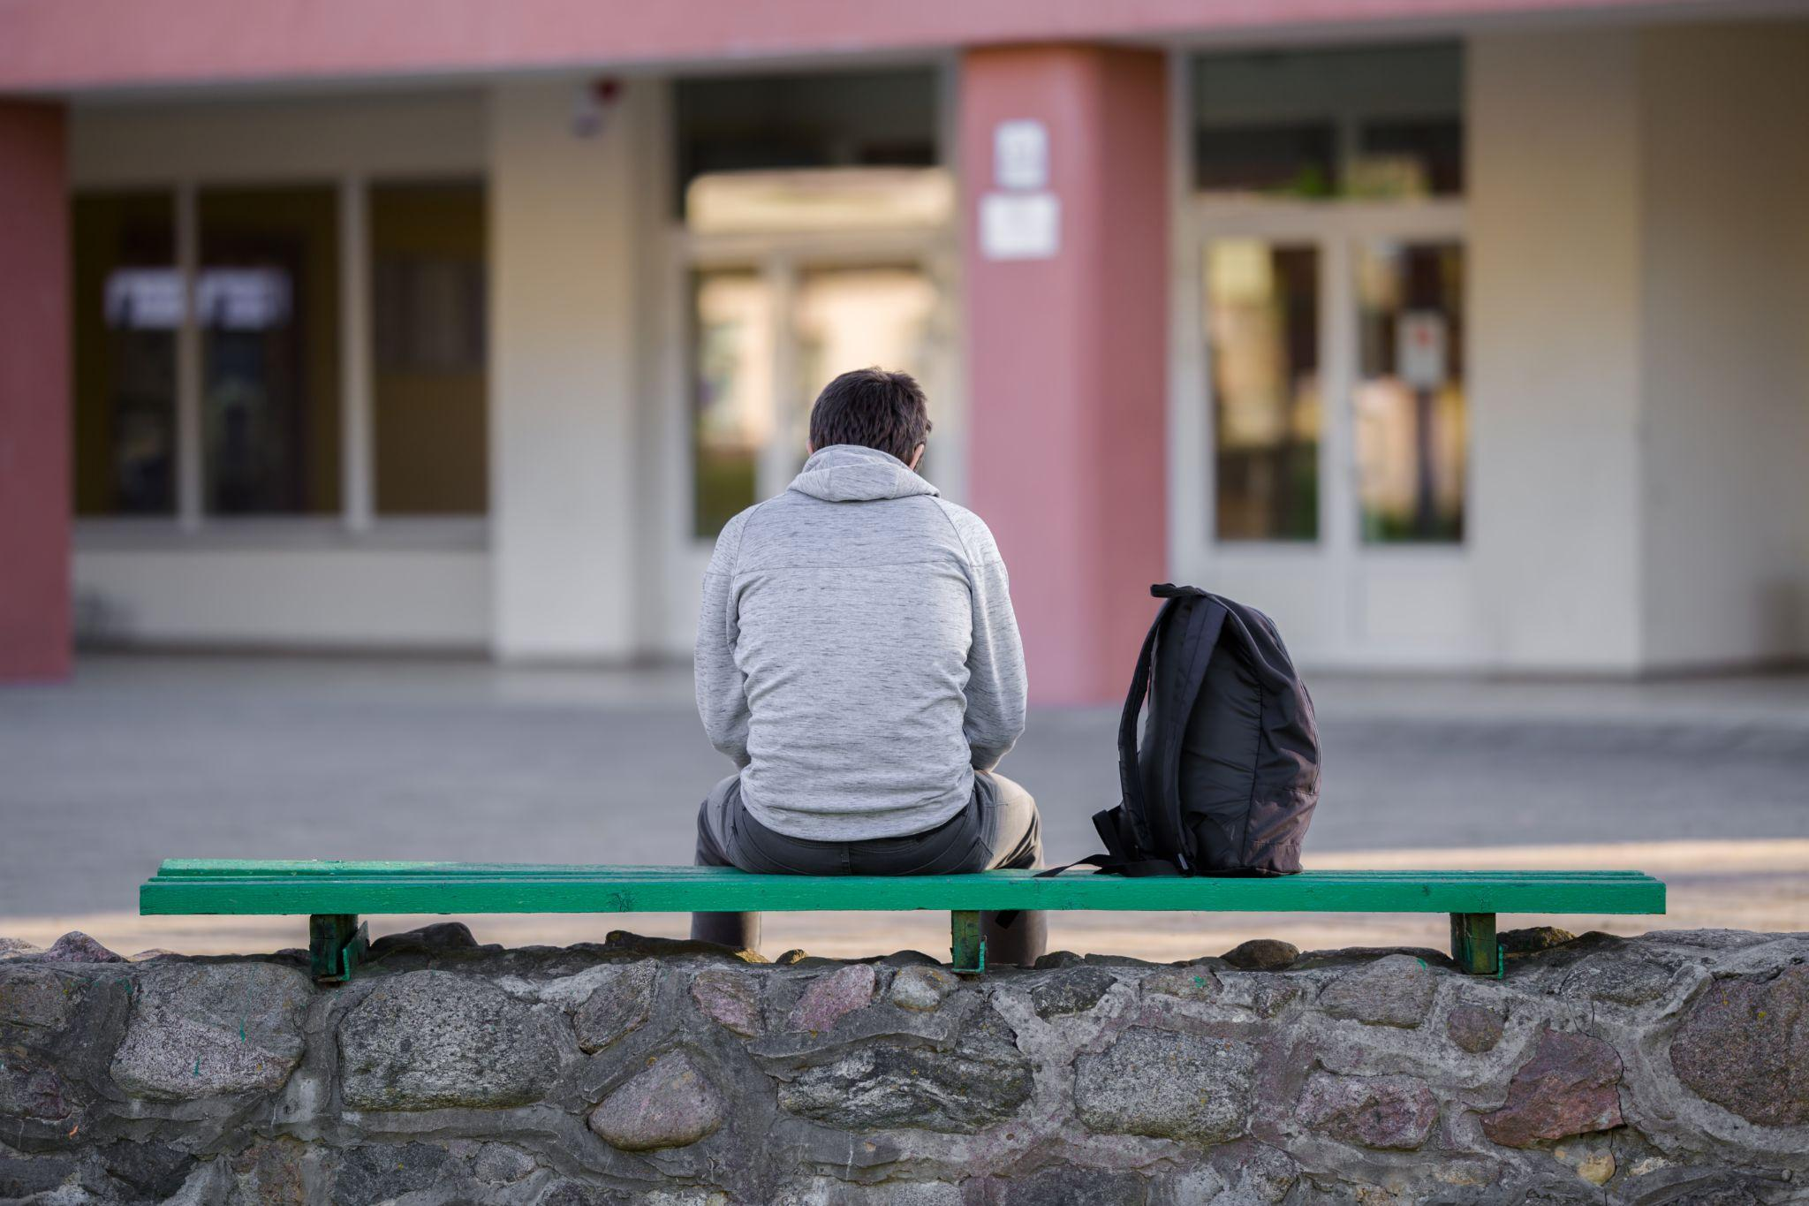
Students Without Parents or Guardians
School staff must notify social or human services if a pupil is “without” a parent or guardian
School and child welfare professionals are encouraged to determine how these referrals will be processed
Notes:
Under Wisconsin statutes in chapter 118, a public school must notify the county department of social or human services if the school becomes aware that a pupil is without a parent or guardian. Though this requirement is not included in chapter 48 where child maltreatment is described. This notification requirement does not apply to any pupil who has a legal custodian or is cared for by a kinship care relative, and it does not include when parents are incarcerated, or deported out of the country and still in communication with the student. School districts and local child welfare agencies are encouraged to meet proactively to determine how these types of referrals will be processed, for example, as a services report as opposed to a report of child maltreatment. More information on this requirement can be found in the Sharing Information Across Systems document in the Additional Resources Section.
Under the McKinney-Vento Act, “unaccompanied youth,” includes homeless children or youth not in the physical custody of a parent or guardian. Best practice guidance stresses the importance of handling the required identification of unaccompanied youth with sensitivity and respect, keeping the academic well-being and best interests of the student at the forefront. Additional advice on best practices in working with unaccompanied youth can be found on DPI’s website.
Stock photo ID:1227303349 (Please note that the images in these slide decks were purchased for use in this training by DPI. They may not be copied and reproduced for inclusion in other training or publications.)

Slide 73
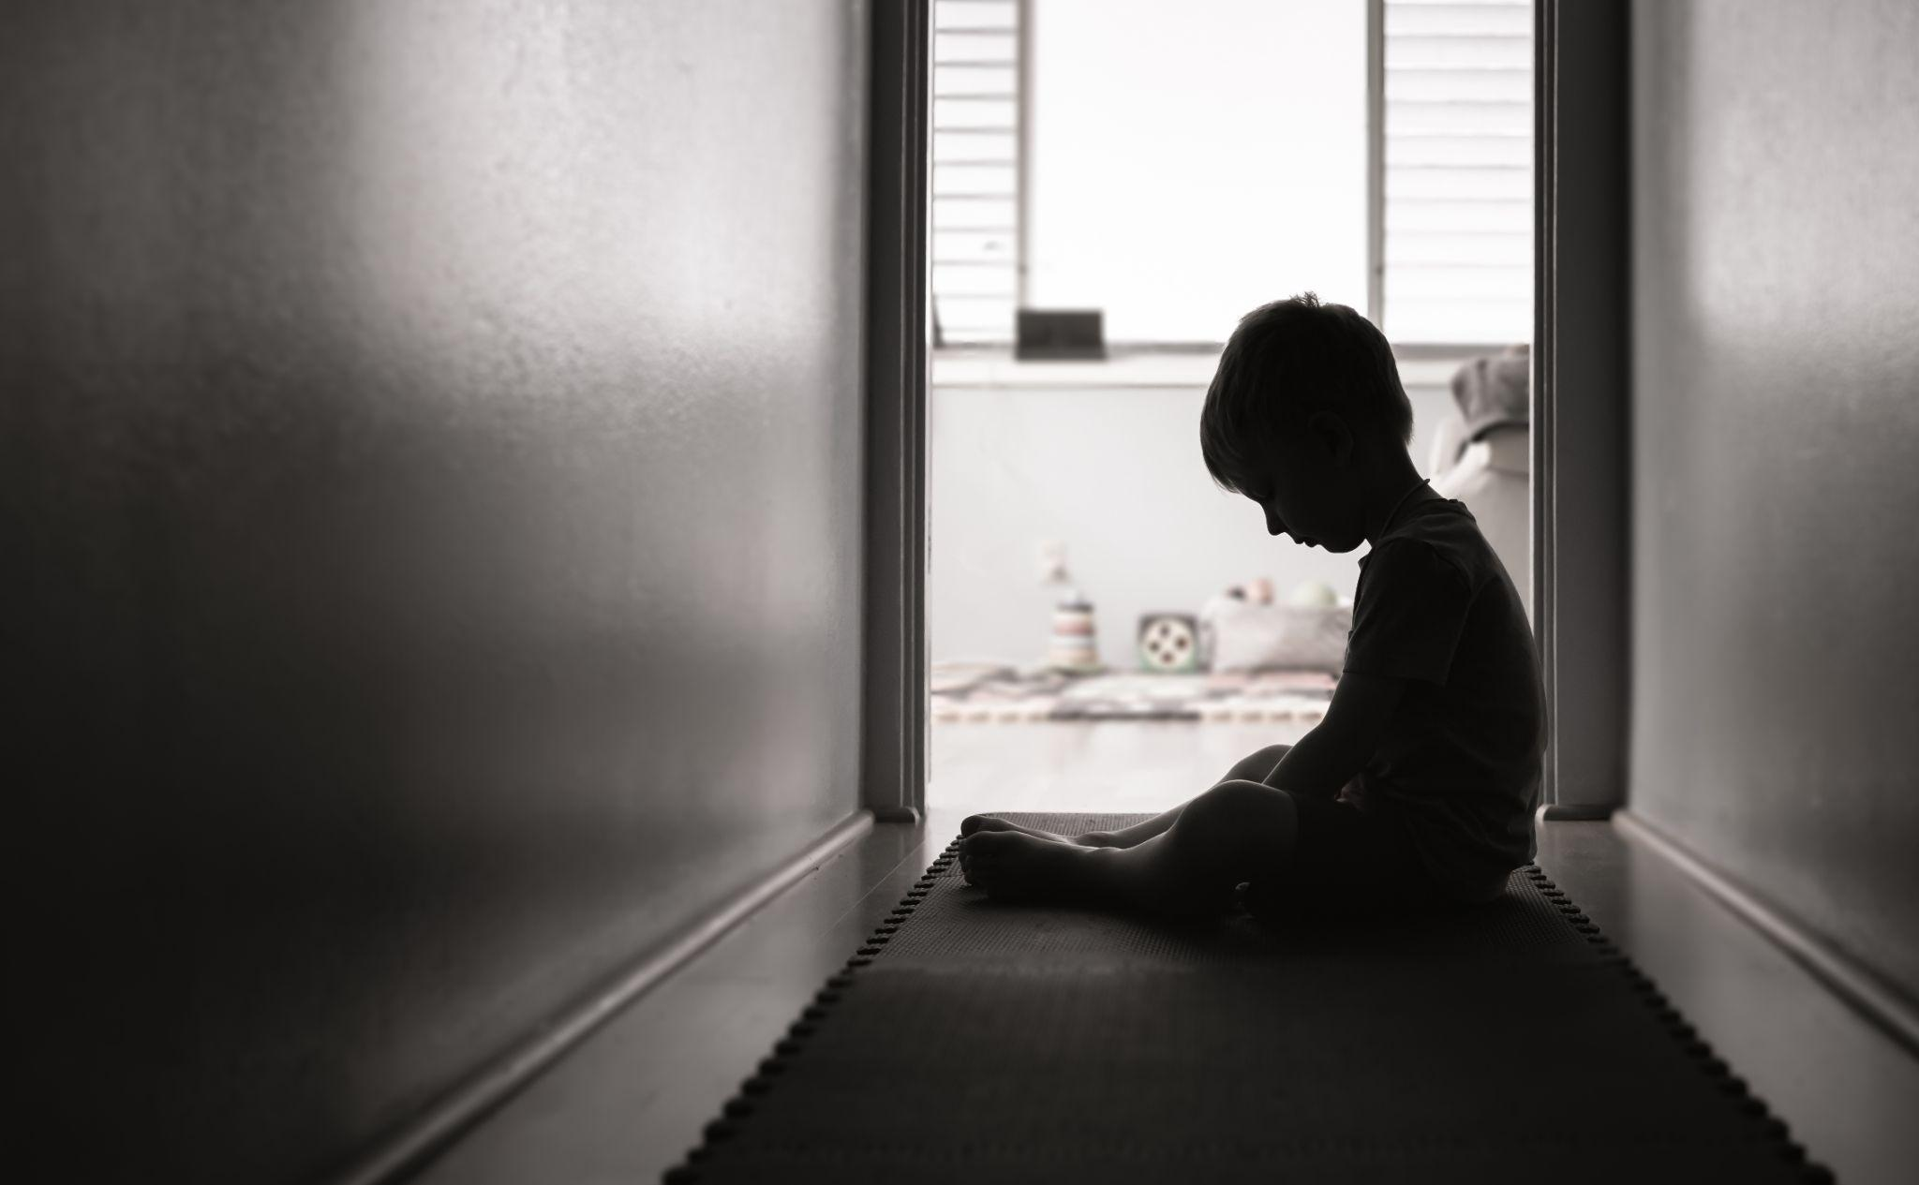
Situations involving Domestic Violence
Domestic violence is harmful, however it does not mean child maltreatment has occurred
Considerations:
Where the child was
their level of fear,
if there is a belief that they have or would intervene in an incident,
if any child was injured or thought that they might be injured
Notes:
Domestic violence is harmful and even when not directed at a child it can result in a wide range of serious consequences, including emotional, behavioral, physical, social, and academic problems (McTavish et al. 2016). Although research indicates that there is a strong correlation between domestic violence and child maltreatment, and even exposure or awareness of violence between caregivers could be recognized as a distinct form of child maltreatment (McTavish et al. 2016), that does not automatically mean child maltreatment is occurring or has occurred based on the statutory definition of maltreatment in Wisconsin.
When considering situations involving domestic violence, it is helpful to note where the child was during the incident, their level of fear, if there is a belief that they have or would intervene in an incident, and if any child was injured or thought that they might be injured as a result of the domestic violence.
Staff should approach conversations with harmed caregivers with empathy and support, and should consider how to make connections to confidential domestic violence support agencies. Creating partnerships with a local domestic violence program can allow staff resources to make referrals as determined appropriate. A list of state supported DV programs can be found in the additional resources section.
Stock photo ID:1277213578 (Please note that the images in these slide decks were purchased for use in this training by DPI. They may not be copied and reproduced for inclusion in other training or publications.)

Slide 74
Unsupervised Youth
There is no law in Wisconsin stating that a child must reach a certain age before they may be left home alone
Notes:
School staff may wonder if they should report situations where children are left unsupervised by caregivers. When examining situations involving unsupervised youth, it’s important to note that age is not always the determining factor when making a judgment about the situation being unsafe. When considering if a report of this nature is appropriate, it is important to include the child's reaction to being unsupervised and their developmental level. It may be appropriate to ask if they have a cell phone, if they know who and when to call for an emergency and if there are any adults that check in on them or know they are home alone, like a neighbor. There is no law in Wisconsin stating that a child must reach a certain age before they may be left home alone.
Additional information for parents about leaving children home alone are provided in the Additional Resources Section.
Stock photo ID:1188257799 (Please note that the images in these slide decks were purchased for use in this training by DPI. They may not be copied and reproduced for inclusion in other training or publications.)

Slide 75
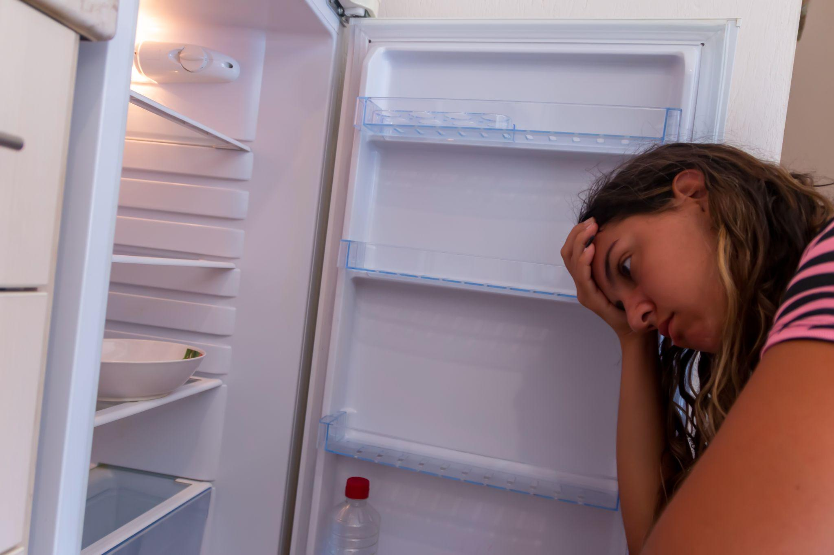
Caregiver Substance Use
Caregiver substance use alone in the home is not maltreatment
Consider the impacts on the children
Notes:
Caregiver substance use alone in the home is not maltreatment, we need to consider if a child’s basic needs are being met and if the child’s physical health is seriously endangered. Caregiver substance use has varying impacts on children. Safety considerations include how the parent’s ability to care for their child is affected, and how the child is impacted.
Some examples where safety concerns may exist include: no food being bought for the family, drug use impacting necessary supervision, parent’s nodding out or passing out while caring for young children, children having access to illicit substances or drug using items like needles where they could ingest them or harm themselves.
Stock photo ID:1417938932 (Please note that the images in these slide decks were purchased for use in this training by DPI. They may not be copied and reproduced for inclusion in other training or publications.)

Slide 76
Physical Discipline
Parental use of physical discipline in and of itself is not abuse
However, spanking is not effective and is harmful
Notes:
Parental use of physical discipline in and of itself is not abuse and is not something that needs to be reported when the legal definition of physical abuse has not been met. Reports should not be made on the sole basis of a disagreement between the mandated reporter and the parents about parenting style.
If spanking does not result in a physical injury that meets the statutory definition of physical abuse, it is not considered abuse. However, many studies have shown that physical punishment, including spanking, can lead to increased aggression, antisocial behavior, physical injury and mental health problems for children (Cuaras et al. 2021; Durant 2012). Studies show that while physical punishment might work in the short term, because children become afraid, it does not work in the long term to change behavior and can even lead kids to become more aggressive with more acting out behaviors (Durant 2012).

Slide 77
Definitions Wrap Up
It is important to be aware of the definitions of maltreatment
Staff should engage critical thinking in the process to determine if reasonable cause exists
Notes:
(Note to facilitator: Wrap Up slides at the end of a section may be omitted.)
It is important for all school staff to be familiar with the definitions of child maltreatment, so that they can recognize when a child may be in need of support, and to reduce unnecessary calls to CPS.
Definitions of terms, as well as additional guidance on reporting can be found in the DPI publication titled The School’s Role in Preventing Child Abuse and Neglect found in the Additional Resources.

Slide 78
Sexual Abuse Defined
Notes:
(Note to facilitator: Title slides may be omitted.)

Slide 79
Sexual Abuse Defined
Not all situations involving sexual contact or intercourse with minors is child abuse
Not every situation requires a report to CPS
Notes:
The definition of sexual abuse can feel complex and includes various factors. Let’s walk through this together.
Sexual abuse can occur between an adult and minor, and also between two minors.
Not all situations involving sexual contact or intercourse with or between minors fall into the definition of child abuse, and therefore not every situation requires a report to CPS.
It is important to slow down and consider the situation and the appropriate response.
Stock illustration ID:1164860554 (Please note that the images in these slide decks were purchased for use in this training by DPI. They may not be copied and reproduced for inclusion in other training or publications.)

Slide 80
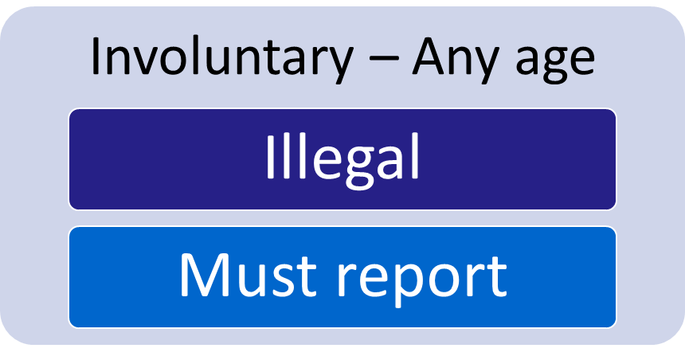
Involuntary Sexual Contact or Intercourse
With a foster parent, worker or volunteer in a group home, RCC, or shelter is abuse
Report if with a caregiver, including school staff, coach, or relative
Notes:
If there is reason to believe that the minor’s participation in the sexual contact was involuntary or not wanted, a report is required. This includes sexual assault by peers or adults.
Sexual abuse also includes sexual contact or intercourse between a child and their foster parent, or a worker or volunteer at a group home, Residential Care Center (RCC), or shelter where they are placed.
In any situation where a minor is participating in sexual contact with a caregiver, for example, a stepparent, a babysitter, a relative, a coach, or employee in a community organization in which the minor participates, there should be reason to doubt whether the minor’s participation in the sexual contact is voluntary because of the power dynamics of such relationships. In any such situation, a mandated reporter should have reasonable cause to suspect the contact is involuntary and should report, regardless of the age of the minor.
Stock photo ID:516822410 (Please note that the images in these slide decks were purchased for use in this training by DPI. They may not be copied and reproduced for inclusion in other training or publications.)

Slide 81
Which Agency to Call When?
Some considerations include
the urgency and immediate need for assistance
which agency has the capacity to respond quicker when needed
whether or not a caregiver was involved
how effectively the local agencies collaborate and when it would be more helpful to report to both agencies
Notes:
It is helpful for schools, law enforcement and child welfare agencies to have staff meet proactively to determine how local reporting of sexual abuse should be handled, and which agency should be called in which situations. Some considerations include
the urgency and immediate need for assistance
which agency has the capacity to respond quicker when needed
whether or not a caregiver was involved
how effectively the local agencies collaborate and when it would be more helpful to report to both agencies

Slide 82
Title IX and Pupil Non-Discrimination
School must respond to allegations of sexual harassment in addition to any criminal investigation
Avoid further harm
Provide survivors with agency, information, and support
Notes:
Sexual violence is a type of sexual harassment and depending on the circumstances of the involuntary sexual contact, a school district may need to consider implications for requirements under Wisconsin’s Pupil Non-Discrimination Law and Title IX of the Education Amendments of 1972. School staff must respond to allegations of sexual harassment consistent with Title IX’s prohibition against sex discrimination in addition to any criminal investigation.
It is important to respond in a trauma sensitive culturally responsive manner to individuals involved in sexual assault situations and take action to prevent further harm. One action that can be helpful is to inform the survivor in a confidential interview that the report is being made and is required by law, and what to expect concerning the investigation procedures.
Additionally, as we discussed earlier in this training, school staff can help inform students and families of the right to a “victim advocate” in cases of sexual assault, human trafficking, or child sexual abuse. They could provide counseling, assistance, or support services free of charge to a survivor.

Slide 83
Trauma Sensitive Response
Safety
Trustworthiness
Cultural Responsiveness
Empowerment
Collaboration
Choice
Notes:
It is important to respond in a trauma sensitive manner to individuals involved in sexual assault situations and take action to prevent further harm. One action that can be helpful is to inform the survivor in a confidential interview that the report is being made and is required by law, and what to expect concerning the investigation procedures.
Additionally, as we discussed earlier in this training, school staff can help inform students and families of the right to a “victim advocate” in cases of sexual assault, human trafficking, or child sexual abuse. They could provide counseling, assistance, or support services free of charge to a survivor.

Slide 84
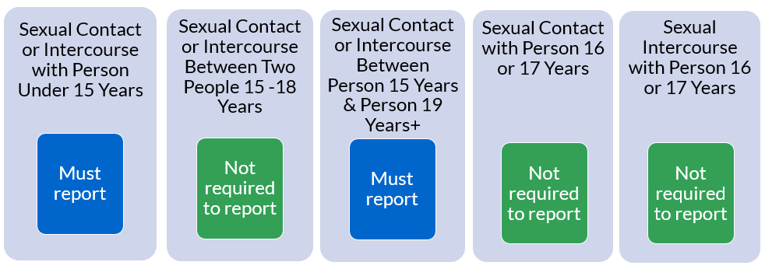
Voluntary Sexual Contact or Intercourse
Disclose to school leaders if it is with school staff including coaches, also with school volunteers over age 20, and report suspected child abuse to CPS or law enforcement. Also, report if it is with a foster parent, or a worker or volunteer at a group home, RCC, or shelter where they are placed.
Wis. Stat. §§ 48.02[1][b], 940.02[2], 940.225 & 948.093
Notes:
The suggested procedures for school staff who become aware that a person under the age of 18 has had voluntary sexual contact or intercourse with another person differ depending upon the minor’s age.
Let’s first consider children who are under 15 years old. School staff who have reasonable cause to believe a child under 15 years old has had sexual contact or intercourse with another person must report this behavior, even in situations where the child claims the sexual contact or intercourse was voluntary
Next let’s consider sexual contact or intercourse with a person who is 15 years old. Sexual intercourse or contact between two people 15 to 18 years old is not considered sexual abuse if it is voluntary. So, there is no requirement for a report to CPS or law enforcement in this case, even though this behavior is illegal. However, sexual contact or intercourse between a 15-year-old and a person who is 19 years old or older is sexual abuse and school staff who have reasonable cause to believe that this has occurred must report this, even in situations where the student claims the sexual contact or intercourse was voluntary.
Now let’s consider 16 and 17 year old students. It is not considered child sexual abuse for an individual to have consensual sexual contact or intercourse with a person 16 or 17 years old However, keep in mind that there are specific penalties for school staff members, coaches, and school volunteers who have sexual contact or intercourse with students. Individuals with reasonable cause to suspect this behavior should contact the school administration immediately and must report suspected child abuse to the local child welfare agency or local law enforcement (Wis. Stat. § 948.095).

Slide 85
Voluntary Sexual Contact or Intercourse
Wis. Stat. §§ 48.02[1][b], 940.02[2], 940.225 & 948.093
Notes:
That’s a lot of complex information to take in, so let’s pause here for a moment. Let’s imagine that a student tells you that they had sexual intercourse with another person. They tell you not to worry, because it was consensual. This student is 15 years old and they tell you their partner was 17. Do you need to make a report? First, you want to ask a few open ended questions to determine the voluntary nature of the situation.
Did they feel safe and do they feel safe now? Did they feel pressure to have sex? How would their partner react if they said no? Was the student drinking or using drugs that may have influenced their behavior? Do they have an intellectual disability or other factors that may have influenced their perception? Was there an exchange for something of value? Is there any other reason to doubt the voluntariness of their participation?
(Note to facilitator: click to show circle) If you do not have concerns, you may not need to make a report. A 15 year old having sexual intercourse with a 17 year old is not sexual abuse if it is consensual.
(click to show arrow) However, after further discussion, let’s say the student admits that their partner was actually 19 years old. With everything else in this scenario being the same, you now likely need to make a report, because sexual intercourse between a 15 year old and a 19 year old does fall into the definition of sexual abuse even if it is consensual.

Slide 86
Voluntary Sexual Contact or Intercourse
Disclose to school leaders if it is with school staff including coaches, also with school volunteers over age 20, and report suspected child abuse to CPS or law enforcement.
Wis. Stat. §§ 48.02[1][b], 940.02[2], 940.225 & 948.093
Notes:
How about another example? Let’s imagine that you learn that a 17 year old had voluntary sexual intercourse with a 21 year old. You ask open-ended questions similar to the last scenario to better understand the voluntariness of the situation.
(Note to facilitator: click to show circle)Though there is an age difference, you determine that you have no concerns about the voluntary nature of the conduct and that a report is therefore not required. You offer to connect the student with the school nurse who could talk with the student about healthy relationships and health care. You discuss with the student how and when to talk with their caregiver about their relationship, or you refer them to the school social worker who is comfortable having this conversation.
(Note to facilitator: click to show red box) Later the student mentions that the 21 year old partner is an assistant coach on the school softball team. You now likely need to make a report and contact the school administration immediately, because there are specific penalties for school staff like coaches and you should have reason to doubt whether the minor’s participation in the sexual contact is voluntary because of the power dynamics of such relationships. In both of these examples, you also should consider helping the youth understand the process that will occur after you disclose the situation to others, and ensuring they have support in managing the impacts.

Slide 87
Health Care Services Exception
To allow children to obtain confidential health care services
Health care provider is not required to report if they are or have provided health care services
Also allows for “a person” not to report if they obtain info that a child is receiving, or has received, health care services
Wis. Stat. § 48.981(2m)
Notes:
There are some exceptions to required reporting worth discussing. A health care provider (such as a school nurse) is not generally required to report sexual contact or intercourse of a child if they are providing, or have provided, health care services to the child. The stated purpose of this exception in state statute “is to allow children to obtain confidential health care services.” But note that there are some circumstances when a report is still required, as we will discuss in a moment.
An additional exception exists under this section, again, for the purpose of allowing children to obtain confidential health care services. A person may not be required to report sexual contact or intercourse involving a child if they obtain information about a child who is receiving or has received health care services from a health care provider, Wis. Stat. § 48.981(2m)(c)4. For example, a student might tell a teacher that they have seen a health care provider in order to obtain birth control Consequently, in order to maintain a minor’s right to confidential health care services, the teacher may not be required to report this type of situation, Wis. Stat. § 48.981(2m)(c)4.
However, there are some circumstances when school nurses and others are still required to report, such as when there is any doubt as to whether the sexual contact or intercourse was voluntary or if the contact or intercourse was with a caregiver. Please review the document Reporting Requirements for Situations Involving Sexual Contact or Intercourse and Students in the additional resources section for more details.
Stock photo ID:1350430734 (Please note that the images in these slide decks were purchased for use in this training by DPI. They may not be copied and reproduced for inclusion in other training or publications.)

Slide 88
More on the Definition of Sexual Abuse
Not all sexual abuse involves physical contact.
Intentionally
causing a child to view or listen to sexual activity,
exposing oneself to a child,
or cause a child to expose themselves
for the purpose of gratifying oneself or sexually humiliating the child
Notes:
Note that not all sexual abuse involves physical contact. Intentionally causing a child to view or listen to sexual activity for the purpose of gratifying oneself or sexually humiliating the child, or intentionally exposing oneself to a child or causing the child to expose themselves for the purpose of gratifying oneself or sexually humiliating the child are included in the definition of sexual abuse. Definitions of terms like sexual contact and intercourse, as well as additional guidance on reporting can be found in the DPI publication titled The School’s Role in Preventing Child Abuse and Neglect found in the Additional Resources.
Stock photo ID:1177793458 (Please note that the images in these slide decks were purchased for use in this training by DPI. They may not be copied and reproduced for inclusion in other training or publications.)

Slide 89
Child Sex Trafficking
Notes:
(Note to facilitator: Title slides may be omitted.)

Slide 90
Trafficking of a Child
Trafficking of a Child - Wis. Stat. §§ 948.051(1) & (2)
(Child abuse definition includes a violation of 948.051, Wis. Stat. § 48.02(1)(cm))
(1) Whoever knowingly recruits, entices, provides, obtains, harbors, transports, patronizes, or solicits or knowingly attempts to recruit, entice, provide, obtain, harbor, transport, patronize, or solicit any child for the purpose of commercial sex acts, as defined in s. 940.302 (1) (a), is guilty of a Class C felony.
(2) Whoever benefits in any manner from a violation of sub. (1) is guilty of a Class C felony if the person knows that the benefits come from an act described in sub. (1)
Notes:
Child Sex Trafficking falls under the definition of child abuse and must be reported, even if the perpetrator is unrelated to the child. It is important to note that trafficking includes not only engaging minors in sex acts in exchange for something of value, but also recruiting, attempting, and benefitting from these acts.
In fact, the definition covers anyone who knowingly recruits, entices, provides, obtains, harbors, transports, patronizes, or solicits any child for the purpose of commercial sex acts who attempts to do those actions, or benefits in any manner from those actions. (The child sexual abuse definition includes a violation of 948.051, Wis. Stat. § 48.02(1)(cm)).

Slide 91
In Exchange for Something of Value
No requirement that a youth was forced or made to do it
Even when a youth agrees to the act, it is still trafficking
A youth might themselves exchange a sexual act for something of value, it is still trafficking
Notes:
There is no requirement that a youth was forced or made to do it. In fact, even when a youth voluntarily agrees to the activity, it is still trafficking if the sexual activity is being done in exchange for something of value.
Common items that are exchanged for sexual activity include money, drugs, hair or nail appointments, housing, food, jewelry, clothing, and transportation.
It is trafficking even if there is no third-party trafficker. This means that a youth might themselves exchange a sexual act for something of value and it is considered trafficking. For example, a youth who is homeless might agree to have sex with someone in order to sleep on their couch for the night. In this case, the person who allows the youth to stay on their couch in exchange for sex is guilty of trafficking.

Slide 92
Trafficking in Wisconsin
Trafficking occurs in cities, suburbs, and rural areas
Trafficking can happen to people of all sexes, genders, races, and economic backgrounds
Due to lies and deception, many youth in these situations do not consider themselves victims
Notes:
Child sex trafficking occurs in cities, suburbs, and rural areas. It is a statewide issue and is more common than many people realize. Trafficking can happen to people of all sexes, genders, races, and economic backgrounds; though some individuals are placed at higher risk. For example, economic needs and pressure can make a person more vulnerable to being trafficked.
Human traffickers often recruit vulnerable youth with lies and deception. They are effective at manipulating youth and often trick youth into thinking the trafficker loves them. They may exploit youth through fraud, power, violence, or even physical abduction.
You should know that many youth who are being trafficked do not consider themselves to be victims. They may not even realize they are being trafficked, because they may believe they are in love with the trafficker, or that since they have agreed to the activity voluntarily that the trafficker has not committed an illegal act.
Stock illustration ID:1404163417 (Please note that the images in these slide decks were purchased for use in this training by DPI. They may not be copied and reproduced for inclusion in other training or publications.)

Slide 93
Staff Should Offer Support
Notice the warning signs
Develop rapport, provide empathy
Allow student to share without passing judgement
Remind them this is something that happened to them and does not define them
Provide examples of how others have gotten out
Connect to advocate
Notes:
Staff should offer support. Minors who exchange sexual activity for something of value deserve our care. Life circumstances have put them in a difficult position, which we cannot fully understand unless we have been through it.
Staff can work to form a positive rapport with students and provide a space where students feel comfortable. School staff should allow a student to share what they choose without passing judgment about them or pressing them for information.
It is most important to remind a student it is something that happened to them, it does not define them, and it is not their fault. They also need to know that many people have gotten out of these situations and they can too.
Additionally, staff are encouraged to refer students to an advocate who provides assistance to survivors of trafficking.
Stock photo ID:498130943 (Please note that the images in these slide decks were purchased for use in this training by DPI. They may not be copied and reproduced for inclusion in other training or publications.)

Slide 94
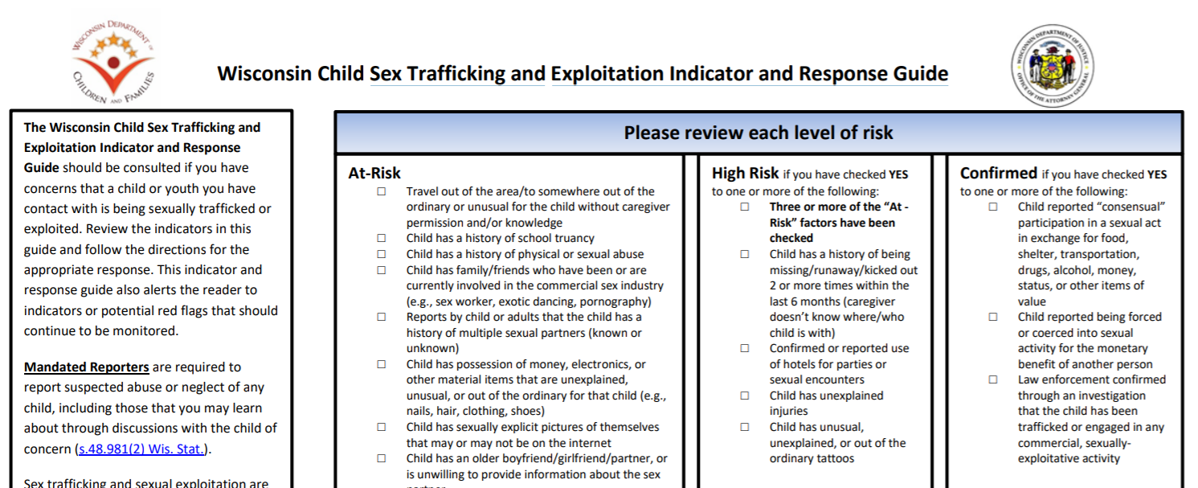
Wisconsin Child Sex Trafficking and Exploitation Indicator and Response Guide
Notes:
A tool exists to support school staff in determining when a report may be appropriate called the Wisconsin Child Sex Trafficking and Exploitation Indicator and Response Guide. (This is found in the additional resource section.) On the tool are listed some examples of at-risk indicators for child sexual trafficking and exploitation. Any single at-risk indicator does not necessarily mean that a student is involved in sex trafficking. When looking at a whole picture of a student’s situation along with the risk indicators, your concern may be heightened. Refer to the guide for further help with recognizing warning signs and knowing when to call CPS or law enforcement.

Slide 95
At-Risk Indicators
Unexplained truancy
History of physical or sexual abuse
Reports by child that they have multiple sexual partners
Travel out of the area that is unusual without caregiver permission or knowledge
Possession of money, electronics, or other material items that are unexplained or unusual for the child
Having older boy/girlfriend or partner
Gang affiliation
Notes:
Some at-risk indicators include:
Unexplained truancy
History of physical or sexual abuse
Reports by child that they have multiple sexual partners
Travel out of the area that is unusual without caregiver permission or knowledge
Possession of money, electronics, or other material items that are unexplained or unusual for the child
Having older boy/girlfriend or partner
Gang affiliation

Slide 96
High Risk Indicators
Three or more at-risk factors (per the Guide)
History of being missing/runaway/kicked out 1 or more times within the last 6 months (especially if caregiver is unsure of whereabouts)
Confirmed or reported use of hotels for parties or sexual encounters
Unexplained injuries
Unusual, unexplained, or out of the ordinary tattoos
Notes:
Some High Risk Indicators include:
Three or more at-risk factors (per the Guide)
History of being missing/runaway/kicked out 1 or more times within the last 6 months (especially if caregiver is unsure of whereabouts)
Confirmed or reported use of hotels for parties or sexual encounters
Unexplained injuries
Unusual, unexplained, or out of the ordinary tattoos
School staff should not actually pull out this guide in front of a student and use it as a checklist. This guide is meant to be referred to before and after conversations where signs of trafficking exist.
Reviewing this guide is a requirement of completing this training.

Slide 97
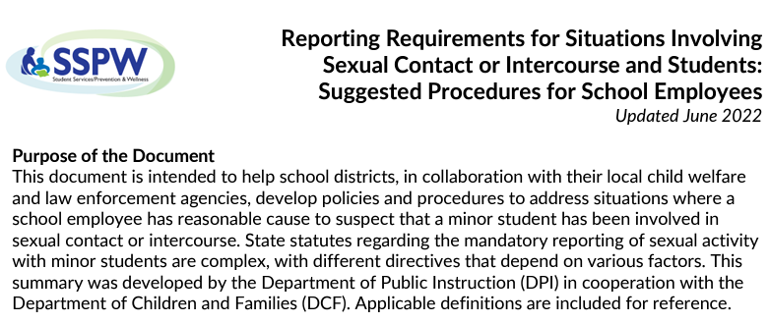
Wrap Up
Notes:
(Note to facilitator: Wrap Up slides at the end of a section may be omitted.)
To wrap up, the definition of sexual abuse can feel complex and includes various factors.
It is important for all staff to increase their awareness of human trafficking. More learning on this topic is found in the Additional Resources Section.

Slide 98
Information Gathering
Notes:
This section describes gathering information and tips relating to talking with students and gathering information.

Slide 99
Clarifying Information
Notes:
When a concern arises, school staff must gather enough information to determine if they have reasonable cause to suspect child maltreatment without asking for unnecessary details or conducting a formal investigation. When a concern arises, school staff must clarify information to determine if they have reasonable cause to suspect child maltreatment without asking for unnecessary details or conducting a formal investigation. This is called a minimal facts interview. Information gathering must proceed immediately and expeditiously, and if and when a school staff member has reasonable cause to suspect child maltreatment they must “immediately” report.
Stock photo ID:1481631850 (Please note that the images in these slide decks were purchased for use in this training by DPI. They may not be copied and reproduced for inclusion in other training or publications.)

Slide 100
What Information is Needed?
Who is/was involved?
What happened?
When?
Where?
Notes:
School staff should clarify only the information necessary to make a report such as
Who? Who is the alleged maltreater? Do they live in the home or have ongoing access to the child?
What happened? What illegal child maltreatment occurred, or what do you believe will occur? Was it one time or more than one time? Were there any visible injuries?
When? When was the last time this occurred? Is there impending danger?
and Where? In which city or town did this occur? In which city or town does the child primarily reside?

Slide 101
Empathetic Listening
Listen openly and calmly
Do not rush or interrupt
Allow student to use terms they are comfortable with and seek clarification
Use age appropriate language
Avoid negative comments about the alleged maltreater
Notes:
When speaking with a student to gather more information, we will walk through some important guidelines
Allow the student to tell you what they want to share, and listen openly and calmly.
Maintain body language and facial expressions that show you are calm and avoid displaying strong reactions or judgements about what they are telling you.
Do not rush or interrupt the student, unless there is a compelling reason to pause the disclosure. For example, a student may begin to share personal information in front of a class.
Allow the student to use terms and language they are comfortable with, and if the child uses a term that you are not familiar with, ask for clarification. For example, what exactly does the child mean when they say that they were hit, punished, or attacked?
Use age-appropriate language that considers the student’s development and ability to understand.
Avoid making negative comments about the alleged maltreater, such as “they are a really bad person” which could contribute to discomfort and confusion. It is common for youth to have complex feelings towards the alleged maltreater.
Stock photo ID:1463773532 (Please note that the images in these slide decks were purchased for use in this training by DPI. They may not be copied and reproduced for inclusion in other training or publications.)

Slide 102
Disclosure is a Process
Do not attempt to force a disclosure
Be mindful of verbal and non-verbal responses
Focus on providing a safe, welcoming environment
Notes:
Disclosure is a process.
In general, keep in mind that disclosure is a process and does not always happen all at once. Do not attempt to force a disclosure.
Instead, you should focus on providing a safe, welcoming environment for the student, and engage in consistent and supportive rapport. This can promote a students’ feeling that they can come to you when they are ready to talk.
Stock photo ID:1222788544 (Please note that the images in these slide decks were purchased for use in this training by DPI. They may not be copied and reproduced for inclusion in other training or publications.)

Slide 103
Open Ended Questions
What happened to you...tell me more about that…
Where were you when that happened?
When did it happen?
Who else saw it happen?
Who else knows about this?
Has this happened before?
What are you most worried about now?
What happened next?
What else?
Notes:
It is necessary to ask open-ended questions to determine the basic information about what happened.
Ask open-ended questions that show neutrality and not assumptions. It can help a student to feel more at ease when disclosing sensitive information if you provide a space where answers are accepted as truth.
Some examples of open-ended questions are:
What happened to you...tell me more about that…
Where were you when that happened?
When did it happen?
Who else saw it happen?
Who else knows about this?
Has this happened before?
What are you most worried about now?
What happened next?
What else do you want to tell me?
What else should I know?

Slide 104
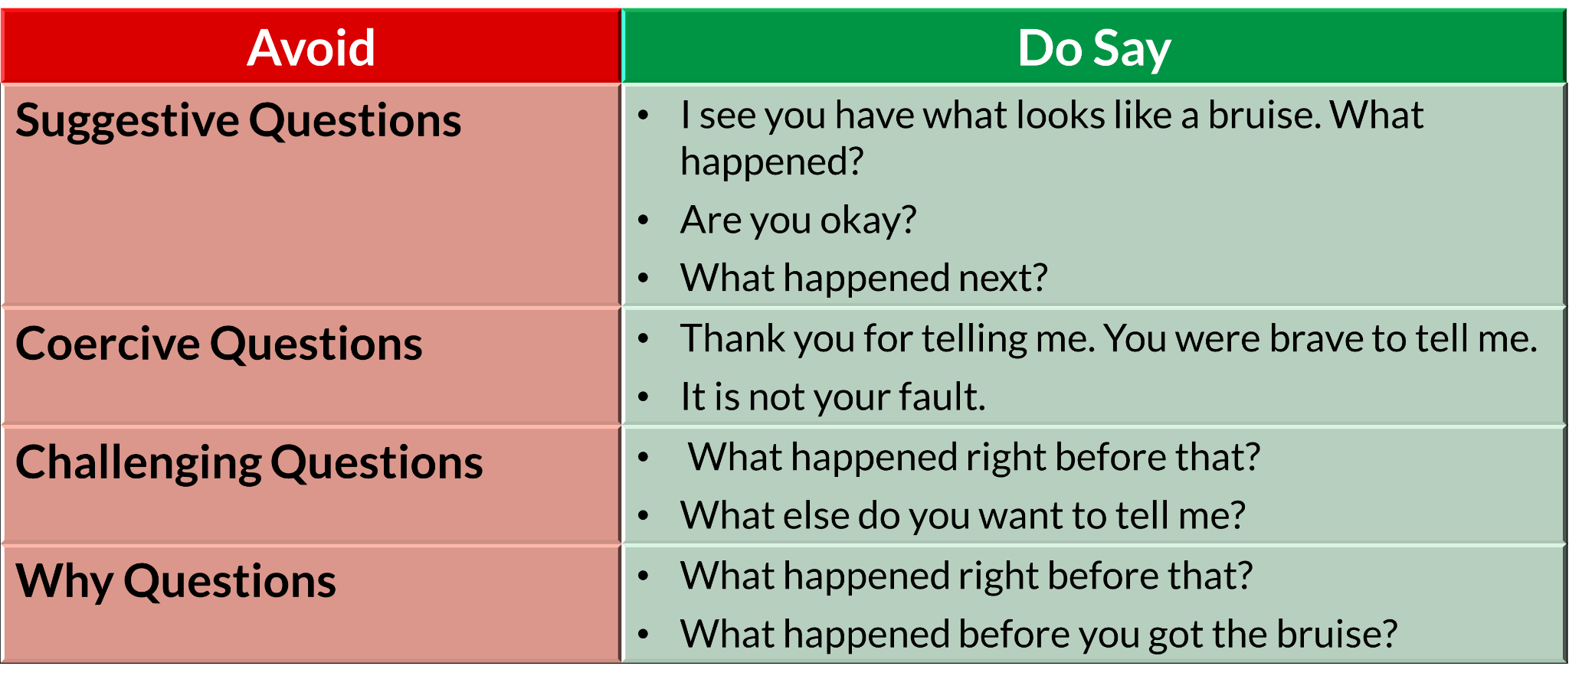
Questions to Avoid
Notes:
There are some types of questions that should be avoided. These include:
“Why” questions imply blame.
Avoid asking such questions as, “Why did they hit you? What did you do?”
Instead ask, “What happened right before that?”, “What happened before you got the bruise?”
Suggestive questions may confuse the child or cause inaccurate statements.
Avoid asking such questions as, “Did you get bruised because he hit you?”, and “Are you trying to tell me that your parent hit you?”
Instead ask, “I see you have what looks like a bruise. Are you okay? What happened?”, and “What happened next?”
Coercive questions could cause a child to feel shame or guilt if another child has been hurt. This could also cause fear or anxiety.
Avoid asking such questions as, “If you don’t tell me who touched you, they could hurt someone else. You don’t want that to happen, do you?”
Instead say, “Thank you for telling me. You were brave to tell me. It is not your fault.”
Challenging Questions may confuse the child, cause fear, or cause inaccurate statements.
Avoid asking such questions as, “Earlier today you told your teacher (blank) happened, was that not true?”, “Your mom is so nice, she wouldn’t do that. Are you telling the truth?”
Instead say, “What happened right before that?”, and “What happened then?”

Slide 105
Provide Reassurance
Thank you for telling me.
You were brave to tell me.
It is not your fault.
I’m glad you told me.
I will need to tell some other people who help to protect children.
I’m going to continue to be here for you.
Notes:
Acknowledge that it is brave to share this information.
It takes a great deal of personal courage to tell someone about being hurt by someone else.
Some examples of phrases that can be helpful for students to hear include:
Thank you for telling me.
You were brave to tell me.
It is not your fault.
I’m glad you told me.
I will need to tell some other people who help to protect children.
I’m going to continue to be here for you.
Once you have established that there is or is not reasonable cause to suspect maltreatment and you have the basic facts of what happened and who was involved, stop asking questions.
Photo - Stock photo ID:1340516750 (Please note that the images in these slide decks were purchased for use in this training by DPI. They may not be copied and reproduced for inclusion in other training or publications.)

Slide 106
Avoid Multiple Questioning Sessions
Do not have multiple school staff ask the student the same questions
Do not ask a student to repeat their story
Do not seek out siblings to interview them
Notes:
Once you have established that there is or is not reasonable cause to suspect maltreatment and you have the basic facts of what happened and who was involved, stop asking questions. Our systems can work together to reduce the number of times a child must tell their story and this starts with school staff.
It is okay to offer comfort to the student, or to have the student seek comfort from their trusted staff member, but it's important to not have multiple staff members ask the same questions.
Do not question siblings.
Additionally, it is not helpful to seek out siblings of the student who has disclosed potential abuse to interview them about their own experiences. Child welfare professionals will determine if and when this may be necessary.
Stock photo ID:170166970 (Please note that the images in these slide decks were purchased for use in this training by DPI. They may not be copied and reproduced for inclusion in other training or publications.)

Slide 107
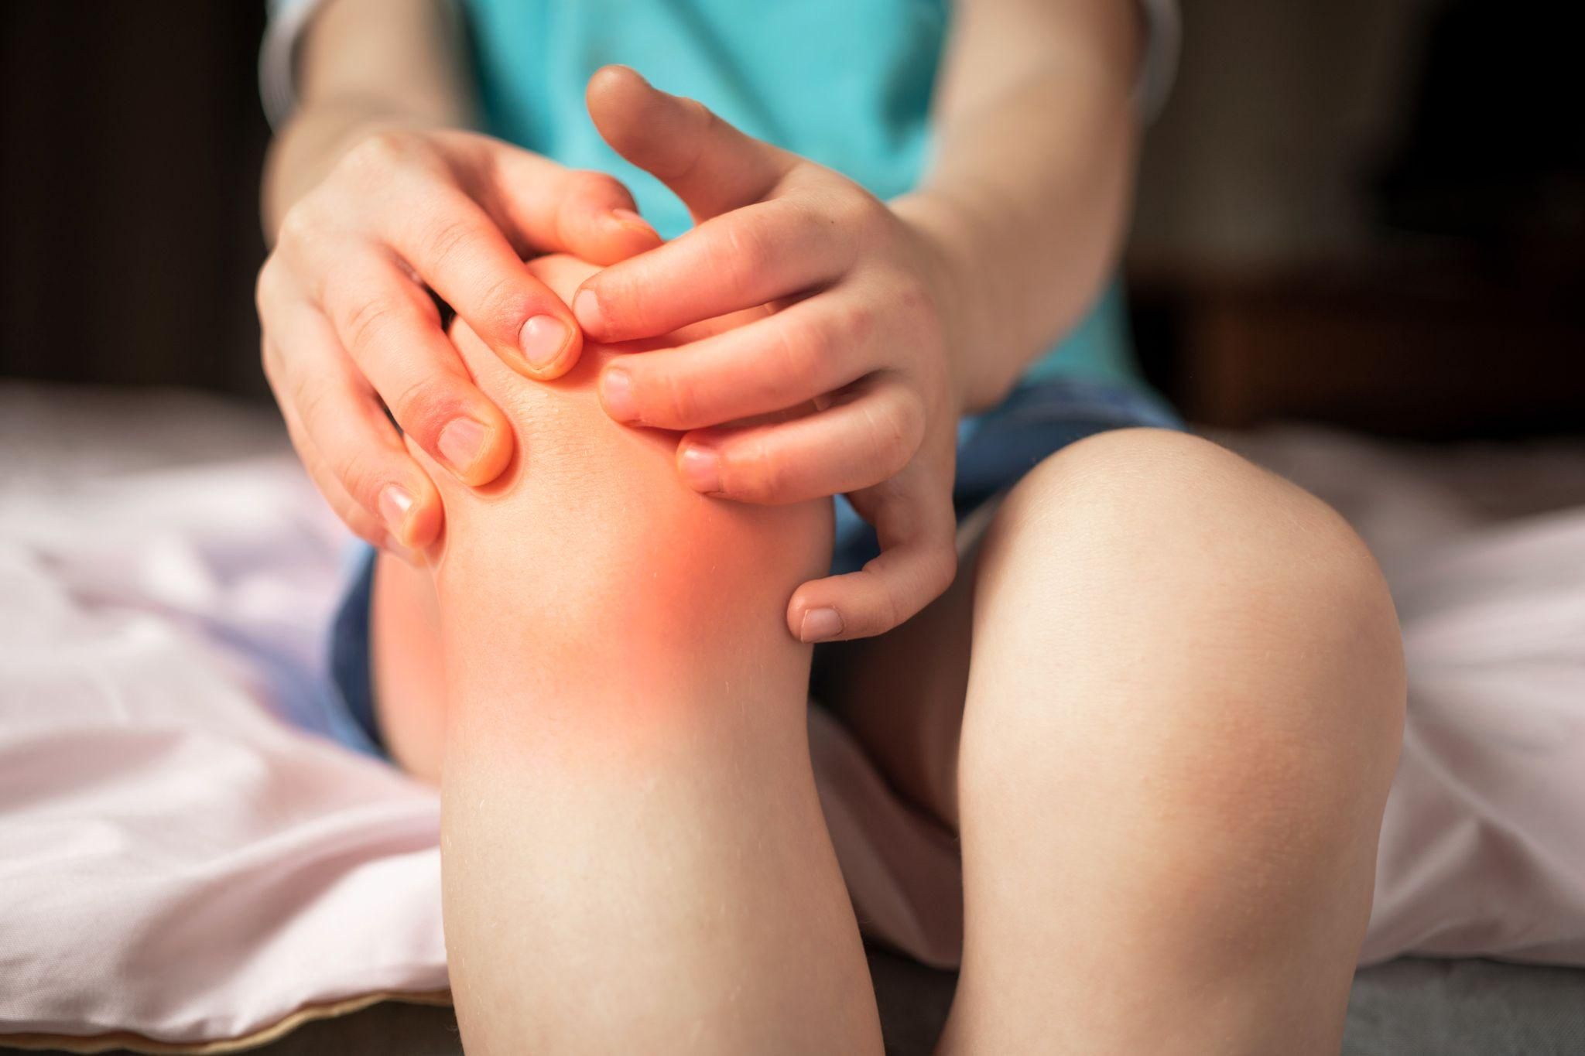
Limit Visual Observation
School staff should exercise caution
Limit visual observation
Notes:
Now that we have discussed how to engage in minimal facts interviewing with students, we will go over some other considerations involved in gathering information. Let’s start by considering visual observations of injuries.
School staff should exercise caution when viewing injuries and generally limit the visual observation of a student to portions of the body that are commonly exposed such as head, arms, or lower legs. A school nurse, in the course of treating a student for an injury or illness, may ask a student to open or take off articles of clothing and, as a result, may observe signs of physical abuse.
Stock photo ID:1254522648 (Please note that the images in these slide decks were purchased for use in this training by DPI. They may not be copied and reproduced for inclusion in other training or publications.)

Slide 108
Disclosure in the Classroom
Student discloses abuse in a classroom discussion
Acknowledge the disclosure, and act to refocus the conversation
Talk with the student privately immediately after class
Student discloses abuse or neglect in a writing assignment
Talk with the student immediately about the possible disclosure
Engage in minimal facts interviewing to gather enough information to establish reasonable cause or not
Notes:
Students may disclose abuse publically in a class discussion or in a writing assignment. Educators can provide safety for students by responding appropriately.
During classroom discussion
It is appropriate to acknowledge the disclosure, and to refocus the conversation and find a way to talk with the student privately immediately after class. Discuss with the class general concerns about the harmful effects of gossiping and about keeping information shared in class private.
In a writing assignment
Talk with the student immediately about the possible disclosure. It is okay for a teacher to ask for support from a pupil services member or other trained staff, in having the follow up conversation about the writing assignment. The purpose of this follow up with the student would be to determine if reasonable cause to suspect maltreatment and safety concerns exist, so long as this does not delay the information gathering. Open-ended questions should include determining if the student verifies that the writing is about a non-fictional situation that involves child maltreatment.

Slide 109
Document Observations After Discussion
Be specific
Use exact phrases
Focus on facts
Shred detailed documentation after making a report
Notes:
Be specific when documenting what the student said occurred or did not occur. Use the student’s exact words or phrases in your notes.
Focus on the facts, and include in your report observations and objective information
To avoid accidental disclosure of this information, shred this documentation after making a report.
Some schools may have a policy of maintaining records of reports. If this policy exists, it is best practice to include limited information including date, staff member name, child information, and brief reason for the call. Best practice also includes maintaining these records in a confidential manner separate from the student’s file.
Stock photo ID:640096500 (Please note that the images in these slide decks were purchased for use in this training by DPI. They may not be copied and reproduced for inclusion in other training or publications.)

Slide 110
Wrap Up
Notes:
(Note to facilitator: Wrap Up slides at the end of a section may be omitted.)
To wrap up this section, we hope you now have a better understanding of how to engage in trauma sensitive information gathering to reduce harm and improve reports. These tips are also provided as a separate document in the additional resources section, which you may wish to keep handy and review occasionally. As a mandated reporter, your ability to critically examine the information that is provided to you, and to ask basic questions about concerns is essential. Thank you for your attention to all of the information in this training and for all you do to support students and families.
The approach you use to engage students and families when gathering information can make a big difference in long-term outcomes.
Lean in to curiosity and collaboration.
Stock photo ID:1352202475 (Please note that the images in these slide decks were purchased for use in this training by DPI. They may not be copied and reproduced for inclusion in other training or publications.)

Slide 111
In Conclusion
Child maltreatment prevention is important
You must report when you have reasonable cause to suspect maltreatment
Reporting has consequences, consider bias and engage critical thinking
Make connections with families
Proactively collaborate with child welfare professionals
Thank you. Your actions matter.
Notes:
In conclusion:
We hope through this training you now understand more about why child maltreatment prevention is important and your role in this process.
We hope you understand the responsibilities of school leaders and staff, so that staff are better able to prevent and respond to maltreatment.
We hope You understand that you must report when you have reasonable cause to suspect maltreatment
We hope you are more aware of the impact of reporting, and that you pause to include critical thinking and an awareness of how bias may be impacting an inclination to report.
We hope you understand the purpose and structure of the child welfare system, so that you have appropriate expectations, and to improve collaboration in supporting families.
We hope you understand the legal definitions of abuse and neglect, to improve accurate reporting of maltreatment, reducing over-reporting and increasing support to students through appropriate services.
We hope you understand how to make a report and how to support families with community-based services whether or not a report is made.
We hope you have a better idea about how to engage in trauma sensitive information gathering, to reduce harm and improve reports.
Remember, local strengths, needs, policies, and priorities differ across the state. Effective prevention and intervention in child maltreatment requires school leaders to proactively and regularly connect with local child welfare professionals related to policies and processes for the mandated reporting of child abuse and neglect.
Again, thank you for all you do to positively impact children and families in Wisconsin. Do not underestimate how much you matter.
Stock photo ID:1364099123

Slide 112
Acknowledgements
Written and Developed By:
Julie Incitti, MSW, ASPW - School Social Work Consultant DPI
Mandated Reporting of Child Abuse and Neglect Training Workgroup
Julie Ahnen, MSSW - Dane County Department of Human Services
Nicole Cain, MSW - Milwaukee Public Schools
Laura Crave, MSW - Children's Wisconsin - Awareness to Action
Jessica Goodman Schutz, MSSW, LCSW - Milwaukee Public Schools
Meghan Mahar, MSW - Walworth County Department of Health and Human Services
Rebecca Murray, MBA - Wisconsin Child Abuse and Neglect Prevention Board
Teresa Nicholas, MSSW, CISW - Verona Area School District
Tim Peerenboom - Wisconsin Department of Public Instruction
Marc Seidl, MSW, CSW - Brown County Health and Human Services Department
Corrie B. Warning, SSW, CAPSW - Milwaukee Public Schools
Beth Wanke LCSW CSAC - Washington County Health and Human Services
Louise Wilson, MS, BSN, RN, LSN, NCSN - Wisconsin Department of Public Instruction
In Consultation With:
The Department of Children and Families
A special thank you to all of the educators, consultants, and community partners that provided insight, answered questions, and served as reviewers on this training.

Slide 113
Importance of Preventing Maltreatment - Section References
Anda, Robert n.d. "The Adverse Childhood Experiences Study: Child Abuse and Public Health." Prevent Child Abuse America. Accessed June, 2023. https://preventchildabuse.org/images/docs/anda_wht_ppr.pdf.
American Academy of Pediatrics and Dave Thomas Foundation for Adoption. 2015. “Helping Foster and Adoptive Families Cope With Trauma.” https://www.maineaap.org/assets/resources/Trauma-Guide.pdf.
Bethell, Christina, Jennifer Jones, Narangerel Gombojav, Jeff Linkenbach, and Robert Sege. 2019. “Positive Childhood Experiences and Adult Mental and Relational Health in a Statewide Sample: Associations Across Adverse Childhood Experiences Levels”. JAMA Pediatrics, 173(11). https://doi.org/10.1001/jamapediatrics.2019.3007.
Centers for Disease Control (CDC). 2022. “Fast Facts: Preventing Child Sexual Abuse.” https://www.cdc.gov/violenceprevention/childsexualabuse/fastfact.html.
Charité - Universitätsmedizin Berlin. 2023. "The far-reaching consequences of child abuse: Study shows link between early trauma experienced by mothers and health problems in their children." ScienceDaily. www.sciencedaily.com/releases/2023/02/230224135044.htm.
Child Welfare Information Gateway. 2021. “Supporting LGBTQ+ Youth: A Guide for Foster Parents.” https://www.childwelfare.gov/pubpdfs/lgbtqyouth.pdf.
Corliss, H. L., Cochran, S. D., & Mays, V. M. 2002. “Reports of parental maltreatment during childhood in a United States population-based survey of homosexual, bisexual, and heterosexual adults.” Child Abuse & Neglect, 26(11), 1165–1178. https://doi.org/10.1016/s0145-2134(02)00385-x.
Crandall et al. (2019) “ACEs and counter-ACEs: How positive and negative childhood experiences influence adult health.” Child Abuse and Neglect, Issue 96. https://doi.org/10.1016/j.chiabu.2019.104089
Crouch, Elizabeth, Elizabeth Radcliff, Melinda A. Merrell, Peiyin Hung, and Kevin Bennett. 2021. “Positive Childhood Experiences Promote School Success.” Maternal and Child Health Journal, 25(10), https://doi.org/
10.1007/s10995-021-03206-3.
Davis, Carrie, Warren Ng, Jose Bauermeister, & Carla Ibarra. 2023. “Community Spotlight: LGBTQ+ Youth: Adolescent Mental Health Crisis Dialogue Series.” Aspen Institute. https://vimeo.com/832724276.
Fang, X., Brown, D. S., Florence, C. S., & Mercy, J. A. 2012. “The economic burden of child maltreatment in the United States and implications for prevention.” Child Abuse & Neglect, 36(2), 156–165. https://doi.org/10.1016/j.chiabu.2011.10.006.
Katz-Wise, S. L., Rosario, M., & Tsappis, M. 2016. “Lesbian, Gay, Bisexual, and Transgender Youth and Family Acceptance.” Pediatric clinics of North America, 63(6), 1011–1025. https://doi.org/10.1016/j.pcl.2016.07.005.
Kim, Soo Young, Seong Joon An, Jong Hee Han, Youbin Kang, Eun Bit Bae, Woo-Suk Tae, Byung-Joo Ham, & Kyu-Man Han. 2022. “Childhood abuse and cortical gray matter volume in patients with major depressive disorder.” Psychiatry Research, Volume 319. https://doi.org/10.1016/j.psychres.2022.114990.
Kreitz, Mary. n.d. “Positive Childhood Experiences”. Child and Adolescent Behavioral Health. Accessed June, 2023. https://www.childandadolescent.org/positive-childhood-experiences/.
Mills-Koonce, W. R., Rehder, P. D., & McCurdy, A. L. 2018. “The Significance of Parenting and Parent-Child Relationships for Sexual and Gender Minority Adolescents.” Journal of research on adolescence : the official journal of the Society for Research on Adolescence, 28(3), 637–649. https://doi.org/10.1111/jora.12404.
Prewitt, Elizabeth. 2020. "States Collecting ACE Data in the BRFSS through 2020." PACES Connection. https://www.pacesconnection.com/g/state-aces-action-group/blog/behavioral-risk-factor-surveillance-system-brfss.
Sullivan P. M. 2009. “Violence against children with disabilities: Prevention, public policy, and research implications.” Clinical child and family psychology review, 12(2), 196–216. https://doi.org/10.1007/s10567-009-0056-1.
Tortora, Owen. 2023. “2021 Wisconsin Youth Risk Behavior Summary Report.” Madison: Wisconsin Department of Public Instruction. https://dpi.wi.gov/sites/default/files/imce/sspw/pdf/WI_2021_YRBS_Summary.pdf.

Slide 114
Mandated Reporting and Supporting - Section References
Bureau of Indian Affairs. 2016. “Frequently Asked Questions Bureau of Indian Affairs Final Rule: Indian Child Welfare Act (ICWA) Proceedings.” https://www.bia.gov/sites/default/files/dup/assets/bia/ois/raca/pdf/idc1-034295.pdf.
Family Resource Center. 2022. Child Abuse and Neglect Prevention Board. https://fiveforfamilies.org/family-resource-centers/.
National Indian Child Welfare Association. 2021. “Disproportionality in Child Welfare Fact Sheet.” https://www.nicwa.org/wp-content/uploads/2021/12/NICWA_11_2021-Disproportionality-Fact-Sheet.pdf

Slide 115
The Role of Bias - Section References
Agarwal, Pragya. 2020. “Understanding Unconscious Bias.” National Public Radio Interview. https://www.npr.org/2020/07/14/891140598/understanding-unconscious-bias.
Bowman, Alison, Laura Hofer, Collin O’Rourke, and Lindsay Read. 2009. “Racial Disproportionality in Wisconsin’s Child Welfare System.” Robert M. La Follette School of Public Affairs University of Wisconsin Madison. https://minds.wisconsin.edu/bitstream/handle/1793/36539/racial.pdf?sequence=1&isAllowed=y.
Child Welfare Information Gateway. 2021. “Child Welfare Practice to Address Racial Disproportionality and Disparity.” U.S. Department of Health and Human Services, Administration for Children and Families, Children's Bureau. https://www.childwelfare.gov/pubs/issue-briefs/racialdisproportionality/
Department of Children and Families (DCF). 2022. “Transforming Wisconsin’s Child Welfare System.” https://dcf.wisconsin.gov/files/familyfirst/research-one-pager.pdf.
Dettlaff, Alan. J., & Eriko Boyd. 2020. “Racial Disproportionality and Disparities in the Child Welfare System: Why Do They Exist, and What Can Be Done to Address Them?” The Annals of the American Academy of Political and Social Science, 692(1), 253–274. https://doi.org/10.1177/0002716220980329.
Ellis, Krista. 2019. “Race and Poverty Bias in the Child Welfare System: Strategies for Child Welfare Practitioners.” American Bar Association. https://www.americanbar.org/groups/public_interest/child_law/resources/child_law_practiceonline/january---december-2019/race-and-poverty-bias-in-the-child-welfare-system---strategies-f/.
Itzkowitz, Miriam, and Katie Olson. 2022. “Closing the Front Door of Child Protection: Rethinking Mandated Reporting.” Child Welfare 100(2):77-98. https://search.ebscohost.com/login.aspx?direct=true&db=aqh&AN=155923742&site=eds-live.
Krase, Katheryn Suzanne. 2015. “Child Maltreatment Reporting by Educational Personnel: Implications for Racial Disproportionality in the Child Welfare System.” Children and Schools, 37(2), doi: 10.1093/cs/cdv005 https://academic.oup.com/cs/article-abstract/37/2/89/452685.
National Indian Child Welfare Association. 2021. “Disproportionality in Child Welfare Fact Sheet.” https://www.nicwa.org/wp-content/uploads/2021/12/NICWA_11_2021-Disproportionality-Fact-Sheet.pdf
Roberts, Dorothy 2002. “Race and Class in the Child Welfare System.” Failure to Protect Frontline. https://www.pbs.org/wgbh/pages/frontline/shows/fostercare/caseworker/roberts.html.

Slide 116
Responsibilities of Staff - Section References
Awareness to Action (A2A). n.d. “Prevention in Youth Serving Organizations.” Accessed June, 2023. https://www.a2awisconsin.org/A2AWisconsin/Prevention.htm.
Bluestein, Jane. 2012. Creating Emotionally Safe Schools: A Guide for Educators and Parents. Health Communications Inc.
Forkey, Heather, Szilagyi, M., Kelly, E. T., Duffee, J. 2021. “Trauma-Informed Care.” Pediatrics, 148(2), e2021052580. https://doi.org/10.1542/peds.2021-052580.
Government Accountability Office (GAO). 2014. “Federal agencies can better support state efforts to prevent and respond to sexual abuse by school personnel.” http://www.gao.gov/assets/670/660375.pdf.
JED Foundation. n.d. “The Comprehensive Approach to Mental Health Promotion and Suicide Prevention for High Schools.” Accessed June, 2023. https://jedfoundation.org/wp-content/uploads/2021/07/The-Comprehensive-Approach-to-Mental-Health-Promotion-and-Suicide-Prevention-for-High-Schools_JED.pdf.
National Center for Safe Supportive Learning Environments. n.d. “Relationships”. Accessed June, 2023. https://safesupportivelearning.ed.gov/topic-research/engagement/relationships.
Readiness and Emergency Management for Schools (REMS) Technical Assistance (TA) Center. 2017. “A Training Guide for Administrators and Educators on Addressing Adult Sexual Misconduct in the School Setting.” U.S. Department of Education. Washington, D.C. https://rems.ed.gov/docs/asmtrainingguide.pdf.
Wisconsin Department of Public Instruction (DPI). 2021. “The Wisconsin School Mental Health Framework.” https://dpi.wi.gov/sites/default/files/imce/sspw/pdf/Wisconsin_School_Mental_Health_Framework_-_Building_and_Sustaining_a_Comprehensive_System.pdf.
Wolf, Molly R. and Doyle K. Pruitt. 2019. “Grooming Hurts Too: The Effects of Types of Perpetrator Grooming on Trauma Sysmptoms in Adult Surivors of Child Sexual Abuse”. Journal of Child Sexual Abuse. 28(3). 345-359. https://doi.org/10.1080/10538712.2019.1579292

Slide 117
The Structure of CPS - Section References
Department of Children and Families (DCF). 2022a. “Child Protective Services (CPS) Process.” https://dcf.wisconsin.gov/files/cps/pdf/2022-cps-process.pdf.
Department of Children and Families (DCF)¹. 2022b. “Wisconsin’s Child Welfare Process Explained: Access.” https://dcf.wisconsin.gov/files/familyfirst/case-flow-access.pdf.
Department of Children and Families (DCF)². 2022c. “Wisconsin’s Child Welfare Process Explained: Initial.” Assessment https://dcf.wisconsin.gov/files/familyfirst/case-flow-initial-assessment.pdf.
Department of Children and Families (DCF)³. 2022d. “Wisconsin’s Ongoing Service Standards.” https://dcf.wisconsin.gov/files/cwportal/policy/pdf/ongoing-services-standards.pdf.
The Department of Public Instruction (DPI). 2018. “Sharing Information Across Systems.” https://dpi.wi.gov/sites/default/files/imce/sspw/pdf/SharingInfo_11-16-18.pdf.

Slide 118
Definitions - Section References
Cuartas, Jorge, David G. Weissman, Margaret A. Sheridan,Liliana Lengua, & Katie A. McLaughlin. 2021. “Corporal Punishment and Elevated Neural Response to Threat in Children.” Child Dev, 92: 821-832. https://doi.org/10.1111/cdev.13565.
Durrant, Joan, & Ensom, R. 2012. “Physical punishment of children: lessons from 20 years of research.” CMAJ : Canadian Medical Association journal = journal de l'Association medicale canadienne, 184(12), 1373–1377. https://doi.org/10.1503/cmaj.101314
McTavish, Jill R., Jen C. D. MacGregor, C. Nadine Wathen, and Harriet L. MacMillan. 2016. “Children’s Exposure to Intimate Partner Violence: An Overview.” International Review of Psychiatry, 28(5): 504–18. https://doi.org/10.1080/09540261.2016.1205001.

