Slide 1
High-Impact Family Engagement Strategies for After School Programs
Stacy Broach
Ruth Anne Landsverk
DPI Title I Team
October 2, 2018

Slide 2
Today’s Objectives
Participants will
Consider the role educational equity plays in building the capacity of schools to engage families
learn and share ideas to develop high-impact family engagement

Slide 3
Know Your Why
Michael Jr: Know Your Why

Slide 4
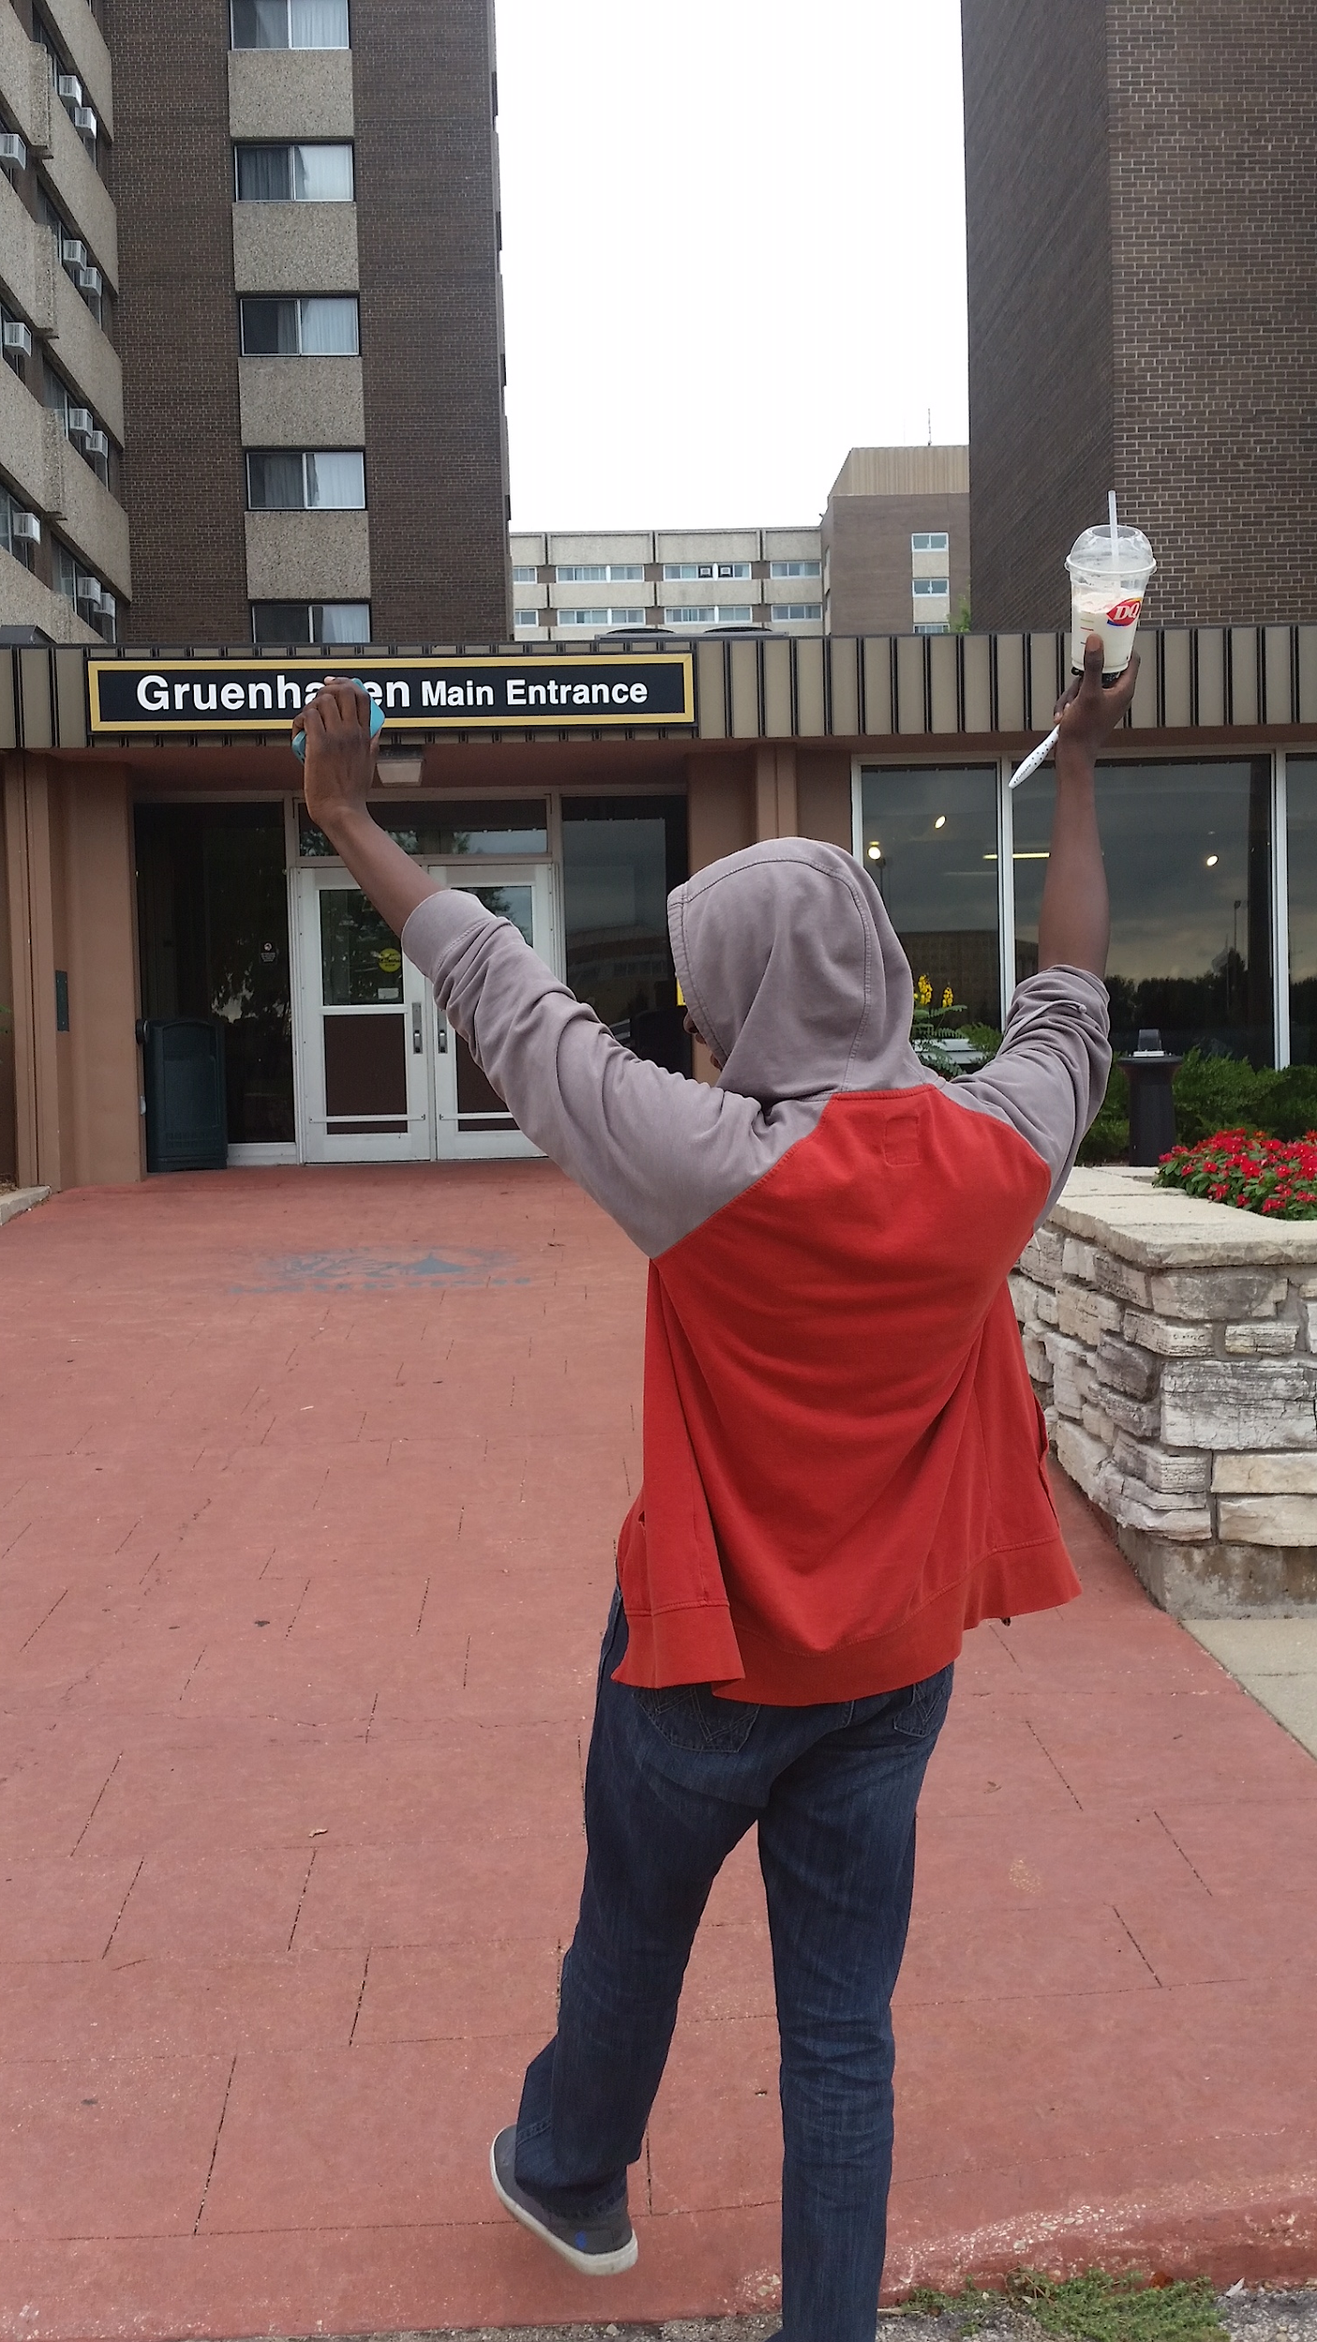
Educational Equity
Educational equity means that every student has access to the educational resources and rigor they need at the right moment in their education across race, gender, ethnicity, language, disability, sexual orientation, family background and/or family income.
Notes:
This is one of my previous students, here he is celebrating that he has finally settled into his dorm room at University of Wisconsin Oshkosh, but his road to this point was not easy. he is an english learner whose family immigrated from the Gambia to the United States when he was very young. He also is a gay male muslim of color who was kicked out of his home because he was gay. Stacy shares story and examples from past roles - and WHY in this work

Slide 5
Educational Equity
What’s your why?
Notes:
Chrissy: What’s your why with educational equity? Take 3-5 min with a partner, and then we can share out
We created this PP with some visuals of what equity is, based on how we articulate it at DPI, in our state, and through conversations with people on our team, and throughout the agency and state. These are a few representations of equity, and certainly not exhaustive; we want to hear/see yours too as we come to a common understanding of what it means for our team.

Slide 6
Culturally Responsive Practices
Culturally Responsive Practices: An approach to teaching that recognizes the value of learners’ cultural beliefs and practices and draws upon them to inform instruction, enhance learner self-advocacy, and bridge learners’ home and school experiences.
.
Notes:
In determining allocation for closing achievement gap, it’s important to put on our culturally responsive lens.
Validate: the intentional and purposeful legitimatization of the home culture and language of the student
Affirmation: the intentional and purposeful effort to reverse the negative stereotypes of nonmainstream cultures and languages portrayed in historical perspective
Think about all you can pay for...what do you do in your district
Then think, how can we use those costs that we have, to best meet needs…
So when looking at staff and fringe benefits...we want it to look like this...quality materials that will make the change…
Culturally relevant pedagogy requires teachers to empower students through teaching and using cultural referents to maximize students’ learning and educational outcomes. As cited by Garcia, Gloria Ladson-Billings outlines three criteria for culturally relevant pedagogy:
• An ability to develop students academically. This means effectively helping students read, write, speak, compute, pose and solve higher order problems, and engage in peer review of problem solutions.
• A willingness to nurture and support cultural competence in both home and school cultures. The key for teachers is to value and build on skills that students bring from the home culture.
• The development of a sociopolitical or critical consciousness. Teachers help students recognize, critique, and change social inequities (Garcia, 2010).

Slide 7
Definition of Culture
Culture describes how we live on a daily basis in terms of our language, ancestry, religion, food, dress, musical tastes, traditions, values, political and social affiliations, recreation, and so on.
(Singleton, 2006)
Notes:
Important to have a working definition of culture

Slide 8
ESSA Title IV
CCLCs must offer families of students served opportunities for active and meaningful engagement in their children’s education, including opportunities for literacy and related educational development.
Notes:
In addition to CCLC charge to provide opportunities for academic enrichment, including providing tutorial services to help students, particularly students who attend low-performing schools, to meet the challenging State academic standards; ‘‘(2) offer students a broad array of additional services, programs, and activities, such as youth development activities, service learning, nutrition and health education, drug and violence prevention programs, counseling programs, arts, music, physical fitness and wellness programs, technology education programs, financial literacy programs, environmental literacy programs, mathematics, science, career and technical programs, internship or apprenticeship programs, and other ties to an in-demand industry sector or occupation for high school students that are designed to reinforce and complement the regular academic program of participating students;

Slide 9
ESSA Stakeholders
Parents of students from subgroups identified in the law
Parents of students from socioeconomically diverse backgrounds
Parents of students with disabilities
Parents of migrant and immigrant families
Parents of English learners
Community based and civil rights organizations
Employers and business organizations
Dear Colleague letter from Secretary King – ESSA Stakeholder Engagement, June 2016
Notes:
Consider representation from all of these groups on your CCLC’s advisory board.
Intent of ESSA: “…parents and communities have the right to engage and help drive, financial, programmatic and policy decisions… progress towards educational equity for all students depends on the meaningful inclusion of the parents and communities that represent students…”
From Parent and Family Engagement Provisions in the Every Student Succeeds Act, the Leadership Conference Education Fund, http://civilrightsdocs.info/pdf/education/ESSA-Parent-Family-Engagement.pdf
Also from this source: Although legally required engagement and consultation is enumerated in the law, parents and communities should seek to be involved far beyond those instances.
Who are the “representative parents” ESSA wants schools to involve? This list isn’t all-inclusive list, but these are some of the stakeholders that ESSA encourages districts to include in planning, carrying out, and evaluating school improvement efforts.

Slide 10
What is High-Impact Family Engagement?
High-impact family and community engagement is collaborative, culturally responsive, and focused on improving children’s learning.
From the National Association of Family, School, and Community Engagement:
https://nafsce.site-ym.com/page/definition

Slide 11
What is High-Impact Family Engagement?
E V E N T S | Low Impact | Moderate Impact | Higher Impact
 | Staff talk with families on orientation day. | Students show their work and perform at quarterly family nights | Gatherings for families and school staff to view student work, share learning strategies and develop a SMART goal
Notes:
Low/Moderate/Higher Impact is on Student Learning or Development. Not only what programs do to engage families but how they do it.

Slide 12
Effective Family Engagement
Use multiple family engagement strategies
Identify a goal of increasing family engagement
Tailor family engagement strategies to the specific population
How Family, School, and Community Engagement Can Improve Student Achievement and Influence School Reform
Notes:
These are key components of promising family-community partnership programs that every school should try to do, regardless of location: offering many kinds of opportunities for families to be engaged, identifying a goal of family engagement to unite staff and families, and tailoring strategies to the specific population(s) of students and families at each school.
Using these strategies, schools are likely to reach more families, unite staff and families around the importance of family engagement, and meet the needs and use the strengths of families each family.
Literature review by the Nellie Mae Education Foundation and American Institutes for Research.

Slide 13
Impact of Family Engagement Strategies on Student Learning
Lower Impact
Higher Impact
Parent help on administrative tasks
Parent training events
Celebrations
Goal-setting talks
Weekly data-sharing folders
Fundraisers
Regular, personalized communication
Parent resource rooms
Back to school night
Home visits
Potlucks
Parent-teacher conferences
Modeling of learning support strategies
Family support services
Positive phone calls home
Performances and showcases
Generic school newsletters
Interactive homework
Classroom observations
Parent help on learning projects
Flamboyan Foundation defines family engagement as collaboration between families and educators that accelerates student learning.
Notes:
Ruth Anne
Some strategies are more likely to improve student achievement than others. Some may be better for building trusting relationships.
An achievement-boosting strategy recommended in “Structuring Out of School Time” in What Works Clearinghouse: frequent communication between day and after-school teachers about each student’s needs and progress.

Slide 14
A CCLC Guiding Principle
“Families are treated as essential partners in program’s efforts to support youth.”
Address student/family needs
Empower families
Staff inform families of student progress
Families inform program structure and activities
https://dpi.wi.gov/sites/default/files/imce/sspw/pdf/clcguideprinciplesfull.pdf
Notes:
One of 12 Guiding Principles developed by DPI to guide CCLC program work. What does this mean? (see dotpoints)

Slide 15
Address Student/Family Need
Have a parent suggestion box
Host a discussion group for families
Strike up conversations with parents that focus on them
Connect with day teachers and district staff
Track meaningful family contacts in a communication log
Invite children to plan a family appreciation event

Slide 16
Empower Families
Families as Assets
Invite families to be “community connectors”
Host opportunities for families to meet one another
Invite families on field trips, to share talents/interests
Sponsor classes to boost families’ skills and knowledge

Slide 17
Turn and Talk
How does your program address families’ needs?
How does your program empower families?
What could you consider doing differently in the future?
Notes:
3 minutes and ask for some examples no more than 5 minutes total suggested.
Structure: Communication, climate
Events
How are these things perceived through what is Said, heard, seen, done

Slide 18
High and Low Impact Communication
High Impact
Face to face
Personal phone calls
Personalized texts and emails
Low Impact
Backpack mail
Robo calls
Group texts
Digital Message Board
Posted flyers
Bulk emails
Notes:
Digital message boards: hallways

Slide 19
Communication Questions to Consider
Do our CCLC’s methods of communication reach our most vulnerable families?
What structures do we have in place to support this?
How do we know?
Notes:
Structure: Communication, climate
Events
How are these things perceived through what is Said, heard, seen, done

Slide 20
Inform Families of Student Progress
Use face time to build positive relationships
Ensure communication with families is frequent, personalized
Consider making one of your four family events a one-on-one “listening session”
Convey how learning happens anytime, anywhere
Notes:
Unique advantages of CCLCs.

Slide 21
Families Shape CCLC Program
Families can help shape program’s Structure and Activities by
Serving on boards and committees
Representing student groups served by program
Participating in surveys, focus groups, one-on-one interviews
Contributing to vision, mission, policies and plans
Notes:
Example:

Slide 22
Guest CCLC Coordinators
Courtney Janak, Phillips
Cola DeNucci, Unity
Notes:
4-5 minutes each talk about highlights of their programs.

Slide 23
Turn and Talk
What are some ways your CCLC
Informs families of student progress?
Invites families to help shape the program?
What additional methods would you consider in the future?

Slide 24
Family Engagement Resources for CCLCs
Build the Out-of-School Time Network Engaging Families Toolkit
Structuring Out of School Time to Improve Student Achievement, What Works Clearinghouse
You for Youth Family Engagement Tools
Arizona CCLC activities

