Slide 1
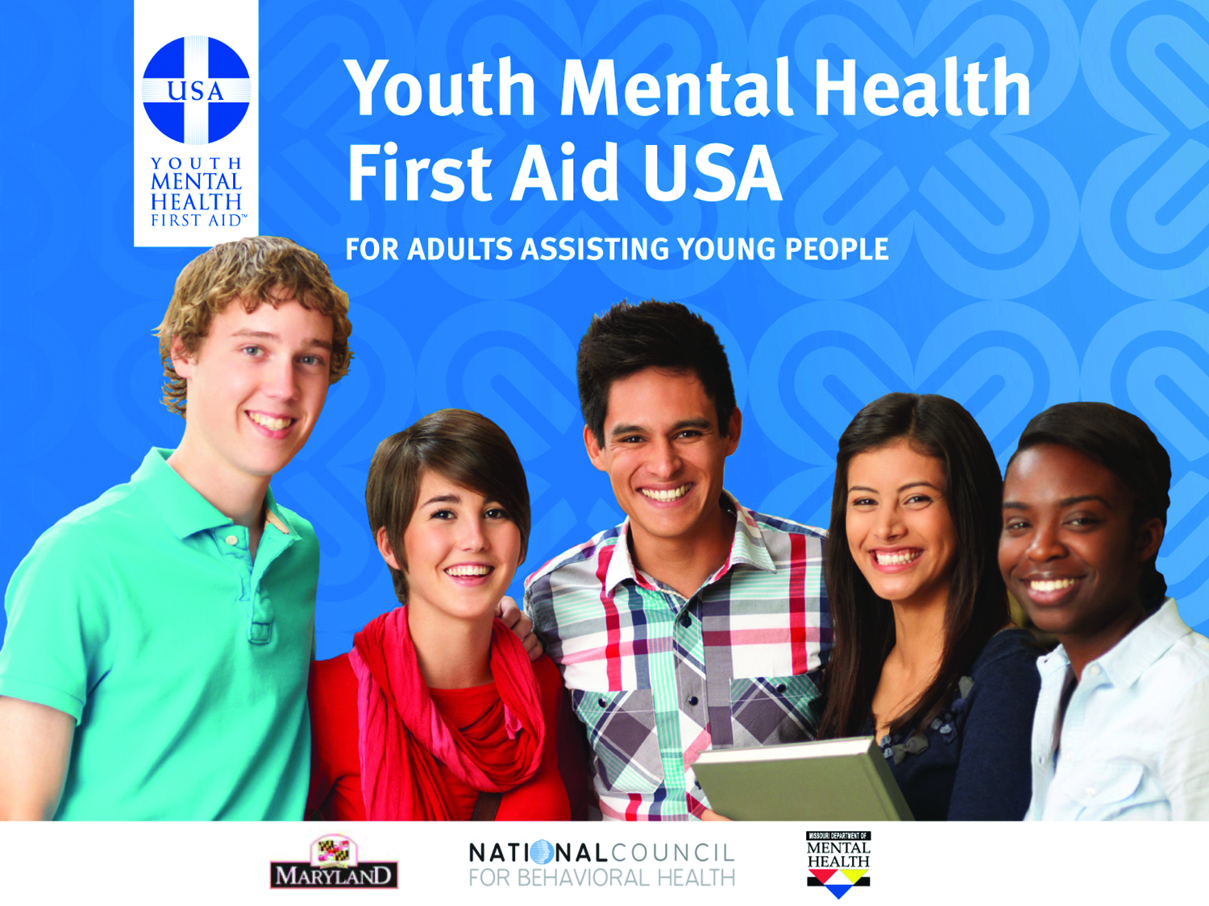


Jackie Schoening, MSW,LCSW
Wisconsin Safe & Healthy Schools Coordinator
Central Region
Carol Zabel, MS
Wisconsin Safe & Healthy Schools Center
Western Region
Notes:
Introduce yourself as speaker – name, title, organization, background
Why are you speaking about Mental Health First Aid today?

Slide 2
Mental Health First Aid is the initial help offered to a person developing a mental health or substance use problem, or experiencing a mental health crisis. The first aid is given until appropriate treatment and support are received or until the crisis resolves.
Notes:
Help offered to a person developing a mental health problem or experiencing a mental health crisis
Like CPR, Given until appropriate treatment and support are received or until the crisis resolves
Not a substitute for counseling, medical care, peer support or other professional treatment

Slide 3
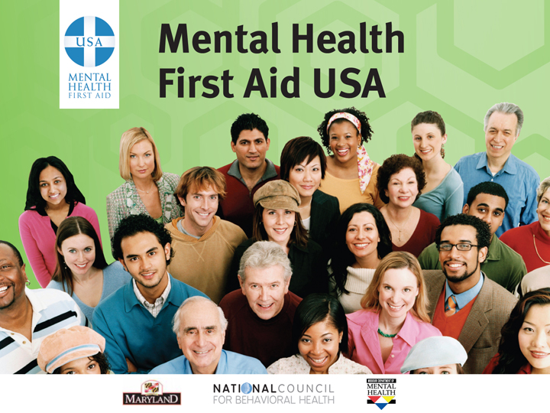

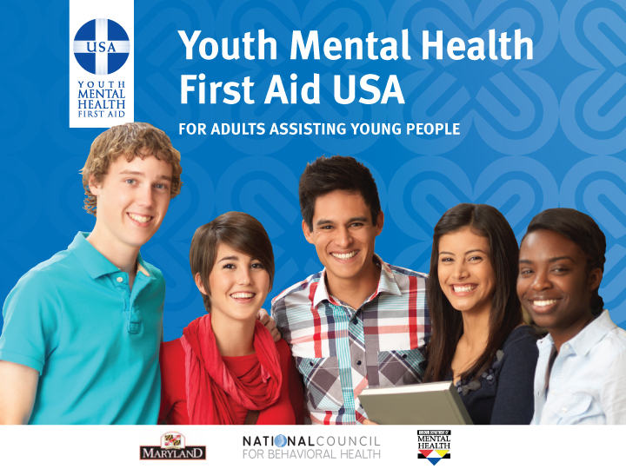
What Participants Learn
Risk factors and warning signs of mental health and substance use problems
Information on depression, anxiety, trauma, suicide, psychosis and substance use
A 5-step action plan to help someone who is developing a mental health problem or in crisis
Available evidence-based professional, peer and self-help resources
Notes:
Learned through an 8-hour training
The course teaches:
Risk factors and warning signs of mental health concerns.
Information on depression, anxiety, trauma, psychosis, and substance use.
A 5-step action plan to help someone developing a mental health concern or in crisis.
Available evidence-based professional, peer, and self-help resources.
Information presented in an interactive classroom environment. Participants have the opportunity to test out the action plan through scenarios, discussions, and other activities.
The standard adult course is available in English and Spanish.
Youth mental health first aid is a separate 8-hour course that specifically teaches participants how to help a youth 12-18 who may be developing a mental health concern or in crisis.

Slide 4

Youth Mental Health First Aid
Action Plan
Assess for risk of suicide or harm
Listen nonjudgmentally
Give reassurance and information
Encourage appropriate professional help
Encourage self-help and other support strategies
Notes:
Briefly describe each action step – what the step entails, give an example.
Note that the plan is not necessarily done in order
Mention that this mnemonic is also the name of the mental health first aid mascot, Algee the koala.

Slide 5
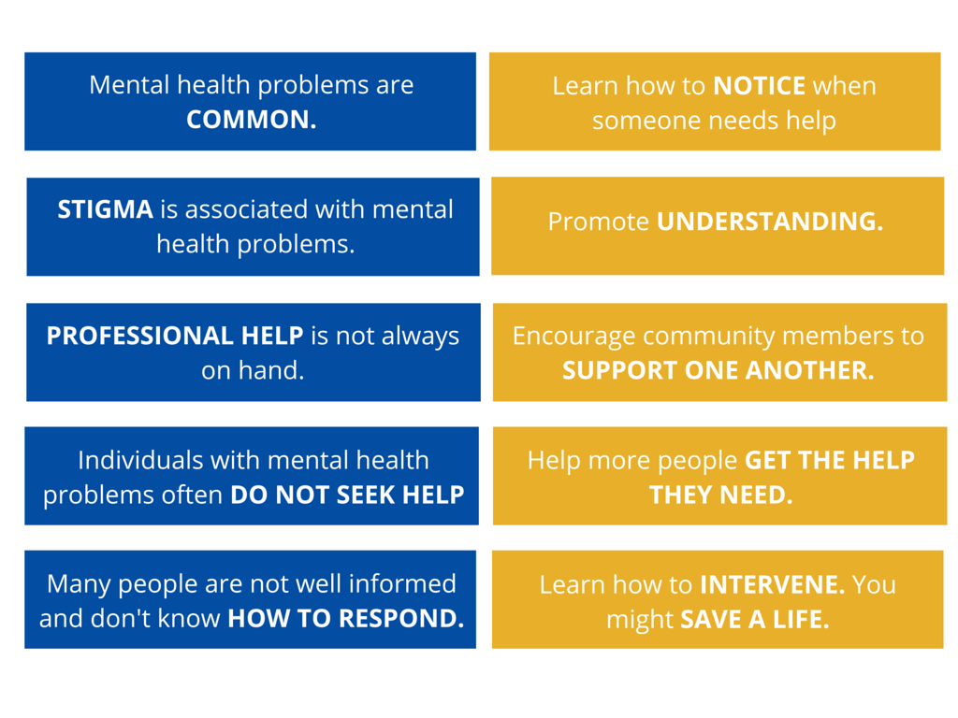
Why Youth Mental Health First Aid?
Notes:
1 in 5 Americans suffer from Mental Illness Each Year according to SAMHSA (Substance Abuse and Mental Health Services Administration)

Slide 6
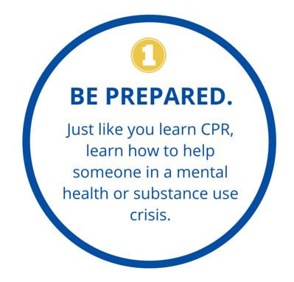
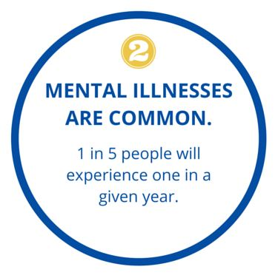
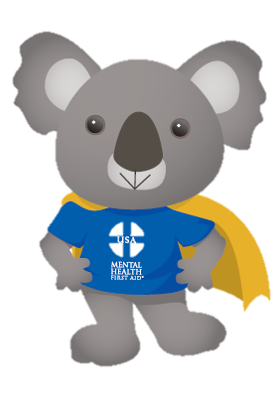
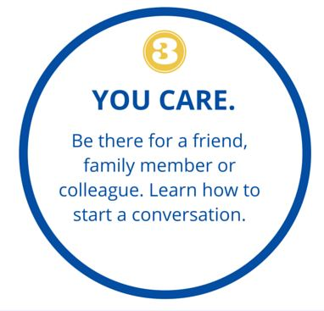
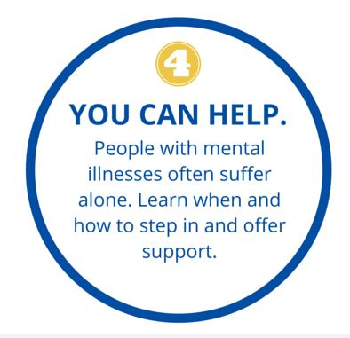
4 Reasons to Become a Youth Mental Health First Aider

Slide 7
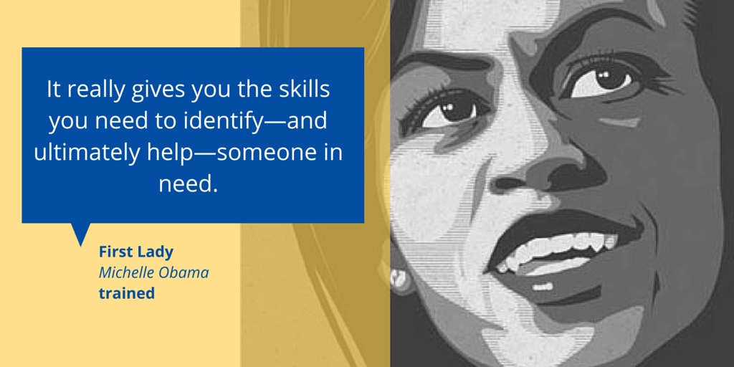
Mental Health First Aiders Are…
Teachers, supervisors, first responders, caretakers, co-workers, journalists, parents, friends and siblings. They’re even First Ladies…
Notes:
Mental Health First Aiders are teachers, first responders and veterans. They’re neighbors, parents, coworkers and friends. They’re people in recovery, and those supporting a family member. They’re First Ladies and Mayors. Mental Health First Aiders are anyone who wants to make their community healthier, happier and safer for all.

Slide 8
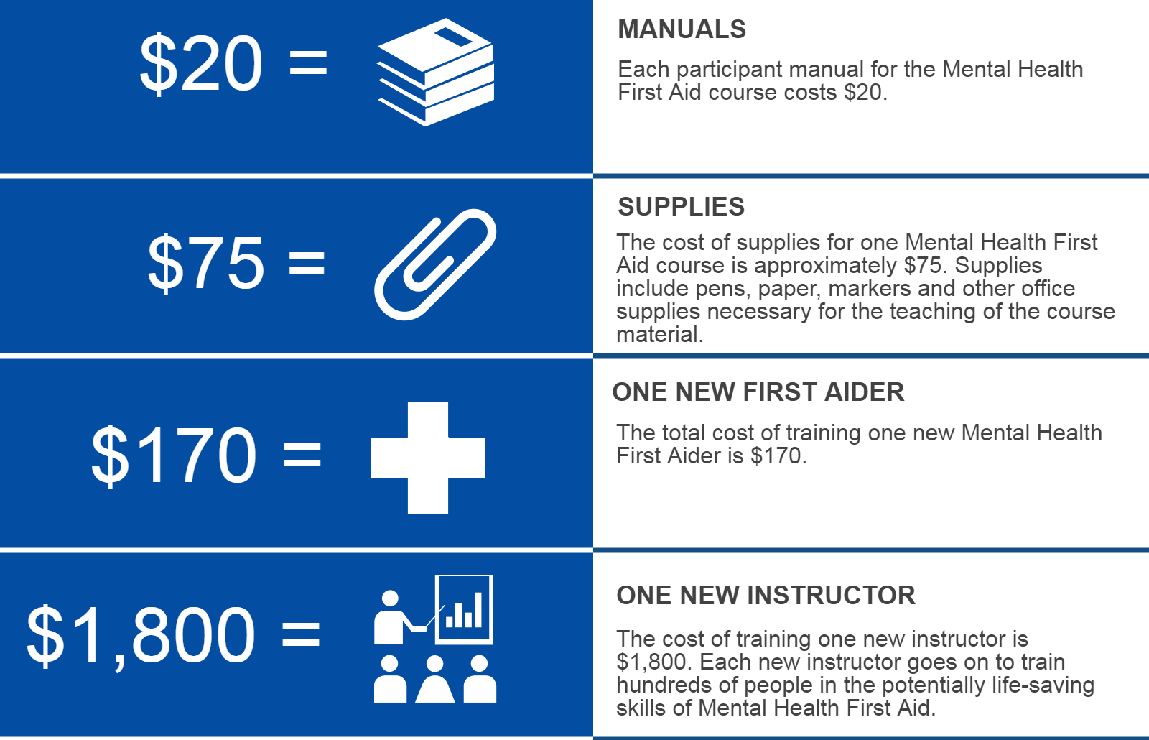
The Value of Mental Health First Aid

Slide 9
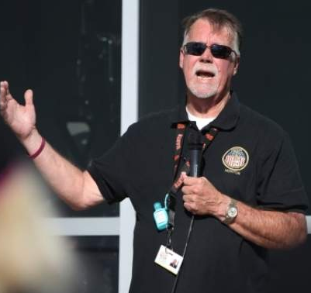


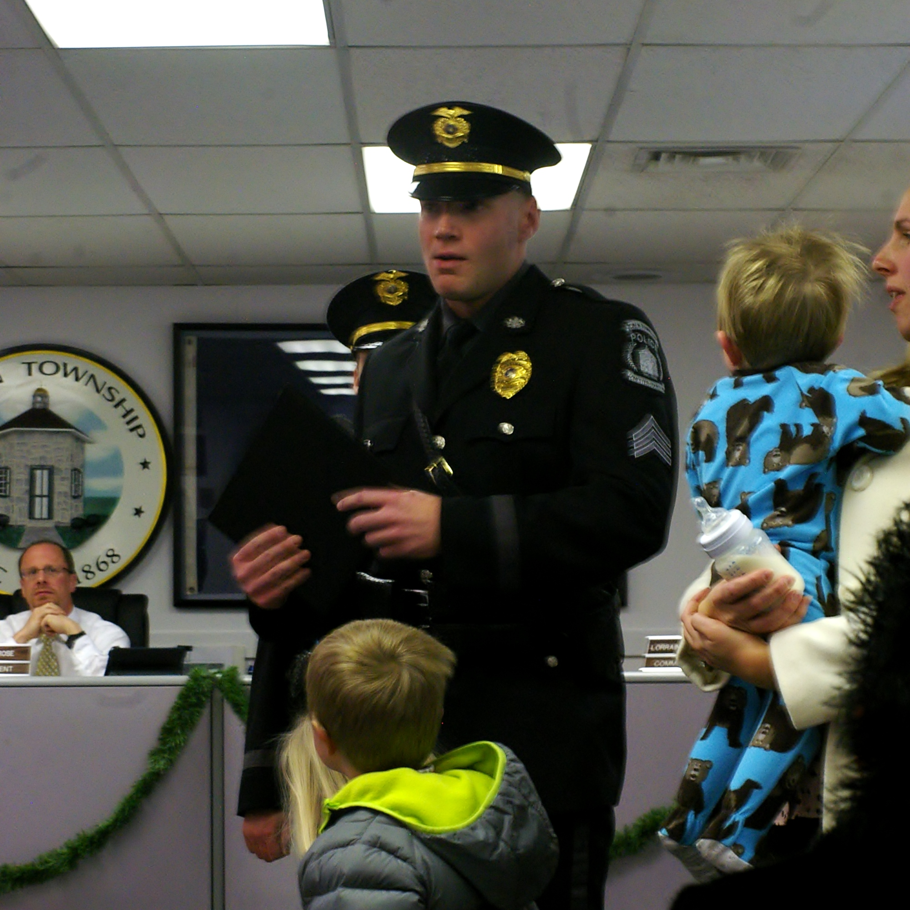
Youth Mental Health First Aid Works
I came upon a HS senior writing his farewell in the library. After a tear filled (on his part and mine internally) conversation guided by my training I was able to convince him to talk to the school counselor. I was told that medical help was sought for the young man.
I learned from my first aid training to have let a child know you are there for them when they are ready. From the training it gave me the words to say. I told the child I notice that you are not participating in class, if you need to talk to me either after school or during class let me know. Now the child is actively engaged in class. a real life situation.”
“On a daily basis, we’re presented with people dealing with mental illness. Every day, this training will be beneficial.”
Notes:
Aside from the fact that Mental Health First Aid is included on SAMHSA’s National Registry of Evidence-based Programs and Practices, we know that Mental Health First Aid works because we hear from people every day who have used the skills they learned to help a person in need.

Slide 10
Wisconsin AWARE Youth Mental Health First Aid
Since early 2016, First Aiders have reported approximately 4,000 referrals since we began tracking referrals.
We have trained over 1,500 First Aiders, most of whom work in schools.
You can have a training at your building FREE – maximum 30 participants, Minimum 20. Complete the inquiry form: www.wishschools.org/resources/YMHFA
Or directly to the inquiry form https://goo.gl/forms/r0st2lslVkMLc3qr1

Slide 11
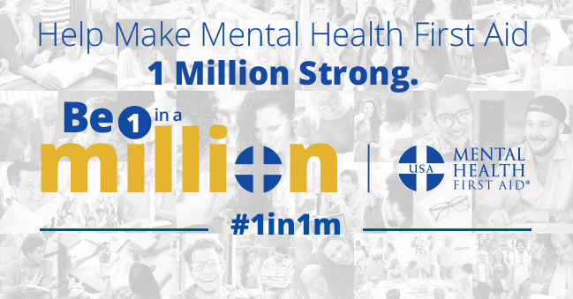
Be 1 in a Million
Campaign launched by the National Council in January 2016 in an effort to train 1 million people in Mental Health First Aid

Slide 12
Youth Mental Health First Aid
Introduces participants to the unique risk factors and warning signs of mental health problems in adolescents
Builds understanding of the importance of early intervention
Teaches individuals how to help an adolescent in crisis or experiencing a mental health challenge
The course is designed for adults who regularly interact with adolescents (teachers, school staff, coaches, youth group leaders, parents, etc.)
Notes:
Do activity here after this slide

Slide 13



Mental Health First Aid
Originated in Australia and currently in 23 countries
Adult course for individuals 18 years of age and older; available in both Spanish and English
Youth Mental Health First Aid is designed to teach caring adults how to help an adolescent (age 12-18) who is experiencing a mental health, an addictions challenge or is in crisis; available in both Spanish and English.
Mental Health First Aid Included in SAMHSA’s National Registry of Evidence-based Programs and Practices
Notes:
MHFA USA is managed Nationally through a partnership between National Council for Behavioral Health as well as Maryland and Missouri State Governments

Slide 14
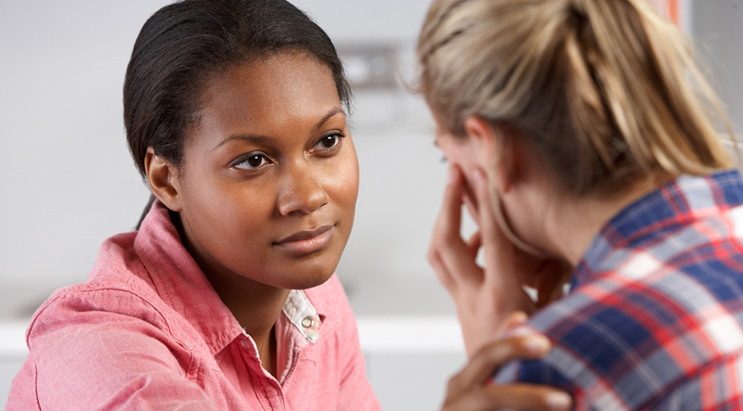

Evidence
Youth Mental Health First Aid….
  …Increases knowledge and understanding
  …Encourages people helping people
  …Supports people getting help
  …Decreases social distance
  …Increases mental wellness
Notes:
Brief Background: program developed in Australia in 2001. Adapted for and managed in the US by National Council for Behavioral Health, Maryland Department of Mental Hygiene, and Missouri Department of Mental Health.
Mental Health First Aid is listed in SAMHSA’s National Registry of Evidence Based programs and Practices
Published, peer reviewed studies about the course show that people who get trained in mental health first aid increase their knowledge of signs, symptoms and risk factors of mental illnesses and addictions; can identify multiple types of professional and self-help resources for individuals with a mental illness or addiction; increase their confidence in and likelihood to help an individual in distress; and even exhibit increased mental wellness themselves. Studies also show that the program reduces the social distance created by negative attitudes and perceptions of individuals with mental illnesses.

Slide 15


Wisconsin Safe & Healthy Schools Center (WISH Center)
https://www.mentalhealthfirstaid.org/take-a-course/find-a-course/
Building the Heart of Successful Schools Conference
December 6, 7 8 Wilderness in Wisconsin Dells
Notes:
This year one of the pre conference is Youth Mental Health First Aid
Keynotes are: Sean Slade – Whole school, Whole Community, Whole Child
And Ross Greene – Lost at School Author – Children will do well if they can.

