Slide 1
21st CCLC APR System Webinar
Teri LeSage
Tanya Morin
Alison Wineberg
March 10, 2017

Slide 2
Agenda
Overview of APR System
Entering Grant and Center Information
How to Report: Activities, Participation, Staffing, and Outcomes
Data Submission
Help Desk

Slide 3
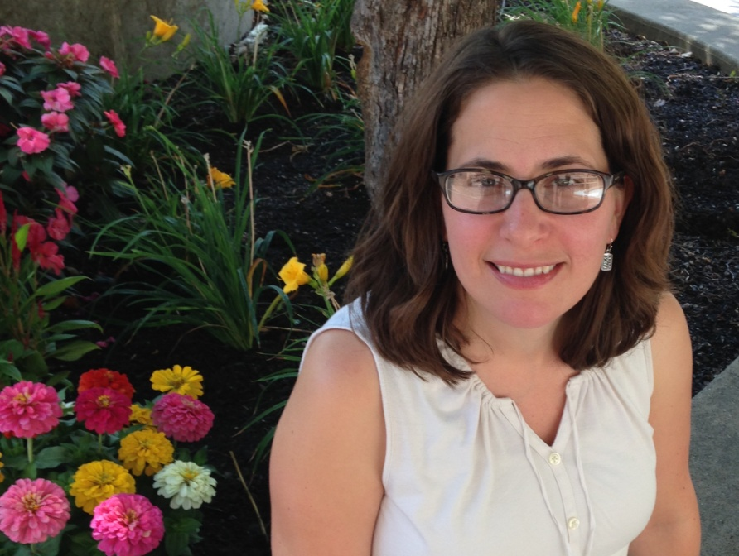
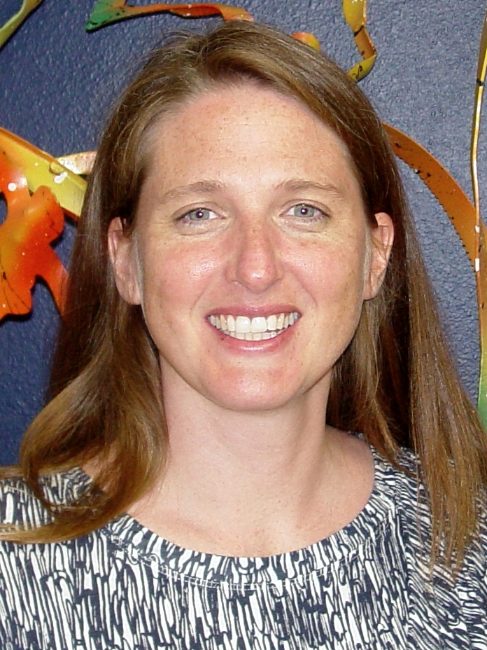
Meet Your Presenters
Teri LeSage, 21st CCLC Grant Consultant
Tanya Morin, 21st CCLC Grant Consultant
Alison Wineberg, 21st CCLC Grant Consultant

Slide 4
What is the APR System?
Annual Performance Report (APR)
Federal data collection system for 21st CCLC grant
Entering data is obligation of grant award
Official name: 21APR
Updated URL: 21apr.ed.gov

Slide 5
What information does the APR system collect?
Collects data related to four areas:
Activities
Staffing
Participation
Outcomes
APR system has four sections aligned with these areas
21APR Data Guide: To access click here

Slide 6
How does the APR system collect data?
Data collected according to three terms:
Summer
Fall
Spring
Three discrete windows of time for entering data related to each of these terms

Slide 7
What are the 2016-17 data collection windows?
Dates for entering 2016-17 data:
Summer data window
March 16, 2017 – April 10, 2017
Fall data window
April 18, 2017 – July 17, 2017
Spring data window
August 1, 2017 – December 1, 2017

Slide 8
What time periods are covered by each of the terms?
Summer term:
Programming from June 13, 2016 - August 26, 2016
Fall term:
Programming from August 29, 2016 - January 20, 2017
Spring term (Activities and Staffing):
Programming from January 23, 2017 - June 9, 2017
Spring term (Participation and Outcomes):
Cumulative
Entire 2016-2017 school year (NOT including summer)

Slide 9
Who can enter data into the APR system?
System allows ONE grantee level user account per fiscal agent
Grantees cannot add additional users
Editing contact information in grant or center profile DOES NOT create new user account
Help desk will only answer questions from registered users

Slide 10
What changes have been made to the APR system this year?
Outcomes now pre-selected by SEA
Ability to view data from other terms
Some changes to way system is navigated
DPI has made slight changes to guidance
Clearer definitions
Additional guidance related to activities and staffing
Slight change in way survey data is used to calculate outcomes

Slide 11
How do I access the APR system?
Access system via following web address: 21apr.ed.gov/
Enter user name and password
Recommended that users interact with APR System via: Chrome, Firefox, or Safari
Will be required to update password periodically

Slide 12
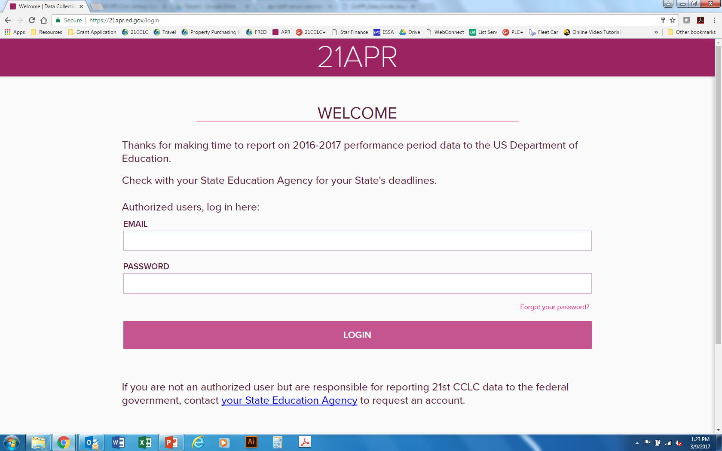
What do I see when I log on?

Slide 13
What are the overview pages?
Grantee Overview page
Information about grantee (i.e. fiscal agent)
Includes list of centers
Click on “Edit” button to change grantee information
Center Overview page
Click on name of center to get to overview page
Information about individual center
Only place to enter information about feeder schools and partners
Information entered applies to entire programming year, not just reporting period

Slide 14
What information can I change on “Grantee Overview” page?
Do NOT Edit
Do Edit
Name of grantee
Grantee award information
Name of centers associated with grant
Do not add or delete centers
Contact name and information
Grantee location
Grantee type
Refers to fiscal agent
School-based, CBO, etc.

Slide 15
What information can I change on “Center Overview” page?
Do NOT Edit
Do Edit
Name of center
Extended Learning Time (ELT) status (Should always be “no”)
Center address
Contact name and information
Center type
Refers to location where program takes place
School-based, CBO, etc.
Feeder schools
Partners

Slide 16
Grantee and Center Overviews: Important Definitions
Feeder School: Choose “Yes” if participants are enrolled in school other than center location
Partners: Entities other than the grantees or school(s) served which provide an in-kind or cash contribution

Slide 17
I am ready to start entering data, what do I do?
Go to “Grantee Overview” page and scroll down to list of centers
Click on name of center for which you will be entering data to go to “Center Overview” page
Click on “Activities” tab that is located in upper right-hand corner of screen OR
Click on “Enter APR Data” button

Slide 20
How do I report on activities?
See 21APR Data Guide, pp. 9-12 for list of categories
Report each activity only once
Exception: College and Career Readiness
Choose category that best describes primary focus or intent of activity
If activity does not easily fit into a given category, choose best fit

Slide 21
How do I report on activities?
For each activity type, required to report:
Frequency of sessions
Number of hours per session
Number of participants
Should report the aggregate or average amount
Intent is capture participation rates and dosage
How many students are participating in those types of activities?
How much time do they spend doing those types of activities

Slide 22
How do I report on activities?
Number of hours per session:
Amount of time on average that a student has access to that type of programming
If number is different for different groups, take average
Unduplicated
Number of students attending sessions:
Average number of students who participate in activities of that type
Unduplicated - Count students only once

Slide 23
How do I report on staffing?
See 21APR Data Guide, p. 13 for staffing categories and definitions
Indicate number of paid and volunteer staff for each category
Select “Paid” if staff members are compensated, even if paid through other funding sources
List day school aides as “Other”

Slide 24
Staffing: Who is an “administrator”? Who is a “subcontractor”?
Administrator:
Staff members who have primary oversight capacity of program
Site coordinator or districtwide program coordinator
Subcontractor:
Individuals who enter into a formal contract to provide services
May include staff from partner organizations who come in to lead specific activities
Also known as “vendors”

Slide 25
What information is collected in “Participation” section?
See 21APR Data Guide, pp. 14 -17
Student attendance (>30, 30-59, 60-89, and 90+ days)
Student grade levels
Student sub groups (gender, race, FRL, ELL, Special Education)
Report according to grade bands (K-5, 6-12)

Slide 26
How do I answer the question about family members?
Final question of “Participation” section
Number of adult family members of CLC participants who attended CLC-sponsored family programming events
Only count family members of students enrolled in CLC program
Can be family members who do not reside in household (i.e. grandparents, etc.)

Slide 27
What outcomes do I report?
For 2016-17 all WI 21st CCLC grantees should report on teacher survey results
Surveys measure change in following areas over course of school year:
Homework & Class Participation
Classroom Behavior

Slide 28
Where can I get the teacher survey?
Teacher survey is posted on the DPI 21st CCLC webpage
Instructions for administering surveys and compiling survey data will also be posted
Updated versions will be posted the week of March 13, 2017
http://dpi.wi.gov/sspw/clc/performance-report

Slide 29
How do I administer teacher surveys?
Surveys administered at end of school year for all regular attendees
Completed by classroom teacher or teacher familiar with student’s homework completion, class participation, and classroom behavior
Obligated to get at least 75% of surveys returned

Slide 30
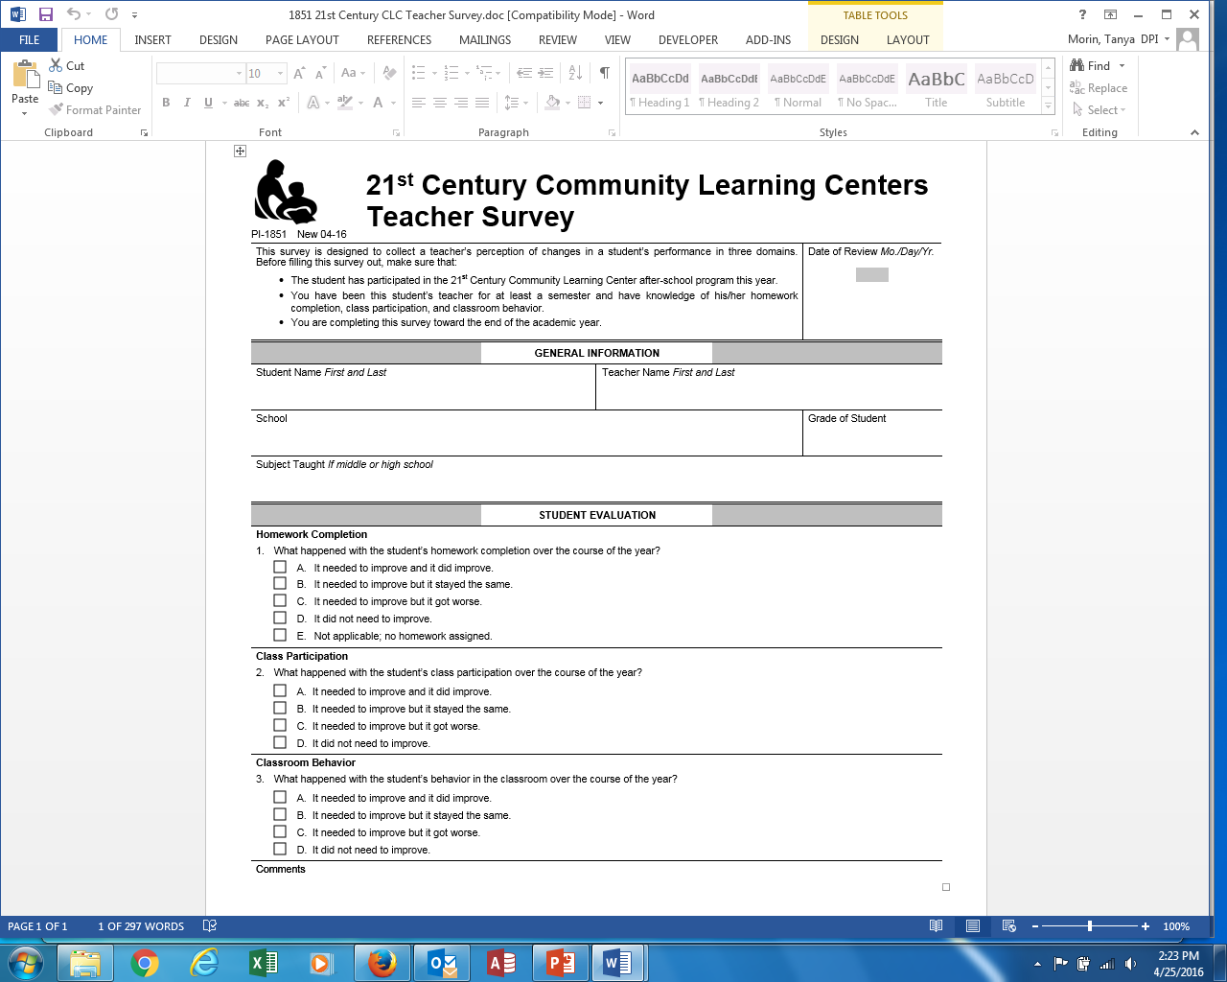

Slide 31
How do I report our teacher survey results?
Use teacher surveys to calculate two numbers:
Number of students who showed improvement in homework completion AND class participation
Number of students who showed improvement in classroom behavior
Report according to:
Student attendance (30-59 days, 60-89, 90+)
Two grade bands (K-5 and 6-12)

Slide 32
How do I calculate homework completion and class participation?
To calculate first number (homework and participation):
Count number of students whose teachers marked:
On Question 1, either
“A” (Did Improve),
“D” (Did Not Need to Improve), or
“E” (Not Applicable)
AND
On Question 2, either
“A” (Did Improve) or
“D” (Did Not Need to Improve)
Only count students who improved (or did not need to improve) in BOTH areas!

Slide 33
How do I calculate classroom behavior?
To calculate second number (behavior):
Count number of students whose teachers marked either “A” (Did Improve) or “D” (Did Not Need to Improve) for Question 3 on teacher survey

Slide 34
How do I know the data was submitted?
Data is saved as you go
To ensure data is submitted:
At end of section, scroll down and hit “Review”
Review data
If correct, scroll down and hit “Submit”
APR system does not send confirmation that data was successfully submitted
DPI reviews and certifies data after system closes

Slide 35
Who do I contact if I need help?
If you get locked out of the system, contact the DPI
For clarification regarding how to report activities, staffing, participation, or outcomes, contact DPI
For all other questions, contact the APR help desk
Notes:
Do you want your contact, specifically?

Slide 36
How do I contact the help desk?
Via the new contact form on the APR website (see next slide)
OR
By email: 21apr@thetactilegroup.com
Reminder: Help desk will only respond to inquiries from registered users

Slide 38
Contacts
Alison Wineberg, Consultant
(608) 267-3751
alison.wineberg@dpi.wi.gov
Tanya Morin, Consultant
(608) 267-9393
tanya.morin@dpi.wi.gov
Teri LeSage, Consultant
(608) 267-5078
teresa.lesage@dpi.wi.gov

Slide 39
Thank You

