Slide 1
Engaging Students and Their Families
Kyle Gregerson, 3rd Grade Teacher
@gregerson_kyle
Bonnie Scheel, 21st CLC Coordinator
River Heights Elementary, Menomonie

Slide 2
River Heights Elementary
Program History
Early Risers – Before School
Schedule
Lesson Plan Examples
Family Nights – Engaging Students and Families
STEAM – Science, Technology, Engineering, Arts, Mathematics
Activities
Questions

Slide 3
Program History
•2007 – 21st CLC funded
•Before and After School Programs
•Transitions
Sustainability with reduced funding
Early Risers - Fee based 2016-17 179 student days
Per student fee $300/year (options)
Boys and Girls Club
Arts Integration Menomonie - PAINT

Slide 4
EARLY RISERS
Program Goals:
Strengthen student academic skills
Teach problem solving
Provide a safe, positive environment
Provide positive adult role models
Connect the community, families and school together
Benefits
Increased academic achievement
Motivation and Social Emotional Skill development
Completion of quality homework
Improved attendance

Slide 5
Early Risers Daily Schedule
 | 6:30-7:15 | 7:15-7:30 | 7:30-8:00 | 8:00-8:10
Monday | Table Games & homework time | Structured Gym Activities | Reading | Large Group Meeting
Tuesday | Table Games & homework time | Structured Gym Activities | Reading | Large Group Meeting
Wednesday | Table Games & homework time | Structured Gym Activities | Math | Large Group Meeting
Thursday | Table Games & homework time | Structured Gym Activities | Math | Large Group Meeting
Friday | Table Games & homework time | Structured Gym Activities | Lg Group Science, Social Studies, SEL | Large Group Meeting

Slide 6
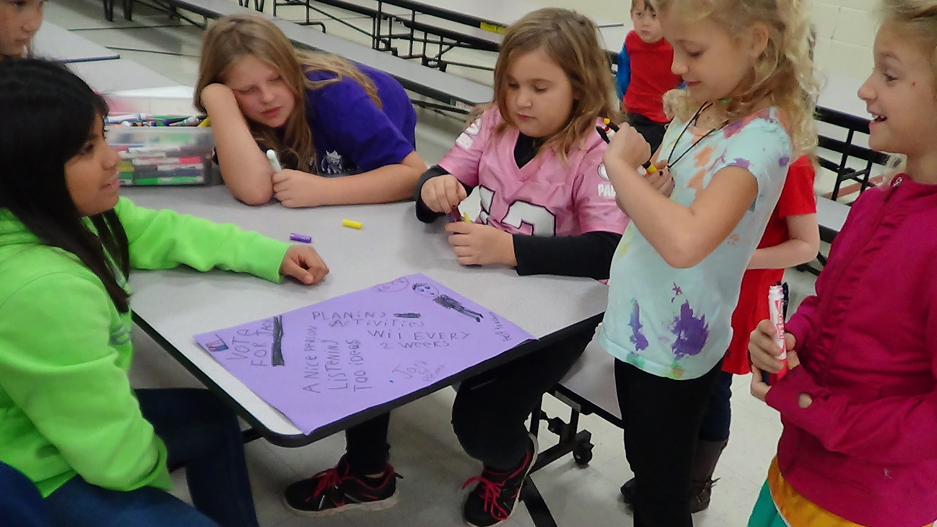
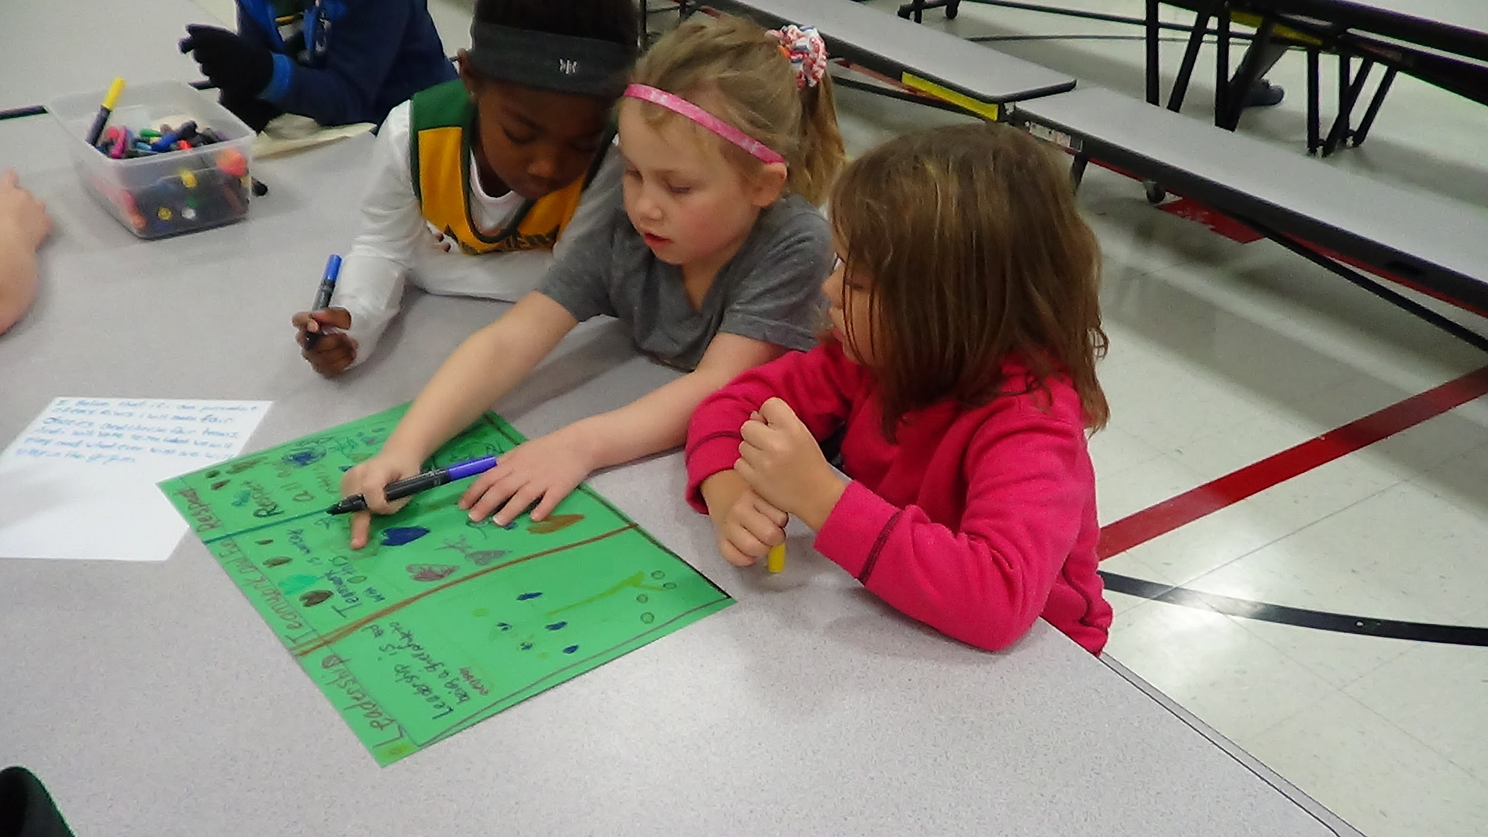
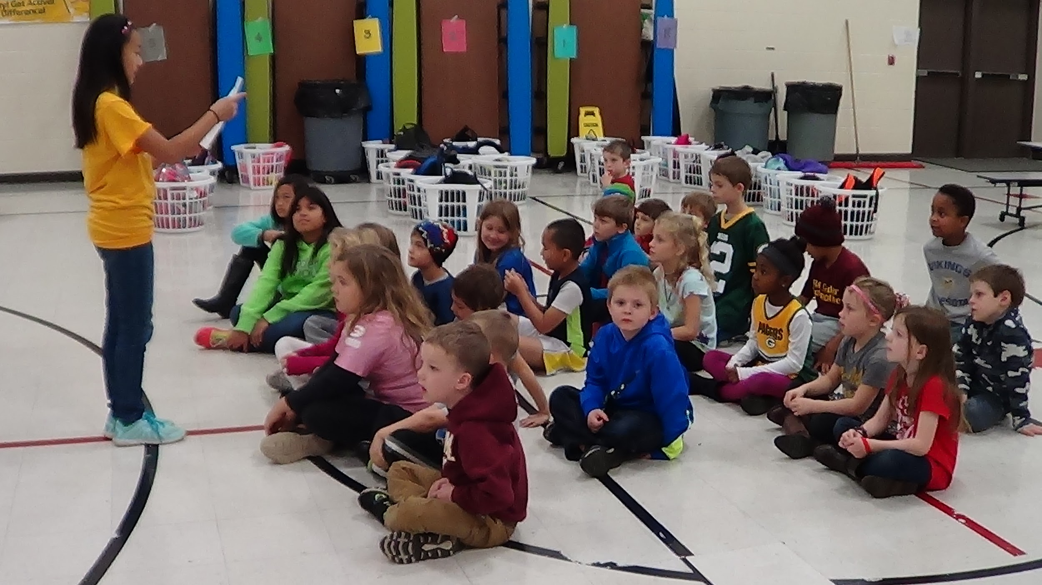
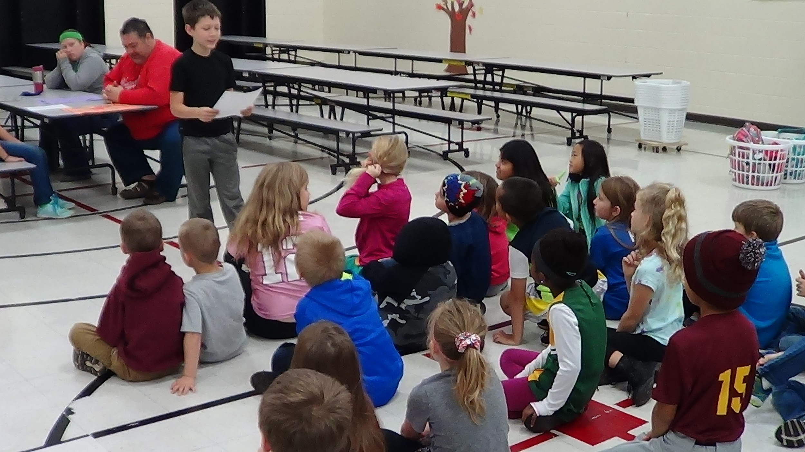
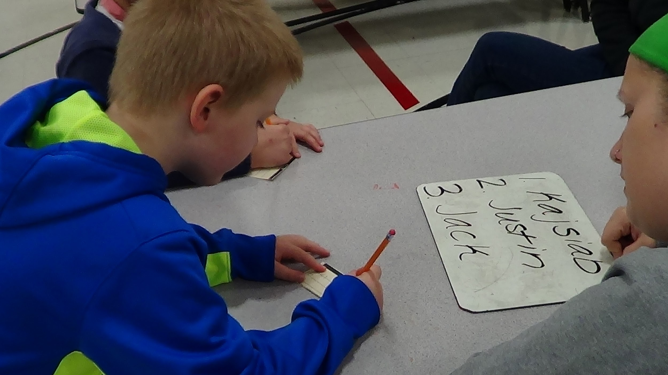
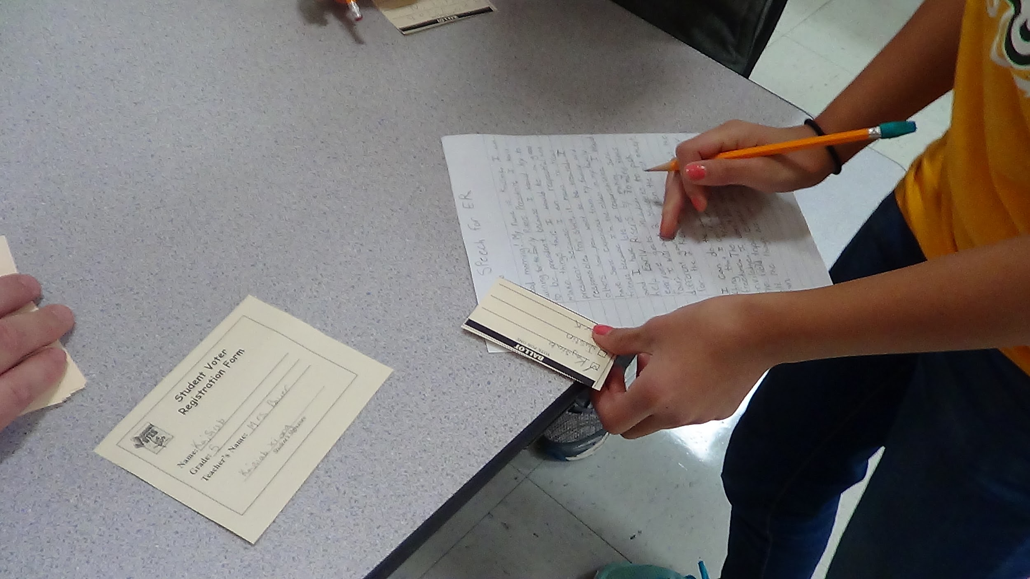
Example - Lesson and Activities
Early Risers Presidential Election
Candidate Posters
Candidate Speeches
Primary Election

Slide 7
Early Risers Presidential Election
Monday - Debate - Final 2 Candidates
Tuesday - Election
Verify Registration and cast vote - “I voted stickers” (Students designed)
Announcement of “Early Risers President”
Twitter, Picture and article for building and
district website.

Slide 8
Family Nights (4 - 6 per year)
Collaborative with Title I, both programming and cost.
Format
5:30 - 6:00 PM Meal
6:00 - 7:00 (7:30) PM Family activities
October, 2016 Family Night
Eureka Math for Parents
GameSTORM - Children
Skills taught through interactive Theater Games:
Listening
Cooperation
Respect
STEAM

Slide 9
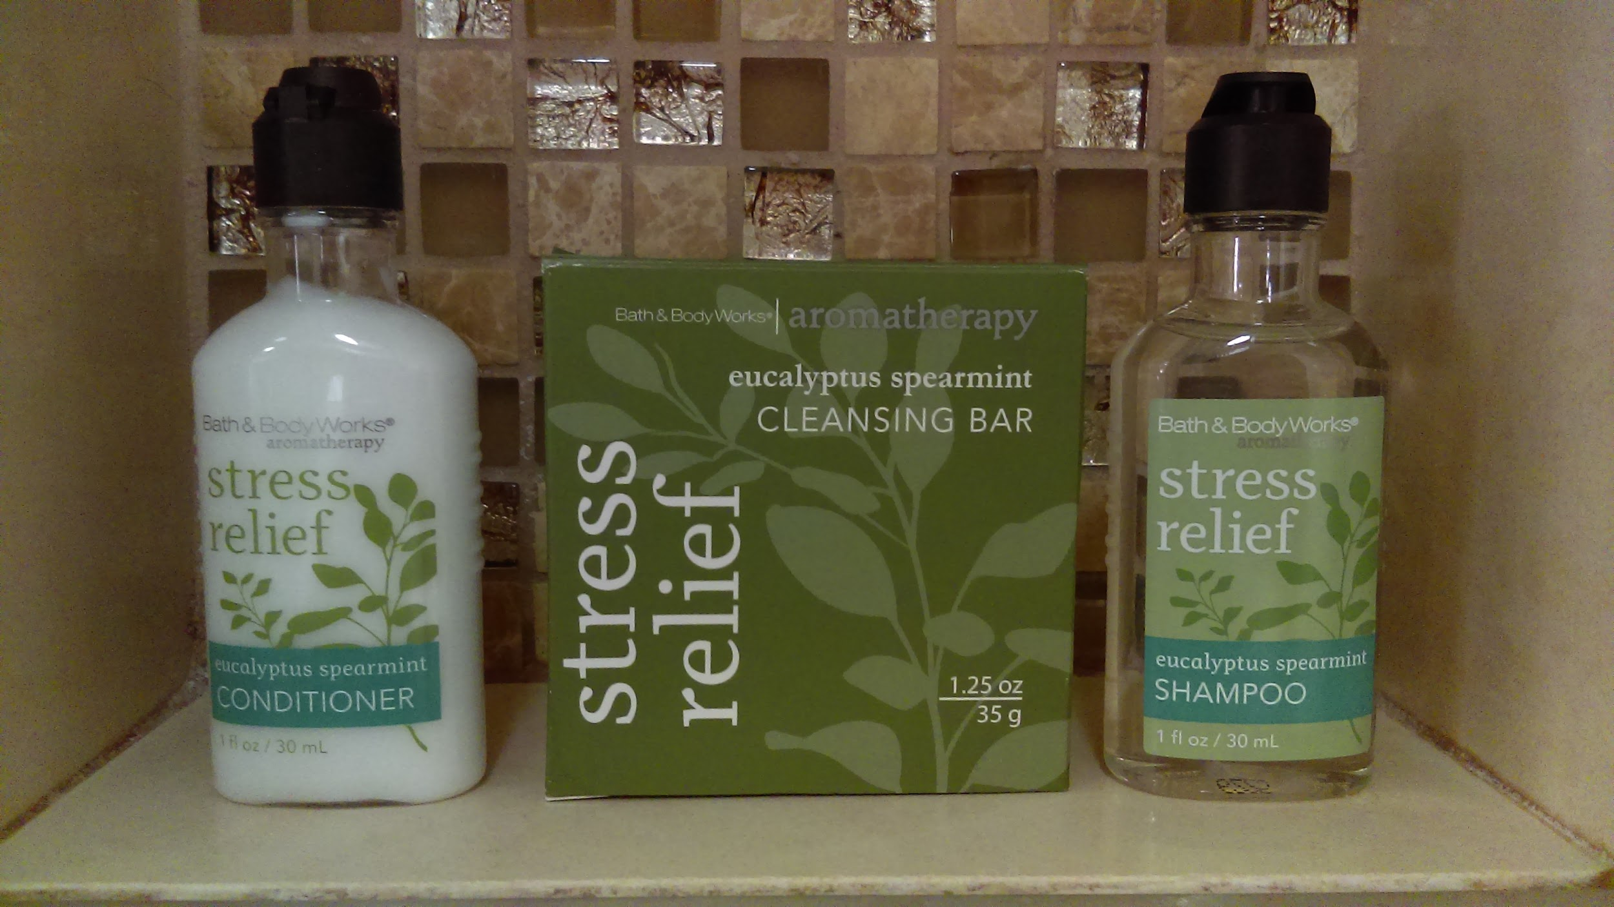

Slide 10
World's Greatest Easy Card Magic Trick
Easy Card Magic Tricks for Beginners and Kids

Slide 11
STEAM ideas
Follow on Twitter for ongoing ideas - @gregerson_kyle
Maker Ed - ideas for short-term activities as well as open-ended long-term projects
Squishy Circuits
Makey Makey
Sphero
Vortex Cannon - sample Vortex Cannon Video
Makersaces.com
STEM top toys
Quiver - 3D augmented reality coloring
Aurasma - Augmented reality
littleBits - Free Synth Kit referral code KyleGregerson

Slide 12
More Ideas
Renovated Learning
Tinkerlab
Build With Chrome
Make
Maker Faire
Resources and Program Ideas
Geocaching Travel Bug - release for school, group, or class
Breakout EDU
Electronics to be recycled for taking apart
City / County Dump
School District

Slide 13
Coding / Programming
Code.org
Bitsbox.com
Teacher’s Page for Bitsbox
Codecademy
Code Combat
Code Avengers
Tynker
Scratch
CodeMonkey

Slide 14
Online Learning
edX.org
Coursera
Udacity
Futurelearn
OpenUpEd
Open2Study
Khan Academy
A Comprehensive list of MOOC (Massive Open Online Courses) providers

Slide 15
Contact:
Kyle Gregerson kyle_gregerson@msd.k12.wi.us
Twitter: @gregerson_kyle
Bonnie Scheel bonnie_scheel@msd.k12.wi.us
bit.do/clcengage

