Slide 1
Equity in ESSA Stakeholder Council
Meeting 4
Dr. Roxie Hentz Facilitator
January 26, 2016
Notes:
Welcome 9:30-9:33 (3 min)
Welcome and thank participants
Brief review of agenda
Parking Lot
Wordle (words generated from meeting)

Slide 2
Welcome
Reintroductions and Reflection Tony Evers
ESSA Updates Jennifer Kammerud, Policy Initiatives Advisor

Slide 3
Leading For Equity: 10 Opportunities for State Chiefs
Prioritize Equity: Set and Communicate Equity Vision and Targets
Start From Within: Focus on the State Education Agency
Measure What Matters: Create Accountability for Equity
Go Local: Engage Local Education Agencies and Provide Tailored and Differentiated Support
Follow The Money: Reallocate Resources to Achieve Fiscal Equity
Start Early: Invest in the Youngest Learners
Engage More Deeply: Monitor Equitable Implementation of Standards and Assessments
Value People: Focus on Teachers and Leaders
Improve Conditions For Learning: Focus on School Culture, Climate, and Social-emotional Development
Empower Student Choice: Influence and Improve Choice and Charter Policies to Advance Equity

Slide 4
Revisiting Group Norms
Actively and respectfully listen and speak
Suspend judgment and assume good will
Express disagreement with ideas, not individuals
Share the airtime
Tell your own story
Notes:
Revising Norms 9:33-9:40 (7 min)
Description:
Remind members that during the last meeting the group reviewed the responses to ,“Are there any specific suggestions you have to make the meetings successful for you?” related to each norm. They then worked in small groups to create sentences or statements that explains what the norm should looks like during meetings.
Explain that on each table there is a “norm table tent,” to be used as a reference, that captures the groups’ thoughts
Read the norms and statements. Ask members to turn to a partner to discuss how we are doing in relationship to the norms.
Ask for a couple of volunteers to share out.
Remind them of the need for Table Facilitators, that I will reinforce norms throughout meeting, and there will be end-of-meeting check-in

Slide 5
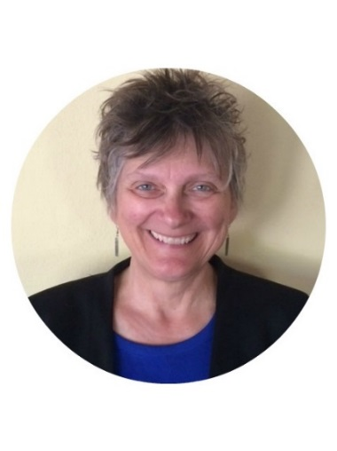
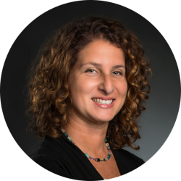
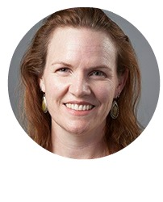
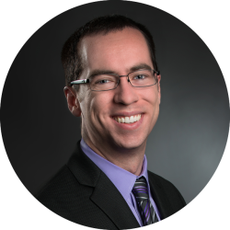
Our Subgroup Facilitator Team:
Heidi Guarino
Education First
Nara Nayar
MWCC
Kevin Duff
Education First
Deb Gurke
MWCC
School Improvement
Accountability
Notes:
Note: Jenn in meeting with Governor of Washington, couldn’t be here today

Slide 6
Subgroups Share-outs
PART 1 Subgroup Ideation
(80 min)
PART 2
Whole Group Share-out & Discussion
(40 min)

Slide 7
Facilitated Whole Group Discussion
20 Minutes/ Subgroup
5 min: Identify 3-5 key takeaways, 3-5 unanswered questions and any immediate next steps
15 min: Whole group responds to subgroup’s thoughts and ask clarifying questions

Slide 8
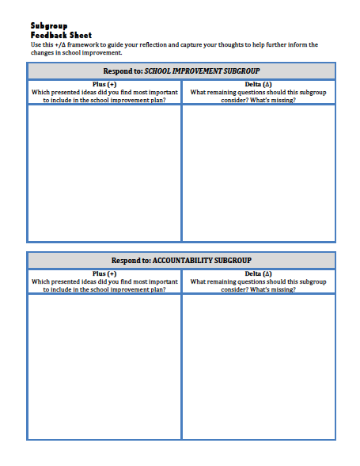
Subgroup Feedback
Part 3
Plus (+) / Delta (∆)
FEEDBACK SHEET

Slide 9
Subgroup Break Out
School Improvement Subgroup:
Take the elevators to 4th floor (Room 419)
Accountability Subgroup:
Remain in P41

Slide 10
Facilitated Whole Group Discussion
20 Minutes/ Subgroup
5 min: Identify 3-5 key takeaways, 3-5 unanswered questions and any
immediate next steps
15 min: Whole group responds to subgroup’s thoughts and ask clarifying questions

Slide 11
Subgroup Feedback
Part 3
Plus (+) / Delta (∆)
FEEDBACK SHEET

Slide 12
Thank You
Next Meeting
Thursday, Feb 23, 2017
9:00 am – 12:00 pm
Madison
**Please leave your nametag on the tables

