Slide 1
Equity in ESSA Stakeholder Council
Meeting 7
Dr. Roxie Hentz Facilitator
April 20, 2017

Slide 2
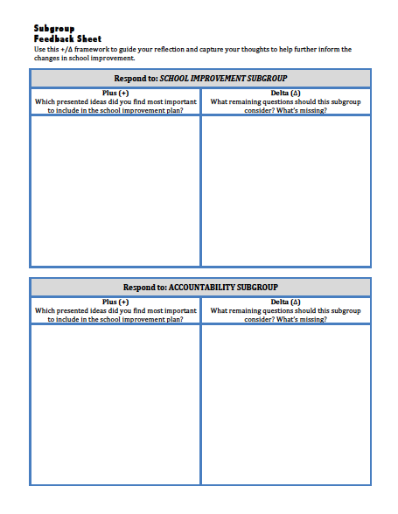
Think Sheet
Plus (+) / Delta (∆)
THINK SHEET

Slide 3
Overview

Slide 4
Overview

Slide 5
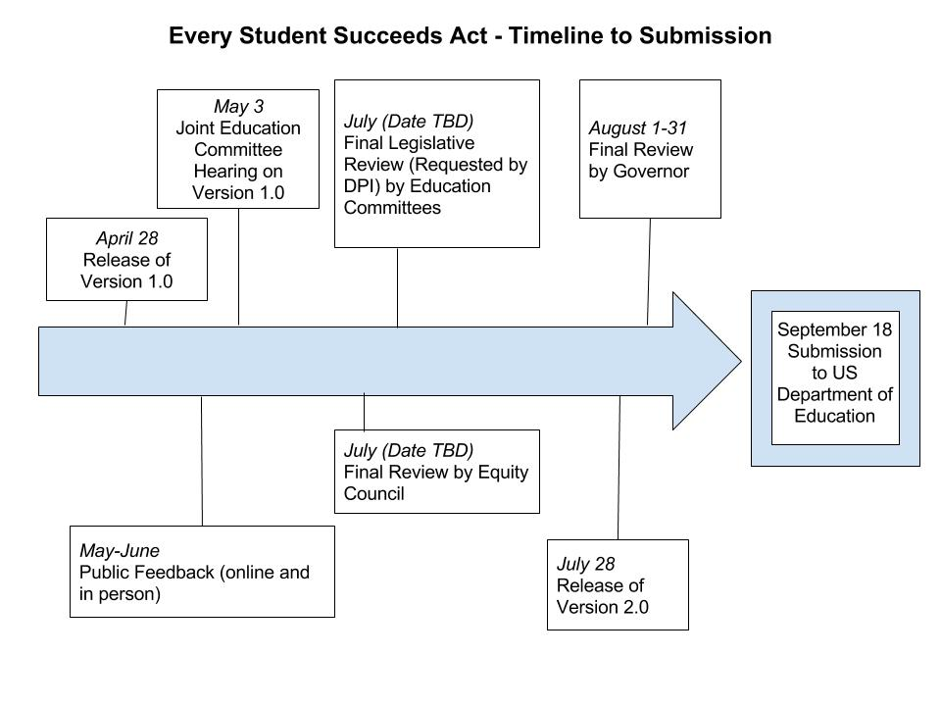
Timeline to Submission

Slide 6
Overview of Plan: School Improvement
Focus on Equity
Authentic and meaningful family and community engagement
Rooted in implementation science
Emphasis on support
Notes:
9:30 (30 mins) Whole group preview of round robin discussions (Jonas, Laura, and Roxie)

Slide 7
Overview of Plan: Accountability
What we heard | What’s in the plan
Long-term goals
Strike a balance between ambitious and achievable goals, but time is of the essence | Cut achievement and graduation gaps in half. Timeline: 6 years
School quality and student success indicator
Focus on what’s actionable, report additional indicators when available, opportunities for local customization | Chronic absenteeism for all schools. Other reporting and local customization will be considered for state accountability report cards.

Slide 8
Accountability and School Improvement:
The Big Picture
Federal Accountability
School Improvement
Annual check points
Identification of schools for Comprehensive or Targeted Support and Improvement (CSI & TSI)
Identification triggers activities to help improve student outcomes.
Accountability & school improvement systems monitor progress and identify when schools can exit CSI and TSI.

Slide 9
Identifying schools: topic #1
Targeted Support Schools
Averages of subgroup overall performance
Cap identification at 10% of schools
Notes:
Decisions informed by primary purpose of federal accountability system: identifying schools

Slide 10
Identifying schools topic #2
Exit Criteria for Comprehensive Support Schools
Three components:
1) overall performance;
2) progress toward goals;
3) local practice (i.e., school improvement activities)

Slide 11
School Improvement: Topic #1
Focus on Support
Decisions driven at local level
Support from the State
Notes:
Focus on support – we heard a clear directive to focus on support, not prescription. I would value the Council’s input on how this plan reflects that.

Slide 12
School Improvement: Topic #2
Exit Criteria for Comprehensive Support Schools
Third component
Required element of sustainability
Notes:
Specifically the requirement that schools demonstrate sustainability – this is aligned with the need for support and the focus on implementation science. If a school makes the 2 test-based criteria, should there also be a sustainabily criteria to ensure continued, long-term growth

Slide 13
Equity

Slide 14
Equity Council: Our Beginning

Slide 15
Overview of Equity: Accountability
Intention: make sure that all high-need subgroups are considered rather than just lowest-performing groups (which could hide some groups) when identifying schools.
To exit Comprehensive and Targeted Support status, schools must demonstrate improved performance overall and for different groups of students.

Slide 16
Overview of Equity: Accountability
Absenteeism rates are higher for high-need subgroups; including this indicator will draw attention to this need.
The long-term goals are set with the intention of reducing achievement and graduation gaps by half in six years.

Slide 17
Overview of Equity: School Improvement
Intentionally called out in plan
Emphasis on decision making at local level to allow for specific context and focus on equity needs in each school
Intentional inclusion of all stakeholders in decision making ensures equity in school level plans
Successful implementation is an equity strategy, as students cannot benefit from an innovation they do not receive

Slide 18
Leading for Equity
“Educational equity means that every student has access to the resources and educational rigor they need at the right moment in their education, despite race, gender, ethnicity, language, disability, family background, or family income.”
-CCSSO

Slide 19
Round Robin
ACCOUNTABILITY
Room Mendota
Round Robin
Purpose
(Plan 1.1)
To collect feedback on draft sections
3-25 minute Stations
EQUITY
Round 1: 10:10-10:35
Round 2: 10:40-11:05
Round 3: 11:10-11:35
Room Monona
SCHOOL IMPROVEMENT
Room Waubesa

Slide 20
Revisiting Group Norms
Actively and respectfully listen and speak
Suspend judgment and assume good will
Express disagreement with ideas, not individuals
Share the airtime
Tell your own story

Slide 21
Think Sheet
Plus (+) / Delta (∆)
THINK SHEET

Slide 22
Equity Council
Next Steps

Slide 23
Thank You
Summer Meeting
To be determined...
Please leave your nametag and notes sheet on the table

