Slide 1
The Benefits of School Breakfast
[Date]
[Name], [Title]
[District Name]
Notes:
Hello, my name is [name], and I am the [title] for [school district name]. Today, we are going to be discussing the benefits and value of participating in our school breakfast program.

Slide 2

Agenda
Background
Nutritious Meals
Time Saver
Academic Performance
Summary
Questions
Notes:
Here is an outline of the presentation. I will first talk about the background of our program, followed by important benefits such as nutrition, time, and academic performance. There will then be time for questions and answers at the end.

Slide 3

Background
School breakfast provides a healthy start to the day for everybody.
Notes:
Eating breakfast gives your child the fuel he or she needs to start the day.
Our school breakfast is a part of the federal School Breakfast Program, meaning that we follow specific nutrition guidelines that were developed to provide appropriate nutrition for your child’s age.
We serve breakfast in [all schools] from [time] to fuel your child’s body and mind.

Slide 4
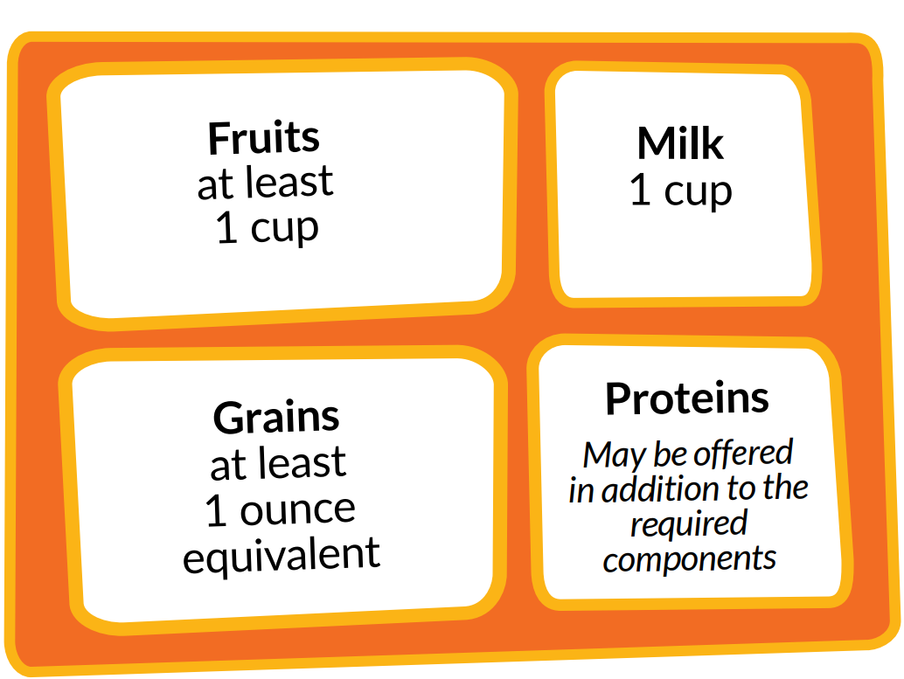
Nutritious Meals
Notes:
Our school breakfasts provide nutritious options for the students. Students will always be offered at least one cup of fruit, one cup of milk, and one ounce equivalent of grains. An example of an ounce equivalent of grains is one slice of bread or one cup of cereal. Protein foods, such as eggs, cheese, and yogurt, and vegetables are frequently served in addition to the required components.

Slide 5

Let us make breakfast!
What would your child do with extra minutes in the morning?
Students may skip breakfast at home
  Not hungry first thing in the morning.
  Feeling rushed in the morning.
  Would rather sleep longer.
Notes:
We know that mornings can be hectic. What would your child do with extra minutes in the morning? Sleep, finish homework, not be rushed to catch the bus?
Additionally, many students don’t want to eat breakfast at home for a number of reasons.
Not hungry first thing in the morning.
Feeling rushed in the morning.
Would rather sleep longer.
Save time in the morning and have your student eat a nutritious breakfast at school.

Slide 6
Academic Performance
Behavior
Concentration
Problem solving
Attendance
Notes:
It has been shown that students who eat breakfast regularly are more likely to have:
•Better behavior in school.
•Improved concentration, alertness, and attentiveness in class.
•Improved abilities to perform problem solving tasks and better perform on standardized tests.
•Fewer absences and late arrivals.
According to the DPI Get School Breakfast Brochure, participating in school breakfast is associated with improved math, reading and memory scores.

Slide 7

School Breakfast Rocks!
Nutritious
Time Saver
Helps students do their best
Notes:
Our school breakfast program rocks! To sum up, our meals are nutritious, save time during busy mornings, and help students do their best in schools and in sports.

Slide 8

Thank you!
Questions?
[Your name and contact information]
[Where to find more information]
Notes:
Thank you for your time today. Once again, my name is [name] and my contact information is on this slide. Are there any questions?

