Slide 1
Title Slide
WISEdata: Annual Tasks Checklist
Jodyann Hunter
Customer Service
March 2024

Slide 2
Objective and Agenda
Inform you of
DPI annual data cycles
What tasks are needed
When they are needed
DPI resources to help you, such as :
Web resources
Live training
9:00 – 9:10, Introduction
9:10 – 9:30, Beginning of Year
9:30 – 9:45, May Snapshot
*Break*
9:50 – 10:10, December Snapshot
10:10 – 10:30, End of Year
Notes:
Since this is such a large audience, there is likely to be people here at all levels of comfort with the WISE reporting system from beginners to more advanced.
If I’m covering material that you already know, maybe lend an ear to a neighbor if they have a question. And congratulate yourself for being wise about WISE.
If I’m covering material that feels overwhelming, remember to check back to the WISEdata Conference webpage and feel free to watch the recording of this session.
There will be hyperlinks on most of these slides directing your to DPI resources (webpages, etc) that can assist you through these data collection cycles at the time when you need it!

Slide 3

Beginning of the Year (BoY) Tasks
Accessing DPI applications:
WAMS, WISEsecure, DSA tasks, User Roles
Updating Agency Contacts:
School Directory, WISEdata Portal, WISEadmin, WISEid, WISEstaff
Preparing your SIS:
Vendor list, Ed-Fi Credential API, Key/Secret
Uploading WISEids for students and staff
Gathering student demographic information
July
August
September
Notes:
Every school year, there are a few tasks that you must complete before the year’s WISEdata collection begins.

Slide 4
Annual Data Collection Cycles
February
July
September
Prep current year demographic data for the Spring Snapshot, ~AND~
Roster data for the upcoming school year.
Spring Snapshot
Prep Year End (YE) completion data
~AND~
Prior year Career and Technical Education (CTE) data
Year End
Prep:
Demographics, District Library Plan, Graduation Plan, TFS
Fall Snapshot
Source: Snapshot Preparation Guidance
Notes:
Borrowed this slide from “Not All Errors Are Equal” presentation
February – Current year demographic* data in preparation for the Spring Demographic Snapshot and Roster* data for the upcoming SY
July – Year End Completion* and prior year Career and Technical Education (CTE)
September – Demographics, District Library Plan, Graduation Plan, TFS
Demographic: Race/Ethnicity, Gender, Grade Level, Disability Status, Economic Disadvantaged Status, Food Service Eligibility, enrollment, food service, Migrant, ELL Status, Homeless, Parent in Military
Roster: Courses, grading periods, sessions, staff, etc.]
Year End Completion: Attendance, Completion, Credential Type, Discipline, and Transcripts

Slide 5
What is Snapshot and Why Do We Collect Data?
A static report that is collected on a predetermined date
Serves as the permanent data source for certified reporting by DPI
Used for the following purposes:
Federal reporting, including ESSA
Public Reporting in the Data Warehouse
Accountability Report Cards
Establishes funding determinations, such as IDEA, high poverty aid, maintenance of effort (MOE), etc.

Slide 6

December and May Snapshot Collections
December Snapshot captures data from three collections:
Year-End Collection
Third Friday of September Collection
October 1 Child Count Collection
Spring snapshot captures student demographic data, outlined on an upcoming slide.
Notes:
Cursory glance – use notification portal and WISE Events Calendar link to stay updated on Snapshot preparation /Data Quality Outreach season.

Slide 7

December Snapshot Prep
Demographics for Both Choice and Public:
Race/Ethnicity, Gender, Grade level, Disability Status,
Economic Disadvantaged Status, Food Service Eligibility
Demographics Only from Public:
Migrant Status
ELL Status
Homeless Status
Parent in Military
September
October
November
December
Year-End Completion Data Includes:
Previous Year’s Attendance
Completion
Credential Type and Transcripts

Slide 8

May Snapshot Prep
Student Demographic Data:
February
March April
Race/Ethnicity
Gender
Grade Level
Disability Status
Economically Disadvantaged Status
Food Service Eligibility
Migrant Status
ELL Status
Homeless Status
Parent in Military
All demographic data is collected for the current school year.
(e.g., May 21, 2024, snapshot will collect data from 2023-24 school year)
Notes:
Every school year, there are a few tasks that you must complete before the year’s WISEdata collection begins.

Slide 9
End of the Year (EoY) Tasks
Review WISEdata Portal Quality Alerts and Data Quality Indicators.
NOTE: These mini tutorials need some updating!
Stay in contact with your SIS vendor:
WISEdata Portal Vendor Resources screen
Data element “close out”
Start enrollment/registration documents for the new school year
April
May
June
July
Notes:
Every school year, there are a few tasks that you must complete before the year’s WISEdata collection begins.

Slide 10
Beginning of the Year (BoY) Checklist Tasks
Notes:
Every school year, there are a few tasks that you must complete before the year’s WISEdata collection begins.

Slide 11
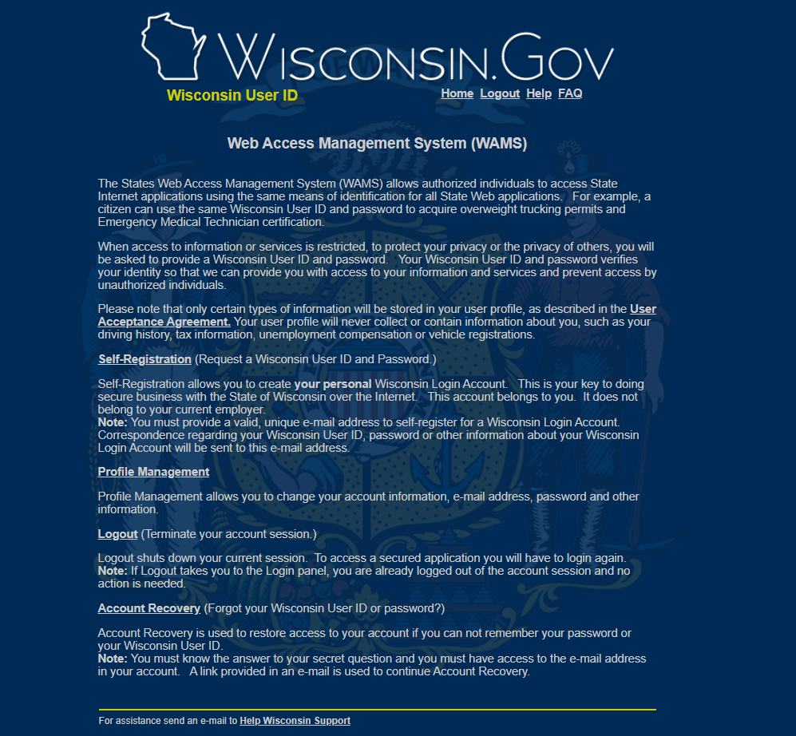
BoY: WAMS Credentials
To access and send data to DPI WISE applications, you will need to get WAMS Credentials (ID and password).
Visit the Customer Services Team WAMS: Detailed Information webpage to help you go through this process.
Creating Your WAMS Account
Updating WAMS When You Change Districts
WAMS FAQ

Slide 12
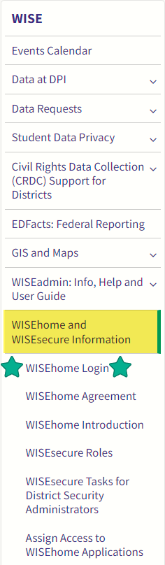
BoY: Accessing WISE Applications
With WAMS credentials, you can now access WISE applications using the WISEhome login
WISEhome and WISEsecure Login Information webpage: overview in written directions or video format
Steps to Request Access to a WISE Application:
Log in with WAMS credentials
Request Access
Customer Access Form
Check Email

Slide 13
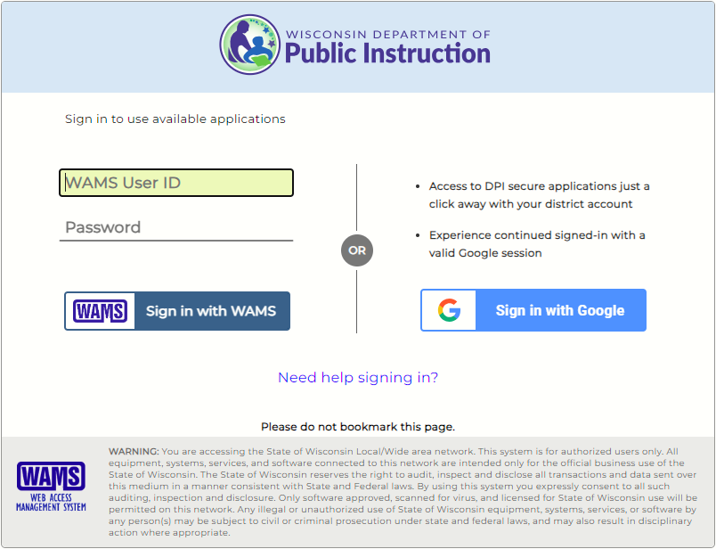
BoY: WISEhome Login
WISEsecure covers all applications with digital data security
WISEhome login portal – 2 ways to sign in
WAMS credentials (left)
Sign in with Google (right)
CAUTION: FIRT TIME LOGGING IN!
Do not use the Google single-click sign in on your very first login!

Slide 14

Google Single Click as 1st Ever Sign In
DPI recommends signing on for the very first time into any WISE accounts using your WAMS credentials as best practice.
Using the Google single sign-on button as your very first sign-on will prevent you from ever being to sign on with your WAMS user ID and password.
Account recovery or password resets problematic

Slide 15
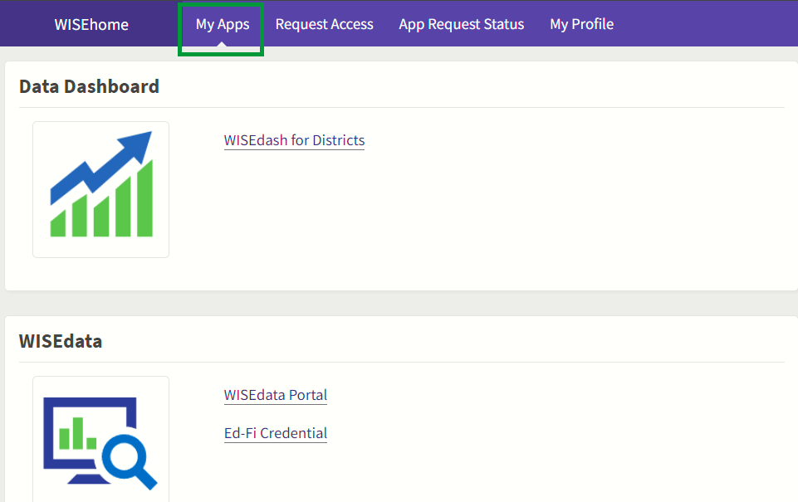
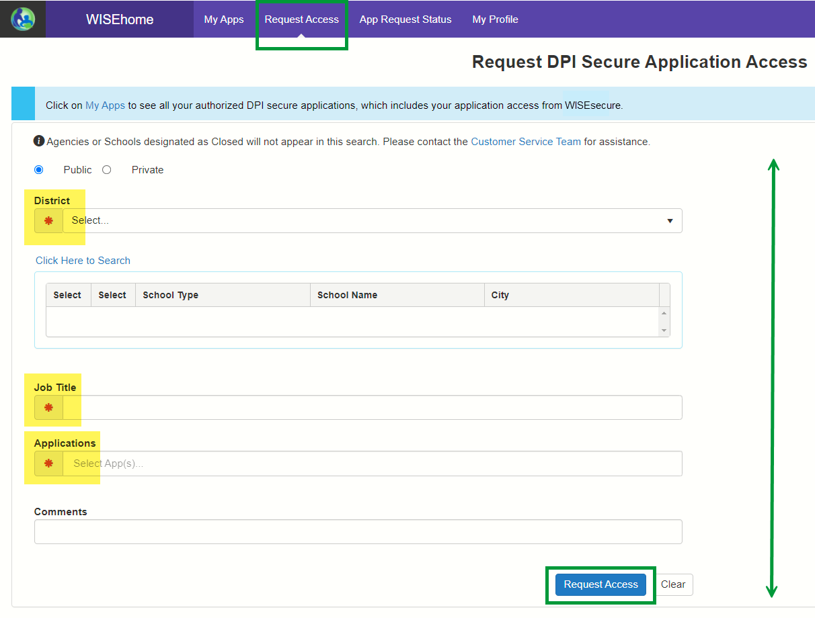
BoY: WISEhome
WISEhome landing screen
Four tabs:
My Apps
Request Access
App Request Status
My Profile
Remember the Request Access screen for slide 10…

Slide 16
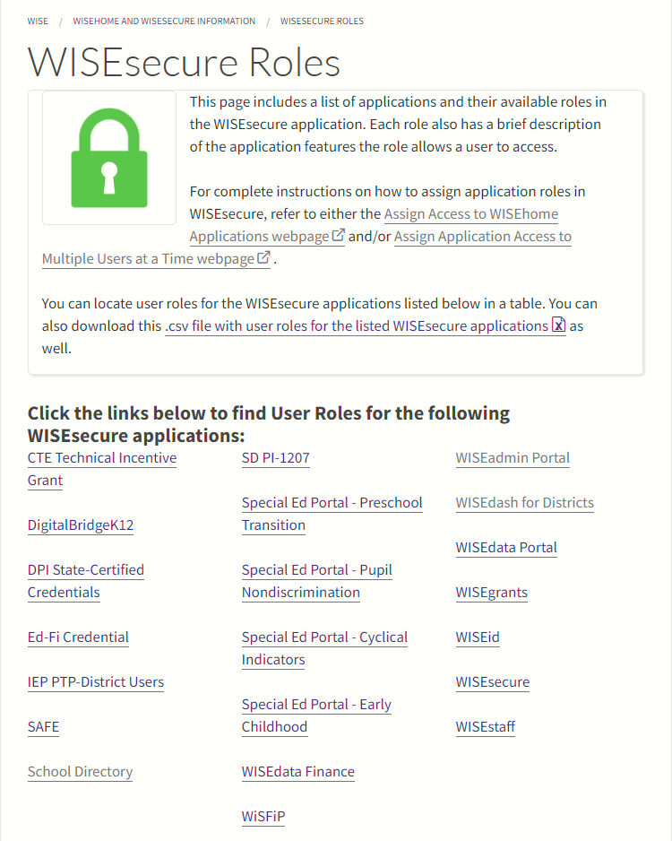
BoY: WISEsecure Application User Roles
Initial login to the WISEdata Portal will prompt you to:
    Complete the WISEhome agreement
    Verify your contact details
    Affirm your accountability for data collections and data quality through the completion of the Acknowledgment screens
New staff must be assigned the correct user role for DPI applications.
One VERY IMPORTANT USER ROLE is the DSA.

Slide 17

District Security Administrator (DSA)
District Superintendent/Choice Administrator or that person’s delegate
Automatically has Application Administrator (App Admin) access as well
Can also assign App Admin role to another
App Admin Role:
Sees who all has access to DPI applications
Add access for new staff and offboard users for former staff
Approves or denies requests, once you request

Slide 18
DSA and App Admin Resource Pages
WISEsecure Tasks for District Security Administrators
Assign Access to WISEhome Applications
WISEhome and WISEsecure Information webpage,
Information for Application Administrators section

Slide 19
Updating Agency Contacts
1st time login after summer break, most DPI WISE applications will prompt user to confirm and edit their contact information.
WISEid: Primary and Secondary Contacts
WISEstaff: Primary and Secondary Contacts
WISEadmin Portal: Primary and Secondary Contacts
WISEdata Portal: Primary and Secondary Contacts
School Director Management Portal (User Guide by Agency Type)
CAO 23-24 SY: FDS, LDS collected in WDP, then pushed into the School Directory. First Day of School/Last Day of School data element page.
Notes:
Ed-Fi session
WISEdata for New Users
SIS to WISE data to Report card session

Slide 20
Data Flow from Your SIS
Your school/district's data is entered in your SIS (vendor tool).
That data is then pushed to WISEdata.
A validation check then runs through a validation in the system.
The data that is validated is used the day and time of snapshot.
Data is loaded into the Data Warehouse.
Finally, the data is “snapped” for reporting purposes.
Notes:
Ed-Fi session
WISEdata for New Users
SIS to WISE data to Report card session

Slide 21
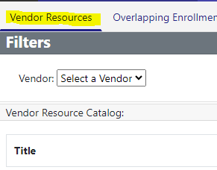

SIS Software/Vendor Tool Resource Pages
Stay on top of your SIS’s latest release.
Check frequently to be sure your SIS software is the newest version.
    Certification Status: Vendor List
    Ed-Fi Credential: Submitting Data to DPI
    Ed-Fi Credential Application mini-tutorial (User Guide)
  Or - select “Vendor Resources” from the WISEdata Portal Resource screen.

Slide 22

Upload WISEid
DPI advises:
a weekly upload of Active Student WISEid files to the WISEid application at the beginning of every academic year
Until your 'SIS-to-WISEdata' transfers are well established.
NOTE: This assumes you utilize a SIS with the Student Identity Integration API to generate new WISEids.
Notes:
Vendors that do not have this feature tend to specialize for Choice schools.

Slide 23
Collect Student Demographic Information
Student demographic information is collected during the registration process and is needed for WISEdata reporting purposes.
Gender
Race/Ethnicity
Ancestry/Ethnic Origin
Tribal Affiliation
Grade Level
Economically Disadvantaged Status
Food Service Eligibility
Disability Status
English Language Proficiency
Homeless Status*
Parent in Military*
Digital Equity
Notes:
All of these data element are ‘snapped’ either in May or in December
Race/ Ethnicity and Ancestry/Ethnic Origin
Race – federal requirement
Ancestry – optional
Disaggregate by racial groups and again by ethnic origin sub-groups: Ex Hmong versus other Asian sub-groups, and then Hmong data by gender (boys and girls have different strengths and weaknesses)

Slide 24

Data Teams
It is strongly advised to form a data team, with a lead designated for every area of data collection. The team should examine and become knowledgeable about data collection, SIS entry, and submission to WISEdata. For instance, in addition to current WISEdata users, the Roster data team should consult with specialists in course work and CTE regarding public schools.
Please view WISExplore for more information.
Reach out to your Local CESA as well.

Slide 25

DPI Outreach: Back to School
Back to School Kick Off Training
Started 2023-24 school year
Was a BIG HIT!
Very detailed info and well attended
Will occur again for 2024-25 SY
See WISE Events Calendar details for training offered in 2024.

Slide 26

BoY: How to Stay Informed
Familiarize yourself with new data elements and the submission process.
Gain knowledge about the latest enhancements with Release Notes.
Review Error and Warning validations through the KBA Portal.
Stay informed by regularly checking the Notifications Portal.
Bookmark and use the WISE Events Calendar to find upcoming events, trainings, conferences, snapshot dates, webinars, and deadlines.
Register for and attend User Group calls.
WISE User Group Webinar: Tuesdays at 1:30 p.m.

Slide 27

BoY Quiz Time!

Slide 28
BoY Question 1
True or false, student demographic information is collected during the registration process and is needed for WISEdata reporting purposes.
True
False

Slide 29
BoY Q1, Answer
True

Slide 30
BoY Question 2
The attendance data element is mandatory for which schools?
Both Choice and Public Schools
B. Private Schools
C. Only Choice Schools

Slide 31
BoY Q2, Answer
Both Choice and Public Schools

Slide 32
BoY Question 3
True or False, Security Administrators have access to offboard users and add access for former and new staff members?
True
False

Slide 33
BoY Q3, Answer
True

Slide 34
BoY Question 4
Where can contacts be updated for WISEdata outreach?
WISEdata Portal
WISEdash for Districts
Dpi.wi.gov

Slide 35
BoY Q4, Answer
WISEdata Portal

Slide 36
December Snapshot Checklist Tasks
Notes:
Every school year, there are a few tasks that you must complete before the year’s WISEdata collection begins.

Slide 37
December Snapshot Collections
There’s a lot of data ‘snapped’ in the December Snapshot!
The main collections are:
Discipline
Roster and CTE data
“Year End” data, Grad Plan and High School Graduates
Third Friday of September Enrollment
October 1 Child Count
Demographics
District Library Plan
Notes:
Each of these collections is made up of multiple data elements. There are some examples for you on the next two slides.

Slide 38

Third Friday of September Enrollment Count
(Part of December Snapshot)
TFS data includes:
Count Date Status
Count Inclusion: 3rd Friday of September
Submitting District
District of Residence
District/School of Accountability
… Among Many others.
  Helpful Resources:
  Enrollment DQ Audit page
  TFS DQ Audit page
Notes:
Here is an example of all the data elements that make up the Third Friday of September data collection….

Slide 39
October 1 Child Count
(Part of December Snapshot)
October 1 data includes:
Count Inclusion
Special Education- sSEPA records Begin
PPP (Parent Placed Private) Enrollment Type
Educational Environment Codes
*Private Choice Schools are excluded from this collection.
Notes:
And here is an example of all the data elements that make up the October 1 Child Count data collection….

Slide 40
Year End Data Collection
(Part of December Snapshot)
This data is covered in our End of Year section!
You can find all the data elements the fall under each collection by visiting the WISE Data Elements landing page, selecting the “Collection” filter you want, and clicking the ‘Apply’ button.

Slide 41
Year-End Student Data Collection
(Part of December Snapshot)
Year End (YE) data encompasses all the data collected at the end of the previous academic year, including:
Parent in Military
Race/Ethnicity
Discipline
District Library Plan
Dropouts
Enrollment Type
Graduation
Exits (Exit Dates, Exit Types)
Roster
Special Education
Term Completion Indicator
Attendance
Food Service Eligibility
Disability Status
Economic Disadvantage Status
Gender
Grade Level
Homeless Status*
Immigrant (Title III)

Slide 42
December Snapshot Collection Prep
School | Previous Year’s Discipline | Previous Year’s Roster and CTE Data | Previous Year’s Year-End** Completion | Current Year’s Third Friday of September | Current Year’s Demographics * / *** | Current Year’s District Library Plan | Current Year’s Digital Equity (NOT REQ’D) Strongly Recommended | Current Year’s Grad Plan/ HS Grad Requirements | Current Year’s Oct 1 Child Count
Public | ✔ | ✔ | ✔ | ✔ | ✔ | ✔ | ✔ | ✔ | ✔
Choice |  |  | ✔ | ✔ | ✔ |  | ✔
***Both Choice and Public Demographics: Race/Ethnicity, Gender, Grade level, Disability Status, Economic Disadvantaged Status, Food Service Eligibility ** Year-End Completion Data Includes: Previous Year’s Attendance, Completion, Credential Type and Transcripts * Public Only Demographics: Migrant Status, ELL Status, Homeless, Parent in Military

Slide 43
DPI Outreach: December Snapshot
Data Quality Outreach: One of the many ways that DPI initiates the examination and engagement of year-end data during the fall season.
Visit the WISE Events Calendar to find webinar and in-person training events.
Visit the Snapshot Preparation Guidance page for details on why snapshot data is so important, and to view preparatory slide decks and webinars.
Visit the Snapshot Data Quality Auditing webpage for detailed 'how-to' information about how to locate and audit your data.
Notes:
Much of our End of Year data (also called Year End data) gets covered in training for the December snapshot.
This is because when the end of the school year rolls around, we know that teachers and school staff tend to go on vacation!! ☺
And when the school year starts up again, that’s when we’re providing you with all that good Back to School Kick Off training, so it makes the most sense for us to cover the YE data collections within December snapshot training.

Slide 44
December Snapshot Quiz Time!

Slide 45
December Snapshot Question 1
Who should submit Discipline data?
Charter Schools
Public & non-district Independent Charter Schools
Department of Health Services (DHS) Students

Slide 46
December Snapshot Q1, Answer
B. Public & non-district Independent Charter Schools

Slide 47
December Snapshot Question 2
Which of these months has a deadline for snapshot?
November
January
December

Slide 48
December Snapshot Q2, Answer
C. December

Slide 49
December Snapshot, Question 3
True of false, Roster data is mandatory for all grade levels from K4 to 12th grade.
True
False

Slide 50
December Snapshot Q3,Answer
True

Slide 51
December Snapshot Question 4
December Snapshot captures data from which collections?
Year-End Collection , Third Friday of September Collection , October 1 Child Count Collection, Demographics
Year-End Collection, Third Friday of September Collection, October 2 Child Count Collection
WISEdata Collection, Third Friday of September Collection, October 1 Child Count Collection, Demographics

Slide 52
December Snapshot Q4, Answer
Year-End Collection , Third Friday of September Collection , October 1 Child Count Collection, Demographics

Slide 53

Break Time
Lots of key information has been covered so far! Please take a 5-minute break to stretch your feet, get a nice cool drink, or use the restroom.
The session will resume in the next 5 minutes.

Slide 54
May Snapshot Checklist Tasks
Notes:
The May snapshot is where those beginning of the year enrollment and registration demographics become very important!

Slide 55
May Snapshot Collections
Student demographic data is ‘snapped’ in the May Snapshot!
The data elements covered are:
Gender
Race/Ethnicity
Grade Level
Economic Disadvantage Status
Food Service Eligibility
Disability Status
English Language Proficiency
Language Instruction Services
Homeless Status*
Parent in Military*
Immigrant (Title III)
Notes:
Data elements with an asterisk (*) are not reported by Choice schools

Slide 56
Spring Snapshot Tasks
Economically Disadvantaged Status
  Economically Disadvantaged Status is determined by household income information.
  Must be reported for students regardless of whether or not the school participates in the National School Lunch Program.
  Economically Disadvantaged Status DQ Auditing webpage
  eLearning for Economic Disadvantages Status
Notes:
This can be a very complicated set of data. Economic Disadvantaged status is different from Food Services eligibility. Our data element pages linked here at the very top has LOADS of information that should help you answer MANY questions.
There is also a Data Quality audting webpage that was prepared specifically for this data to help prepare you for the December snapshot.
And the eLearning has been recently reviewed and updated to provide you with aligned content.

Slide 57
Spring Demographic Snapshot
All Data Collected is from Current School Year School | Disability Status | Gender | Grade Level | Economic Disadv | ELL | Food Service Eligibility | Homeless | Migrant Status | Parent in Military | Race / Ethnicity
Public | ✔ | ✔ | ✔ | ✔ | ✔ | ✔ | ✔ | ✔ | ✔ | ✔
Choice | ✔ | ✔ | ✔ | ✔ |  | ✔ |  |  |  | ✔

Slide 58
DPI Outreach: Spring Snapshot
DPI provides some Year-End training.
If you want to see more opportunities for this, "Submit Feedback” to tell us about your needs.
This training covers details for how to complete the year-end tasks (“rollover”) in your SIS.
  Your SIS vendor may also offer training. Please reach out to your vendor tool representative for more information.

Slide 59
May Snapshot Quiz Time!

Slide 60
May Snapshot Question 1
What does ELP stand for?
English Language Proficiency
Empowering Language Proficiency
English Learner Proficiency

Slide 61
May Snapshot Q1, Answer
English Language Proficiency

Slide 62
May Snapshot Question 2
Which one of these are part of the Student Demographic Information that is needed for reporting?
Gender
B. Grades
C. Height

Slide 63
May Snapshot Q2, Answer
Gender

Slide 64
End of the Year (EoY) Checklist Tasks

Slide 65
EoY 'Close Out' Tasks:
Year End (YE) data encompasses all the data collected at the end of the previous academic year.
Data Element 'Close Out' Tasks:
  Attendance
  Credential Type (Diploma Type)
  *Discipline
  (*) ELP Scores
  Exit Dates
  Exit Types
  Food Service Program Exit Date
  *Roster
  sSEPA Record End Date
  Term Completion Indicator

Slide 66
DPI Outreach: Year-End Data
DPI Begins Review and Outreach of YE data each Fall.
When the Customer Services team begins their fall Data Quality Outreach, we (the Customer Services Team)suggest that:
You start looking at year-end data FIRST
Then, dive into the new school year’s data.
It may be confusing to know which data to look at from which year, so we have guidance on what to focus on and what is safe to ignore:​ (next slide)
Notes:
For example, in the Fall of 2024 (with the beginning of the 2024-25 school year), WISEdata Portal will present validation messages from:​
the 2023-24 school year AND​
from the 2022-23 school year. ​
For example, in the Fall of 2023 (with the beginning of the 2023-24 school year), WISEdata Portal will present validation messages from:​
the 2022-23 school year AND​
from the 2021-22 school year. ​

Slide 67
EoY: What Year to Focus On
School Year | Data/Record | Data/Record | Data/Record | Data/Record | Data/Record
Current Year (e.g., 2023-24) | Oct 1 Counts | Special Education records | Student Demographics | Student Enrollments | TFS Counts
Prior Year (Last Year) (e.g., 2022-23) | Attendance | Discipline | Diploma Information | Exit Dates | Exit Types
 | Program Data | Roster Data | Special Education Records | Student Enrollment Records
2nd Prior Year (2 Years Ago) (e.g., 2021-22) | Only Resolve Data Issues (i.e., errors and warnings) with any outstanding full-term dropouts from two-years-prior school year |  | Ignore Data Issues (i.e., errors and warnings) with dropout data.
Notes:
This table details what data from which of the three active school years in WISEdata Portal you need to focus on for Year End data.

Slide 68
EoY Quiz Time!

Slide 69
General Question 1
What can you do when you have a question or need further clarification ?
Submit a help ticket
Send a letter to DPI via mail
Keep your questions to yourself

Slide 70
General Q1, Answer
Submit a Help Ticket

Slide 71
General Question 2
Where would you go to get help on processes supporting data-informed decision-making for school and district leaders?
The Help Ticket
WISExplore
WISE Events Calendar

Slide 72
General Q2, Answer
B. WISExplore

Slide 73
General Question 3
True or False, training opportunities are available 24/7.
True
False

Slide 74
General Q3, Answer
True
eLearnings can be accomplished at any time!

Slide 75
Resources
WISEdata Annual Tasks Checklist
Choice-specific Yearly Reporting Requirements
WISEtraining webpage
WISEdata Events Calendar
WISE User Group Webinar
Snapshot Preparation Guidance page
Snapshot Data Quality Auditing pages

Slide 76
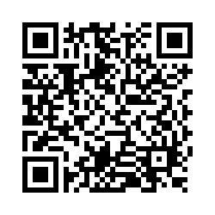
Questions?
Thank you! Thank you!
Please scan the QR code to provide us with your feedback!

