Slide 1
Data Matters
World Language Education
Pam Delfosse, Literacy and Math Team
Jaidaa Shafaei, WISEdata Collections Team
WISEdata Conference
March 6, 2024
Notes:
2:45 - 4:00 75 minutes Kilimanjaro Suite 4Description: Join us to gain insights into best practices for reporting students in world language education programs. Learn how to categorize students based on program type, linguistic background, and standards-based learning goals. This session will include scenarios to guide data-reporting for world language education programs.
Welcome and introductions
Topics for discussion with Jaidaa
-conversion to MS PPT slides in Teams
-accessibility, styling/branding
-notes
-screen shots program type/model, course selection, language of instruction
-shift from student to roster level reporting? (problematic for non-ELs in LIEPs?)

Slide 2
Session Goals
Communicate impact of world language data
Share data trends
Improve data fidelity
Share guidance and examples
Address questions
Identify areas for support

Slide 3
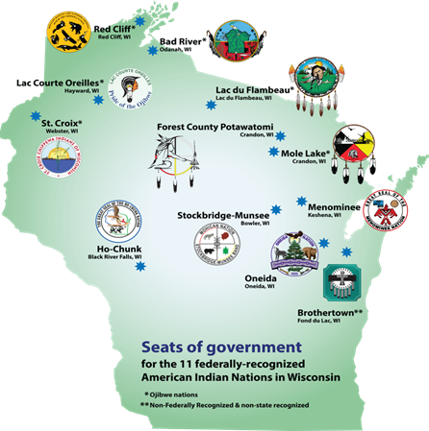
Land and Language Acknowledgement
The Wisconsin Department of Public Instruction acknowledges and honors the linguistic and cultural heritage, and inherent sovereignty, of the American Indian Nations of Wisconsin.
Tribal Nations of Wisconsin
Notes:
As we begin today’s session on the topic of data for world language learning, it is important to recognize the first nations, cultures, communities, and languages of this region. Today, we gather on land which is home to the Hochunk people.

Slide 4
Six Indigenous Languages of WI
Hocak (Ho-Chunk)
Ojibwe
Oneida
Menominee
Mohican
Potawatomi
American Indian Studies Resources
Waadookodaading Ojibwe Language Immersion School
Notes:
There are 6 indigenous languages spoken by the 11 federally-recognized American Indian Nations in our state.
Prior to this year, course data for these languages was collected under the umbrella term, “American Indian Language”. We will now have language-specific course options and data to support Indigenous Language revitalization in our state. Many elder speakers of these languages were lost during the global health pandemic. Support for American Indian languages matters now more than ever. Thank you for your help collecting and reporting data on where these languages are being supported in our school communities.

Slide 5
Hmong Language Data in Wisconsin
“I feel more confident talking about myself…I feel like I can show my Hmong, instead of holding it in.”
~Ani
(Student within Hmong Language and Culture Enrichment Program)
Wisconsin Life: Hmong Culture
Notes:
We also began collecting data on Hmong language learning this school year. Hmong is the 3rd most spoken language in Wisconsin. Language is an important element of one’s culture and identity. This new data set will help us identify which schools are teaching Hmong so that we can improve our systems of support for Hmong language programs and the diversity of students within them.

Slide 6
New Roster Codes for 2024-25
In addition to the five course codes for Hmong and Indigenous Languages, we have introduced four additional options, mirroring other prevalent World Languages (WL) courses.
Conversation and Culture
Native Speakers
Immersion
Young Learners
Notes:
Jaidaa - 1 through 5 and AP, adding a range of course options similar to other common WL courses

Slide 7
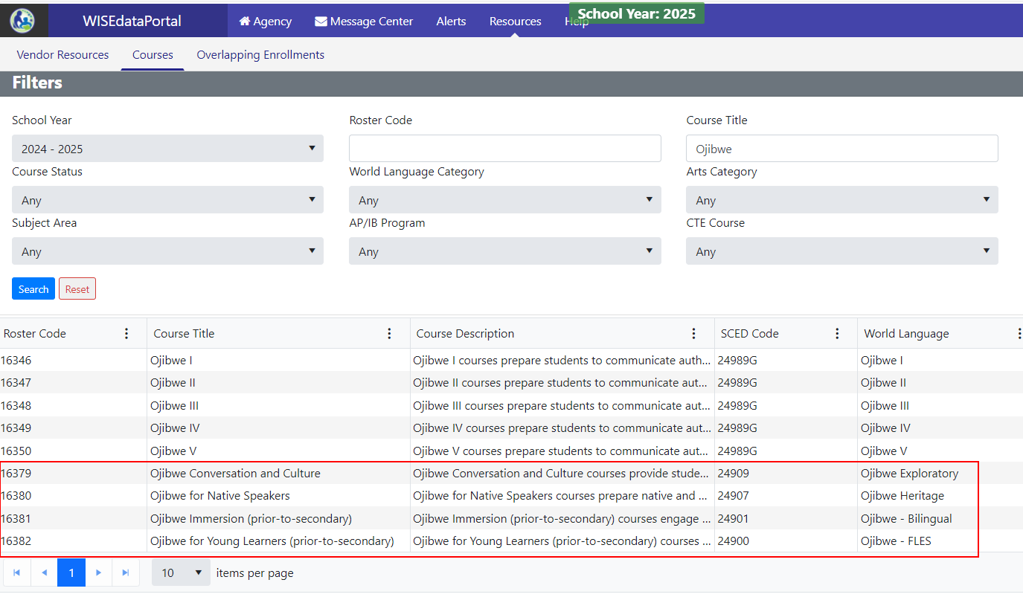
WISEdata Portal Courses screen
Notes:
Jaidaa

Slide 8
Data Use
Statutory compliance
Program development
Research
Access and innovation
Policy and budget
Teacher recruitment and retention
Workforce development

Slide 9
World Language Data: Trends & Implications
Comparative Data Review 2012-2013, 2017-2018, 2022-2023
Significant declines in high school student enrollments
Higher enrollment rates by students of color
Enrollment declines by economically disadvantaged youth
Reduced access to learning languages other than Spanish
Improved rate of LEA data reporting!
Notes:
https://docs.google.com/document/d/1uyHl7SwyEfxJk0WktMTmLYmnF0-_CsNqxW2Ntd3xGOk/edit?usp=sharing
Pam add data

Slide 10
WL vs LIEP Programs
World Language Education Program Models | Language Instructional Education Programs (LIEP)
Educational programs and learning environments that are focused on developing language, intercultural and global competence in Languages other than English (LOTE). Student learning is anchored in the Wisconsin Standards for World Languages. | The Elementary and Secondary Education Act (ESEA) specifically defines a LIEP as an instructional education program: (A) in which a limited English proficient child is placed for the purpose of developing and attaining English proficiency, while meeting challenging state academic content and student academic achievement standards, as required by section 1111(b)(1); and (B) that may make instructional use of both English and a child’s L1 to enable the child to develop and attain English proficiency and may include the participation of English proficient children if such course is designed to enable all participating children to become proficient in English and a second language (L2). Student learning is anchored in the WIDA English Language Proficiency Standards and often includes content area standards.
Notes:
LIEP centers ELD and EL academic achievement
WL LOTE

Slide 11
English Learners in World Language Programs
Programs through which English Learners are accessing English Language Services are LIEPs, not world language programs.
English Learners may also be enrolled in a world language program.
Somali speaking EL in an ESL LIEP and also taking Chinese as a World Language
Spanish speaking EL in an ESL LIEP and also enrolled in a Spanish for Native/Heritage Speakers World Language program
French speaking EL in an ESL LIEP and also enrolled in a Secondary World Language French AP class

Slide 12
World Language Learners
in Bilingual Programs
Students who are not ELs, but who are enrolled in a bilingual education LIEP, are reported using world language program data.
Former EL who continues to learn within a two-way dual language program
Native English speaker who is enrolled in a two-way dual language program along with EL peers
Student who is not an EL and whose home/heritage language is used within a dual language program

Slide 13
Common WL Codes for Former ELs & Simultaneous Bilinguals
One-Way Dual Language Education Program OWDL
Two-Way Dual Language Education Program DLTW
Dual Language Education Developmental Bilingual - Heritage Learners DLDB-HL
Notes:
BI - DLTW Bilingual LIEP
BI - DLDB Bilingual LIEP

Slide 14
LIEP or World Language Program?
Program Data Quiz:
Is the program providing English language development to English Learners?
Is the program designed to support access to subject matter learning in Languages other than English (LOTE)?
Is the student a non-EL or former EL?
Is the primary or sole goal of the program to develop or sustain proficiency in LOTEs for second language learners?
Notes:
Post questions to audience to answer. Gesture with L or W

Slide 15
Relevant Statutes and Rules
Access to world language education beginning in grade 7 and through grade 12 is required by State Statute 121.02(1)(L)/5
State Administrative Rules require instruction with frequency and duration needed to realize the objectives of a sequential standards-based curriculum. PI8.01(L) 4/6
World Language Education Rules and Recommendations
Notes:
Access to world language learning is influenced by state statutes and administrative rules. Schools in Wisconsin are required to provide regular access to sequential, standards-based world language learning, in grades 7-12.

Slide 16
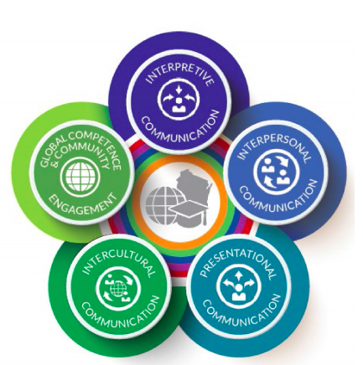
World Language Data Elements
Course Codes (/courseOffering)
World Language Program (/section)
Language of Instruction (/section)
Learners (/studentSectionAssociation)
Notes:
Pam
https://docs.google.com/document/d/1zfUmfpKH7GIZhJdl40_Nbu0rYW-AT43jgCnW4TVjQAk/edit#heading=h.c4wc3cra6e1t

Slide 17
Link to World Language Program Types
Exploratory World Language (PK-6) EXWL
Elementary School World Language ESWL
Content-Based World Language (PK-6) CBWL
One-Way Dual Language Education OWDL
Two-Way Dual Language Education (Non-ELs in bilingual LIEP) DLTW
Secondary Level World Language (6-12) WLSL
Heritage Learner World Language HLWL
American Indian Language AIWL
Facilitated World Language Study FWLS
Notes:
This is the list of the World Language Program Types. A diversity of courses, languages, and learners exist with these programs.

Slide 18
Language of Instruction
Language used for teaching and learning within the course
Course-level data element
English as default
Language of Instruction Data Element Page
Notes:
Data for any and all district courses now includes the option to submit the language of instruction for that course. English is coded as the default language. If a course is facilitated in a LOTE e.g. Spanish, Chinese, or French, schools may now report the language of instruction. This will be a powerful tool for identifying content areas being learned within bilingual LIEP and world language programs. This knowledge will help us prepare and recruit educators, connect bilingual content teachers, and showcase and support the growth of dual language education in our state…..

Slide 19
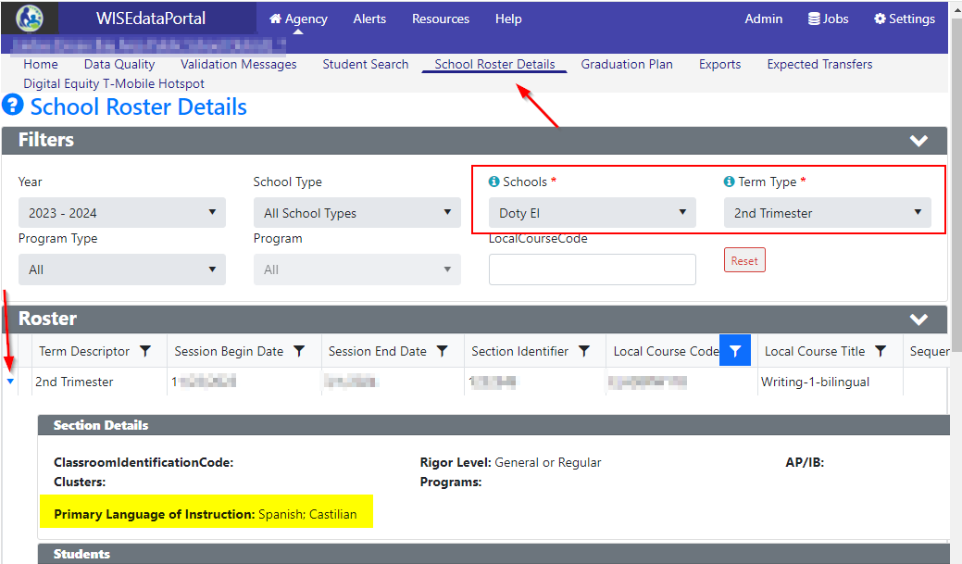
Language of Instruction in WISEdata Portal
WISEdata Portal > School Roster Details
Notes:
Jaidaa

Slide 20
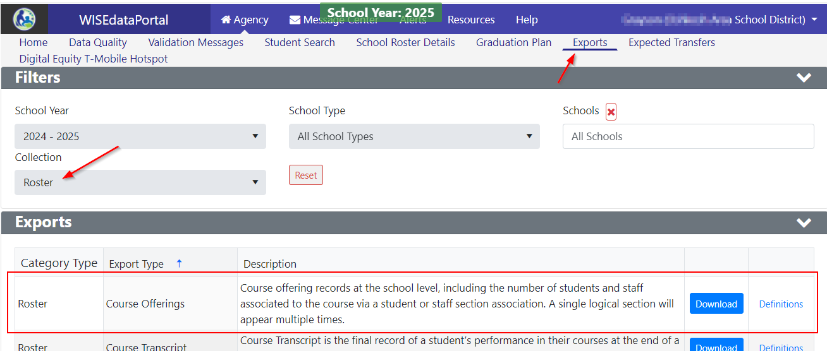
Language of Instruction in WISEdata Exports
WISEdata Portal > Exports > Course Offering (Column Z)
Notes:
Jaidaa

Slide 21
WL Program on Student-Level vs. Course-Level
LEAs should report the World Language (WL) Program on the course-level (/section). This enables LEAs to submit data for students in a bilingual class, comprising English Learners (EL), non-EL, or former EL students, without the necessity of individually editing each student in the SIS.
If a student is enrolled in a section with a WL program reference, DPI will automatically include them in the appropriate WL program at the student level.
Notes:
Jaidaa
Math class taught in Spanish with a WL program as Two-Way Dual Language Education
Half ELs > Reported under LIEP
The other half > Reported with a WL program / ELs should be excluded from the DLTW

Slide 22
WISEdata Validation Messages
Sending the Course
Course sent but using a general WL course code
Error 7188
Course sent but no students in WL program across any grade KG-12
Warning 7191
Course sent but linked to an invalid course/WL program and grade level
EXWL and grade greater than 6
Warning 7185
SLWL and Grade below 6
Warning 7440
Missing SLWL across any grade level 7-12
Error 7193
ESWL and grade greater than 5
Warning 7186
Course is ‘Exploration of Multiple World Languages’ and grade is PK-6, but WL program on is NULL or not EXWL
Warning 7477
FWLS and grade below 9
Warning 7192
CBWL and grade above 6
Warning 7190
Course is ‘Exploration of Multiple World Languages’ and grade is 7-12
Warning 7187
Notes:
Jaidaa - https://dpi.wi.gov/wise/data-elements/WL AND https://docs.google.com/document/d/1zfUmfpKH7GIZhJdl40_Nbu0rYW-AT43jgCnW4TVjQAk/edit?tab=t.0#heading=h.c4wc3cra6e1t
Error 7188 (course-level): LEAs should select a specific World Language Course instead of a Generic course
CourseIdentificationSystemDescriptor = Generic
Warning 7191 (student-level): No student from one or more grade levels KG-12 is registered in a WL course.
School districts are required to provide access to a WL course that allows students to study a foreign language.
Schools with grade levels KG to 6 should confirm whether world language courses are offered, and may acknowledge the warning.
Schools with grade levels 7 to 12 are required by statute to provide instruction in one or more world languages at each grade level.
State Statute 121.02(1)(L)(5) requires school districts to “provide regular instruction in foreign language [sic] in grades 7 and 8.” State Statute 121.02(1)(L)3 requires schools to “provide access to an educational program that allows pupils each year to study foreign language” in grades 9-12.
Error 7193 (student-level): Missing SLWL for grades 7 to 12
Secondary Level World Language Program (SLWL) access to world language learning is required in grades 7-12.
Warning 7440 (student-level): Missing SLWL for grade less than 6.
Secondary Level World Language Program (SLWL) access to world language learning should be offered in grades KG to 6.
Warning 7185 (student-level): Course associated with EXWL is offered to grade levels greater than 6.
Exploratory World Language (EXWL) introduce Pre-K-6 learners to one or more languages for limited instructional time
Warning 7477 (student-level): Students in Introduction to World Language courses should be associated with an EXWL program.
Introductory courses in multiple languages (SCED code 24040) is offered in grades PK-6, but either the WL program is missing or not equal to Exploratory World Language (EXWL).
Warning 7186 (student-level): Course associated with ESWL is offered to student in grade level greater than 5
Elementary School World Language Program (ESWL) articulate with middle school programs through a language proficiency development pathway
Warning: 7187 (student-level): Introductory courses in multiple languages were submitted for students in grade levels 7-12.
SCED code 24040 is for PreK-6 learners
Warning 7190 (student-level): Course associated with CBWL is offered to grade level above 6.
Content-based World Language Program (CBWL) academic content learning facilitated in a language other than English. PreK-6 students in this learning environment for less than 50% of instructional time.
Warning 7192 (student-level): Course associated with FWLS is offered to grade level below 9.
Facilitated World Language Study (FWLS) high school learners, with two or more years of world language study, engage in self-directed learning of a new, less-commonly taught language.

Slide 23
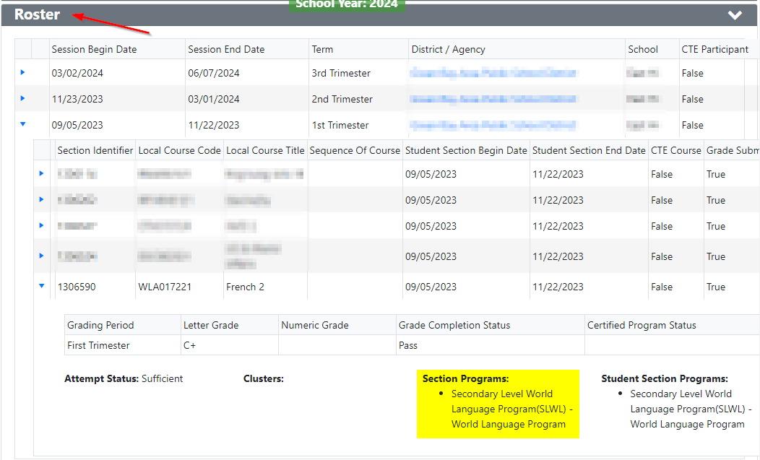
WL Program in WISEdata Portal: Roster
WISEdata Portal > Student Details > Under the Roster panel
Notes:
Jaidaa – If a student is enrolled in a section with a WL program reference, then DPI adds them to the appropriate WL program (student-level).

Slide 24
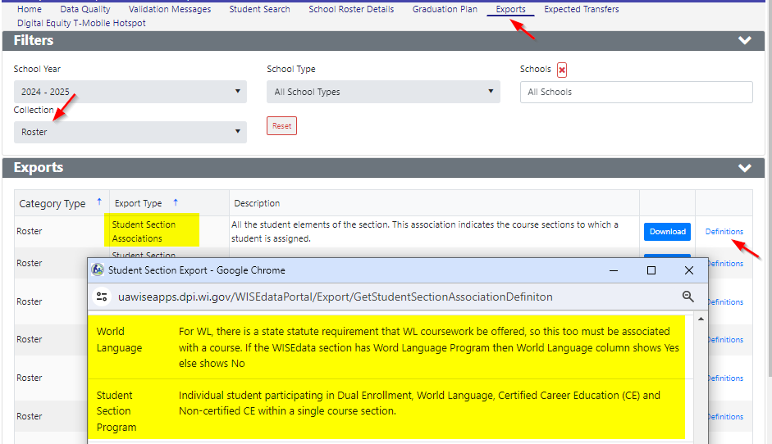
WL Program in WISEdata Exports
WISEdata Portal > Exports > Student Section Associations (Column W or X)
Notes:
Jaidaa

Slide 25
Check for Understanding
For whom is LIEP reporting required?
May an EL be reported as enrolled in a World Language program?
May a native English speaker be reported as enrolled in an LIEP?
If a student speaks a language other than English at home, should they be reported as enrolled in an LIEP?

Slide 26
Resources to Learn More
World Language Education Program Models
World Language Programs data element page
LIEPs Serving English Learners
America’s Languages Report
Making Languages Our Business Report
The Wisconsin Language Roadmap
Wisconsin Seal of Biliteracy
National Landscape & Seal of Biliteracy Reports

Slide 27
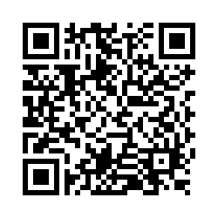
Questions?
Thank you! Thank you!
Please scan the QR code to provide us with your feedback!

