Slide 1
Title Slide
Ed-Fi Credential:
It’s your data - you control the flow.
Heather Kluck
Vendor Relationship Manager
March 2024

Slide 2

Today’s Objectives
Learn about the Ed-Fi Credential application and related terms
Introduce the WISEdata data flow
Understand the purpose and function of Ed-Fi Credential application
Learn how to create a Vendor Subscription
Verify vendor data flow
Vendor Conversion

Slide 3

Sample Text Slide
Let’s Start with Definitions
What is Ed-Fi? Ed-Fi is short for all things from the Ed-Fi Alliance, a nonprofit that wants to help all school districts and states share information easily.
Credentials are a means of authentication to verify a user. The user could be a person or an application, such as an API.
Ed-Fi Credential is an application that you, the Local Education Agency (LEA), use to control the flow of data to WISEdata applications.

Slide 4
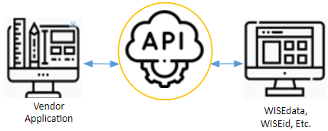
What is an API?
What is an API?
Sitting between you, your certified vendor, and the WISE applications is the application programming interface (API) . This interface is a way for two or more computer programs to communicate with each other.
This data needs to be sent in a secure manner, and your management of a vendor subscription is where it all starts.

Slide 5
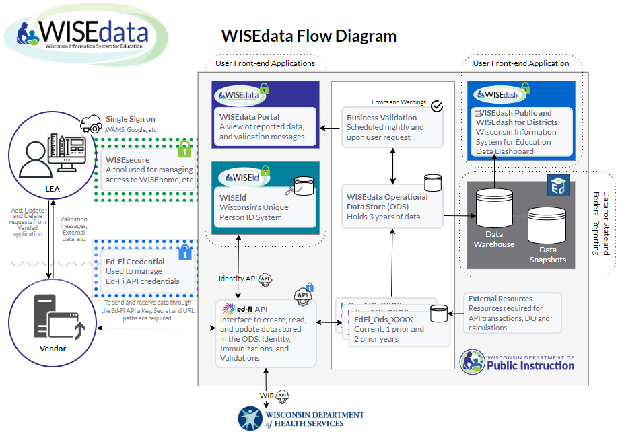
WISEdata Flow Diagram

Slide 6
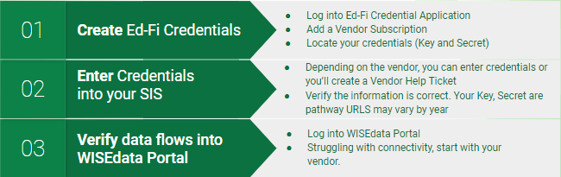
Establishing API Connectivity: Step 1

Slide 7
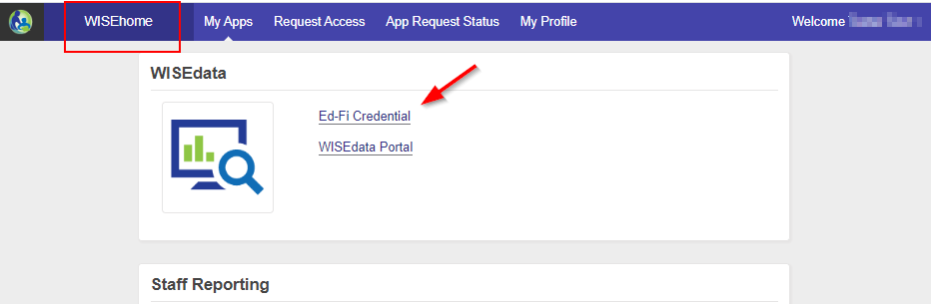
Ed-Fi Credential
Ed-Fi Credential
The Ed-Fi Credential Application is the tool you use to grant permissions to vendors that have your permission to share your data with the state.
No access? Ed-Fi Credential is limited to 1-2 people per LEA. If you think you should be one of those, Request Access.

Slide 8
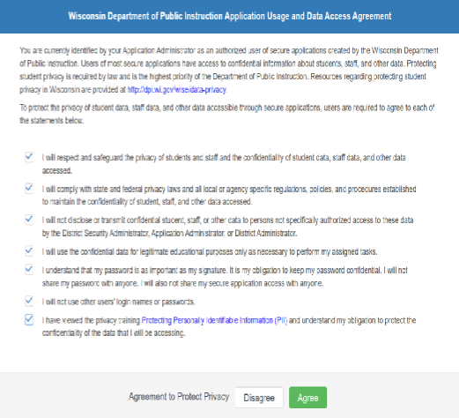
Ed-Fi Credential Initial Access
Prior to logging in, read and review the Agreement to Protect Privacy.
Protecting student privacy is required by law and is the highest priority of the Department of Public Instruction. Resources regarding protecting student privacy in Wisconsin are provided at http://dpi.wi.gov/

Slide 9
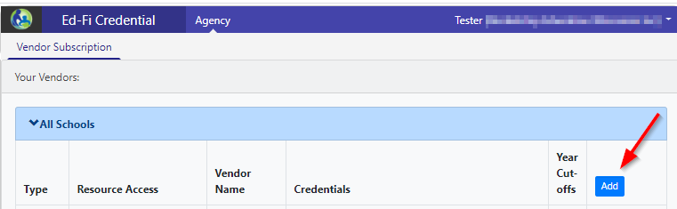
Create Vendor Subscription (1 of 3)
Create Vendor Subscription (1 of 3)
Click the Add button to add a new vendor subscription.

Slide 10
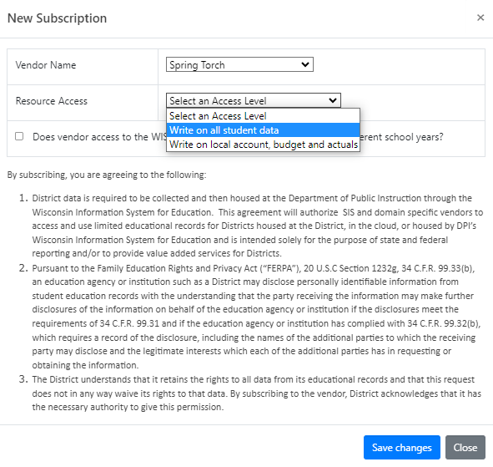
Create Vendor Subscription (2 of 3)
In the New Subscription window, fill out the below fields, and then click Save Changes.
Vendor Name
(Select from the drop-down list)
Resource Access
(Select ‘Write on all student data’)
Click Save Changes

Slide 11
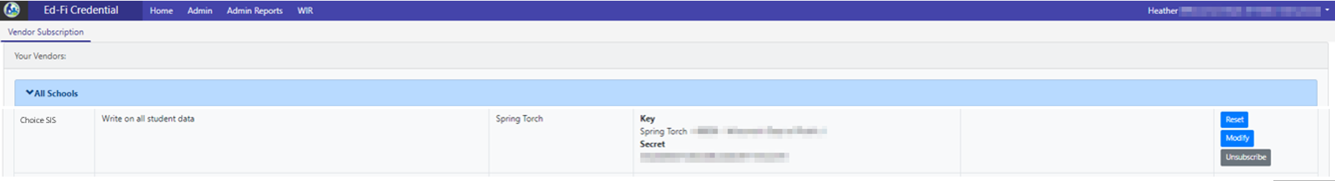
Create Vendor Subscription (3 of 3
Create Vendor Subscription (3 of 3)
Back on the Vendor Subscription page, you will see the vendor listed along with the API credentials (Key/Secret). Your Secret is stored in a hashed format once used by a vendor. Your SIS and WISEdata connection is established.
LEAs own the management of these subscriptions (Add, Delete, Update).
If you are switching vendors or ever have questions, create a Help Ticket.

Slide 12

Ed-Fi Credentials Demo 1

Slide 13


What to do with the Ed-Fi Credentials
Never email your key and/or secret!
When you have a new subscription or “reset” an existing one, the secret is visible. Because the secret is new, data will not be transmitted through the Ed-Fi API until your SIS/Vendor has the credentials.
This is also true for API URLs.
X
Never email your credentials!

Slide 14
Establishing API Connectivity: Step 2

Slide 15
Establishing API Connectivity: Step 3

Slide 16
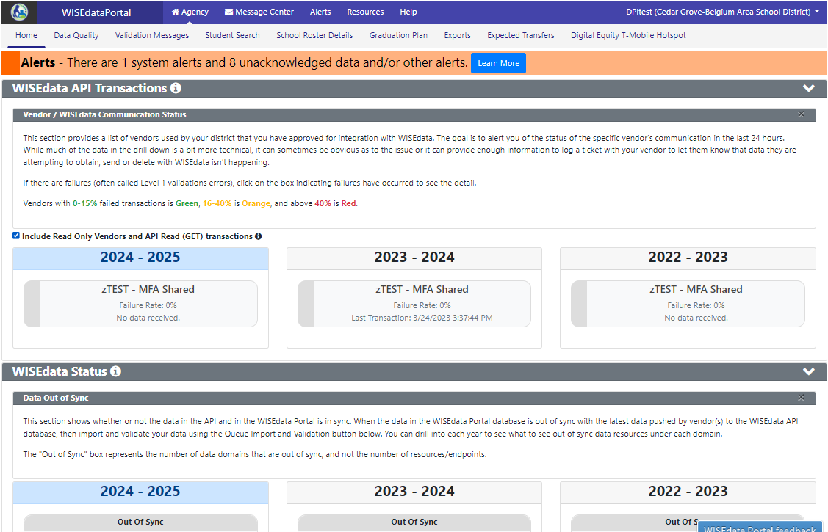
Verify Data Flow
From the WDP, go to the “Home” page and then scroll down…
Vendor READ API transactions may be included or excluded depending on whether the user has checked / unchecked the ‘Include API Read (GET) transactions’ checkbox.

Slide 17
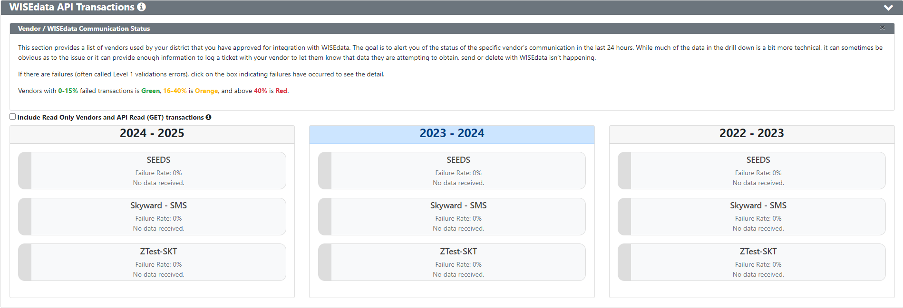
Verify Data Flow: WISEdata API Transactions
Failed Transaction Rate: Green = 0-15%, Orange = 16-40%, Red = < 40%
Notes:
Still not seeing any API transactions? Contact your vendor.

Slide 18
Ed-Fi Credentials Demo 2

Slide 19
SIS Conversion Guidance
By state law, the product schools choose must also comply with Wisconsin's interoperability technology standards.
Check the Certified Vendor List.*
Converting from one system to another or adding a supporting system, think SpEd, will require planning and effort to ensure a smooth transition.
If you are switching vendors, check out the SIS Conversion Guidance page on the DPI site.
Notes:
If not on the list, the New Vendor Application should be submitted between July 1st and October 31st to be considered for the next school year.

Slide 20
When to Convert
Most conversions take place in the summer at the end of the DPI calendar year, i.e., a school turns off SIS A reporting June 30 and turns on reporting in SIS B on July 1.

Slide 21
System Overlap
DPI recommends converting when the calendar year switches but keeping SIS A open until after the fall/winter snapshot is taken. This is also true with 3rd party, for example, SpEd Vendors.

Slide 22
SIS Contract Negotiations:
Alternatives to Consider
Require the SIS to create a tool that would allow schools to enter and edit prior year records manually.
Require that a SIS can handle the past three years of reporting data, not merely the prior year.
Strive in your contract negotiations to obtain a vendor that will be able to meet your reporting needs, future years and the prior year data. For Ed-Fi guidelines on RFPs, schools can review the Ed-Fi Alliance Released Model RFP.

Slide 23
Ed-Fi Credential: SIS Conversion
In the Ed-Fi Credential application in WISEhome, click Add Subscription to turn on SIS B (preferably after July 1).
Unsubscribe (turn off) SIS A after the December snapshot date once count date data is entered and checked for quality.
  If you are converting from one vendor to another, and need assistance, please submit a Help Ticket to ensure your vendor subscriptions are properly configured.

Slide 24
Modify Ed-Fi Credentials Demo 3

Slide 25
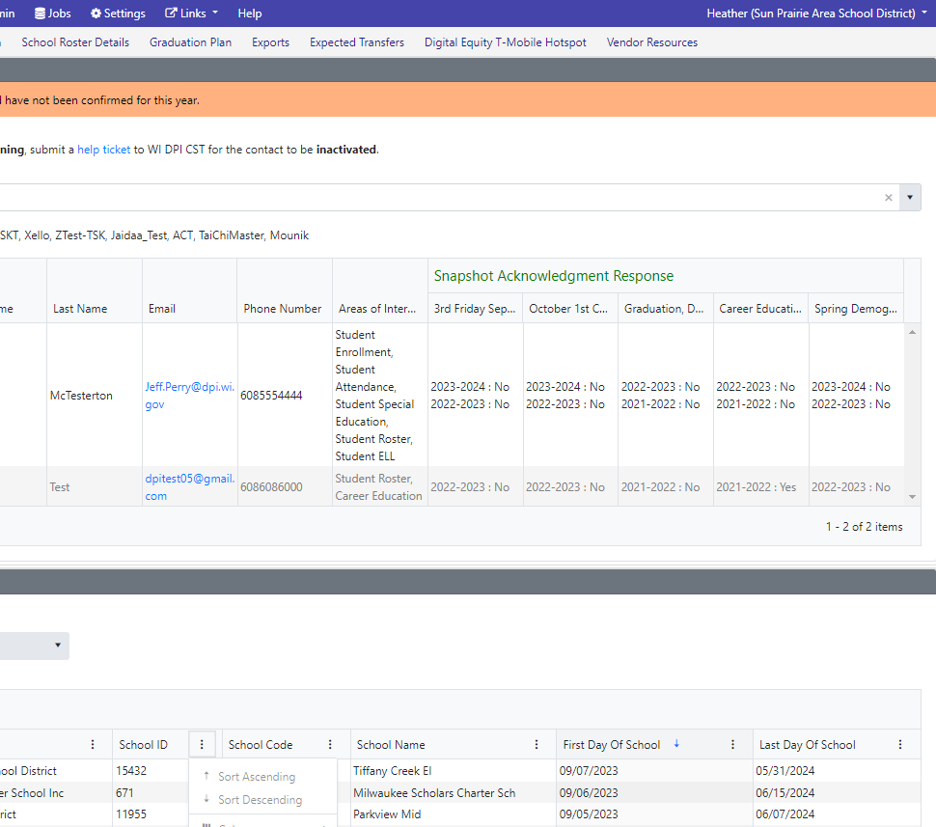
Not New, but Worth Repeating
First day of School and Last day of School are collected from sessions data entered into your SIS and can be found in WDP below where you find your contacts.

Slide 26
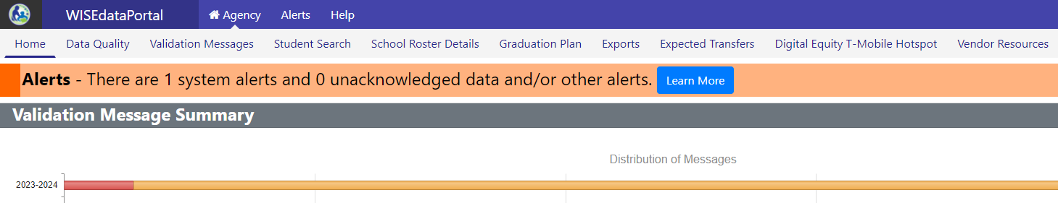

Not New, but Also Worth Repeating
Vendor Resources: When looking for information from your vendor that could be helpful when using WISEdata Portal, you may be able to find it here.
Missing something that could be helpful?
Contact your vendor to make a request.

Slide 27

Resources
Certified Vendor List
Request Access to a WISE Application
WISEtraining landing page
Ed-Fi Credential: User Guide
SIS Conversion Guidance

Slide 28
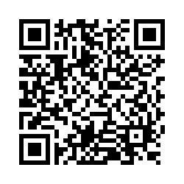
Questions?
Thank you! Thank you!
Please scan the QR code to provide us with your feedback!

