Slide 1
WISE For Principals and District Administrators
Jeff Perry
DPI Customer Services Team
March 2024

Slide 2
Today we will...
Talk about WISEdata at a high level
Relate some of the WISEdata responsibilities of administrators
Look at some of the WISE tools available to administrators
Answer your questions!

Slide 3
What is WISEdata?
WISEdata is a multi-vendor, open data collection system that allows school districts, charter schools, and Choice schools to submit data to DPI from their student information system (SIS) vendor. Data can also be sent from some third-party vendors.
WISEdata receives Enrollment, Graduation, Completion/Exit, Third Friday of September & October 1 count dates, Attendance, Discipline, Special Ed, Roster coursework & CTE data… and more!
WISEdata links to WISEid to ensure data is attached to the appropriate person

Slide 4
Data Submission Process
LEA / School / District
Student Information System
WISEdash for Districts
WISEdata Portal
WISEdash Public Portal
Data Entry
LEAs enter student data into local SIS
WISEdata Submission
LEAs push data from SIS to WISEdata for validation
Validation Review
LEAs monitor and review errors and warnings and make any necessary corrections in SIS
WISEdash
WISEdata updates WISEdash

Slide 5
Why Do We Collect Data?
Meet all required State and Federal reporting requirements
Funding
Help schools and educators monitor student progress
Analyzing data can help determine if additional services may be needed and can assist with monitoring trends
Inform education research and data analysis

Slide 6
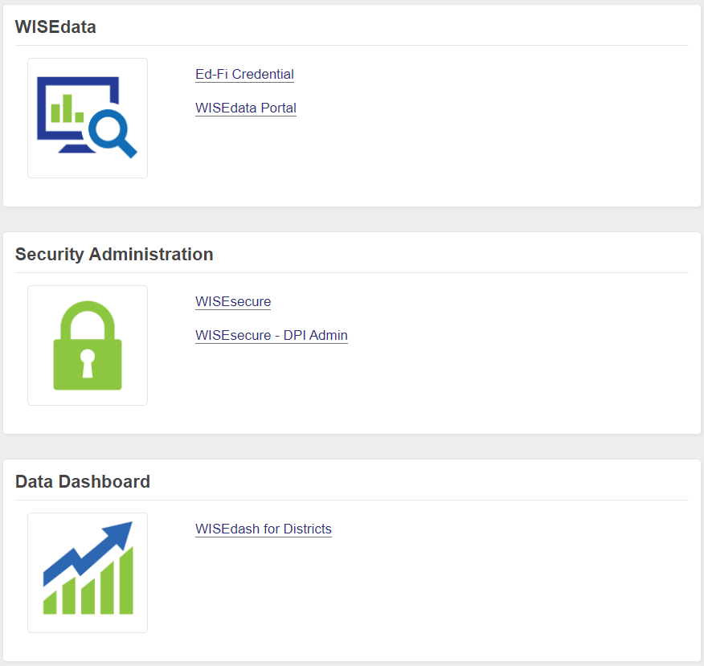
DPI WISE Apps
There are many DPI software applications related to WISEdata

Slide 7
Accessing WISE Applications
User Security Setup: WAMS IDs and/or Enterprise Google accounts are used to log in to WISE applications via WISEhome. District Security Administrators (DSAs) and Application Administrators will assign user roles to access WISE applications.
WISEhome – homepage/menu for your WISE application access
Request a User Role - instructions on how to request an application user role
WISE User Roles - different user roles within each application
Notes:
https://dpi.wi.gov/wise/wisehome-info
https://dpi.wi.gov/wise/wisehome-info#request-access
https://dpi.wi.gov/wise/wisehome-info/wisesecure-roles
To access any WISE applications, including WISEdata, you will need either a Enterprise Google account or a WAMS ID. It is possible to have and use both, but only if you login with a WAMS ID first. Instructions on setting these up can be found at WISEhome linked here on this slide.
A Google Enterprise account is through your school or district and not a personal account.
When creating a WAMS ID make sure you use your school email address as this helps with data privacy and school security in the event you leave your district.
You can request access to a WISE application by submitting your request in WISEhome. Instructions are linked here. Access to WISE applications is granted at the district level by your application administrator or your district security administrator (DSA). When you create a new request it is routed to them for approval.
Once assigned a user role, you are able to see your WISE applications when you first log into WISEhome. If an application is missing, you will want to make sure you did indeed submit a request or if you've already submitted a request you will want to follow up with the application administrator at your district for approval.

Slide 8
WISEsecure
WISEsecure is the application used to assign access to the DPI apps

Slide 9
WISEsecure: Assigned Roles
For successful WISEdata reporting your LEA will need personnel assigned to:
WISEid – Create and update student and staff identifiers
WISEdata Portal – Verify data and view validations
School Directory – Database updates including contacts
WISEdash For Districts (public districts only) – Robust set of data dashboards
WISEadmin Portal – For administrators, data errata, library plan & more
Ed-Fi Credential- If changes are needed to vendor product subscriptions

Slide 10
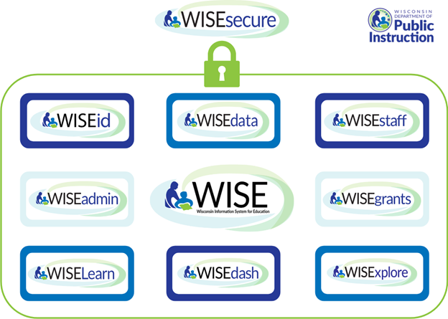
WISE Applications via WISEsecure

Slide 11
WISEsecure: Tools
Other important tools related to WISEdata:
WISEstaff (public districts only)
Secure Access File Exchange (SAFE)
WISEgrants
Special Education apps
WISEdata Finance

Slide 12
WISEsecure: DSA
District Administrator or Choice Administrator is responsible for either performing the DSA role or delegating that authority to another.
The DSA is responsible for setting up application administrators, annually reviewing access, and is also responsible for the District's data privacy policies required under §118.125(2). Refer to the Student Data Privacy Resources page for more information.
To request to be assigned as a DSA for your organization, or to delegate the role to another, first you must create a WAMS ID. Then complete the District Administrator Authorization Form.

Slide 13
WISEsecure: Features
Manage Security - assign users access to applications
Pending Access - approve pending access requests
Offboard Users - remove application access to users that are no longer with your district
Email Domain Restriction - restrict user requests to specific email domains to help with security of user access
Access Viewer - review current access for users

Slide 14
WISEsecure: Demo
Demo!
WISEhome Information Page
District Administrator Authorization Form
WISEsecure UAT demo

Slide 15
WISEdata Timeline
July 1- first day of DPI school year
August “deadline”
School Directory updates (contacts, low-high grade ranges, school openings/closings, Kindergarten info, etc.)
Check SIS & third-party vendor data flow
School year begins
TFS & Oct. 1 count dates
December snapshot
School Directory year flip
Spring Demographics snapshot
School year ends
June 30- last day of DPI school year
Yearly tasks are documented in detail on the WISEdata Annual Tasks Checklist.

Slide 16
WISEdata
WISEdata Process
Data submitted by SIS to WISEdata
After L1 error check, data lands in repository database
Data is imported to WISEdata Portal and validated against business rules
Data free of critical errors is imported to WISEdash database

Slide 17
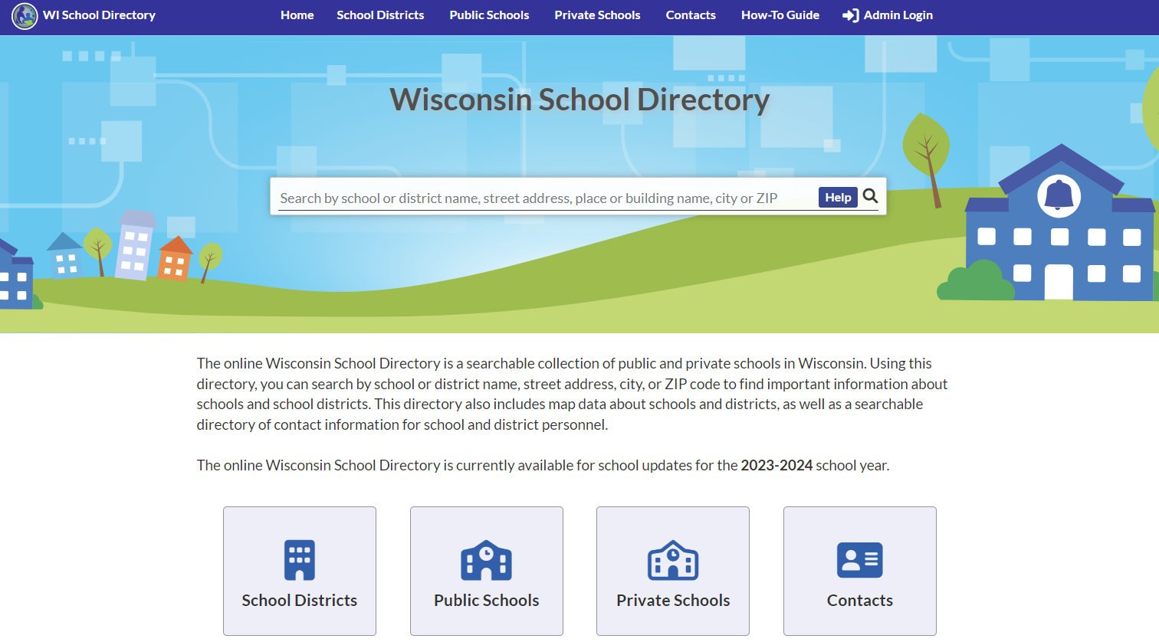
School Directory: Demo
School Directory – let’s demo it!
Contact information provided districts/schools School Directory app is displayed in the public directory

Slide 18
School Directory
A new version of the School Directory admin application is available!
This is a big improvement over the old app
App is used by LEAs to update directory information such as phone numbers, contact info, low-high grade range, etc.
User Guides available

Slide 19
WISEadmin Portal
WISEadmin Portal gives administrative users, such as District or Choice administrators, a centralized location for reviewing snapshot acknowledgments, agency contacts, and key performance indicators
WISEadmin Portal is also used for submitting data errata letters and district library plan data, and for setting up local data sharing agreements

Slide 20
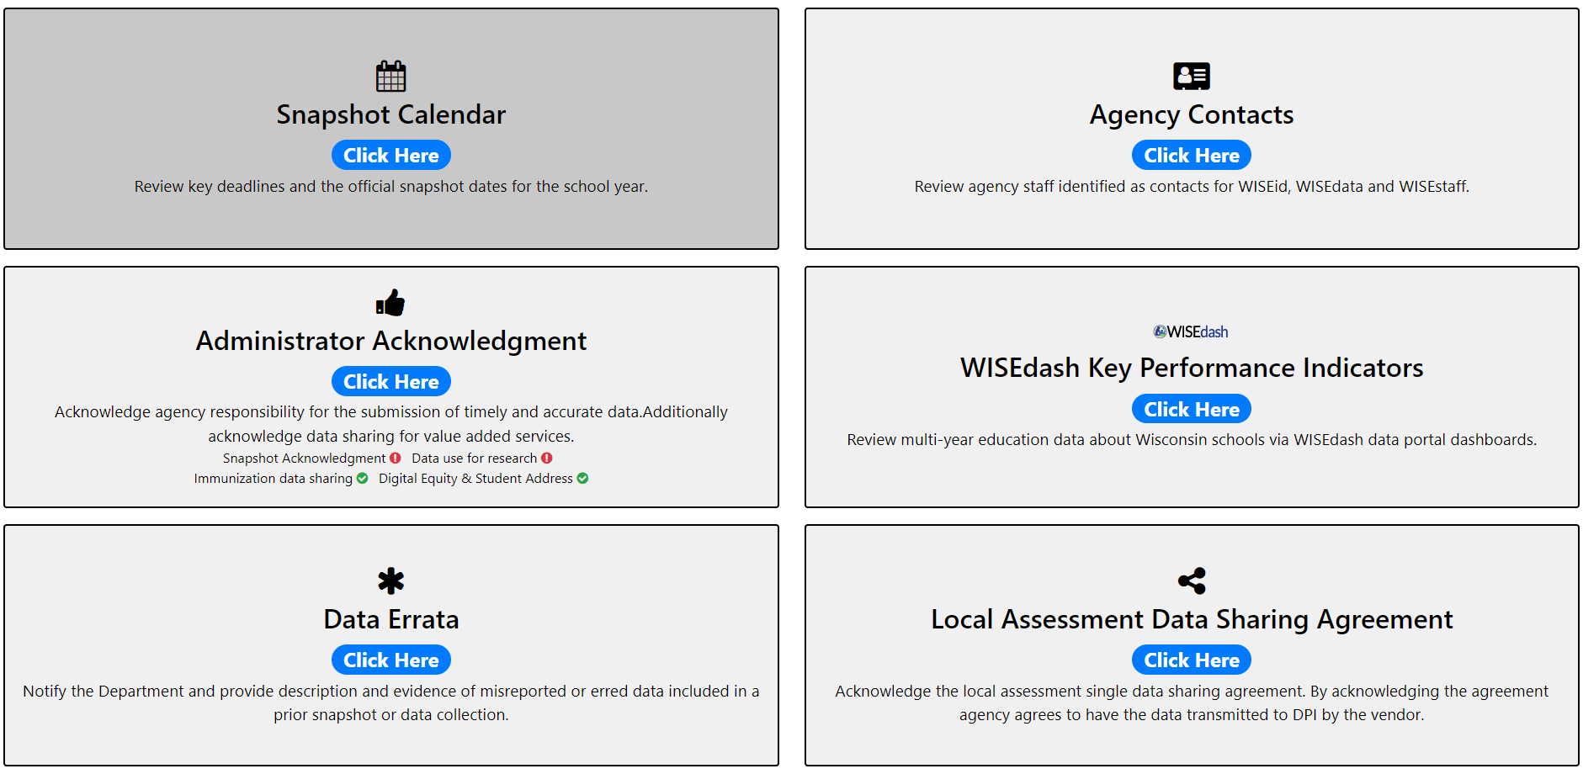
WISEadmin Portal: Landing Screen

Slide 21
WISEadmin Portal: Features
“One-stop shop” for district/Choice administrators to complete annual work items related to WISEdata, WISEdash, and WISEstaff
Links to a summary dashboard in WISEdash for Districts designed specifically for district and school administrators (public schools only)
Provides ‘opt-in’ for data sharing immunization data connection to WI DHS WIR, local assessment data sharing (MAP and PALS), data use for research, data sharing for digital equity and student address
Communicates Cyber Incidents

Slide 22
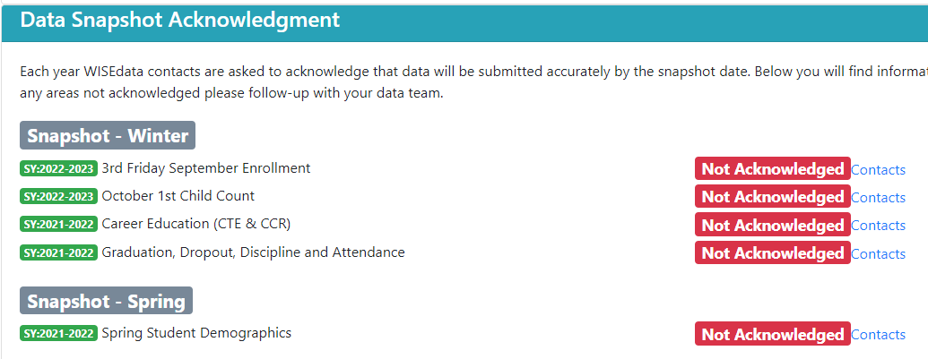
WISEadmin: Administrator Acknowledgement
Use the Administrator Acknowledgment page to review snapshot requirements

Slide 23
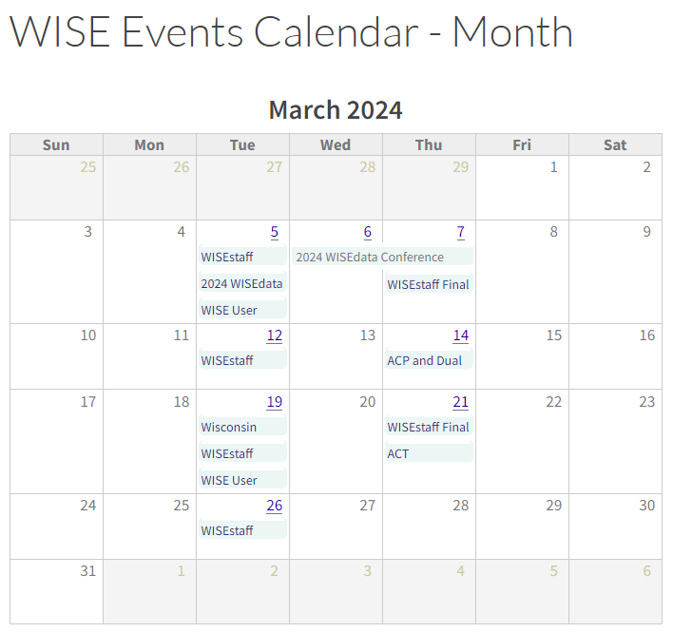
WISEadmin: Snapshot Calendar
The Snapshot Calendar tile provides a quick link to the WISE Events calendar on the DPI website for easy access to upcoming important dates

Slide 24
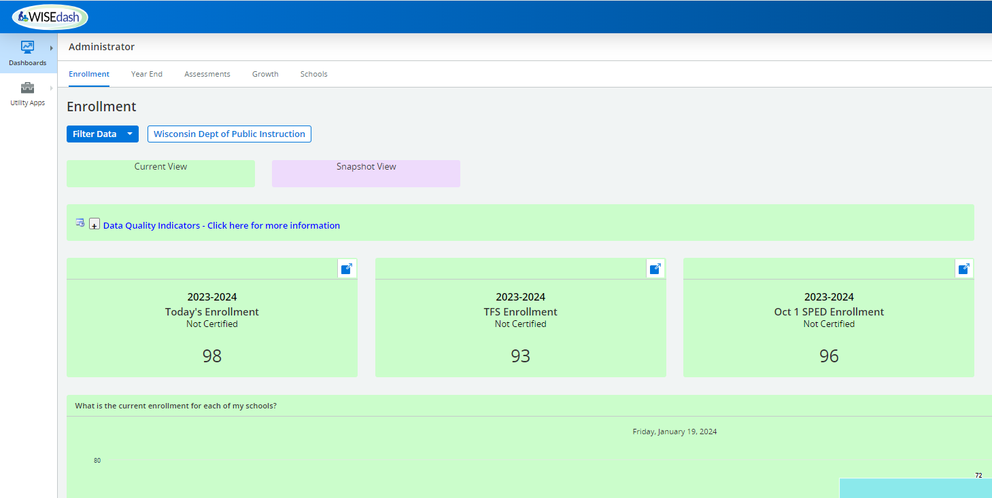
WISEadmin: WISEdash KPI (1 of 2)
The WISEdash Key Performance Indicators tile provides a quick link to the WISEdash For Districts Administrator dashboard

Slide 25
WISEadmin: WISEdash KPI (2 of 2)

Slide 26
WISEadmin: Agency Contacts
The Agency Contacts tile displays your currently defined agency contacts for WISEdata Portal, WISEid and WISEstaff for review to make sure departed personnel aren’t listed
Also included is a list of all WISEdata agencies

Slide 27
WISEadmin: Local Assessment
The Local Assessment Single Data Sharing Agreement tile allows public districts to enter a data sharing agreement whereby local assessment data from PALS or MAP can be displayed in WISEdash For Districts
Note that STAR data is also viewable in WISEdash For Districts but uses a different process

Slide 28
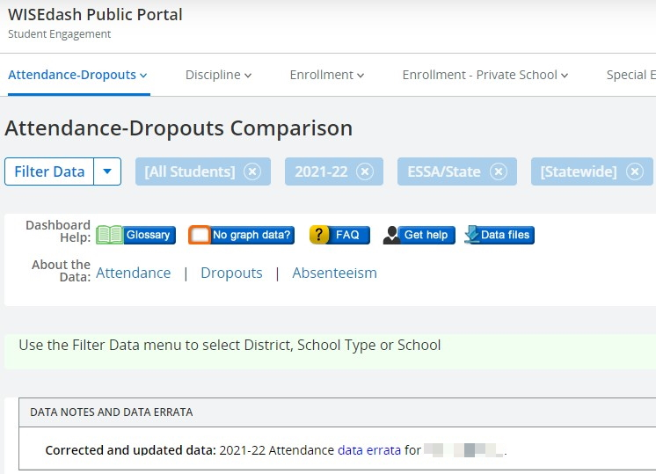
WISEadmin: Data Errata
The Data Errata tile begins the process of submitting a data errata letter
While data cannot be changed after a snapshot, a data errata letter can alert the public, researchers, DPI teams and others that snapshot data was submitted incorrectly in error
Letters are posted on the DPI website and referenced in WISEdash Public
Note that PII should never be included in a data errata letter
NOTE: PII should never be included in a data errata letter!

Slide 29
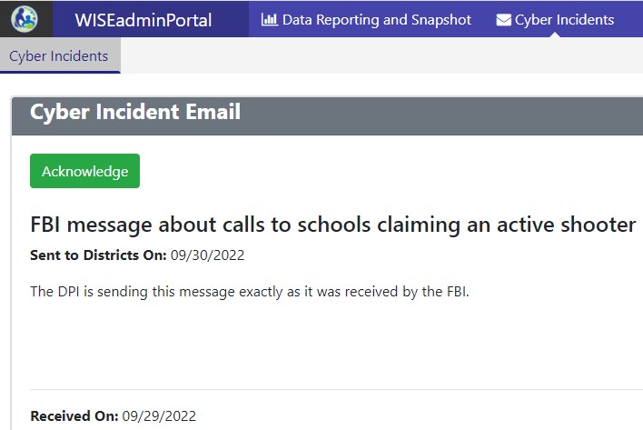
WISEadmin: Cyber Incidents
If DPI receives information about a cyber-related incident that LEAs should be made aware of, we will make that information available in WISEadmin Portal

Slide 30
Other WISEdata Topics
Data Teams
Data Privacy
District Administrator page and other resources

Slide 31
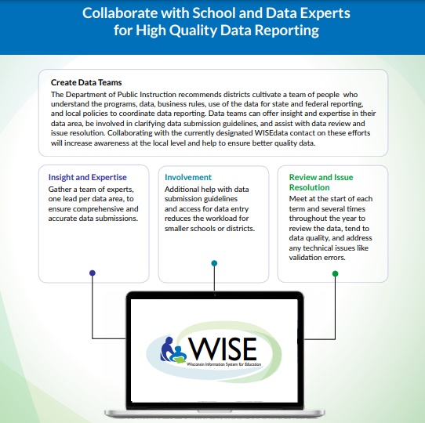
Data Teams
Insight and Expertise
Data Leads
Involvement
Help with Data Submission
Review and Issue Resolution
Ongoing meetings to review, discuss data, and correct errors

Slide 32
Data Privacy
Data Privacy: Protecting student privacy is required by law and the highest priority of DPI. DPI data collection and reporting systems must protect privacy and be useful, valid, and reliable. The ISSI team works to secure the infrastructure, software, hardware and systems to prevent unauthorized access to data.
External Confidential and Non-Confidential Data Requests
Federal Reporting
Secure Access File Exchange (SAFE)
Notes:
Data privacy is an important part of student reporting. We have many webpages available to you with additional information and tools on this topics but the main objective is to ensure that your district’s data is protected at all times. This can be something as simple as offboarding staff application access once they have left your district’s employment and as well as not including Personally Identifable Information (PII), such as student names and WISEids, together in a non-secure communication format such as emails, shared spreadsheets, or work chats.

Slide 33
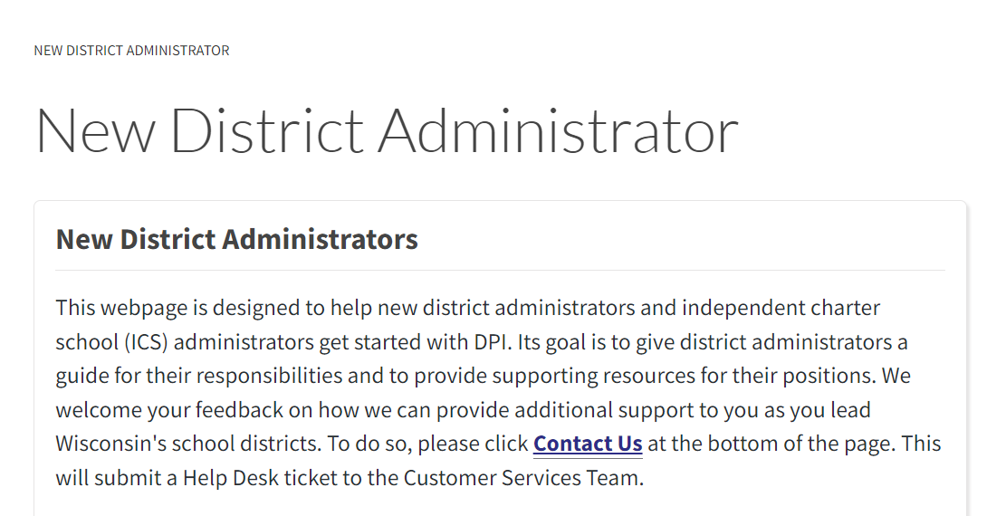
District Administrator Webpage
District Security Admin set up
School Directory submission
Student Snapshot preparation
Report card guidance
Important deadlines
Helpful resources and contacts
New District Administrator page

Slide 34
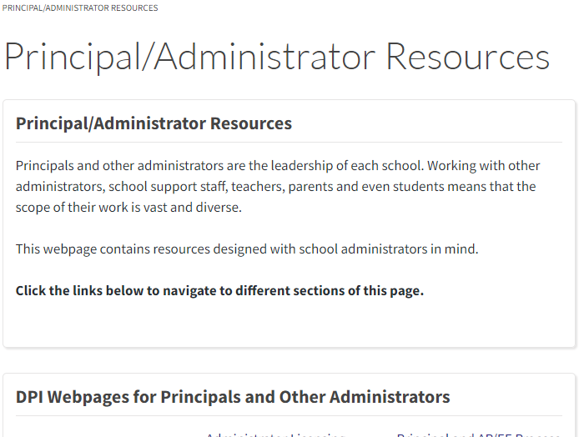
Principal/Administrator Resources Webpage
Administrator Licensing Info
Choice Administrator Training and Access to OAS
Principal Eval Rubric Training
And more!
Principal/Administrator Resources page

Slide 35
Resources (1 of 2)
WISEdata Reference Guide for Administrators: Reference guides for District Administrators on the WISEdata, WISEdash, and ASM tools.
For District Administrators: Designed as a “go-to” for information that is most relevant to administrators.
New District Administrator: Designed to help new district administrators and independent charter school (ICS) administrators get started with DPI.
Choice Administrator Training and Access to OAS: Training for Choice administrators of private schools first participating in the Choice program and new Choice administrators of schools currently in the Choice program.
Data Inquiry Journal At-A-Glance: Overview guide for users of the data inquiry journal.
Notes:
Here are some additional resources that may be of interest based on some of the topics we discussed today

Slide 36
Resources (2 of 2)
WISEdata Annual Tasks Checklist: a general guide for helping ensure necessary snapshot tasks are completed.
WISEdata Flyer: High level overview describing how WISEdata has improved our data collection process, data quality, and system integration.
Data Elements: List of links to all WISEdata data elements and their descriptions, uses, and codes
Knowledge Base Articles: Useful articles on validations and other related topic
WISEdata Events Calendar: View deadlines, trainings, webinars, etc.
WISEdash Reference Guide for Administrators: Reference guides for District Administrators on WISEdash.
WISEdash Flyer: High level overview of features included in WISEdash for Districts.
Notes:
Here are some additional resources that may be of interest based on some of the topics we discussed today

Slide 37
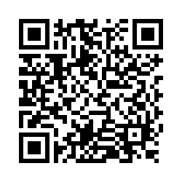
Questions?
Thank you! Thank you!
Please scan the QR code to provide us with your feedback!

