Slide 1
WISE Website Showcase
WISE Website
Showcase
Kina Stringfellow
CST - Technical Writer
March 6 & 7, 2024

Slide 2
Session Goals
Showcase our website updates so you know:
  How to contact us for different purposes
  Where to go to find updates
  Where to go to find training information

Slide 3
Overview
Contact Us:
CST (WAMS, Tips)
Help Ticket
Submit Feedback (bottom of each page)
Updates:
Release Notes
WISE Events Calendar
Top Five postings on Google Workspaces
Training:
WISE landing page
WISEtraining landing page

Slide 4

Two pages to Bookmark
Customer Services Team
WISEdata landing page
Everything else we’ll look at today is pretty easy to find from these 2 main starting points.

Slide 5

The ‘Submit Feedback’ Button
PURPOSE: You providing feedback to DPI about content on a specific page
I read and send back individualized responses.
The Customer Services Team uses input to provide improved experiences based on your feedback.
Per Page or General Submission: the more specific you are, the better service and feedback I can provide.

Slide 6
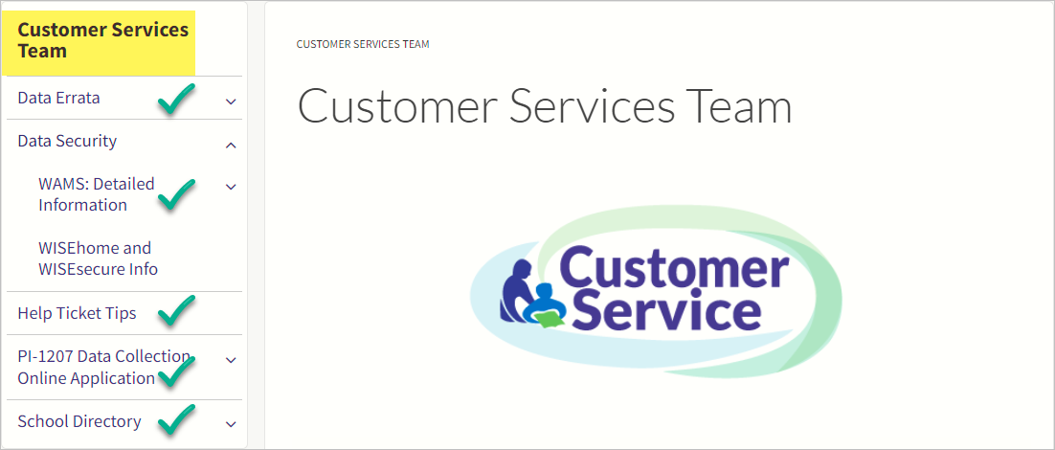
Customer Services Team Pages
https://dpi.wi.gov/cst
Data Errata
WAMS
PI-1207
School Directory
  Public Portal
  Management Portal

Slide 7
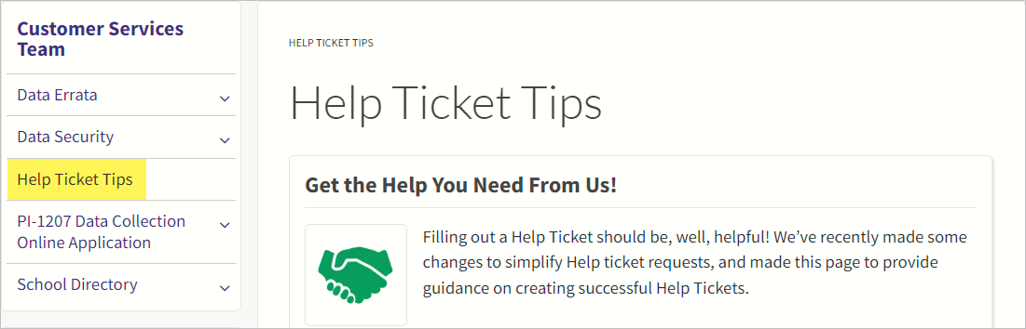
Customer Services Team: Help Ticket Tips
https://dpi.wi.gov/cst/tips-for-help-tickets

Slide 8
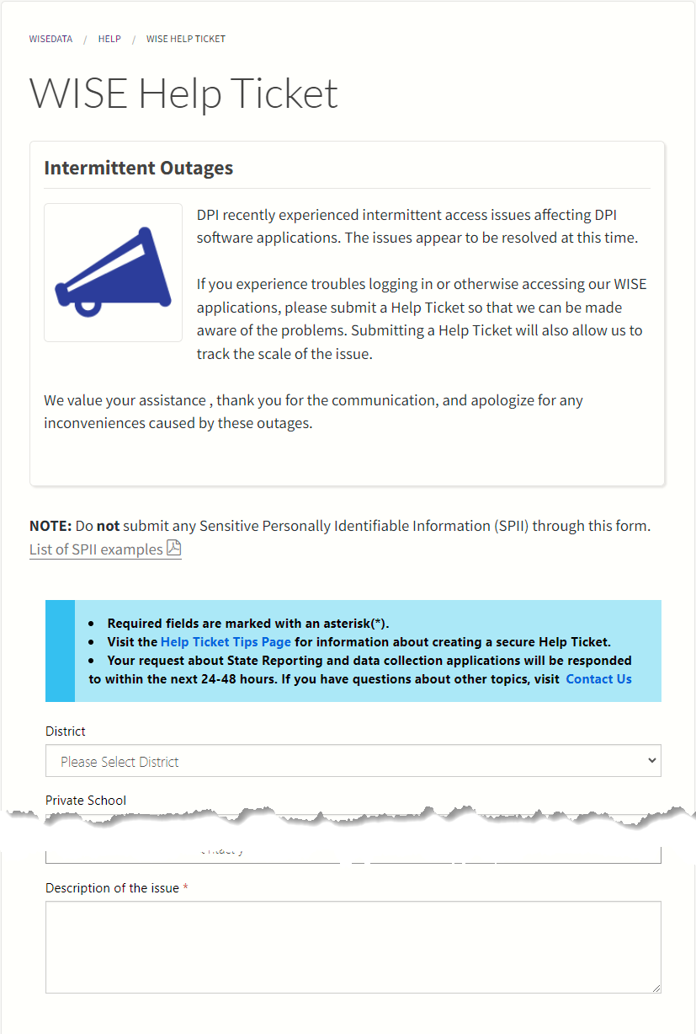
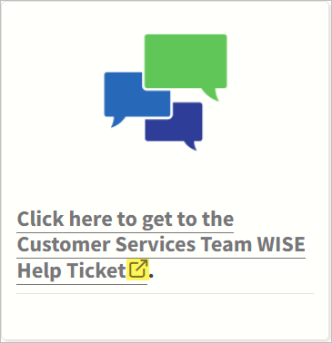

Customer Services Team: The Help Ticket
https://dpi.wi.gov/wisedata/help/request
Opens in new window (same as right-clicking your mouse).
PURPOSE: Assist with case-specific scenarios containing PII for Data Quality

Slide 9
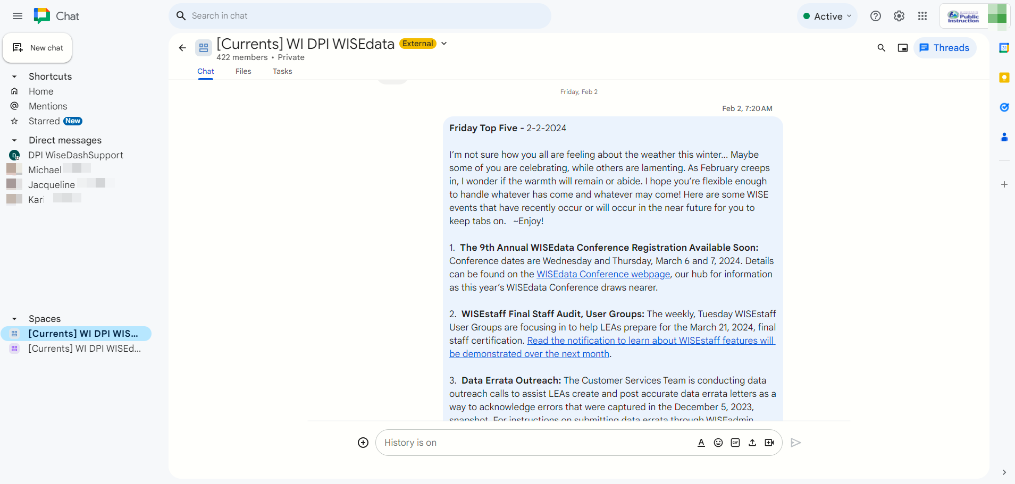

Google Currents
Google Currents/Google Workspaces Chat is being replaced with a Microsoft Teams Channel!
Stay tuned for communications from the Customer Services Team.
Platform change will occur next week.
Same great information – different platform.

Slide 10
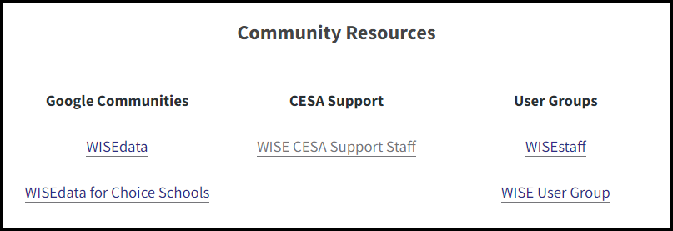
Google Current Links: WISEdata Help
PURPOSE: Provide a community space where WISE users can assist and share with each other. Stay current with CST postings

Slide 11

The BEST page to Bookmark
https://dpi.wi.gov/wisedata
Because everything here is a gem!

Slide 12
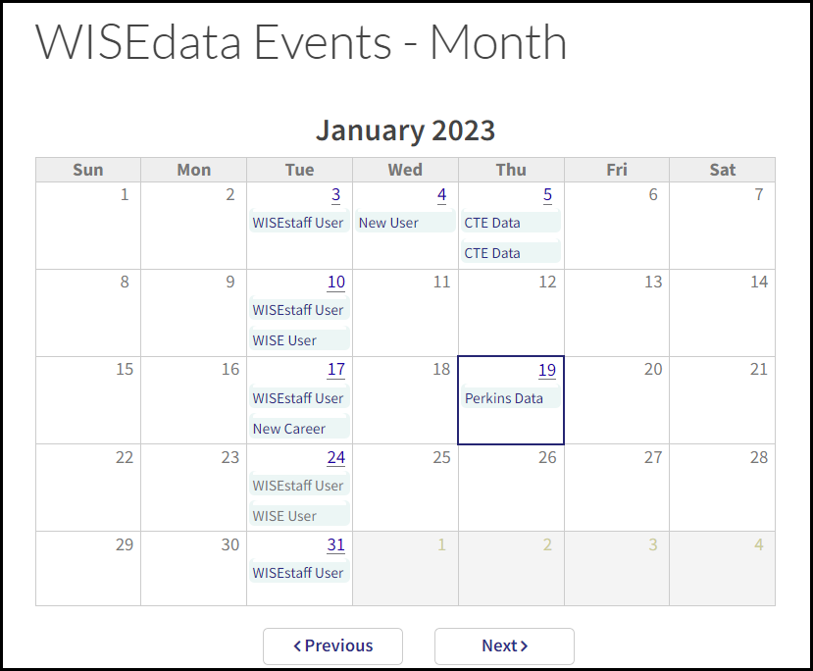
WISE Events Calendar
wisedata/events/month
Lists all training offered
WISEdata
WISEstaff
CTE
more

Slide 13
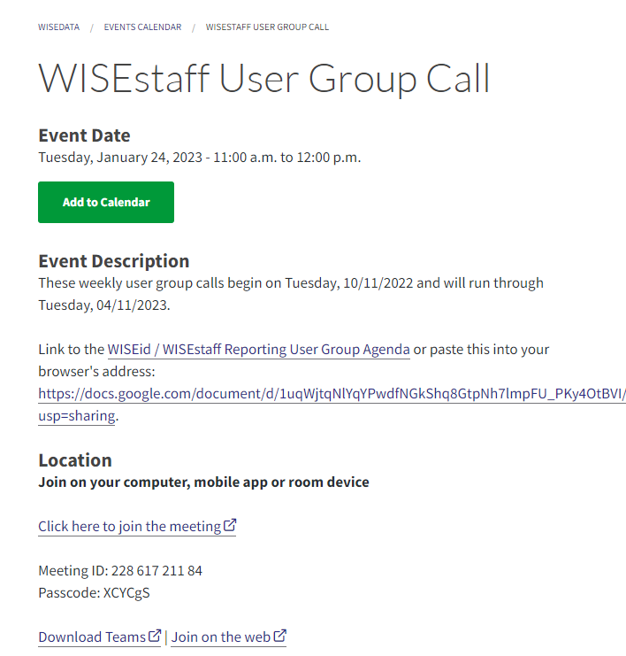
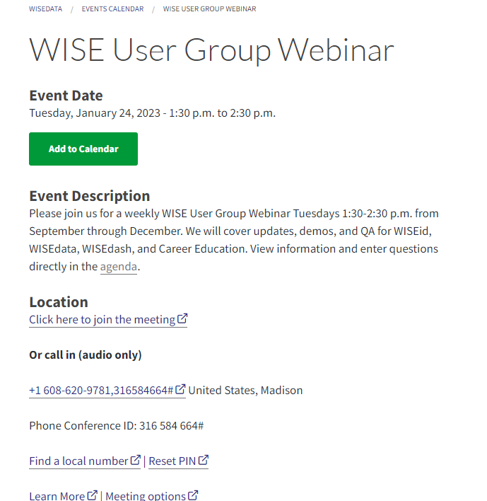
Weekly User Groups
Join bi-/weekly via MS Teams
Monthly New User Training
Hosted by live DPI staff
Questions asked and answered
1st Wed: New Users (1:30 – 3 p.m.)
Tuesdays: WISEstaff (11 a.m. – Noon)
Tuesdays: WISE User Group (1:30 – 2:30 p.m.)

Slide 14
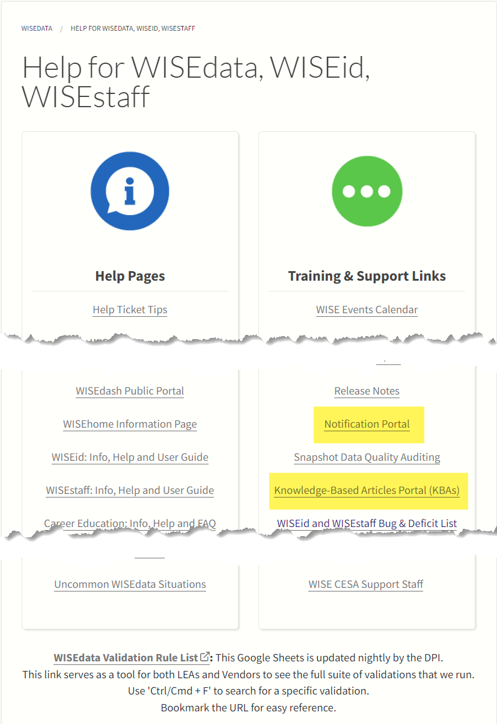
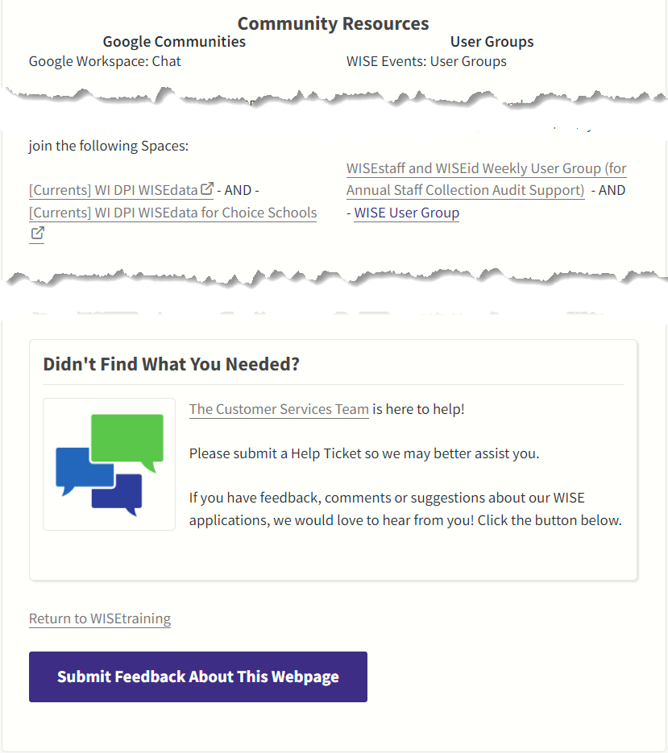
WISEdata Help Page
https://dpi.wi.gov/wisedata/help

Slide 15
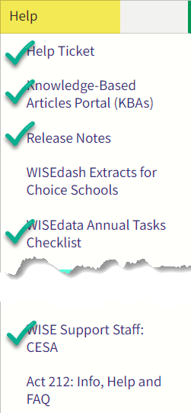
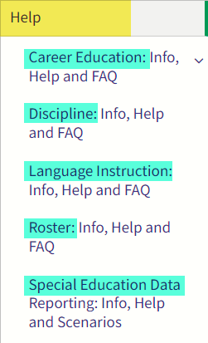
WISEdata Help Submenu
https://dpi.wi.gov/wisedata/help
KBA Portal
Notification Portal
Annual Tasks Checklist
Info, Help and FAQ
CESA Staff (“WISEsupport”)

Slide 16
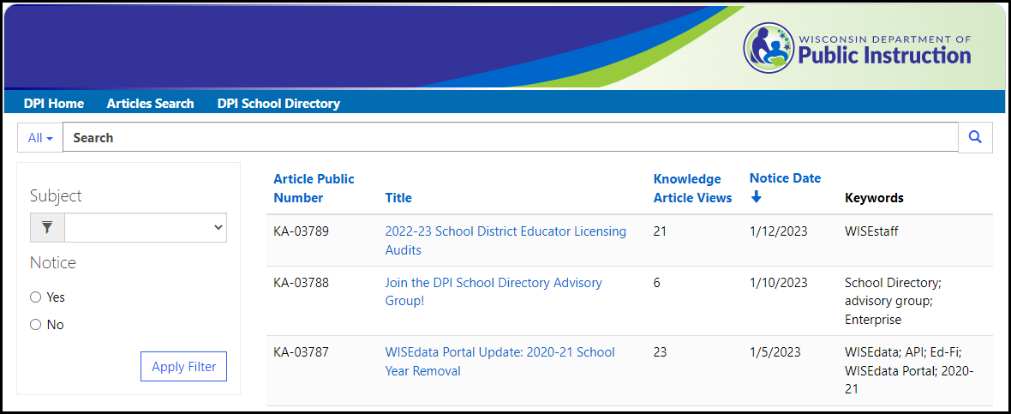
Knowledge Based Articles - KBAs
https://dpidynamicsprd.powerappsportals.com/articles-search-page/
Use for L2 Validation help
Search the portal, or click the hyperlinks in WISEdata Portal

Slide 17
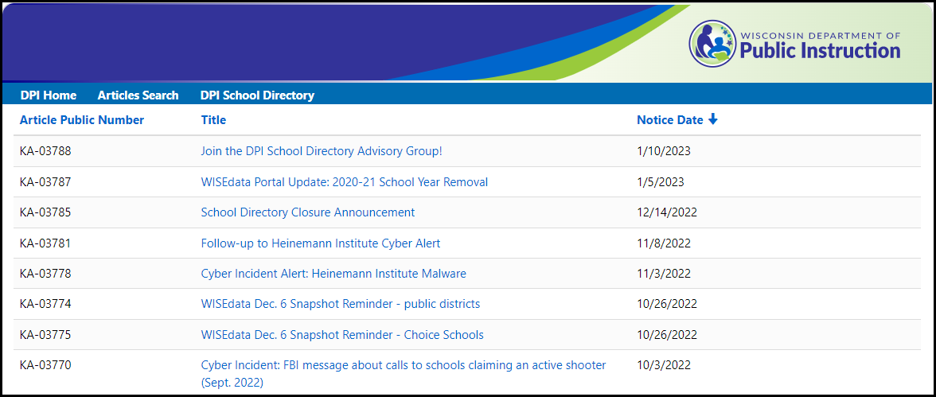
Notification Portal
https://dpidynamicsprd.powerappsportals.com/notices/
Use for communications sent by CST to WISE contacts
Listed by date

Slide 18
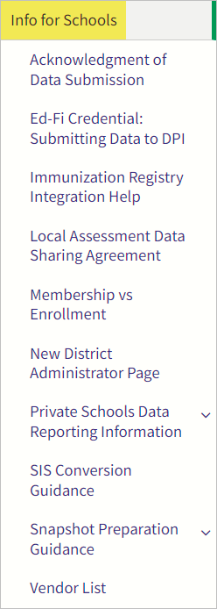
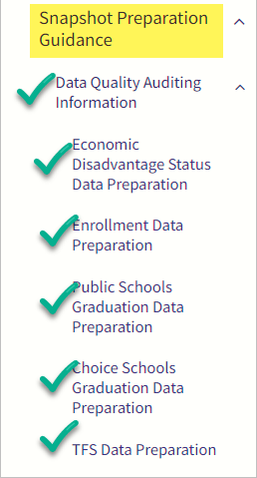
WISEdata Help: Info for Schools Submenu
https://dpi.wi.gov/wisedata/schools
Info for Schools submenu
NEW! Ed-Fi Credential
NEW! Private School Data Reporting
NEW! Snapshot DQ pages

Slide 19
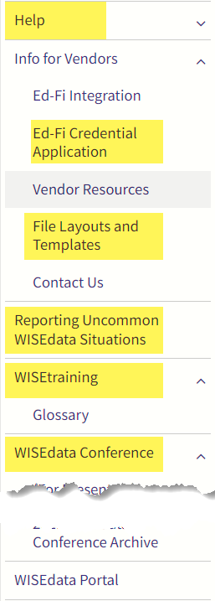
WISEdata Help: Info for Vendors
https://dpi.wi.gov/wisedata/vendors
Info for Vendors submenu
Ed-Fi User Guide
Files and Templates
“Contact Us” = Help Ticket for Vendors

Slide 20
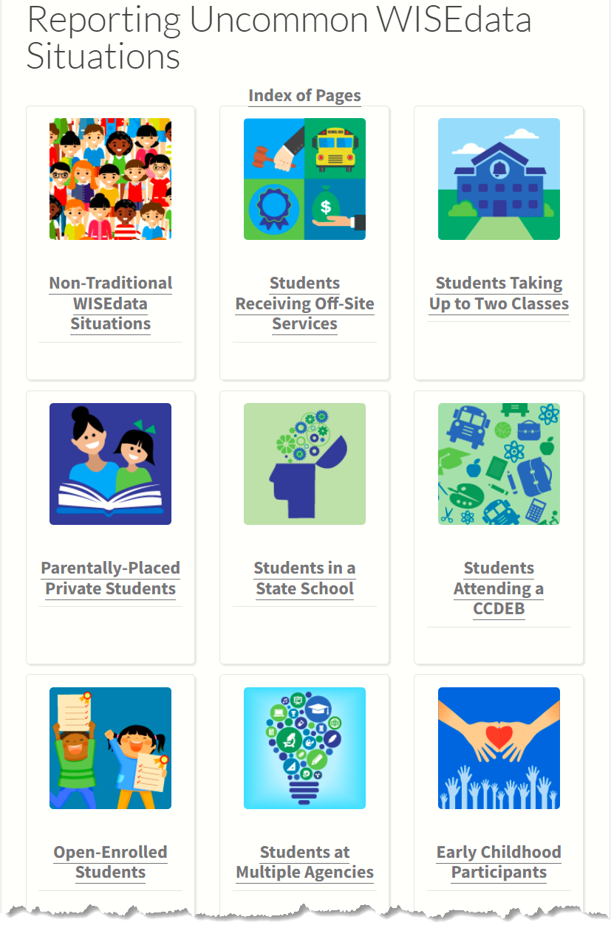
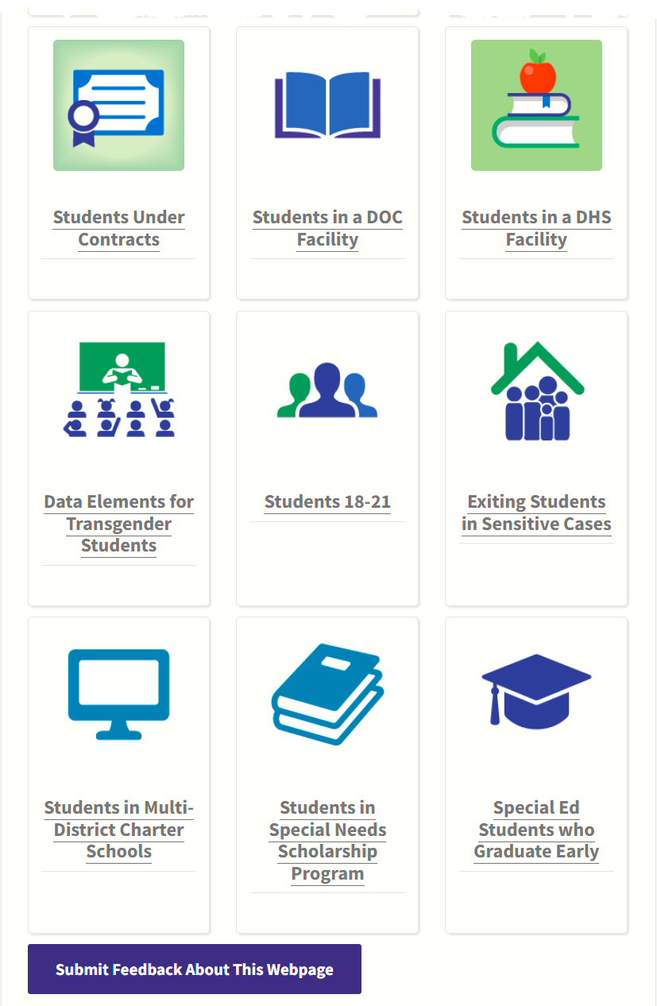
Reporting Uncommon WISEdata Situations
https://dpi.wi.gov/wisedata/help-portal/uncommon-situations
Unique scenarios
Submit Feedback emails helped revise confusing and outdated content!
Off-Site Services, Students in Day Treatment Centers

Slide 21

WISEtraining
wisedata/wise-classroom
Redesigned to group by topic
Tiles or Index
Embedded videos
Left-side menu support pages
  WISEdata Portal Tutorials

Slide 22
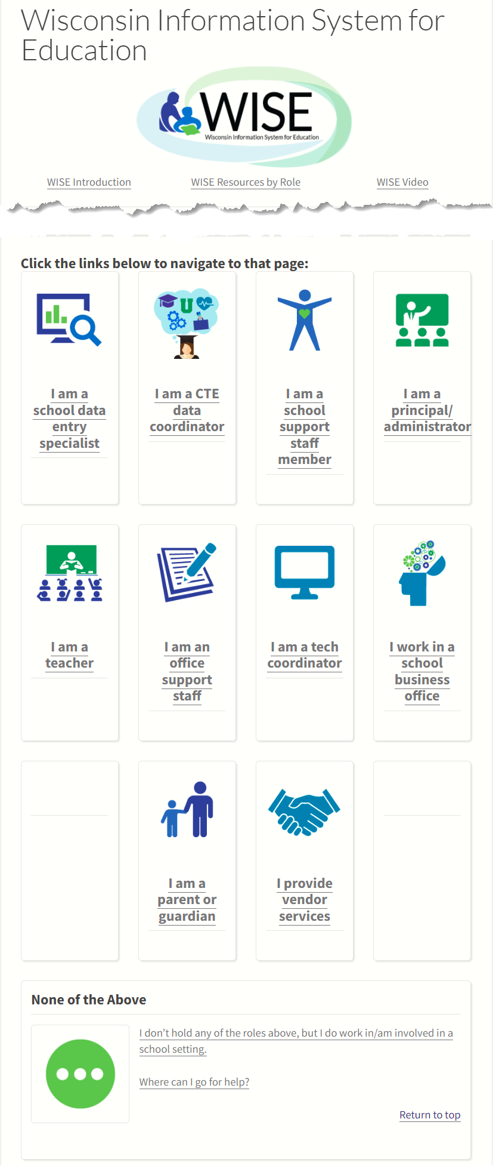
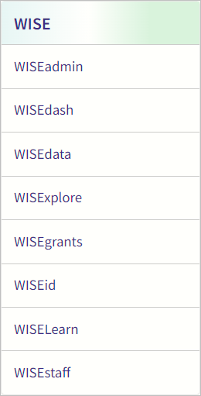
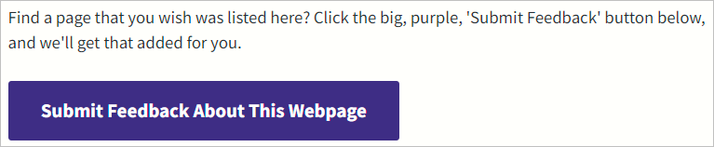
WISE Menu
https://dpi.wi.gov/wise
Redesigned to group by role
Tiles to Resource Pages
Great Opportunity to improve with your Submit Feedback suggestions!

Slide 23
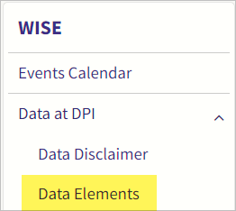
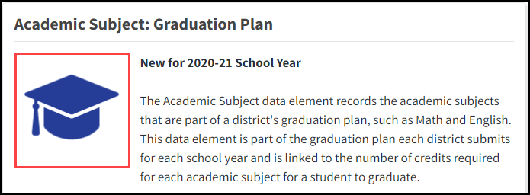
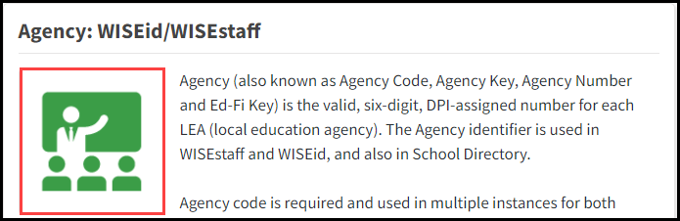
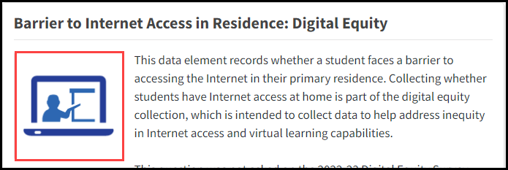
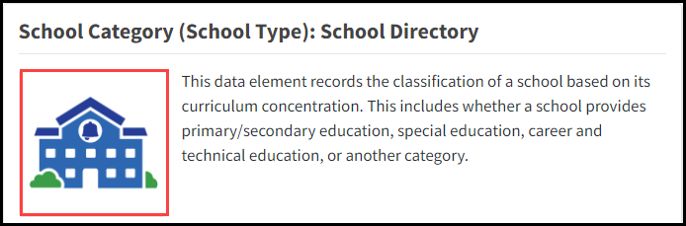
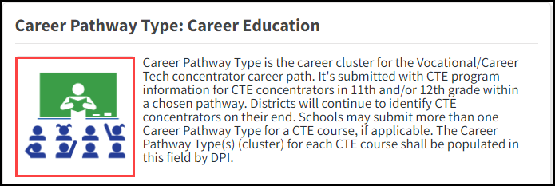
Data Element Icons
Each page includes the data element name, a description, value/s (as applicable), collection (icon), uses, along with information & FAQ

Slide 24
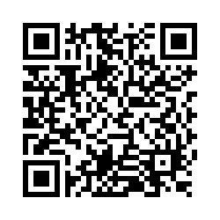
Questions?
Thank you! Thank you!
Please scan the QR code to provide us with your feedback!

