Slide 1
WISEdata Portal: Not All Errors are Equal
Jeff Perry
Kari Krakow
March 2024

Slide 2
Today we will…
Review validation prioritization tips to help prepare for Snapshot
Spotlight common Errors and Warnings from 2023-24 and provide solutions
Answer your questions

Slide 3
Spring Demographics Snapshot (1 of 4)

Slide 4
Spring Demographics Snapshot (2 of 4)
DPI will conduct the student Spring Demographic Snapshot on May 21, 2024.
These demographics are captured on the snapshot date and used in assessment data reporting for the State Accountability Report Cards, Indicator 3 for children with disabilities, federal consolidated state performance reports (CSPR), and ESSA federal Accountability Indicators.
Public districts & Independent charter schools: Migrant Status, English Language Learner, Homeless, and Parent in the Military
All LEAs: Race/Ethnicity, Gender, Grade Level, Disability Status, Economically Disadvantaged Status, and Food Services Eligibility

Slide 5
Spring Demographics Snapshot (3 of 4)
These data elements are not collected in the Spring snapshot and can be set aside until later:
Roster
Discipline
Attendance
Prior year data
These topics will be collected as part of year-end during the December snapshot. Also, there is no need to focus on any prior year errors and warnings, as those also do not impact the Spring snapshot.
Prioritize working validations related to demographics.

Slide 6
Spring Demographics Snapshot (4 of 4)
Common Demographics-Related Errors and Warnings

Slide 7
Error 6815
Demographics related validations:
Error 6815: Student demographics missing for an enrollment
This error appears if a school submitting an enrollment for a student doesn't also submit that student's demographic information
To clear the error, submit the demographics information
Remember there are two parts to WISEdata Demographics: “Demographics” and “Demographics - School Level”

Slide 8
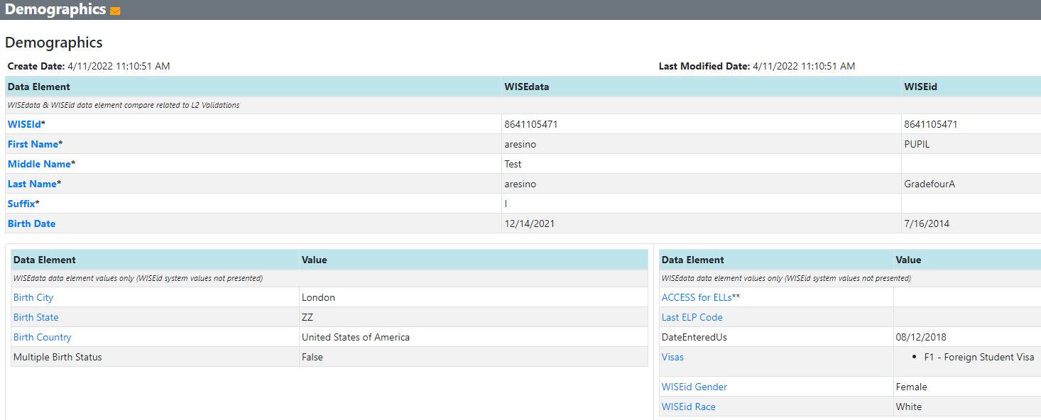
Error 6815: Student Level Demographics
UAT Test Data

Slide 9
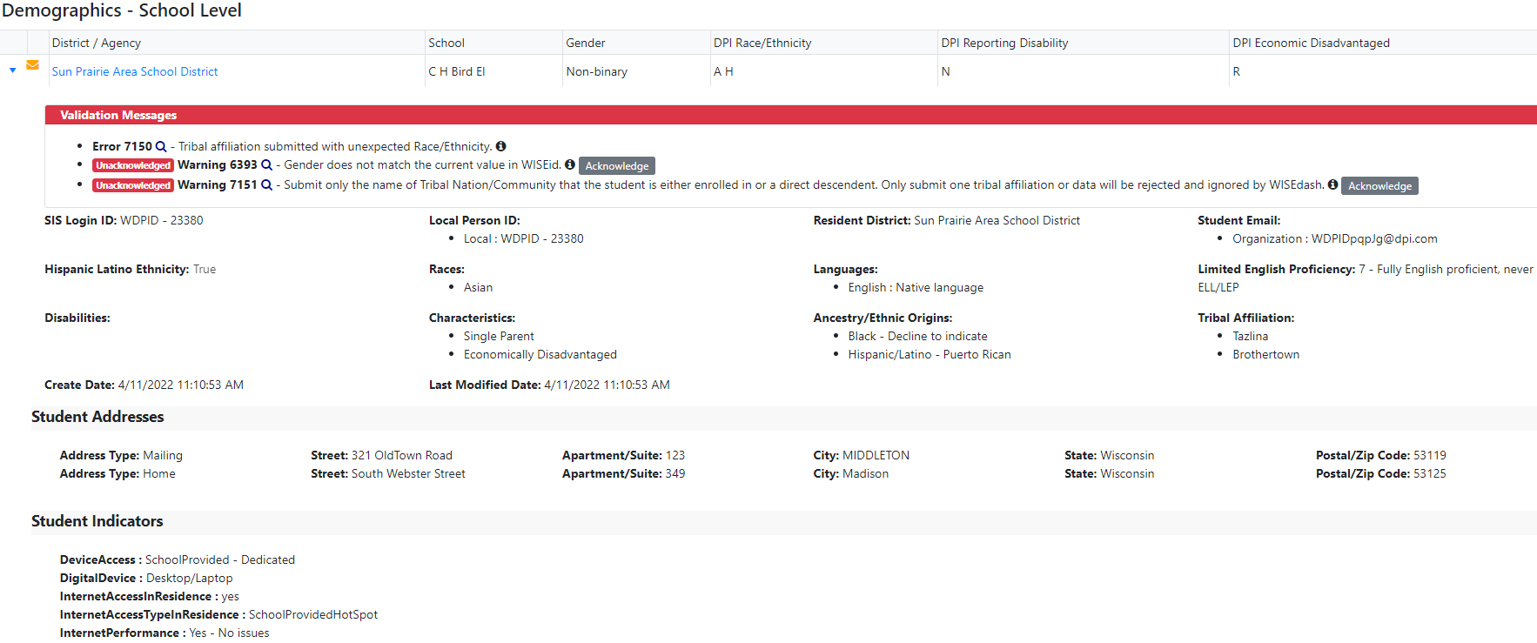
Error 6815: School Level Demographics
UAT test data

Slide 10
Warning 7152
Demographics related validations:
Warning 7152: Tribal affiliation information is missing
Tribal Affiliation pertains to Native American students who are government registered with a tribe recognized by the federal government. It is not the same as race/ethnicity
If no Tribal Affiliation has been indicated by the parent/guardian then acknowledge the warning

Slide 11
Error 7055
Demographics related validations:
Error 7055: Student Food Service program record overlap exists within the same school
Multiple student food service program associations exist for this student in the same school, and the End Date of one record falls on or after the Begin Date of another
If no End Date has been sent, WISEdata calculates the record as ending June 30, and that will likely overlap with any other record
Set an End Date at least one day before the subsequent record’s Begin Date
If an Overlap occurs DPI will decide which record to use for reporting purposes

Slide 12
Warning 7480 (1 of 3)
Demographics related validations:
Warning 7480: Prompting Choice Schools to Verify Newly Reported ELP Codes
New for the 2023-2024 school year
This warning will trigger when a Choice school submits an SEOA record with an ELP code (1-6) and if there is no available data for the prior school year's ACCESS for ELLs' Overall Composite Proficiency Level
Choice schools are required to report the ELP codes of students receiving services under Title III, part A through equitable participation

Slide 13
Warning 7480 (2 of 3)
Demographics related validations:
Warning 7480: Prompting Choice Schools to Verify Newly Reported ELP Codes
ACCESS testing takes place in the winter of each school year, with results coming back in the spring
ACCESS scores should be entered as part of year end data
When a new school year begins, the ELP Code being entered for the fall of the current school year should be the same as the ACCESS score from the previous spring’s results

Slide 14
Warning 7480 (3 of 3)
Demographics related validations:
Warning 7480: Prompting Choice Schools to Verify Newly Reported ELP Codes
If the ELP code cannot be verified or supported with an ACCESS test score from the previous school year, or a screener score from the current school year, then remove the ELP code from your SIS and resubmit your data to WISEdata Portal to clear the warning
If the ELP code can be verified, then acknowledge the warning
Verify the data is accurate by viewing the following screens in WISEdata Portal:
Data Quality: set “Data Quality Indicators” filter to “Students by ELP Code”
Exports: “Student Demographics” (column AB, labeled ELP code)

Slide 15
Warning 7473 (1 of 3)
Demographics related validations:
Warning 7473: Last ELP code mismatch
The SEOA ELP Code is 7 and does not align with a previously submitted ELP Code
This student was previously identified as an EL and should be reported as either EL with their latest ELP code or ELP 6 (Former EL)
Students who have taken ACCESS but have not exited should have their latest ELP code reported, even if it is not from the previous school year
Students who have exited EL status should retain ELP 6 - Former EL to differentiate them from their Never-EL (ELP 7) peers

Slide 16
Warning 7473 (2 of 3)
Demographics related validations:
Warning 7473: Last ELP code mismatch
This warning often occurs when a student transfers from one school to another Another possibility is that, at some point in the student's academic history, an incorrect ELP code was assigned
DPI designed this warning to help maintain accuracy of ELP code data
DPI encourages users to verify the accuracy of the ELP code submitted before they acknowledge this warning or change an ELP code

Slide 17
Warning 7473 (3 of 3)
Demographics related validations:
Warning 7473: Last ELP code mismatch
Tip: Public districts can use the Student Profile in WISEdash For Districts to view all ELP codes reported for all enrollments, even reporting made by other LEA’s.
Choice schools: if the student was reported ELP by a public district DPI can look it up in WISEdash for you
The KBA does a great job of explaining how to determine if there was a prior erroneous ELP code reported, with screen shots from WISEdata Portal and WISEdash For Districts
KBA: https://dpidynamicsprd.powerappsportals.com/knowledgebase/article/KA-03829/en-us

Slide 18
Error 6899 (1 of 2)
Demographics related validations:
Error 6899: An ELP score from the immediately prior school year exists for the student, but screener test results have been submitted
This error appears if the sLIPA Assessment Year (AKA “screener test”) date is the current school year, but the student has taken the ACCESS for ELLs assessment in the immediately prior school year
A student's current year ELP code should be based on the ACCESS for ELLs assessment score from the immediately prior school year, and the Assessment Year should reflect the prior school year
To fix this, adjust the student's sLIPA LIEP record to reflect the proper ELP code and Assessment Year

Slide 19
Error 6899 (2 of 2)

Slide 20
Error 7052
Demographics related validations:
Error 7052: Missing economic disadvantages characteristics
Either all student characteristics are missing from the student demographics record, or the student characteristics have been submitted but the True/False value is missing
Economic status must be reported for all students
Even if the school doesn't participate in a food service program or have a food service eligibility form, the student's economic status must still be collected
There may be an Alternate Household Income form on file or other economic indicators in the student’s record

Slide 21
Error 7161 (1 of 2)
Demographics related validations:
Error 7161: Special Education record (sSEPA) ends before enrollment
In most scenarios the sSEPA end date and enrollment end date should match
If the Student is Continuing in Special Education (Reason Exited Special Education = C), fix the error by sending another sSEPA
If the student is exiting the district (Reason Exited Special Education = E) and sSEPA ends before enrollment, fix the error by changing the sSEPA End Date to match the Enrollment End Date
A sSEPA ended early at year end will likely result in the student not being designated as SPED

Slide 22
Error 7161 (2 of 2)
Demographics related validations:
Error 7161: Special Education record (sSEPA) ends before enrollment
It is especially important to resolve this error for high school graduates!
If the sSEPA record ends before the enrollment record with exit type HSC, then the student will NOT be reported as a special education graduate

Slide 23
December Snapshot

Slide 24
December Snapshot (1 of 4)
The student Snapshot will occur December 10, 2024.
2023-24 Year End Attendance, Discipline, Completion, Roster, Career Education
2024-25 Third Friday of September Enrollment
2024-25 October 1 Child Count of students with disabilities
2024-25 High School Graduation Requirements (Graduation Plan)
2024-25 Digital Equity data (Not required strongly recommended)

Slide 25
December Snapshot (2 of 4)
Demographics (all LEAs): Race/Ethnicity, Gender, Grade Level, Disability Status, Economically Disadvantaged Status, and Food Services Eligibility
Demographics (public LEAs only): Migrant Status*, English Language Learner, Homeless, and Parent in the Military
*LEAs do not submit migrant data directly; LEAs are verifying the data imported into WISE from MIS2000

Slide 26
December Snapshot (3 of 4)
How do I prioritize
WISEdata Portal validations, data quality and verification work?

Slide 27
December Snapshot (4 of 4)
These data elements will not be collected in the December snapshot and can be set aside until later:
Prior year (2023-24) count inclusion TFS & Oct 1 values
Current year (2024-25) Roster, Attendance & Discipline
All “third year” 2022-23 validations not pertaining to dropouts; this year’s data is available in WISEdata only for the review of dropouts

Slide 28
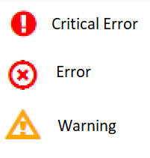
Validation Messages
There are three types of Validation Messages. They should all be addressed, however it’s a good idea to start with the most severe first.
Critical Error: Data will not be captured in the Snapshot
Regular Error: Data will be captured but may be reported incorrectly
Warning: Data will be captured, but it was submitted in an unexpected way

Slide 29
Validation Messages: Warnings
Data will be captured, but it was submitted in an unexpected way
Data should be reviewed for accuracy
If after review the data as submitted is correct, acknowledge the warning
Warnings are a lower priority, but it is still important to review them as they can have an impact on your snapshot
We will talk about a few specific warnings in a moment!

Slide 30
Troubleshooting Validation Messages (1 of 4)
WISEdata - Home
Validation Message Summary
Data Pipeline Status
Level 1 Errors (errors stopping data flowing from your vender to WISEdata, errors in your vendor)

Slide 31
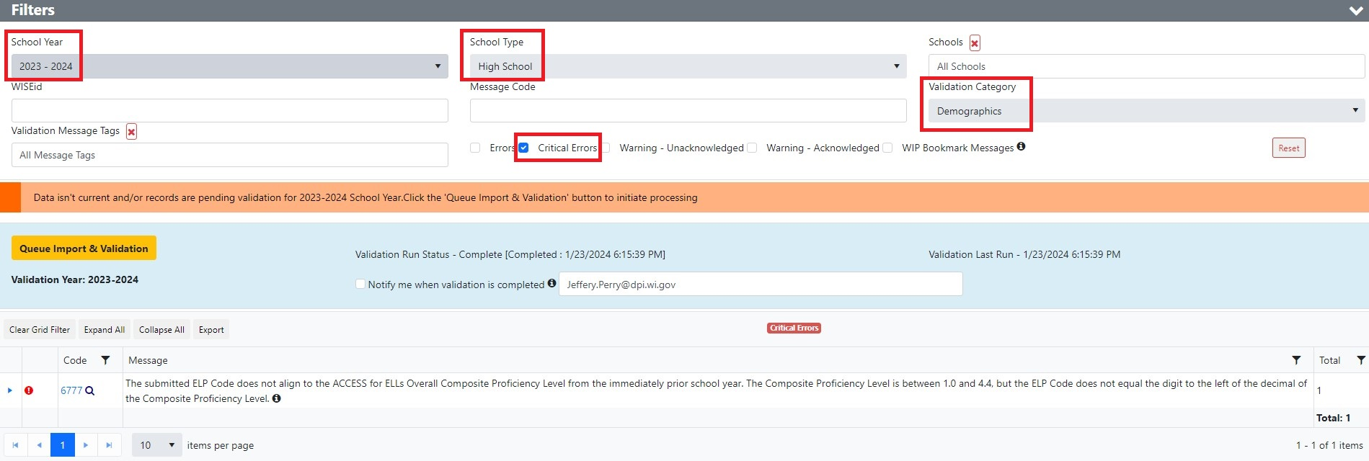
Troubleshooting Validation Messages (2 of 4)
WISEdata - Validation Messages
Validation Category
Aging Column
Tags

Slide 32
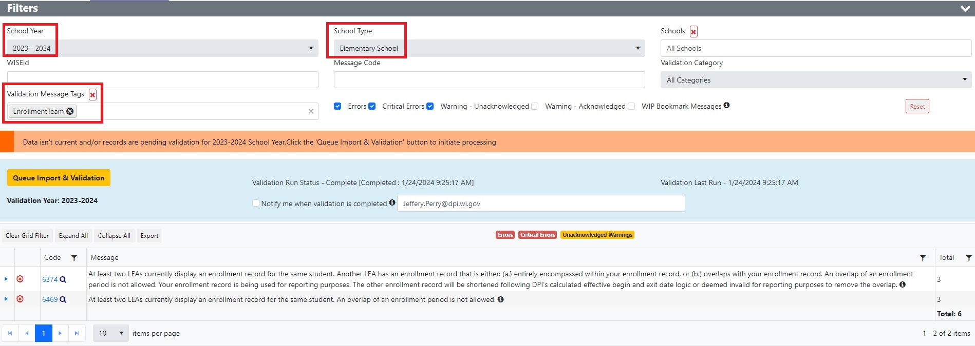
Troubleshooting Validation Messages (3 of 4)
WISEdata - Validation Message Tags

Slide 33
Troubleshooting Validation Messages (4 of 4)
WISEdata - Validation Message Tags

Slide 34
Data Review
Before it was mentioned that you should review data pertaining to dropouts… how does one do this?
Dropouts are calculated in WISEdash
Public districts & ICS schools: view dropouts in WISEdash For Districts (YE Completion Snapshot dashboard, Dropout Crosstab)
Choice schools: view dropouts in the WISEdata Portal WISEdash extracts (Dropouts - Dropout Rate)
If a student displays as a dropout but you believe they are not, review the reported exit type; a TC with no subsequent WISEdata enrollment will be calculated as a dropout
There may be other scenarios– open a help ticket if you have questions!

Slide 35
L2 Errors Cycle
February
July
September
Current year demographic data in preparation for the Spring Snapshot, as well as Roster data for the upcoming SY
$$$$
Spring Snapshot
$$∗$$
Year End
Year end completion data and prior year Career and Technical Education (CTE) data
Demographics, District Library Plan, Graduation Plan, TFS
$$$$
Source: Snapshot Preparation Guidance
Fall Snapshot
Notes:
February – Current year demographic* data in preparation for the Spring Demographic Snapshot and Roster* data for the upcoming SY
July – Year End Completion* and prior year Career and Technical Education (CTE)
September – Demographics, District Library Plan, Graduation Plan, TFS
Demographic: Race/Ethnicity, Gender, Grade Level, Disability Status, Economic Disadvantaged Status, Food Service Eligibility, enrollment, food service, Migrant, ELL Status, Homeless, Parent in Military
Roster: Courses, grading periods, sessions, staff, etc.]
Year End Completion: Attendance, Completion, Credential Type, Discipline, and Transcripts

Slide 36
Common Errors and Warnings

Slide 37
Warning 7445 (1 of 3)
Warning 7445: Section with Students Exists but Staff Section Association is Missing
This warning is most important for CTE courses
When associated with a non-CTE course/staff member the warning may be acknowledged because no state or federal reporting requirements apply
However, to obtain Roster data that is as accurate as possible, DPI encourages resolving the warning

Slide 38
Warning 7445 (2 of 3)
Warning 7445: Section with Students Exists but Staff Section Association is Missing
Make sure that a staff member is associated with the section
Make sure that the staff member’s WISEid and Local Person ID are correctly entered in the WISEid app
If the course/section is not being taught (should not exist) for the current enrollment period, then delete the course/section or designate it as not state reportable

Slide 39
Warning 7445 (3 of 3)
Warning 7445: Section with Students Exists but Staff Section Association is Missing
For CTE Courses:
Only a CTE-licensed teacher is allowed to teach a CTE course
The staff section association is conditionally required for CTE and CCR reporting, and CTE and CCR data are required in state and federal reporting, thus Warning 7445 must be resolved, not merely acknowledged, for CTE courses
Make sure that a CTE-licensed teacher is associated with the CTE course
If the teacher associated with the CTE course is not CTE-licensed then it cannot be reported as CTE, and a non-CTE Roster code should be used

Slide 40
Warning 7187
Warning 7187: Introductory courses in multiple languages submitted by grades 7 to 12
Introductory courses delivering an Introduction to World Language through instruction in multiple languages are not expected for students in grades 7 to 12
This course code should be offered for students who are in grade 6 or lower
Make sure the student’s grade level has been reported correctly
Make sure that the World Language Program association is reported correctly
Find a different course code
See the World Language Programs data element page for more information.

Slide 41
Warning 6781 (1 of 4)
Warning 6781: The submitted ELP Code of 7 indicates the student was never an EL, but the student took the ACCESS for ELLs test in the immediately prior school year
The submitted ELP Code 7 indicates the student was never an English Learner, but the student took the ACCESS for ELLs test in the immediately prior school year, possibly in another district
This rule runs from July through March for grades KG through 12
The ELP Code should be equal to the digit to the left of the decimal point of the ACCESS for ELLs Composite Proficiency Level, except when it has been determined the student is now English Proficient (e.g. Former EL - ELP Code 6) (ex: ACCESS score 3.2 = ELP code 3)
If a parent refuses EL services, then submit "No ESL – No ESL program available" as the language program service, but still submit the appropriate ELP code

Slide 42
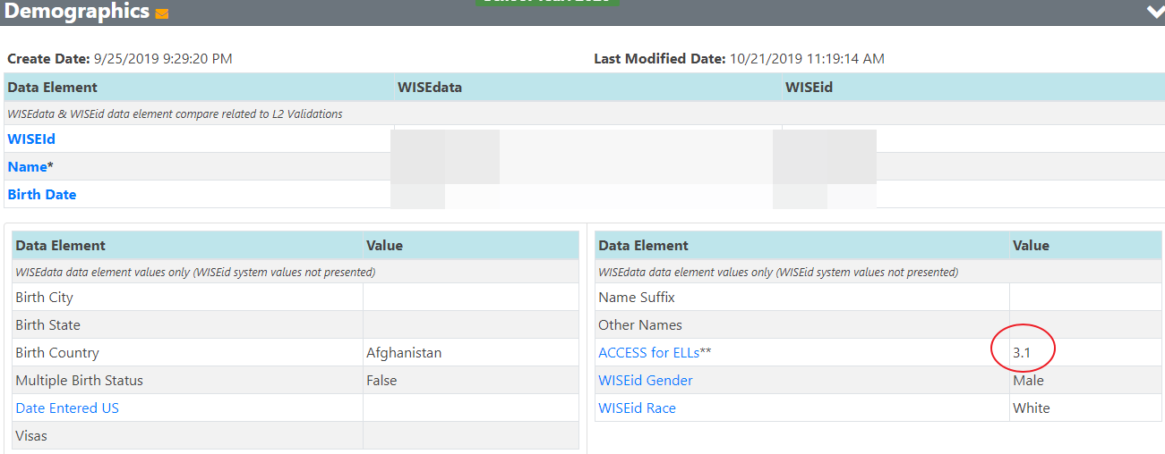
Warning 6781 (2 of 4)

Slide 43
Warning 6781 (3 of 4)
Warning 6781: The submitted ELP Code of 7 indicates the student was never an EL, but the student took the ACCESS for ELLs test in the immediately prior school year
There are rare instances where the ACCESS for ELLs was administered to students who are not and never were ELs. If you have confirmed that occurred in this instance, then acknowledge the warning. This requires the district to file a form with DPI and to keep local records of the misclassification or re-classification. If you acknowledge this warning, be sure to have this information on file. Otherwise, correct the student's ELP code in your SIS.

Slide 44
Warning 6781 (4 of 4)
Warning 6781: The submitted ELP Code of 7 indicates the student was never an EL, but the student took the ACCESS for ELLs test in the immediately prior school year
A valuable resource for all things EL:
English Learner Policy Handbook

Slide 45
Error 6777 (1 of 3)
Error 6777: The submitted English Language Proficiency Code (ELP Code) does not align to the ACCESS for ELLs Composite Proficiency Level from the immediately prior school year. Composite Proficiency Level is between 1.0 and 4.4, but the ELP Code does not equal the digit to the left of the decimal of the Composite Proficiency Level.
You'll receive this error when your submitted ELP Code doesn't match last school year's ACCESS for ELLs Composite Proficiency Level, rounded to the lowest whole number (For example, an ACCESS for ELLs score of 1.6 = an ELP code of 1)
To clear the error, modify the ELP Code to match the ACCESS score and resend to WISEdata
Remember that students with an ACCESS score of 4.4 or lower cannot be reclassified to an ELP code 6

Slide 46
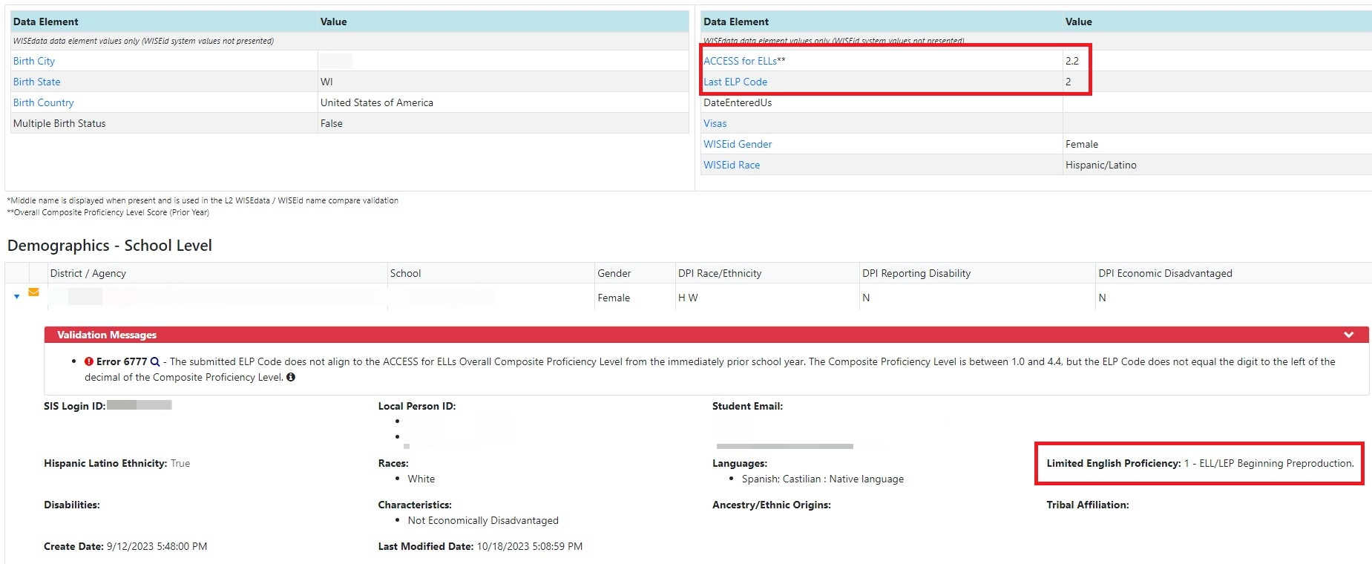
Error 6777 (2 of 3)

Slide 47
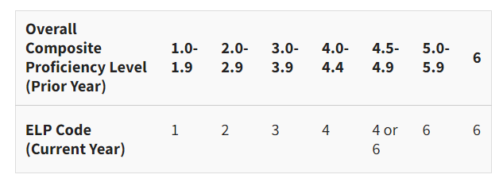
Error 6777 (3 of 3)

Slide 48
Warning 6614
Warning 6614: Student is enrolled, but Special Education Program Association appears to be missing
An active IEP/ISP has been reported by another district, but not by your district; the active IEP/ISP could be from the previous school year or the current school year
If the student has returned to regular education, then acknowledge this warning and contact the other district to end date their sSEPA record
If the student is receiving Special Education services, then submit a sSEPA

Slide 49
Error 7094 (1 of 2)
Error 7094: Non-primary coursework enrollment exists but primary enrollment is missing
When a non-primary enrollment is submitted there must be a corresponding primary enrollment for the student
If the non-primary enrollment status is correct, then work with the district providing primary education services, as that district must submit a primary enrollment for this student

Slide 50
7094: Non-Primary Enrollments
Available only for public schools
Parent Placed Private (PPP): student with an IEP receiving primary education at private school and special education services from public school– may have an associated primary enrollment
Coursework: student taking courses at a public school other than their primary school– always should have an associated primary enrollment
Enrollment Types: https://dpi.wi.gov/wise/data-elements/enrollment-type

Slide 51
Coursework Non-Primary Enrollments (1 of 3)
When do you use Coursework enrollment?
Student takes classes at more than one school in your district
Student from another public district takes class(es) at your district

Slide 52
Coursework Non-Primary Enrollments (2 of 3)
Coursework non-Primary enrollments should include only roster information
Attendance, discipline, graduation, and program data from the non-Primary school must be communicated to and submitted to WISEdata by the school of Primary enrollment

Slide 53
Coursework Non-Primary Enrollments (3 of 3)
When do you NOT use Coursework enrollment?
Student from a private school takes class(es) at your district
Student being home schooled takes class(es) at your district

Slide 54
Error 7094 (2 of 2)
The error could throw if:
You submitted a Coursework enrollment, but the primary district has not yet submitted their enrollment-- the error will clear when they submit the primary enrollment
You submitted a Coursework enrollment, but you haven’t yet submitted the primary enrollment-- the error will clear when you submit the primary enrollment
You submitted a Coursework enrollment when you shouldn’t have (for a private school or home school student, for example)
You accidentally submitted the wrong non-Primary enrollment type (you intended it to be PPP, for example)

Slide 55
Error 6743 (1 of 3)
Error 6743: Special Education Exit Reason is blank when an sSEPA End Date has been set
Either:
Update the sSEPA to add the appropriate Special Education Exit Reason
Or…
Update the sSEPA to remove the sSEPA End Date

Slide 56
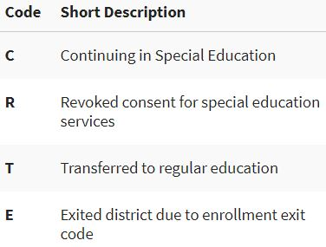
Error 6743 (2 of 3)
sSEPA Reason Exited
If a student leaves your district, remember to use “E” (not “C”)
(continued)

Slide 57
Error 6743 (3 of 3)
Error 6743: Special Education Exit Reason is blank when an sSEPA End Date has been set
Continuing in Special Education: another sSEPA record is expected to be reported
Revoked consent: usually due to the family revoking the provided special education services for the student
Transfer to regular education: student’s IEP has ended and special ed services will no longer be provided
Exited District Due to Enrollment Exit Code: student is leaving your district or will no longer be enrolled
Reporting Exit due to Enrollment lets our system know not to expect another sSEPA record from your district
If a student is moving somewhere else, in state or out of state, private or public, use the SPED Exit Reason E
If you attempt to use Reason C but the student is no longer enrolled in your district, an error will throw as the system expects another sSEPA record

Slide 58
Warning 6751
Warning 6751: No Discipline records for this school in this school year
This school-level warning displays if no Discipline data has been submitted to WISEdata for a district school
If there is Discipline data, then push the records to WISEdata
If there is no Discipline data to report, then acknowledge the warning
Districts MUST acknowledge this warning, as doing so satisfies requirements for the federal Gun Free Schools Act
REMINDER: Report all expulsions, all out of school suspensions, and in-school suspensions for students with IEPs

Slide 59
Warning 7106
Warning 7106: Zero students counted for October 1 Child Count of students with disabilities for this school
If no students with disabilities are eligible to be counted for the October 1 Child Count, acknowledge the warning
If there are reportable students, then submit the necessary data to WISEdata
Several data elements are used to calculate October 1 Child Count Inclusion for a student, including:
Enrollment covers Oct 1
Student’s age is between 3-21 on Oct 1
Count Date Receiving Services is Present or Absent
Student is assigned to a valid grade level for both the submitting school and FAPE Accountable school
REMINDER: Even if you use a third-party special education vendor, the Oct. 1 Count Date Receiving Services info still comes from your main SIS

Slide 60
Error 7139 (1 of 5)
Error 7139: Invalid Educational Environment Setting based on student age and grade level for the effective period of the special education record
How to Fix: This error appears if a student’s submitted educational environment is not appropriate for the student’s submitted age and grade level for their special education (sSEPA) record, as determined by the sSEPA record's submitted end date. To fix this error, submit the correct educational environment for the student, or correct the end date if it is incorrect or has not been submitted. Refer to the Educational Environment data element page to determine the appropriate environment to submit for the student.

Slide 61
Error 7139 (2 of 5)
Error Text: Invalid Educational Environment Setting based on student age and grade level for the effective period of the special education record. Educational Environment Setting codes are defined for two age groups: Preschool (Age 3 to 5 not in KG) and School age (Age 5 in KG to 21). If the child is age 5 and the grade is KG or higher, the school-age educational environment categories will be used. If the child is age 5 and the grade is K3, K4, or PK, the preschool educational environment categories will be used. If the child is age 3-4 then the preschool educational environment categories should be used. If the child is age 5 in KG -21 then the school age ed env categories should be used. To ensure accurate federal reporting, it is critical that the sSEPA that covers October 1 has a valid educational environment for the student age as of October 1.

Slide 62
Error 7139 (3 of 5)
The error is thrown in the following (four) situations:
1) Student is age 3 or 4 on the sSEPA end date and the ed env code is submitted as school age, then you get the error. To fix the error change the education env code to preschool.
2) Student is age 5 on the sSEPA end date, grade level is < KG, and the ed env code is submitted as school age, then you get the error. To fix the error change the education env code to preschool.
3) Student is greater than or equal to age 5 on the sSEPA end date, grade level is > = KG, and the ed env code is submitted as preschool, then you get the error. To fix the error change the education env code to school age.

Slide 63
Error 7139 (4 of 5)
4) Student is age 5 on begin date and grade level <KG and age 6 on the end date. In this case, separate the sSEPA record for age 5 and age 6. On the sSEPA record where the student is age 5 on sSEPA end date and grade level is < KG and the correct education env code is preschool. An error will be thrown if any other ed env code is used. On the sSEPA record where the student is age 6 on sSEPA end date irrespective of grade level, the education env code is school-age.
Notes:
Probably the most common scenario we see with this error is when a student has a birthdate and they change from age 5 to age 6 during the school year. Since their grade level doesn’t change, it is sometimes confusing to know that an Ed Environment change is still required. When a student turns 6, their existing sSEPA record will end and a new age 6 sSEPA record will begin, which will also prompt a new Ed Environment code to be reported to a School-Age code. So if you are looking at this error and aren’t sure what’s wrong, take a look at that birthdate.

Slide 64
Error 7139 (5 of 5)
The error often throws when a 5-year-old in K4 turns 6 before June 30, which is the end of the DPI school year (scenario #4 above).
Since the student’s grade level doesn’t change, it is sometimes confusing to know that an Ed Environment change is still required.
When a student turns 6, their existing sSEPA record will end and a new age 6 sSEPA record will begin, which will also prompt a new Ed Environment code to be reported as a School-Age code.

Slide 65
Helpful Resources
WISEdata Help: links to WISE help pages and useful resources
Data Elements: list of links to all WISEdata data elements and their descriptions, uses, and codes, as well as FAQs and use cases
WISEtraining: E-learnings, mini tutorials and short videos
Knowledge Base Articles: useful articles on validations and other related topics
Uncommon Situations: documentation for situations “outside of the norm”
Info for Schools: basics of getting started with WISE– “Welcome to WISEdata!”
Google Community- Public: view and post questions and comments from fellow users
Google Community- Choice: view and post questions and comments from fellow users Snapshot Preparation Guide: helpful tools to prepare for a data snapshot
WISE Events Calendar: view events, deadlines, trainings, webinars, etc.

Slide 66
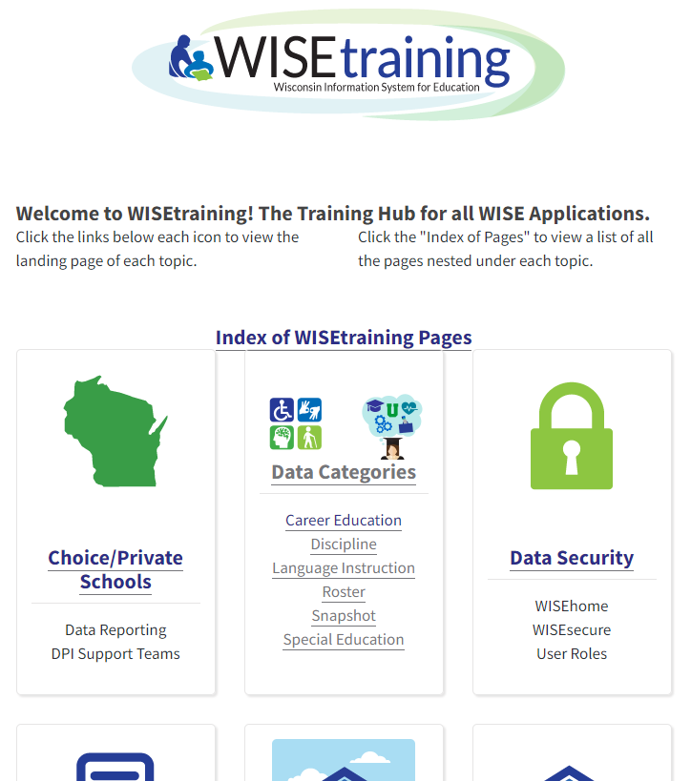
WISEtraining
WISEtraining

Slide 67
We Want Your Feedback
Most WISE apps feature a feedback widget icon in the lower right-hand corner used to enter a new suggestion and/or vote on suggestions made by others.
https://feedback.dpi.wi.gov/

Slide 68
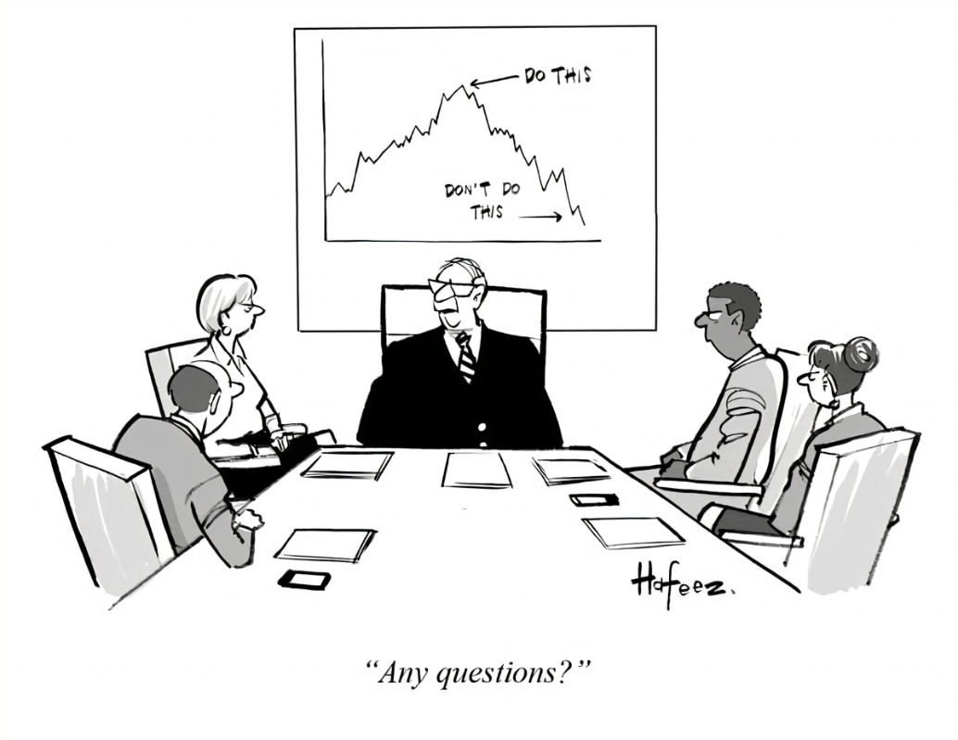
Where to Get Help
DPI Customer Services Help Ticket

Slide 69
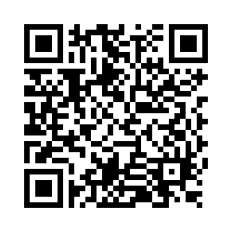
Questions?
Thank you! Thank you!
Please scan the QR code to provide us with your feedback!

