Slide 1
Title Slide
WISEdata: Student Enrollment From Start to Finish for Choice Schools
Emily Colo
Office of Educational Accountability
Carrie Boe
Customer Service Team
March 6 & 7, 2024

Slide 2
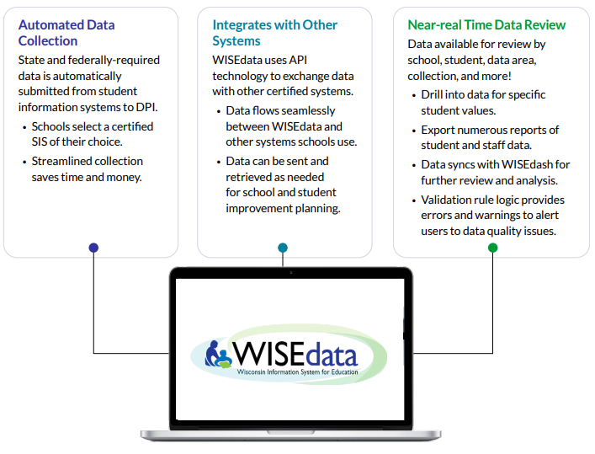
WISEdata
WISEdata
WISEdata Flyer
Automated Data Collection
  Required data submitted automatically.
  Streamlined collection saves time and money.
Integrates with Other Systems
  API Technology
  System Integration
Near-real-time Data Review
  DQ Dashboards
  Exports
  Validation Rules
  Sync nightly to WISEdash

Slide 3
What is WISEdata?
What is WISEdata?
WISEdata is a multi-vendor, open data collection system that allows school districts, charter schools, and private schools participating in a parental Choice program to submit data to DPI from the student information system (SIS) vendor of their choice.
WISEdata links to WISEid to ensure data is attached to the appropriate person.
WISEdata houses Graduation/Dropout, Completion/Exit, Third Friday of September Enrollment, and Attendance data.

Slide 4
Why do we collect data?
Why do we collect data?
Meet all required school state and federal reporting mandates
Inform education research and data analysis through reporting tools
Better understand and improve educational outcomes for Wisconsin students
Maintain high data quality and security policies and standards to ensure data privacy
Provide tools for stakeholders, including educators, school officials, and DPI staff.

Slide 5
Data Submission Setup
Data Submission Setup
SIS Selection: School selects a student information system (SIS).
Credentialing: School’s SIS must certify that their product is configured to WI Ed-Fi API standards to work with WISEdata.
User Security Setup: All users must register for WAMS IDs.
  WAMS IDs are used to log in to WISE applications via WISEhome.
  District administrators will assign users designated security roles to access the various WISE applications.

Slide 6
Data Submission Process
Data Submission Process
WISEid Setup: Request WISEids for all students and staff. This task is ongoing and can be done concurrently with data entry into your SIS.
Data Entry: Enter student data into the local SIS, including demographic, enrollment, and outcome data.
WISEdata Portal Submission: Schools push data from their SIS to the WISEdata Portal for validation.
Validation Review: Users monitor and review the errors and warnings and make any necessary corrections.
Continuous Collection: Schools maintain high quality data, updating information as needed.

Slide 7
Data Snapshots for Reporting
Data Snapshots for Reporting
DPI snapshots are taken at specific points during the year to be used for state and federal reporting requirements, including:
Student rosters for statewide assessments (Forward, PreACT Secure, and The ACT)
School report card data:
  TFS enrollment and student demographics
  Spring semester student demographics (for associating with assessment outcomes)
  Year-end attendance, exit status, and high school completion status

Slide 8
Data Quality for Snapshots
Data Quality for Snapshots
While it is best practice to maintain quality data throughout the year, it is pivotal to have data submissions correct when the snapshot occurs.​

Slide 9
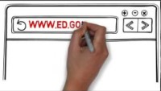
Student Data Privacy
Student Data Privacy

Slide 10
Enrollment
Enrollment
Streamline processes to collect required data elements through completion of enrollment paperwork
Prepare enrollment paperwork/ SIS Parent Portal

Slide 11
Obtain WISEids for New Students/
Refresh WISEids
Obtain WISEids for New Students/
Refresh WISEids
All Student Report Card Opt-In or Opt-Out:
  If your school opted in:
  report all students (Choice and non-Choice participants)
  If your school opted out:
  report only Choice participants
  Verify if your SIS is implementing the Identity Integration tool to ease your WISEid reporting burden.

Slide 12
Research WISEdata Elements 1 of 3
Review WISEdata Elements (1 of 3)
Use the WISEdata Data Elements pages to view all the specific data elements for WISEid and WISEdata.
  In the School Type drop-down, choose Choice Schools and click the Apply button. This will limit the list to data elements collected for Choice Schools.
  The main page provides a quick summary of each element.
  The links take you to individual pages that provide more detail about the element and which codes to report, as well as uses and FAQs.
  This resource will be a staple when completing WISEdata reporting tasks and should be referenced often.

Slide 13
Review of Student Data Elements 2 of 3
Review WISEdata Elements (2 of 3)
Choice School Program Participant
  True/False. Fundamental Choice school data element.
  Only 'Opt-in' schools should have False values. If an 'Opt-out' school sets Choice participant to False, that record will be discarded in the WISE data warehouse.
Student Economic Status
  economically disadvantaged True/False.
  Not all Choice participants are economically disadvantaged!
  !!Getting this element correct is important to report card scoring!!

Slide 14
Review of Student Data Elements 3 of 3
Review WISEdata Elements (3 of 3)
Food Services Program Association
  Free/reduced-price/full-priced meals/Unknown
  Alternate Household Income Form
English Language Proficiency (ELP)
  Home Language Survey
Disability Status
  Parentally Placed Private Flag
Ancestry/Ethnic Origin
Tribal Affiliation
Digital Equity

Slide 15
Data Elements: Enrollment Dates
Effective begin and end dates
When students leave, be sure to exit them with exit type and date

Slide 16
Data Elements: Count Dates
Third Friday of September (SIS entry):
  Count Inclusion (flagged/marked in SIS)
  Choice School Program Participant
    Please ensure your TFS submission matches the counts submitted via the Choice Online Application System (OAS).

Slide 17
Optional Data Elements for Deeper Insight
    Verify that your SIS vendor is participating in these collections.
    Digital Equity Gap
    Immunization*
    Tribal affiliation and ancestry/ethnic origin*

Slide 18
Collaborating with Local School District
Title Services Consultation
If receiving Title I services, use economic status that was collected for WISEdata reporting.
If receiving Title III services, work with LEA to have students assessed with ACCESS.
Parentally Private Placed (PPP)
Students need to be reported by both agencies that are providing services.

Slide 19
WISEdata Portal: Data Quality
Goal:
Provide LEA with a set of tools that allow you to:
Verify the data the vendor is sending is landing in WISEdata
Execute data quality checks and correct at the source
Solution:
The WISEdata Portal!

Slide 20
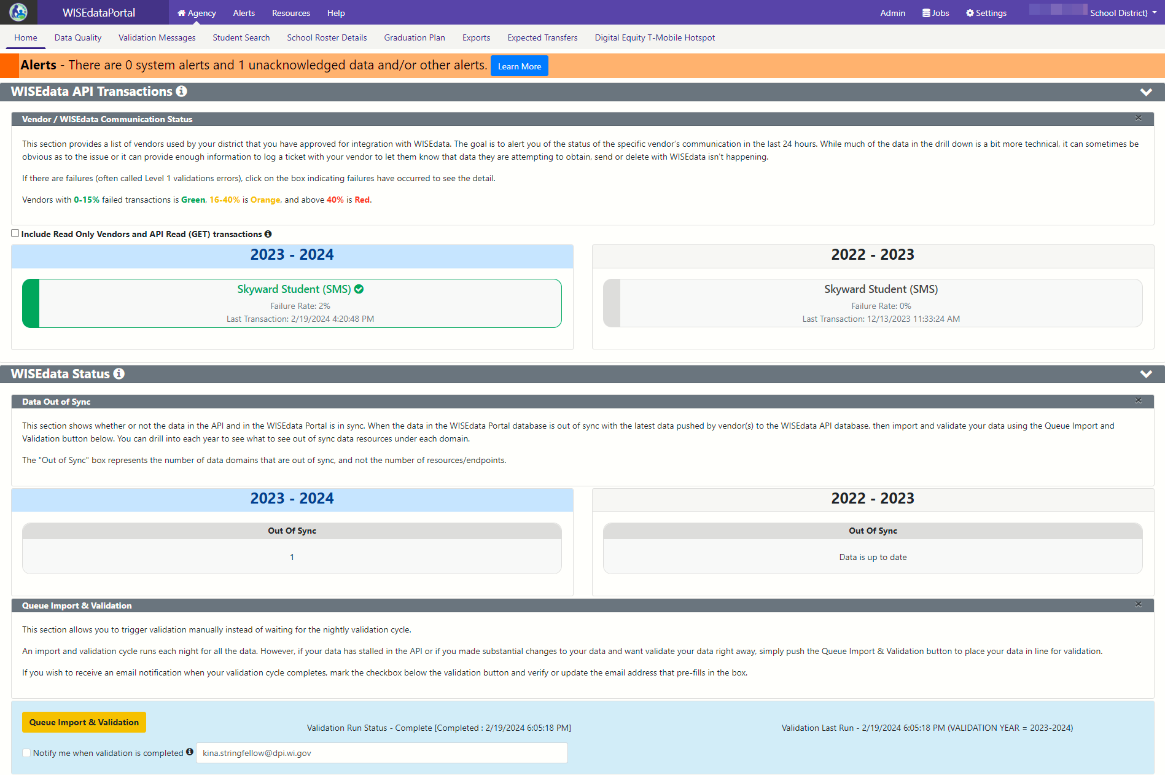
Let’s Jump In!
Navigate to WISEhome.
Log in using your WAMS or Google login information.
Select WISEdata Portal.

Slide 21
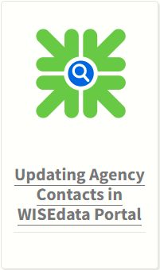
Confirm Contact Information
My Contacts→ Top-Right Corner
  If Contacts need to be updated, please take the time to update now.
  WISEdata Portal Mini-Tutorial webpage:
  Updating Agency Contacts in WISEdata Portal

Slide 22
Update Contacts in WISEid and WISEdata
Both Primary and Secondary Contacts are required for each agency and must be updated each year.
Generic contacts receive general communications from DPI.
*Choice schools’ contact will default to previous Choice administrator starting.
Use the Edit or Delete icons to the right of the email address to make changes or delete a contact.

Slide 23
Your Vendor System
Begin Submitting Data
Begin submitting data from your vendor tool (i.e., SIS) to WISEdata via Ed-Fi.
Make sure all needed data is entered into SIS.
Resolve validation messages, errors, or alerts located in your SIS vendor tool.
Missing data cannot be validated!

Slide 24
Your Vendor System and WISEdata
Review and Resolve L1s
Review Level 1 (L1) errors using your vendor report, vendor error logs, or the WISEdata Portal Home Page.
  These errors prevent the data from getting to DPI. If these errors aren’t cleared, you will need to request assistance from your vendor.
  You can find more information about using the WISEdata Portal Home Page features in this mini tutorial.
Resolve theL1 errors in your vendor system and re-submit the data to WISEdata. Repeat as needed.
Correct ALL data with errors in your vendor system.

Slide 25
New Design, WISEdata Home Screen:
Three Sections
WISEdata, API Transactions
WISEdata Status
Queue Imports and Validations
1
2
3

Slide 26
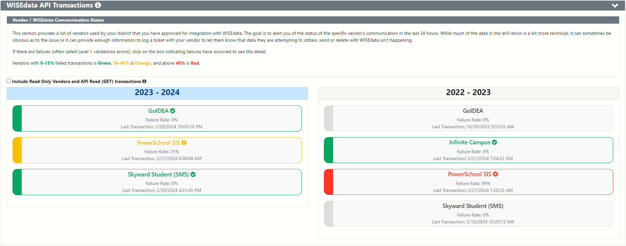
WDP Home, Section 1: WISEdata/API Transactions
Vendor Communication Status
Failed Transaction Rate: Green = 0-15%, Orange = 16-40%, Red = < 40%

Slide 27
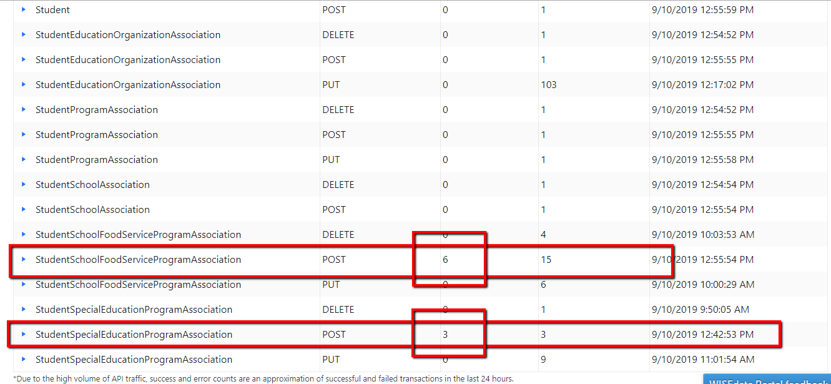
WDP Home, Section 1: WISEdata/API Transactions
Vendor Communication Status, API Details
When you click on any of these vendor ‘buttons,’ a new tab will open in your browser, showing you a detailed list of all API transaction errors, detailing what areas are impacted.
Vendors may need this information to help re-establish data flow

Slide 28
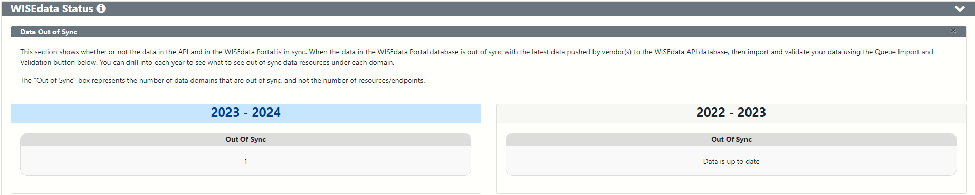
WDP Home, Section 2: WISEdata Status
Data Out of Sync

Slide 29
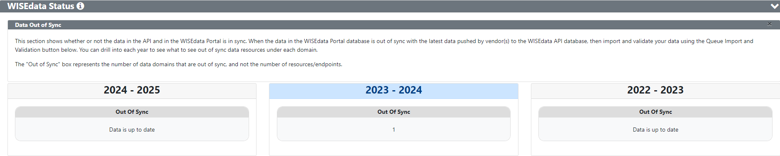
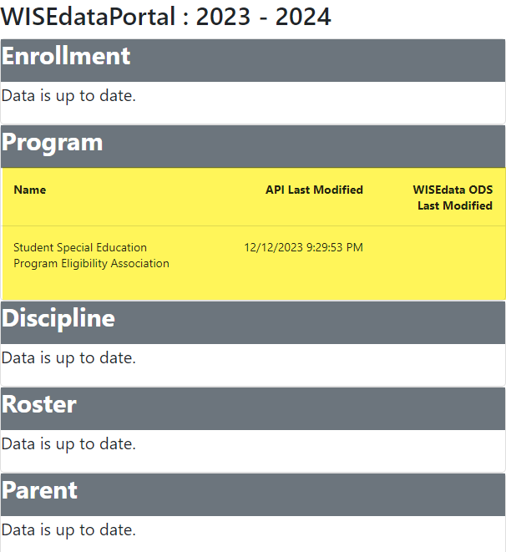
WDP Home, Section 2: WISEdata Status
Data Out of Sync, API Details

Slide 30
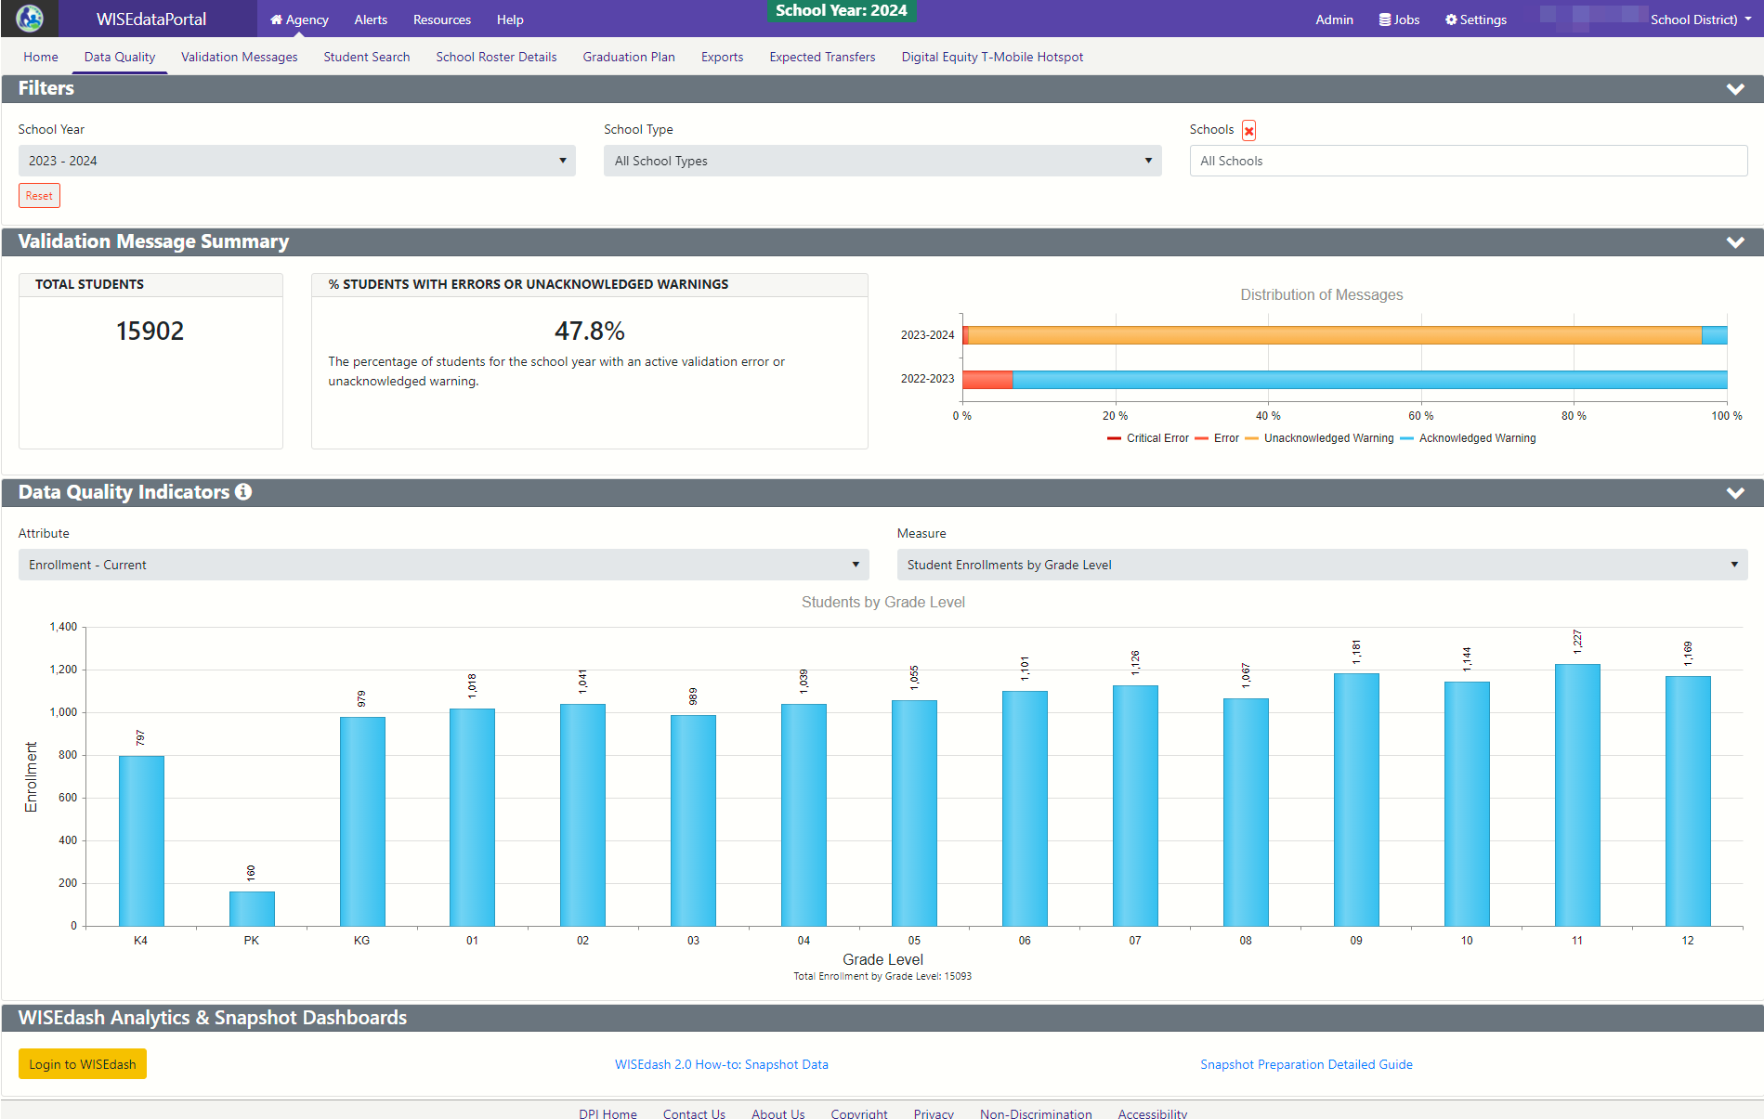
WDP Data Quality Screen, New Design:
1
2
3
4

Slide 31
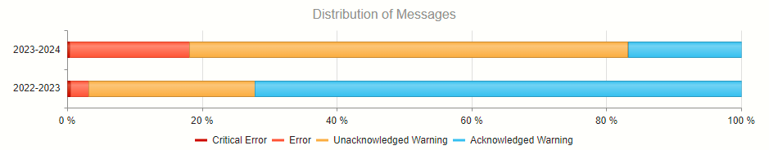
WDP DQ, Section 2: Validation Message Summary
Distribution of Messages
Critical Error: Dark Red
Error: Red
Unacknowledged Warning: Orange
Acknowledged Warning: Green/Blue

Slide 32
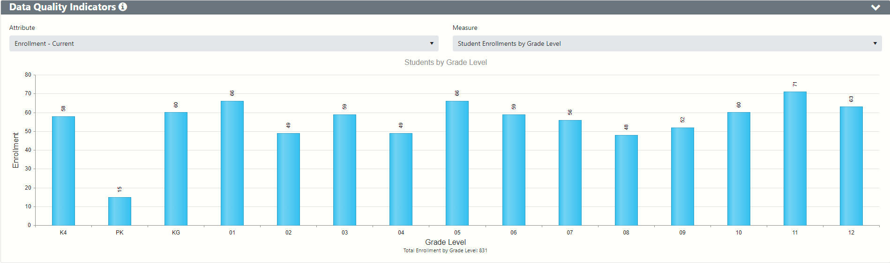
WDP DQ, Section 3:Data Quality Indicators
Notes:
Use the Data Quality page and the Data Quality metrics to verify that all of the steps mentioned so far have been successful. If the high level metrics are not matching what is expected, your next steps are to identify individual students that may be missing or being sent with incorrect values.
On the screen, you can see there are two Enrollment graphs. The first on the left is for current enrollment counts - these counts can change based on the students exiting and entering your district. The second on the right is only for count dates - TFS and Oct 1. These counts should remain the same once you have these count inclusion values finalized and should not change throughout the year.

Slide 33
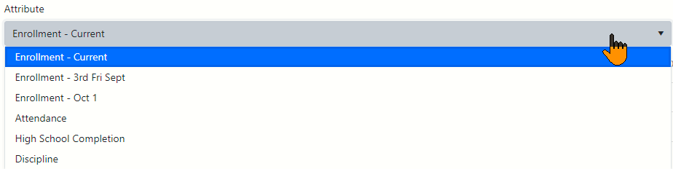
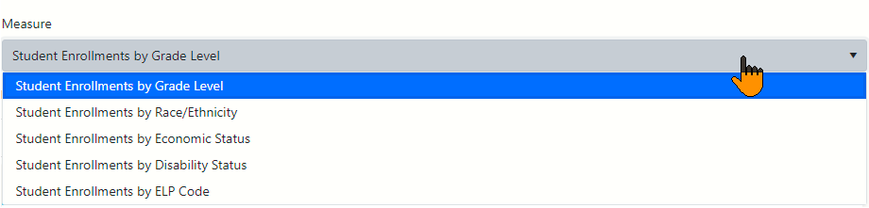
WDP DQ, Section 3:Data Quality Indicators
Filters for QDI Dynamic Graphs
Notes:
Use the Data Quality page and the Data Quality metrics to verify that all of the steps mentioned so far have been successful. If the high level metrics are not matching what is expected, your next steps are to identify individual students that may be missing or being sent with incorrect values.
On the screen, you can see there are two Enrollment graphs. The first on the left is for current enrollment counts - these counts can change based on the students exiting and entering your district. The second on the right is only for count dates - TFS and Oct 1. These counts should remain the same once you have these count inclusion values finalized and should not change throughout the year.

Slide 34
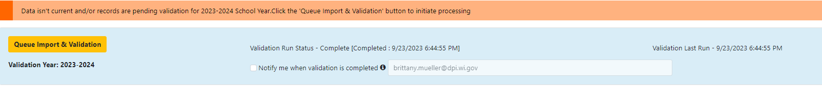
WDP Home, Section 3
Queue Imports and Validations
Run Import & Validation in the WISEdata Portal (on WDP Home Screen)
This will import the data from WISEdata Ed-Fi into the WISEdata Portal and then run validations.
If the Import & Validation job is not manually queued, it runs for all agencies around 5pm.
Notes:
Pior to running a validation, make sure your data is current from your SIS. This can be done on the home screen. It's important to work with your SIS to know how to manually push data and when the data is schedule to flow if not manually pushing. Example, different years may push at different times from your SIS.
When you run a validation, it will only run the validation for the school year you are on, so make sure if you are working on multiple years you run the validation for each year.

Slide 35
Queue Imports and Validations
A validation request is queued with a projected time of processing
  Look to see that validation has completed…
  Use the email feature!
Import & validation can be requested in WDP from either of the these screens:
  Home page
  Validation Messages page

Slide 36
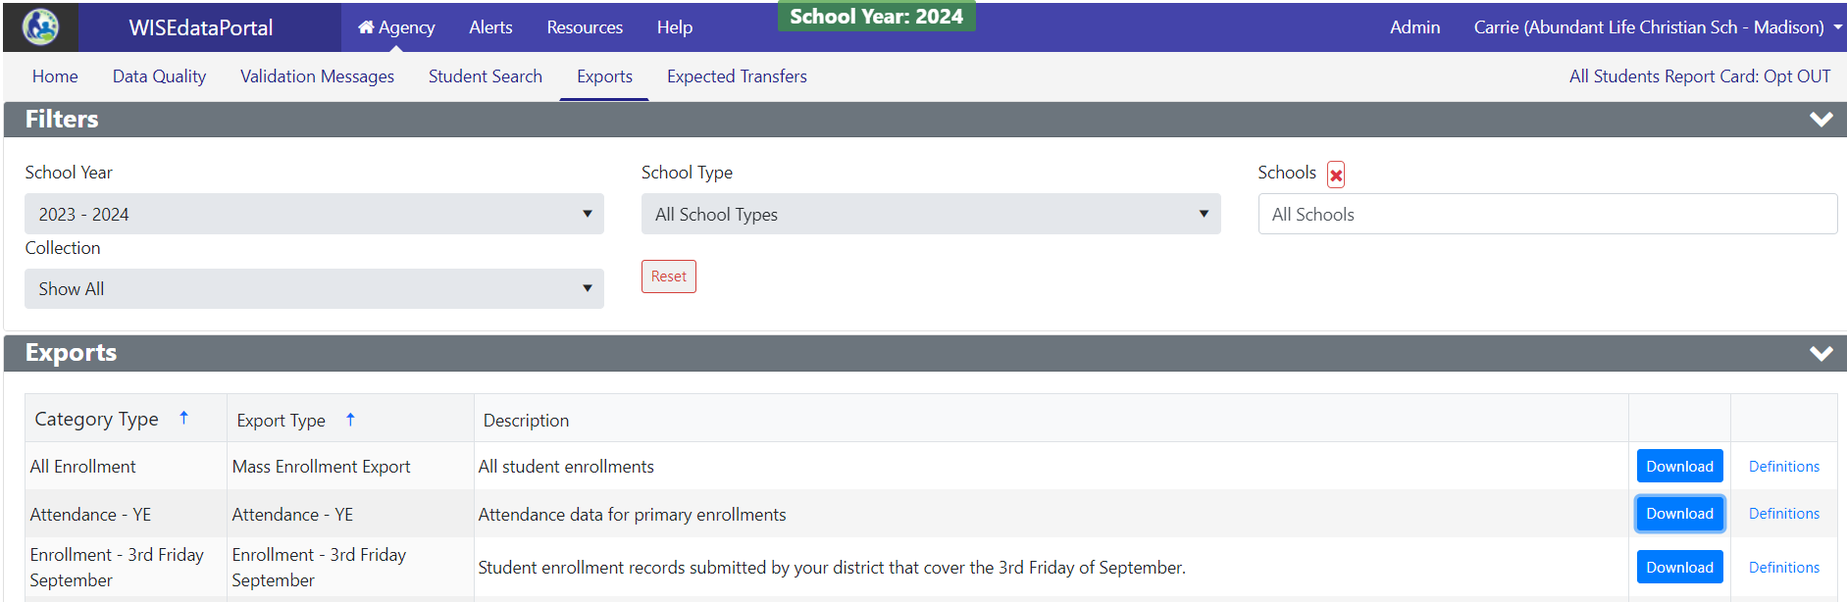
Verify Choice Counts Using WISEdata Exports
Use WISEdata Enrollment- 3rd Friday of September Export to verify Choice counts.

Slide 37
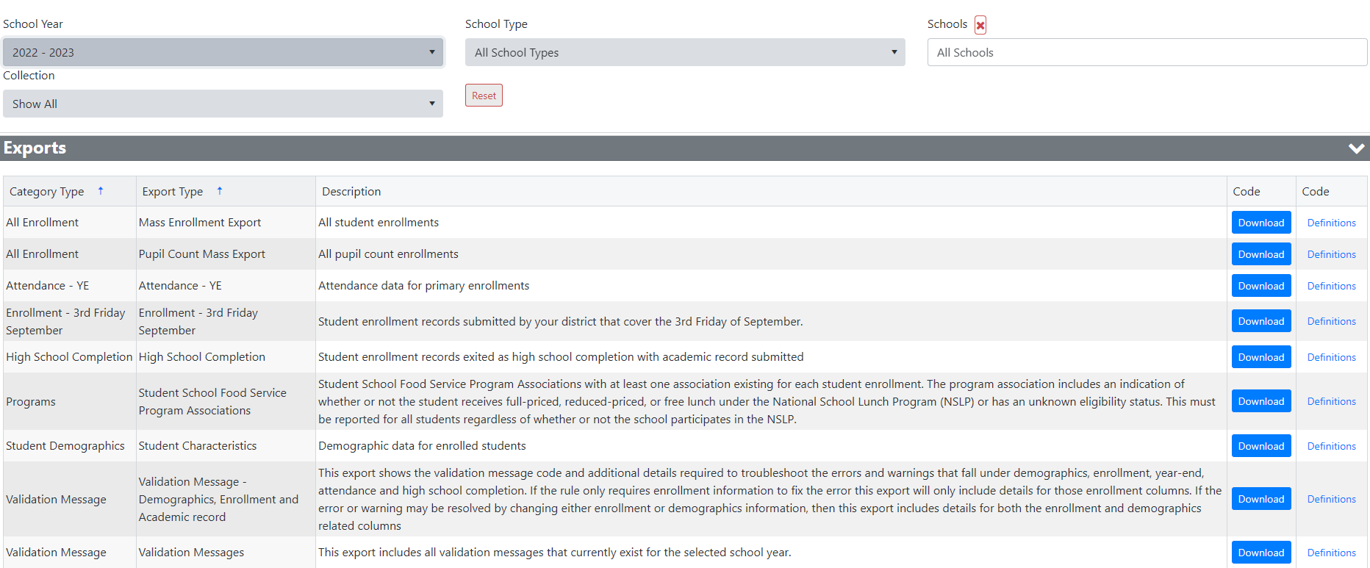
WISEdata Portal Exports

Slide 38
Using Exports
Allow users to slice the data in various ways.
Provide mass exports of most prominent data, including the Mass Enrollment Export and Validation Message Export.
Use 'Mass Enrollment Export' to check that all student enrollments are submitted and that they have the correct Choice Participant value.
Use 'Student Characteristics' export to check econ status, disability status, English proficiency level (ELP), etc.

Slide 39
WISEdash Extracts for Choice Schools
Accessing WISEdash Extracts Export from WISEdata Portal:
Download the extract you want to see under the WISEdash Extracts section.
WISEdash Extracts are intended to help Choice schools access graduation and dropout rate information normally available only in WISEdash for Districts.
WISEdash Extracts work similarly to normal WISEdata Portal exports and allow Choice schools to download reports that they can use to track graduation cohorts and calculate graduation, high school completion, and dropout rates.

Slide 40
WISEdash Extracts, Details
Extract Name | Description
Graduation & HS Completion Rate | This report shows students included in the numerator and denominator of the Graduation Rate (regular diploma) and High School Completion Rate.
Graduate Future Cohorts | This report show the cohort for high school completion in which a student is placed based on grade level and school year of their first entry into high school.
Dropout Rate | This report shows students included in the numerator and denominator of the annuals dropout rate.
Absenteeism | This report shows students’ status regarding chronic absenteeism under the Wisconsin state definition.

Slide 41
Validation Knowledge Base Articles
Click the KBA links (in the Code column) to learn more about the issue and how to correct it.
Knowledge Base Articles (KBA) provide information on common topics, answers to questions, and solution suggestions for validations.
You can search the Knowledge Base Article database directly.

Slide 42
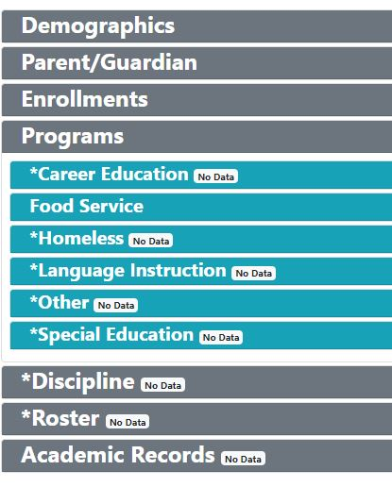
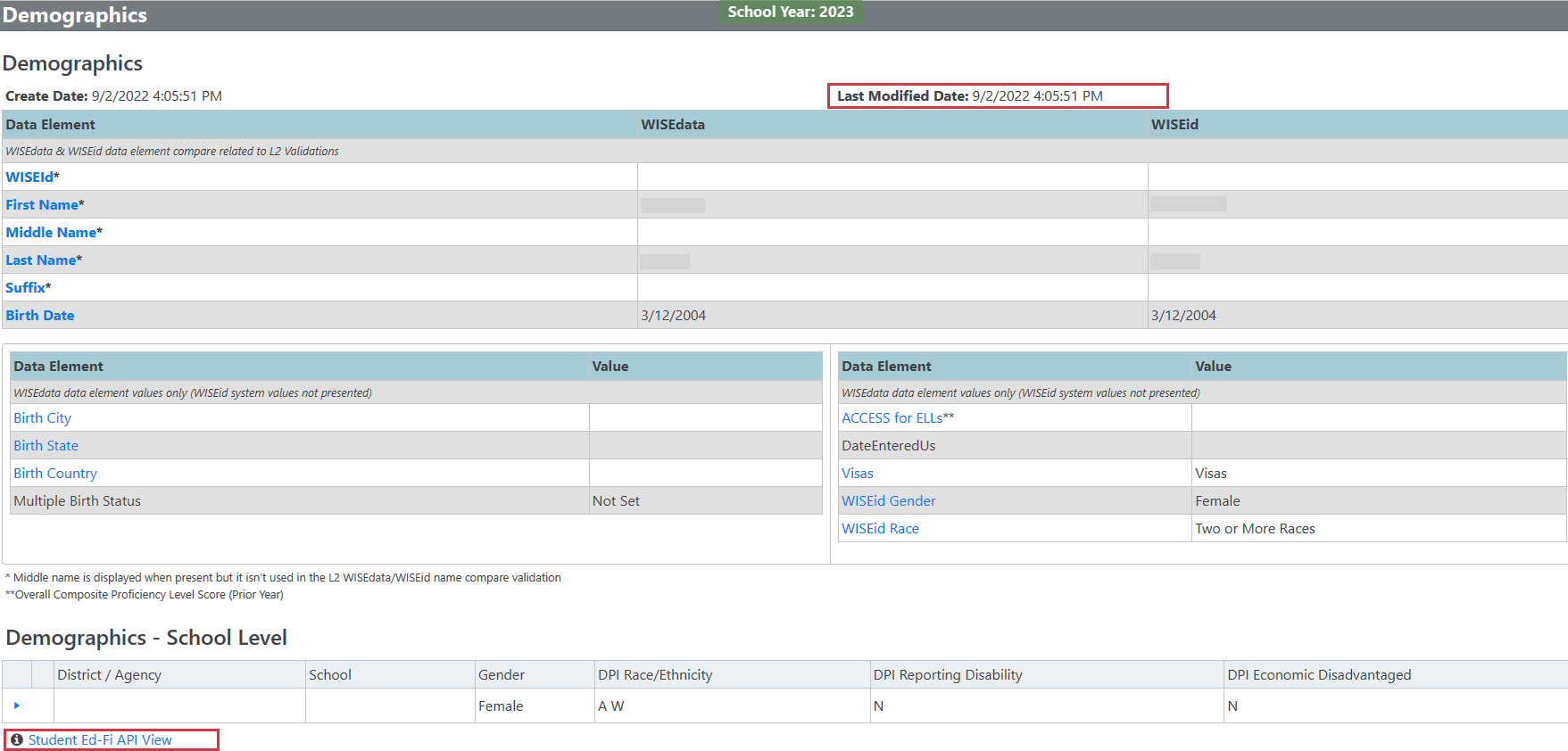
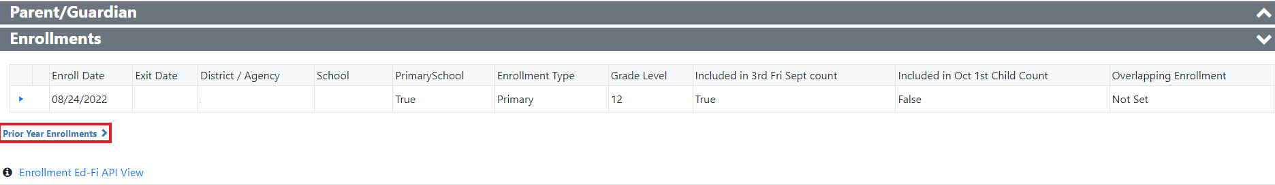
Student Details Features
Student Details Features
Notes:
Briefly talk through features of reviewing Student Details Screen
Demographics: WISEid is authority. Change there.
Characteristics with Create & Last Modified Date
Ed-Fi API Views for troubleshooting
Enrollments, programs, special ed, Discipline details: drill down for details and determinant values

Slide 43
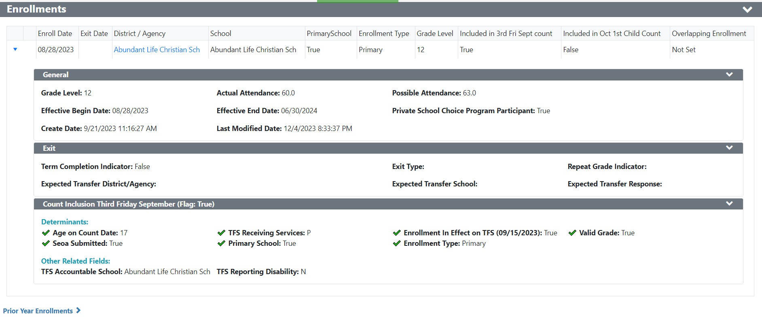
Student Detail Features

Slide 44
Closing the School Year in WISEdata
Exit date should reflect last day of receiving educational services unless your school has a specific policy regarding exit date.
Exit Type entered into SIS
High School graduates require credential type of a regular diploma entered into SIS
Exit Code Decision Process

Slide 45
Exit Type: TC
Transfer to another WI school covered by WISEdata or continuing in the same school. Known to be continuing.
A school covered by WISEdata includes:
    a Choice school that opted into the All-School Report Card,
    a Choice participant transferring to a school that opted out of the All-School Report Card or a public school.
Notes:
TC: Use this exit type if you have evidence (e.g., a records request or email enrollment notification) that the student transferred to a school covered by WISEdata. Covered schools include schools in Wisconsin school districts under ch.119 and ch.120, stats., and non-district charter schools under s. 118.40(2r), stats.

Slide 46
TC: Known to Be Continuing
Transfer Confirmation: To confirm that a student transferred out, the school or district must have official written documentation that the student enrolled in another school or in an educational program that culminates in the award of a regular high school diploma. (34 C.F.R. §200.19(b)(1)(ii)(B)(1))
Notes:
In the case of a student who transfers to another school covered by WISEdata (Exit Type TC), that transfer is officially documented through the submission of a WISEdata record by the receiving district/school. No additional documentation is required.
In the case of transfers to schools not covered by WISEdata (Exit Types TNC for in-state and TOS for out-of-state), official written documentation may include: a request for student records from a receiving public or private high school or an educational program (that culminates in a regular high school diploma)or a written record of a response from an official in the receiving school or program acknowledging the student’s enrollment.
Evidence of transfer to home-based private education includes a copy of the completed Home-Based Private Educational Program Registration form (PI-1206).
A conversation with a parent or neighbor of a student would not be considered official written documentation of a transfer.
A student cannot be assumed to be continuing simply because the student’s status cannot be documented. Use a "not known to be continuing" exit type in these situations.

Slide 47
Exit Type: TNC
Transfer to a WI school not covered by WISEdata. Known to be continuing.
TNC should be used when a student is transferring within WI:
  to home-schooling,
  to a private school not participating in the Choice program, or
  as a non-Choice participant to a Choice school not opted into the All-Student Report Card.
Notes:
TNC: Use this exit type if you have official written documentation (e.g., a records request) that the student transferred to a state or district-approved WI educational program not covered by WISEdata. This may include transfer to, for example, a private school, full-time home-based private education, or other approved program.

Slide 48
Exit Type: EC
Expected transfer/promotion to a new school covered by WISEdata. Not known to be continuing.
Take care to limit the use of ETC to only students for whom you have evidence of the transfer. Refer to the ODO slide later in the presentation for information on exiting a student when there is no evidence of transfer.
Notes:
ETC: Use this exit type if the student has moved to another WI school district OR was expected to enroll in another school in your district AND is not known to be continuing in an educational program. This exit type requires that your district identify the expected new district if the move is to another WI school district or the expected new school if the student was expected at another school in your district.
DPI recommends using the ETC exit type code only after a validation is returned by WISEdata indicating that 'TC' must not be used. It is DPI's hope that all uses of the ETC exit type code will be replaced by a more specific exit type by the year end snapshot each year. Additionally, schools should avoid using the ETC exit type code during the summer for bulk/mass exits, as they will most likely need to be changed to a TC code in the fall.

Slide 49
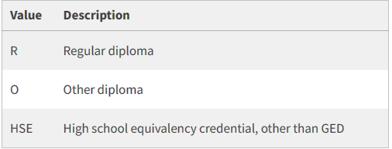
Exit Type: HCS
High School Completion: Use this exit type if the student earned a high school completion credential on or before the exit date. This exit type requires that your district submit a high school completion credential type.
Credential Type (Diploma Type) refers to the kind of completion certificate the student attained after completing high school. Credential/Diploma type is expected only for students who complete high school.

Slide 50
Exit Types: MA and BCA
Reached Maximum Age for Services
Exiting with MA should be used only for students with disabilities who continue through age 21 and will not receive a high school completion credential.
Below Compulsory Age
This exit type applies if a student was under the compulsory age for attendance, six, on the school exit date.
Notes:
MA: Use this exit type if all of the following applies:
the student's exit date is on or after the end of the most recently ended school year prior to the count date,
he/she turned 20 prior to the beginning of the current school year and turns 21 prior to DPI's official school calendar year end, and
he/she did not receive a high school completion credential prior to the count date.
If a student exits school prior to the max age year, then use the exit code of dropout, ODO. If the student transfers midterm during the final year of FAPE-eligibility, use an appropriate transfer code, such as TC; MA should only be used at the end of the school year. If a student earns a diploma, use the HSC exit type instead.
MA should only be used for the last possible year a student is eligible for FAPE, not when a student is between the ages of 18-20. If a student continues to attend school and receive services after he or she is no longer FAPE eligible (reached Max Age), do not submit this student to WISEdata.

Slide 51
Exit Type: CE
Compassion Exit: Starting with the 2022-23 school year, DPI started collecting Compassion Exit (CE) as an Exit Withdraw Type Descriptor. The Exit Type and validation rules apply to sensitive, extenuating cases limited to when a student is:
    abducted and presumed dead,
    terminally ill and no longer able to receive education services,
    removed to an unknown location by ICE, or
    unable to receive education services for the remainder of the school year due to mental health or addiction treatment and is expected to return during the next school year.

Slide 52
Exit Types: ISM & TOS
Interstate move. Move to another state within the country. Not known to be continuing.
Use this exit type if a student is known to have moved to another state within the country and is not known to be continuing.
Transfer Out-of-State. Known to be continuing.
Use this exit type if a student moved out-of-state or out-of-country, and you have official written documentation (e.g., a records request) that the student is continuing in an educational program.

Slide 53
Exit Type: ODO
Other, Dropout, or Possible Dropout: Use this exit type if the student is a known dropout or if the student is not known to be continuing in an educational program and no other exit type applies.

Slide 54
Exit Type: ODO, Important Details
If you expected one of your students to transfer to another district but the student never ended up enrolling at that district or any other district, then you should enter ODO for the student's exit type.
Even if you sent records in preparation for the transfer, if the subsequent school never enrolled the student, the student remains your responsibility.
You will need to investigate the student's whereabouts.
If after investigation, you find the student is no longer enrolled anywhere, then submit ODO.

Slide 55
Reporting Scenarios: Example 1
Using the data quality indicators’ “Enrollments”, I can only see 18 3rd graders when I have 20 in attendance.
What tools should we use to find out what students we are missing?

Slide 56
Reporting Scenarios: Example 2
2. I do not see any information populated for the data quality indicator “Enrollment- Students by Economic Status”.
What tools can I use to verify if this information is being received?

Slide 57
Reporting Scenarios: Example 3
You are experiencing Error 6469 due to overlapping enrollment. You look at the student details to find that a student who is receiving speech services is marked as “Primary Enrollment” at both the Choice school and public school.
What do you do?

Slide 58
Helpful Resources
WISEdata Help: links to WISE help pages and useful resources
Data Elements: list of links to all WISEdata data elements and their descriptions, uses, and codes
Knowledge Base Articles: useful articles on validations and other related topics
Info for Schools: basics of getting started with WISEid
Google Community: WISEdata community to view and post questions and comments to fellow users
WISEdata Events Calendar: View deadlines, trainings, webinars, etc.

Slide 59
Reporting Deadlines and Snapshots
May 21, 2024, Snapshot
  2023-24 Spring Demographics
Summer Data Quality Review - August 2024
  2023-24 Year End Attendance & Completion
ACCESS for ELLs student roster
  Captured in fall along with ELP code (1-7) to facilitate testing
  Timing announced annually in the DAC digest
October 2024 - 6 weeks prior to snapshot
  DPI Data Quality outreach begins
December 10, 2024, Snapshot
  2023-24 Year End Attendance & Completion
  2024-25 Third Friday of September Enrollment
  2024-25 Digital Equity Data (recommended, not required)
Student Assessment student rosters
  Captured in January to facilitate Forward, ACT, and PreACT Secure testing
  Timing announced annually in the DAC digest
See the WISEdata Events page for the most up-to-date information.

Slide 60
Getting Help
WISEsecure, WISEhome, WAMS Help Ticket
WISE Help Ticket for WISEdata Questions
Google Currents/Workspaces is switching over to Teams!
Stay tuned for communications from the Customer Services Team.
Platform change will occur next week (by March 15, 2024)
Notes:
Have a question, comment, and/or suggestion? Submit a help ticket and someone will respond to your question.
Two separate help tickets: one specifically around security and access and one for WISE questions

Slide 61
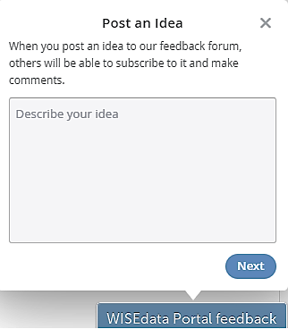
Giving Feedback
Within most DPI applications you can:
Provide feedback directly
Enter a new suggestion
and vote on suggestions made by other people

Slide 62
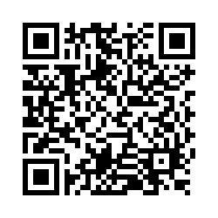
Questions?
Thank you! Thank you!
Please scan the QR code to provide us with your feedback!

