Slide 1
WISEdata Finance and Wisconsin School Finance Portal Updates
Matt Baier & Mark Elworthy
School Financial Services
Department of Public Instruction
WISEdata Conference
March 2024

Slide 2
What is WISEdata Finance?
Vendors pull the current Wisconsin Uniform Financial Accounting Requirements (WUFAR) Chart of Accounts (COA) from DPI
District crosswalks ledger to a Local COA in WUFAR and pushes data to WDF
The Local detail COA rolls up to the required DPI COA level
District pushes financial data as three sets of data: Local Accounts, Budget Amounts and Actual Amounts

Slide 3
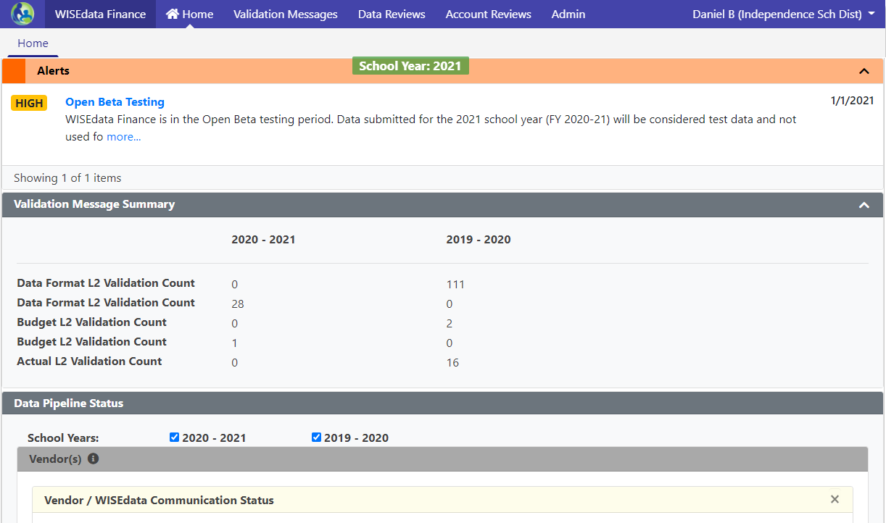
Mindset Shift: WISEdata Finance
Data submissions in WISEdata Finance are point-in-time looks, and it helps to think about data validations more as bringing issues to your attention than giving you a list of errors to clear
“Doing the report” will mean pushing clean data.
Fixing your books and pushing that data to WDF is how you fix your reporting.

Slide 4
WISEdata Finance FY 2022-23
Continuing to work with small number of districts to complete Aid Certifications and Annual Report
Issues in Aid Certification/Annual Report transition varied from needing to update WUFAR COA, general accounting, and vendor integration.
Special Education reporting completed through the PI-1505-SE
Tax Levies, Debt Schedules, and Referenda moved to WiSFiP
ESSA School-Level Reporting updated to utilize WDF data

Slide 5
WISEdata Finance - FY 2023-24
Complete submission of the Budget Report
Reporting Referenda for 2024
Updates to Annual Report to collect Fund Balances including Debt Balances
Additional addenda in WDF for Common School Fund / OPEB
Special Education Annual Report transition
Transition additional SAFR reports to WiSFiP

Slide 6
Dramatic Transition
What do all of these things have in common?
The Wisconsin Uniform Financial Accounting Requirements.
WUFAR
(pronounced wuh-fer)

Slide 7
WUFAR is KEY
Simplified and flexible chart of accounts - ensures adherence to state and federal financial reporting requirements, and gives LEAs the ability to segregate and group accounts.
Revisions to WUFAR are done on at least a yearly basis to address needed changes, fix errors, or adhere to requirements under GAAP and GASB.
DPI Chart of Accounts integrated by the vendor. Ensure your local accounts account for changes to WUFAR and the DPI COA so accounts roll up correctly.
Notes:
What are the drivers of the system modernization?
The system has become difficult to manage, utilize outdated or overly-expensive technologies (classic ASP, .NET webforms, and Oracle), and no longer meet DPI IT standards.
School-level reporting: nothing we had could accommodate this. Data was collected through .csv files and the data was not identified by location or school level.
A chart of accounts is an organizational tool.
Not rip and replace, rather custom-configure a system that works with our needs

Slide 8
Chart of Accounts (1 of 2)
Vendors mapped the LEA’s detailed accounts to a general umbrella DPI account - WISEdata Finance displays both the DPI account and the local detailed account.
Local Account | DPI Account | Budget | Actual
27E-100-411-152000-347 | 27E-100-410-152000-000 | $1,500.00 | $1,292.13
27E-100-412-158000-019 | 27E-100-410-158000-000 | $5,000.00 | $2,563.00
By using the “mapping” methodology, DPI no longer has to create hundreds of accounts every time a new grant is created.
By collecting the Local Account, DPI’s program areas have access to the level of detail necessary to determine compliance with Federal grant regulations.

Slide 9
Chart of Accounts (2 of 2)
Vendors mapped the LEA’s detailed accounts to a general umbrella DPI account - WISEdata Finance displays both the DPI account and the local detailed account.
Local Account | DPI Account | Budget | Actual
27E-100-411-152000-347 | 27E-100-410-152000-000 | $1,500.00 | $1,292.13
27E-100-412-158000-019 | 27E-100-410-158000-000 | $5,000.00 | $2,563.00
By using the “mapping” methodology, DPI no longer has to create hundreds of accounts every time a new grant is created.
By collecting the Local Account, DPI’s program areas have access to the level of detail necessary to determine compliance with Federal grant regulations.

Slide 10
Validations
Two levels of validation rules at work:
L1 validations reject your data before it can be stored in our data warehouse. Validation message are triggered when you push data to DPI. Some examples are rejected accounts, invalid school codes, etc.
L2 validations are run on data saved into the data warehouse (have passed the L1 validations). Examples include: WUFAR mismatches, Amount errors, Project/Program Tag issues
Although validations display in WISEdata Finance, all modifications to the data will happen within your SIS.

Slide 11
Landing Page - Validation Summary Panel
Panel has been updated to display count summary for L1 data validations, L2 data and financial validations, and Addenda by status.

Slide 12
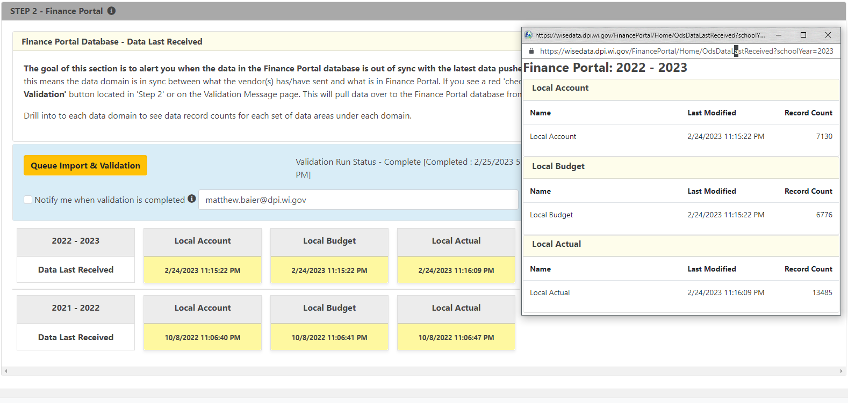
WISE Data API / Finance Portal panels
Notes:
Queue Import & Validation - Manual button to trigger validation run status. Otherwise will run automatically after a set amount of time.
Clicking on yellow panel with timestamp will pop up a window that will display summary information and counts for Local Account, Local Budget, and Local Actual.

Slide 13
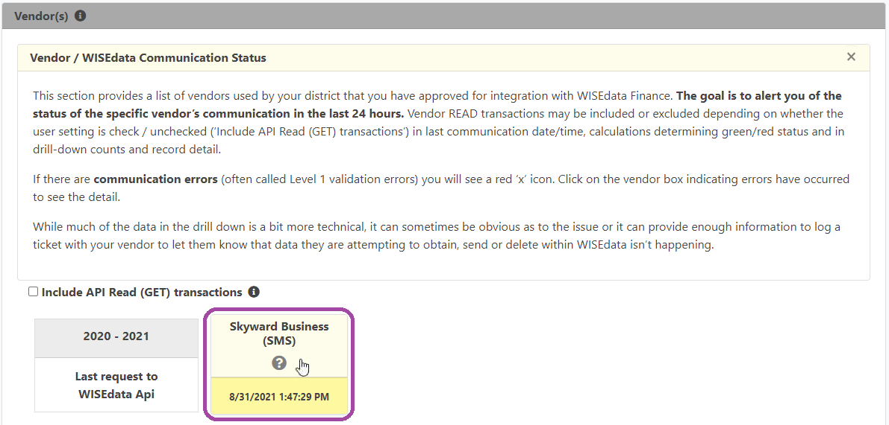
L1 Validations
“How can I see if we have rejected accounts?”
On the WISEdata Finance home screen, scroll down to the panel beneath the Validation Message Summary panel, the “Vendor / WISEdata Communication Status” section. There is a yellow box for each school year that shows when the WISEdata Finance API received the last submission from your vendor.
You can click on the box to get details:
Users are redirected to a screen that shows summary error and success counts for Account, Budget, and Actual records.
Additionally the screen will show a record of all L1 errors logged in the last 30 days.

Slide 14
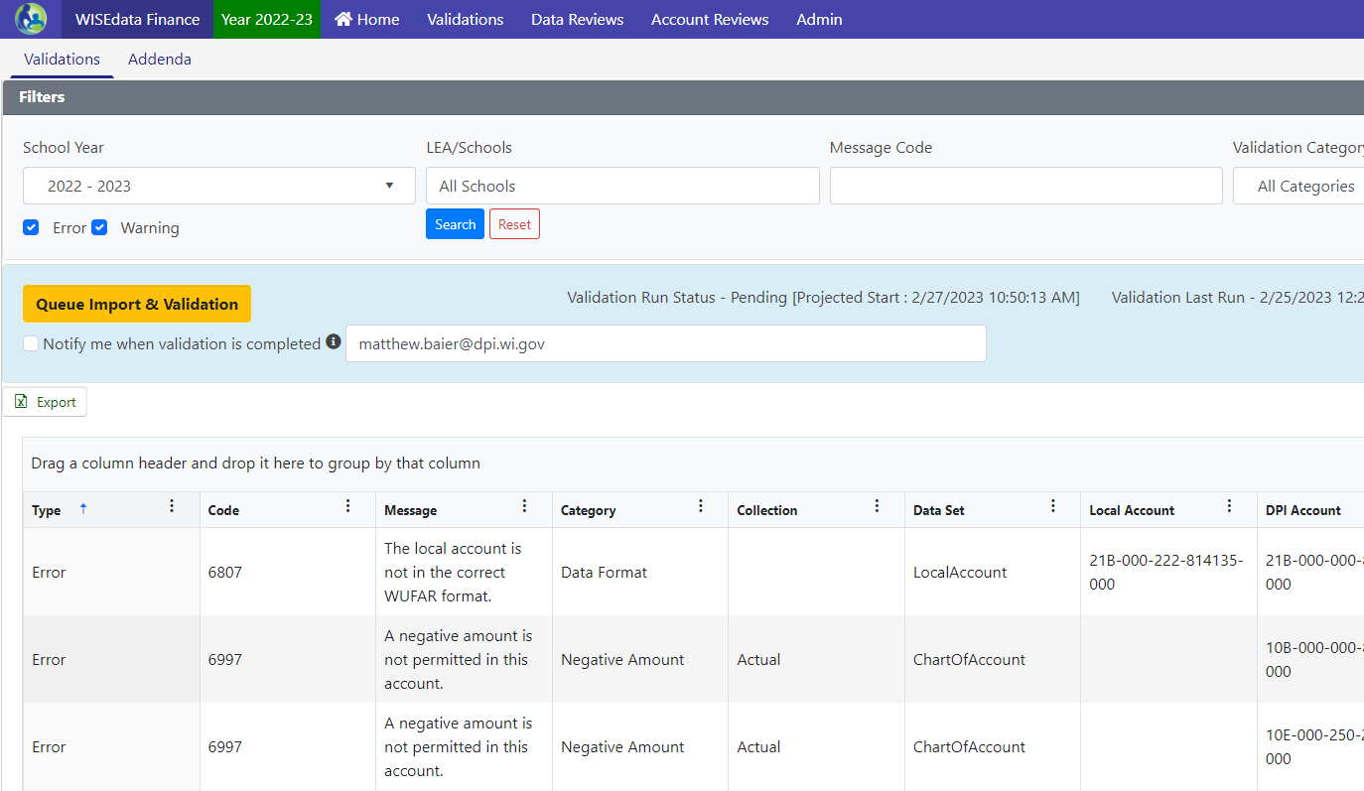
L2 Validations (1 of 2)
“How do I see our validations?” Access through Validations menu > Validations tab
This screen will list all L2 validations (data format and financial) as of the last validation run.

Slide 15
L2 Validations (2of 2)
L2 Validations
Review Data Format validations. These validations indicate issues related to COA mapping and should be reconciled.
Budget and Actual validations are more nuanced and have different meaning throughout the year.
Notes:
We are working on it

Slide 16
Data Format Validations
Data Format Validations - Indicates something is not mapped correctly and may not roll up as needed

Slide 17
L2 Fiscal Validation Types
Negative Amount
Fund Transfer
On Record
Trial Balance
Notes:
These are laid out in this order for a reason. This is the order I work through them because as some of the negative amount and transfer validations are cleared, your trial balance validations may disappear.
Do a section and reupload to see what validations still remain, the reupload time may save you trying to fix something that is already taken care of.

Slide 18
Negative Amount Validations (1 of 2)
Updated the Negative Amount Validations in the system.
Previously triggered by any individual local account with a negative amount (Budget or Actual).
Updated to only trigger Negative Amount Error if the rolled up DPI Account has a net negative amount.

Slide 19
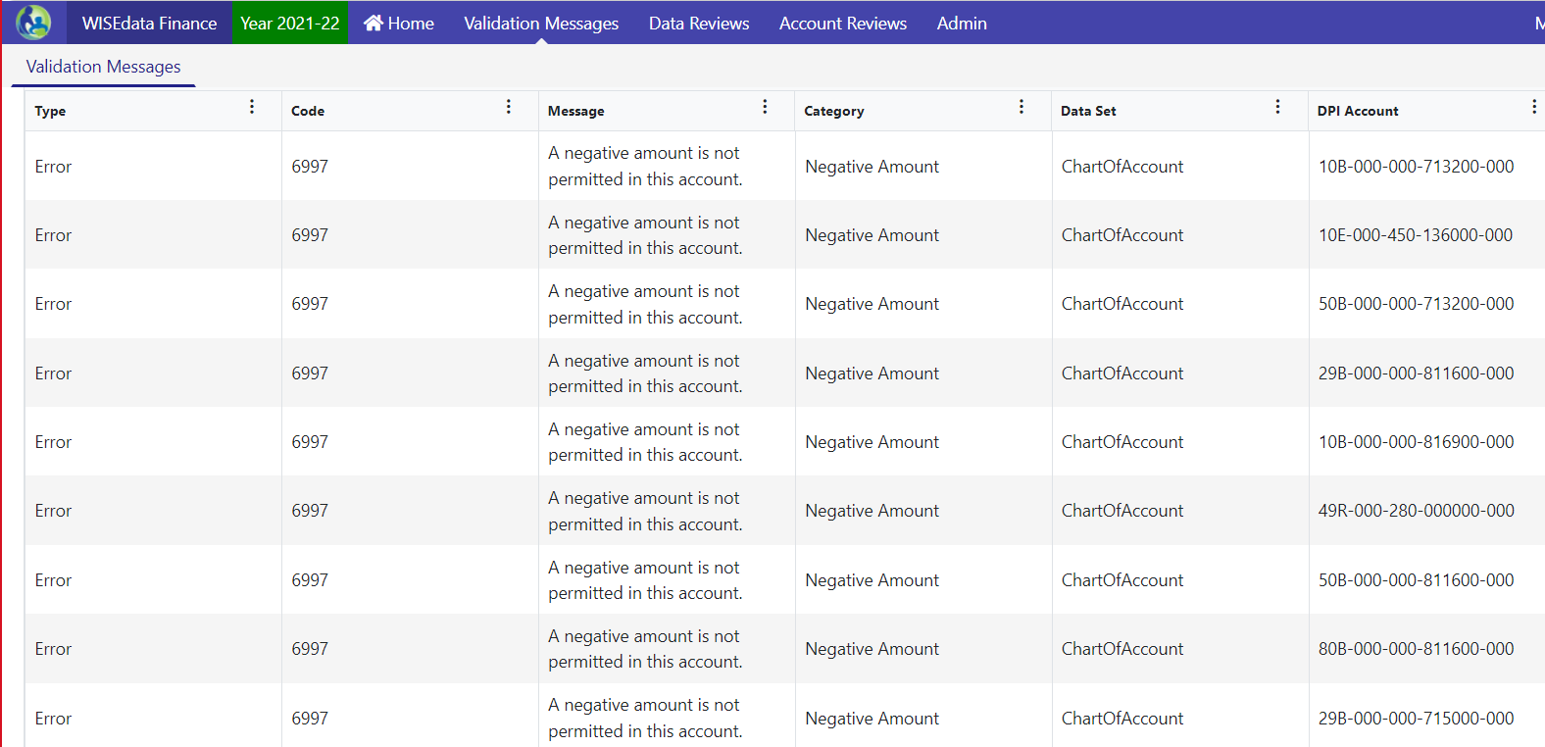
Negative Amount Validations (2 of 2)

Slide 20
Fund Transfer Validations
When the transfer into a fund doesn’t match the transfer out of the fund it came from.
When the Due to a Fund doesn’t equal the Due from Fund - fix by running function 714000 and function 812000 totals in balance sheet detail report, comparing and adjusting so they are in alignment.

Slide 21
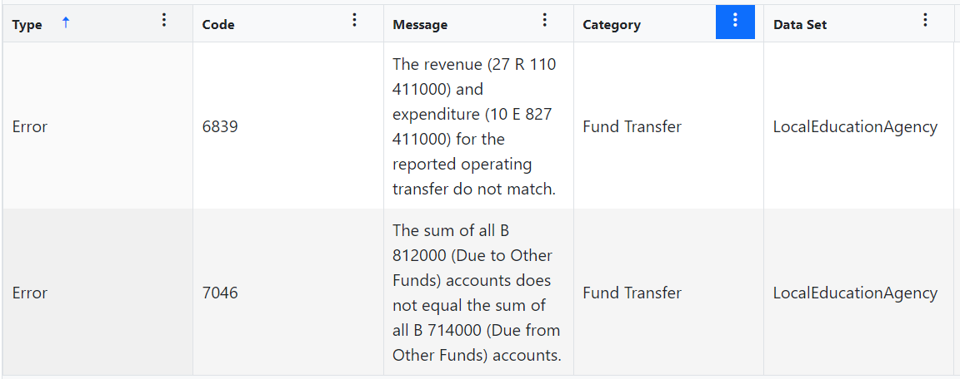
Fund Transfer Examples

Slide 22
Trial Balance Validations
Revenues minus Expenditures doesn’t equal the change in Equity.
Assets don’t equal Liabilities plus Equity.

Slide 23
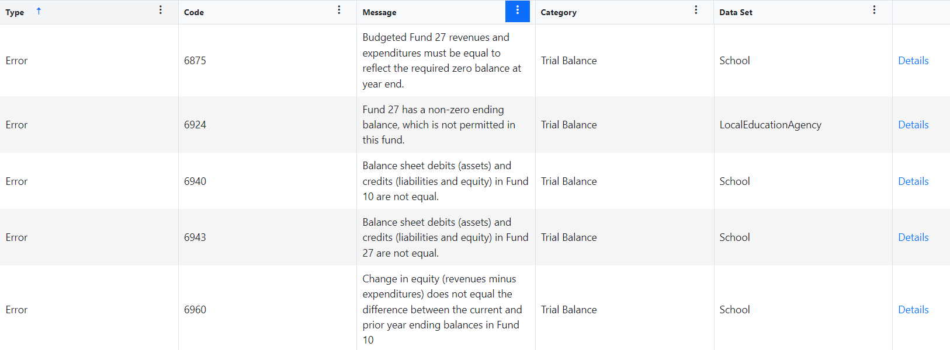
Trial Balance Example 1
Not quite as simple
Notes:
Identify the amount you are off and it’s a matter of searching through transactions of what might not have been recorded, recorded twice, recorded in the wrong fund etc.
I like to run reports by account type and search for the amount of the difference to see if it pops up right away.
Review journal entries as well to make sure the difference didn’t come from a journal entry made.

Slide 24
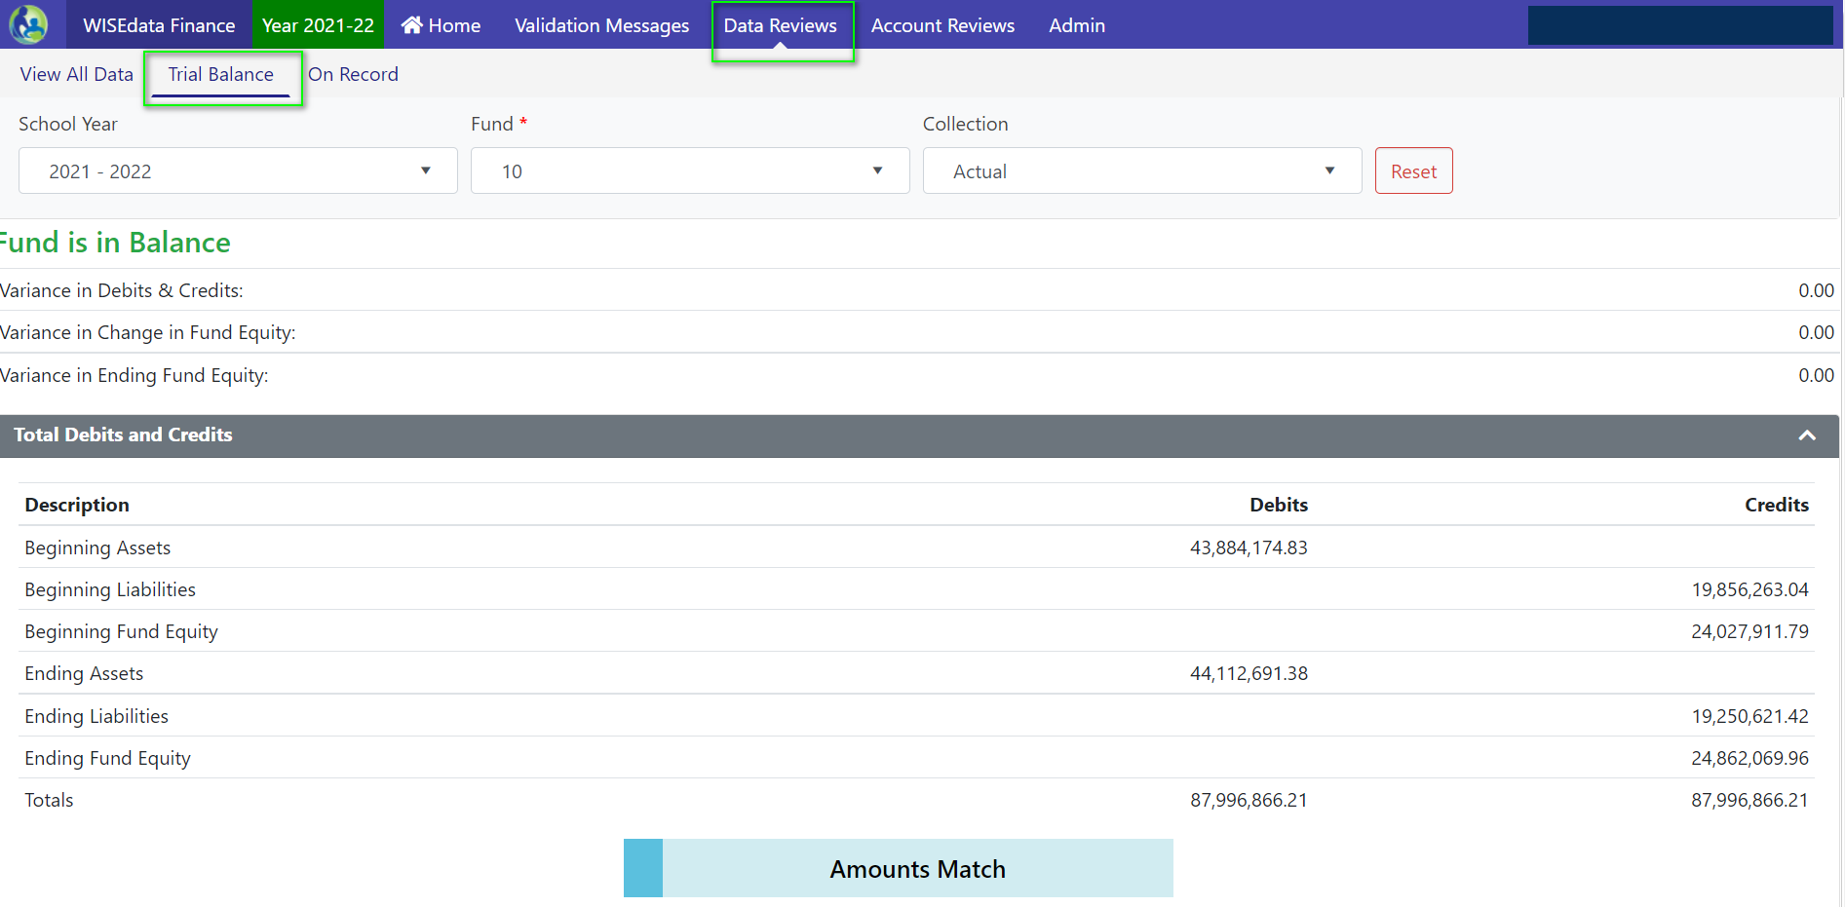
Trial Balance Example 2

Slide 25
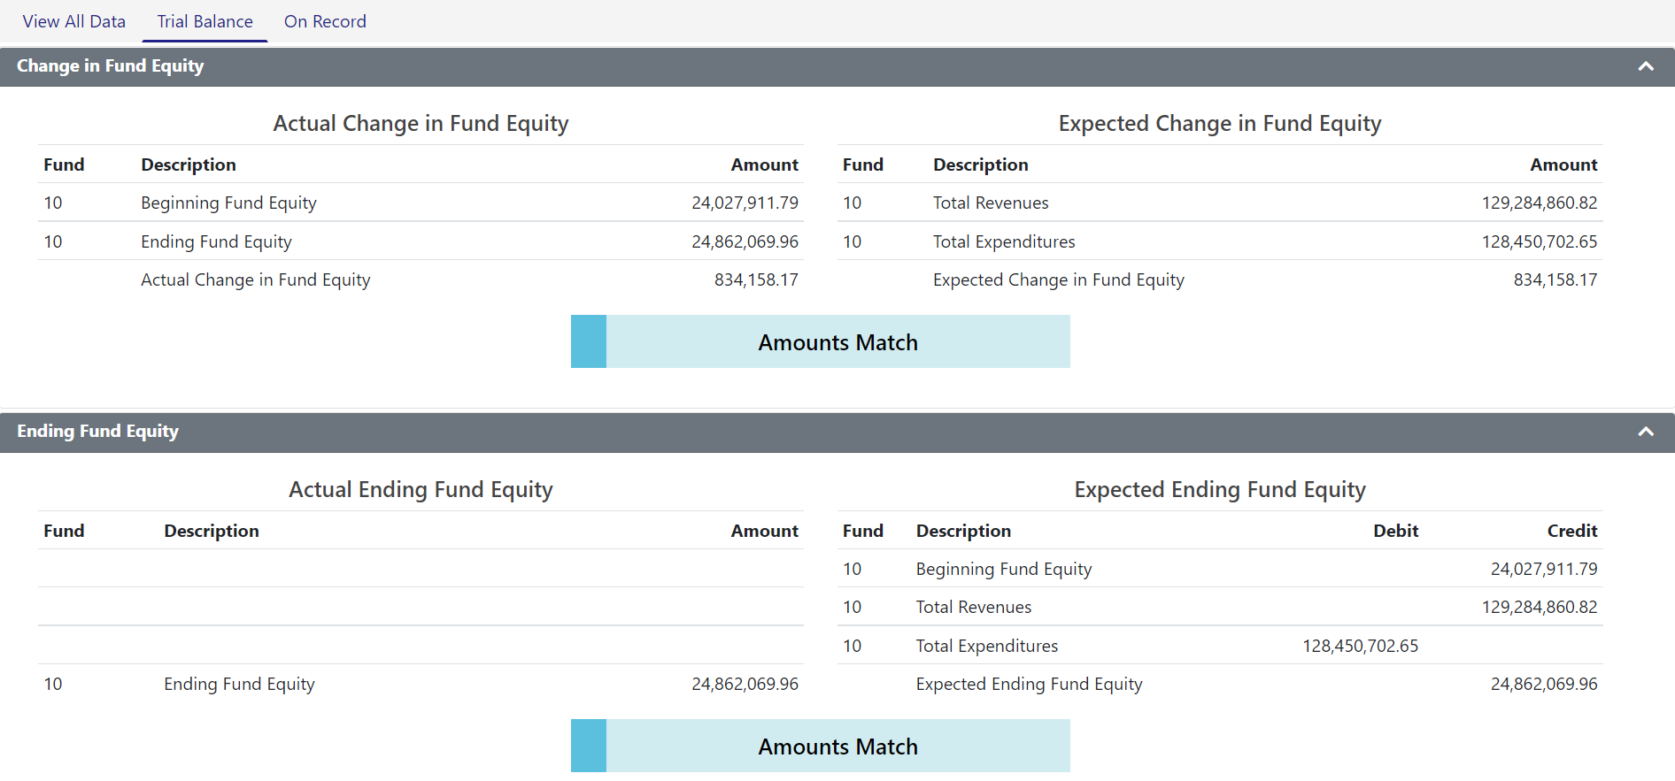
Trial Balance Example 3

Slide 26
Validations Updates
Our areas of focus concerning validations in WISEdata Finance:
Updated validations to allow a de minimis amount (less than a dollar) before triggering
Determining timeline for activating budget/actual validations through fiscal year
Building more comprehensive views of L1 validation data
Adding additional validations as needs identified

Slide 27
Addenda (1 of 2)
Reporting addenda to collect additional information based on accounts and amounts triggered within WISEdata Finance.
Required responses collected through WDF and viewable in the Budget and Annual Report in WiSFiP
Building addenda into WDF for Common School Fund / OPEB contributions

Slide 28
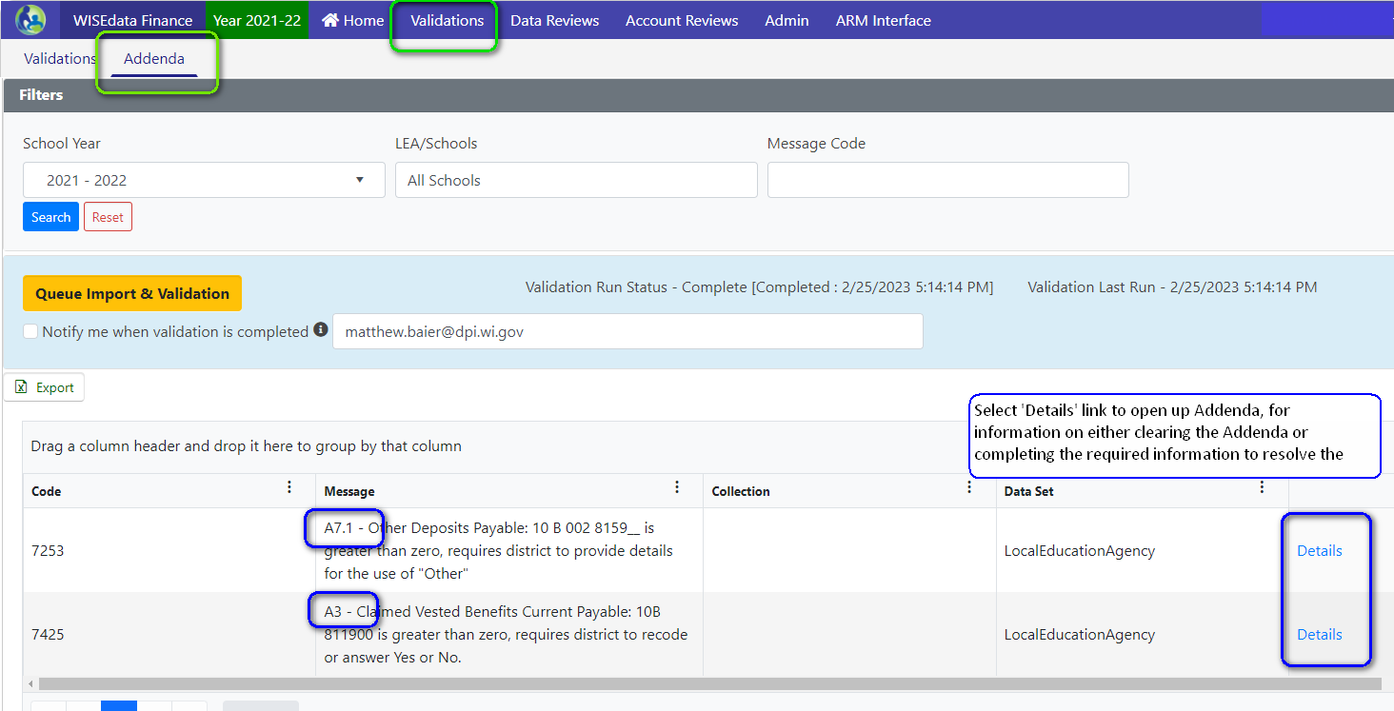
Addenda (2 of 2)

Slide 29
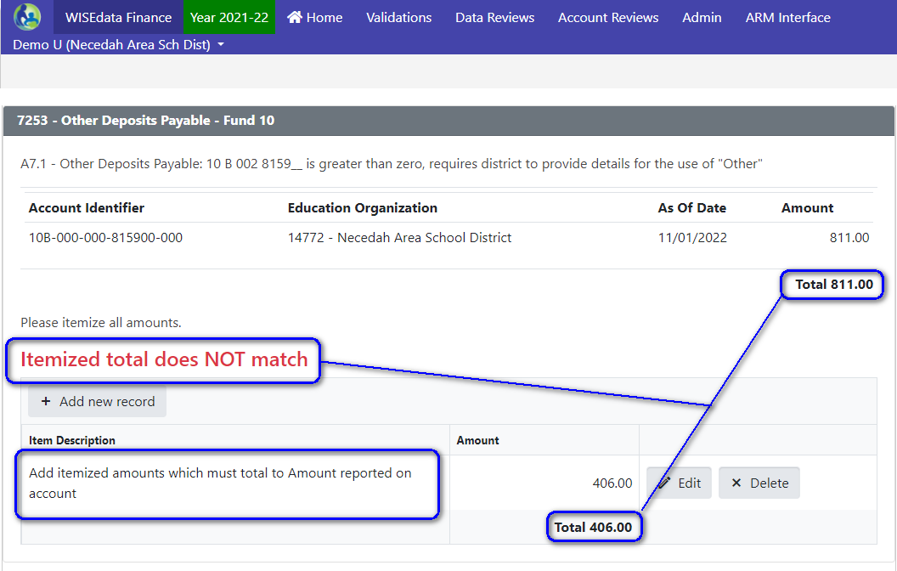
Pending Addenda

Slide 30
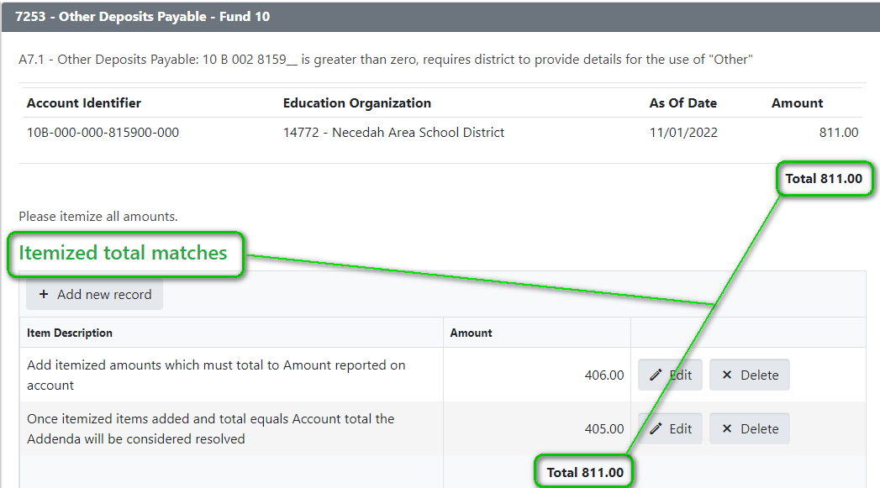
Resolved Addenda

Slide 31
Project/Program Tags
Additional data element attached to a local account
Indicates what the account project code is for in the case of a conflict between local and DPI-specified project codes or to indicate non-DPI funding sources (FedDirect, FedOther, WisOther)
Only required if above conditions apply
If using a DPI project code for a non-DPI local purpose, also use LocalUse.
If no conflict then the LocalUse tag is not required for local project codes, although it will not cause any problems if you do so.

Slide 32
Best Practice
Make pushing financial data to WISEdata Finance the last step of your monthly bank reconciliation
Setup a scheduled job to push data if your vendor offers the functionality

Slide 33
Financial Reporting Development Timeline
ESSA School-Level Reporting
Special Education Annual Report (replace the PI-1505-SE)
Public Financial Dashboard
Transitioning Existing SAFR reports to WiSFiP
Internal Modules for Aid Runs/Revenue Limits/Reporting
On-going Maintenance and Enhancements

Slide 34
School-Level Reporting
After some delay, we have opened the School-Level Reporting module in WiSFiP for 2022-23.
The report utilizes your financial data to determine district-level vs. school-level (by school) and federal vs. state/local expenditures
LEAs provide data to define Location and Project Codes
Allows for much more accurate and streamlined federal reporting

Slide 35
Special Education Annual Report (1 of 2)
Developing the Special Education Annual Report for 2023-24.
DPI is auditing, with stakeholder input, the Fund 27 Chart of Accounts as part of the next WUFAR revision.
A majority of the functionality needed to transition this report already exists. LEAs are already pushing local Fund 27 accounts to DPI.
Creating additional L2 validations in WDF to ensure proper Project Code coding for Fund 27.

Slide 36
Special Education Annual Report (2 of 2)
Beyond your Fund 27 actual accounts by Project, the report will include:
Addenda to track SPED grant payments into and out of the LEA
Validations to ensure school mental health personnel costs meet proration requirements from Act 221
Reports detailing aid estimates, grant reconciliation, year-to-year comparisons

Slide 37
WISEdata Finance and WISEgrants
As we continue to transition reporting to the new platform using WDF data, we will also be able to continue to make connections between existing DPI applications, such as WISEgrants.
This allows us to streamline existing functionality and make compliance easier.
IDEA Maintenance of Effort was the first thing we wired to utilize WDF financial data.
Notes:
See slide

Slide 38
Live Data = More Possibilities
And now, with live financial data, the possibilities for federal grant monitoring are endless.
Periodic reconciliations lead to timely financial corrections.
LEA staff can use software tools to identify their own issues rather than waiting for DPI assistance.
LEA staff can accurately and efficiently monitor their compliance throughout the year rather than after year-end.
Tools built using the data will guide LEAs in maximizing their federal, state and local funding options, leaving no funding on the table.

Slide 39
IDEA MOE Report with WISEdata Finance (1 of 2)
With WISEdata Finance, the IDEA MOE Compliance report displays the LEA’s current financial data. At any point, LEAs can view their progress towards meeting this compliance test. Depending on the time of the year, the LEA can begin making decisions regarding special education expenses - whether or not funding sources need to change.

Slide 40
IDEA MOE Report with WISEdata Finance (2 of 2)
WISEgrants uses it own labels for account strings so that non-fiscal staff can easily understand the Chart of Accounts.

Slide 41
WISEgrants and WISEdata Finance
Tracking of federal expenditures and revenue by Project codes aid in ensuring accurate claiming of allowable costs and help streamline program and fiscal monitoring of federal programs.
We are continuing to work on aligning WISEgrants WUFAR accounts to align with WISEdata Finance and the DPI COA.
Federal grants management requires additional levels of details, scrutiny, and compliance which would prevent any ‘full’ automation of grant budgeting and claiming.

Slide 42
Contact Us
For WISEdata Finance questions visit DPI's WISEsupport page to submit a help ticket.
General SFS questions
Matt’s Booking page

Slide 43
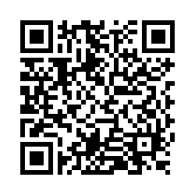
Questions?
Thank you! Thank you!
Please scan the QR code to provide us with your feedback!

